Slide 1
Criminal Justice
Improvement Committee
Grant Award Workshop Breakout
September 2022

Slide 2
Property Control Record & Equipment Certification
This form should be used to inventory all equipment purchased during the life of the grant.
Authorizing Agency
Implementing Agency
Project Name
Project Number
Project Director's Name
Phone # and E-mail Address
Notes:
This form is not in GEMS, but is required for all grantees to complete. This will help document the equipment that is purchased with grant funds.

Slide 3
Equipment Information
Item Description:
Serial/other identification No.:
Date Transaction Completed: | Date Equipment was Acquired:
Cost: | Vendor:
Location of Equipment: | Assigned to:
Purpose of Equipment: | Purchased by:
Insurance Coverage:
Item Description:
Serial/other identification No.:
Date Transaction Completed: | Date Equipment was Acquired:
Cost: | Vendor:
Location of Equipment: | Assigned to:
Purpose of Equipment: | Purchased by:
Insurance Coverage:
Item Description:
Serial/other identification No.:
Date Transaction Completed: | Date Equipment was Acquired:
Cost: | Vendor:
Location of Equipment: | Assigned to:
Purpose of Equipment: | Purchased by:
Insurance Coverage:
Item Description:
Serial/other identification No.:
Date Transaction Completed: | Date Equipment was Acquired:
Cost: | Vendor:
Location of Equipment: | Assigned to:
Purpose of Equipment: | Purchased by:
Insurance Coverage:
Item Description:
Serial/other identification No.:
Date Transaction Completed: | Date Equipment was Acquired:
Cost: | Vendor:
Location of Equipment: | Assigned to:
Purpose of Equipment: | Purchased by:
Insurance Coverage:
Notes:
This form is also not in GEMS, but is required by all grantees who purchase equipment with the grant fund.

Slide 5
Progress Report Must be submitted annually
FUNCTIONS
For Grantee:
internal assessment of project accomplishments
For GCC:
evaluation by Project Director of the grant’s progress
information required for GCC report to U.S. D.O.J.
NOTE: When filling out this report, please explain thoroughly. No one word answers!

Slide 6
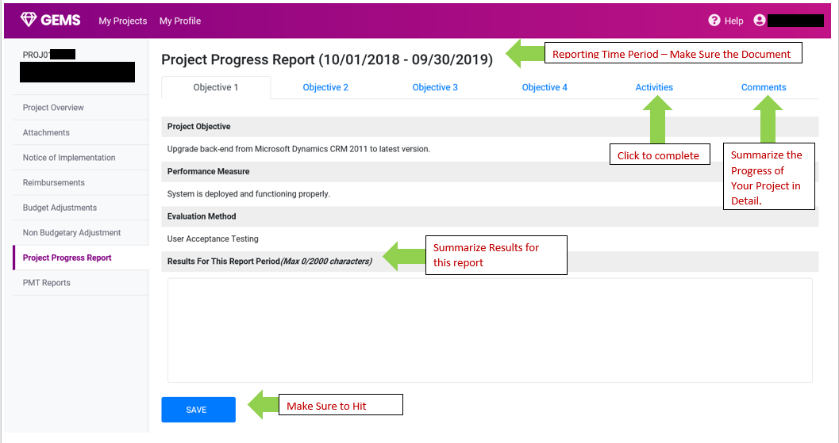
PROJECT PROGRESS REPORT
Notes:
With a start date of July 1, your first report will be due by October 10th.
They are REQUIRED Quarterly on the 10 day of the month following the close of the quarter.
We make every effort to notify all JAG grantees by the end of each quarter by email about the upcoming PMT due dates…
We expect the same from our grantees in responding by the due dates of the PMT Report.

Slide 7
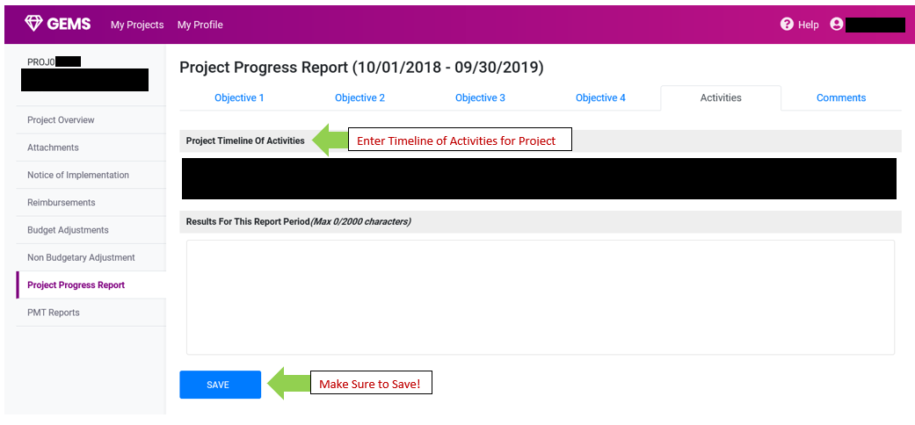
PROJECT PROGRESS REPORT
Notes:
With a start date of July 1, your first report will be due by October 10th.
They are REQUIRED Quarterly on the 10 day of the month following the close of the quarter.
We make every effort to notify all JAG grantees by the end of each quarter by email about the upcoming PMT due dates…
We expect the same from our grantees in responding by the due dates of the PMT Report.

Slide 8
All grant awards are contingent on receipt by GCC of 2022-2023 Federal funds. Grant start and end dates are subject to change based on the date we receive those funds. Changes in the specifics will be communicated to you by your Grant Administrator: Notice of Grant Implementation Due within 60-days of the grant start date (as listed on the Grant Award) Expense Reimbursements Budget Adjustment Requests As needed by grantee Property Control Record Lists all purchased equipment along with final progress report, prior to approval of final expense reimbursement. Expenditure Forecasts Upon request of your GMS
Grant Management Reports Due…

Slide 9
Standard Grant Conditions (SGC)
IMPORTANT!!!!
Grantees must provide their Procurement or Purchasing Policy
Equipment vendors must provide proof that they are not debarred or suspended from receiving state and/or federal funds
GCC does not reimburse sales tax:
- only report expenses stopping at the subtotal should be submitted for reimbursement. All entities may however claim a refund from the State for sale tax

Slide 10
Tasers and Non-Lethal Weapons
All LEAs that purchase non-lethal taser devices must present the following to their assigned Grant Administrator within the first 90-days of implementation of the grant:
copy of the agency’s Procurement Policy must be submitted to GCC prior to purchases.
copy of each agency’s Use Of Force Policy, and the Departmental protocol for the use of non-lethal weapons and lethal weapons.

Slide 11
Bulletproof Vest Purchases
As with BVP Grants, grantees that wish to purchase vests with JAG funds must certify that law enforcement agencies receiving vests have a written “Mandatory Wear" Policy in effect for all uniformed officers while on duty.
This policy must be in place for at least all uniformed officers before any funding can be used by the agency for vests. There are no other requirements regarding the nature of the policy.
Certification of “Mandatory Wear” Policy must be received by GCC within 30-days of grant implementation & received prior to purchase of vests.
Bulletproof Vests must be American made.
A Mandatory Wear Concept and Issues Paper and Model Policy are available by contacting the BVP Customer Support Center at vests@usdoj.gov or toll free at 1–877–758–3787.

Slide 12
Other Required Local Policies
* Body/Dash Cam Policy
Must cover camera usage, image/data storage, retention, and protection.
* Custodial Interrogation Recording Equipment Policy
Must cover serious crime category(s) determined by agency.
Must conform to best practices, including entire interrogation recorded.
Must state equipment to record both suspect and interrogation officer(s).

Slide 13
REQUEST/SCOPE CHANGES
In Previous Years, Requests were allowed to change the items on Local Law Enforcement Equipment Grants. As your project starts and is implemented in the near future, it is imperative that you review your budgets and items requested. The Criminal Justice Improvement Committee is going to start emphasizing in the new grant cycle, which items can be requested. If your potential change is not one of these items, this request may be denied.
Allowable Requests this year will be
Radios (priority given to VIPER Radios)
Cameras (priority given to Body Cameras, but other like purpose devices can be requested, but will be given lower priority including In-Car Cameras and Street Cameras)
Body Armor (must be made in the United States of America)
Mobile Data Terminals
Non-Lethal Weapons

Slide 14
Program Performance Measures for Justice Assistance Grant (JAG) Programs
Notes:
Good morning---
In addition to the reports and forms that we have shared with you, there is one report that is required by Federal law and must be completed in a timely manner---
-- this is the Performance Measurement Tool – or PMT for short
Since the 2009 passage of the Recovery Act, all JAG funds have been subject this reporting requirement.

Slide 15
Performance Measurement Tool (PMT)
Federal statutes REQUIRE PMT reports be submitted on-line directly to BJA, in a timely manner.
A copy must be provided to the assigned Grant Administrator.
GCC Planning Staff must then compile & enter its own compilation report to BJA.
Failure to observe these conditions and deadlines may result in an immediate hold of grant funds and may endanger the State’s entire allocation. If the state report is not submitted in time, OJP can put a hold on the state allocation.
Notes:
Though GCC oversees collection of the data. the PMT Report is made on-line and directly to the Bureau of Justice Assistance in Washington DC.
A copy of your PMT report must be submitted to your assigned grants manager as a part of your case file.
Once your information is complete, GCC staff has to compile and submit it’s own report based in part on your responses.
Failing to submit this information to BJA can and will result in suspending your grant.
If not corrected, failing to report can endanger the not only your own grant but state's entire allocation if not corrected.

Slide 16
Performance Measurement Tool (PMT) User Guide for
Fiscal Year 2015 Justice Assistance Grant (JAG) Programs
Data Entry for Subrecipients
(includes Disparate Jurisdictions)
June 2016

Slide 17
Major Changes for Fiscal Year 2015 Awards
New accountability measures
New narrative questions
New measures flow based on funding amount
New reporting schedule

Slide 18
Measures Reporting
The revised measures will only take effect for fiscal year (FY) 2015 and future awards.
FY 2014 and prior awards will continue to report on the current measures and reporting schedule.
Revised Measures
Current Measures
FY 2012
FY 2013
FY 2014
FY 2015

Slide 19
Measures Reporting
If you have awards from FY 2014 or before as well as awards from FY 2015, you will have to report on awards from FY 2014 or before using the current measures and report on FY 2015 awards using the revised measures.
FY 2014 Award
FY 2015 Award
Jul.–Sept. 2015
Oct.–Dec. 2015
Jan.–Mar. 2016
Apr.–Jun. 2016

Slide 20
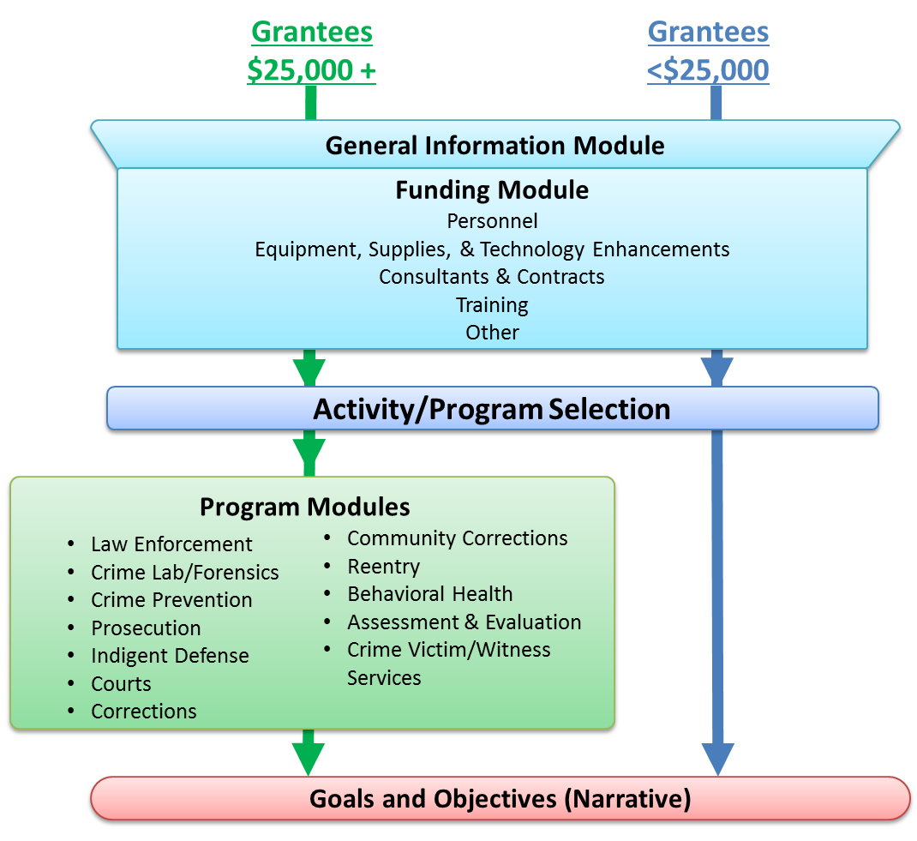
Revised JAG Measures Sections

Slide 21
PMT Reporting Schedule
Your grantor will provide due dates for data entry completion for each reporting period.
Type of Data Required | Reporting Period
Performance Measures | October 1–December 31
Performance Measures | January 1–March 31
Performance Measures | April 1–June 30
Performance Measures and Narrative | July 1–September 30
FY 2014 and Prior
Type of Data Required | Reporting Period
Performance Measures and Goals and Objectives | October 1–December 31
Performance Measures | January 1–March 31
Performance Measures and Goals and Objectives | April 1–June 30
Performance Measures | July 1–September 30
FY 2015 and Future
Notes:
21

Slide 22
More Information
FY 2022 JAG PMT Measures Web site:
https://bjapmt.ojp.gov/
The old site was a .org address. This has now been changed to the .gov extension. If you have the old site bookmarked, please replace it with this website.

Slide 23
Terms Used
GRANTEE | The primary recipient of a Federal award from BJA. This organization submits an application to BJA for the Federal award—for example, the state, local recipient, or fiscal agent.
GRANTOR | The organization that makes secondary awards to other entities from the BJA award. Usually the same as the grantee—for example, the state, local recipient, or fiscal agent.
GRANT | The funding or award received from BJA.
SUBRECIPIENT | An organization or agency that does not receive funds directly from the Federal government but from the state or another agency.
SUBAWARD | The secondary award made from the grantee’s Federal award.
PROJECT DESCRIPTION | A short description of the project that the application represents, and the purpose of the requested funds.
REPORTING PERIOD | A time period in which activities were conducted and funds expended and obligated. This period falls within the grant’s project period. Example: January to March and April to June, for quarterly reporting.

Slide 24
PMT Step by Step
Subrecipients Data Entry
Step 1. Log In (slides 10–13)
Step 2. Profile (slides 14–15 )
Step 3. Information & Resources Page (slide 16)
Step 4. Subrecipient Awards Page (slides 17–18)
Step 5. General Award Information Page (slide 19)
Step 6. Data Entry (slides 20–27)
Goals and Objectives (slides 22–23)
Review (slide 24)
Complete (slides 25–27)
Helpful Hints (slides 28–29)
Resources (slides 30–31)

Slide 25
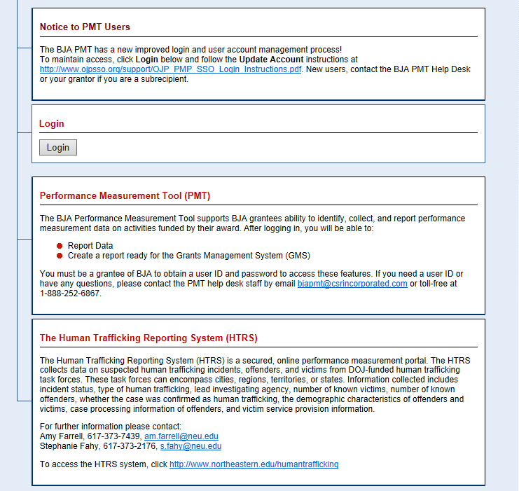
Step 1: Log In
https://bjapmt.ojp.gov/
The BJA PMT is designed to support grantees and their subrecipients by recording progress for the grant program.
Grantees set up and manage subrecipient accounts in the PMT. As a subrecipient, contact your grantee to request and obtain access to the PMT.
Click Login to continue.
Notes:
25

Slide 26
Step 1: Log In

Slide 27
Step 1: Log In
Users added to the subrecipient account by the grantee will receive an e-mail from BJA PMT with instructions on how to create a new user account.
Enter information in all required fields, and click Update to continue.

Slide 28
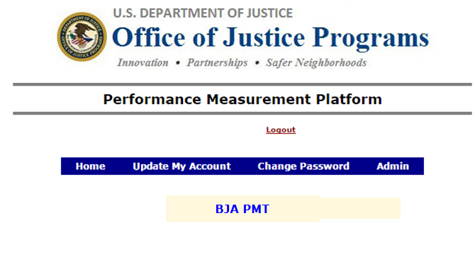
Step 1: Log In
Here you can update or change your account and password information.
Click BJA PMT to continue.
Notes:
[READ SLIDE]

Slide 29
Step 2: Profile
Select the Grantee Organization or Subgrantee Organization profile, depending on your role, to enter/edit data.

Slide 30
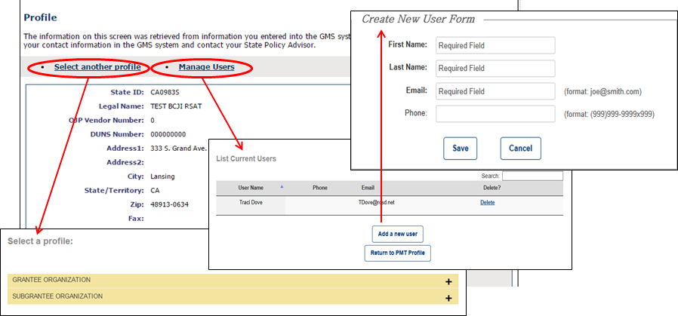
Step 2: Profile
Check your profile for accuracy.
If any changes are needed, contact your grantor.
Click Select another profile to go back to the list of your assigned profiles (if applicable).
Click Manage Users and Add a new user or Delete to update the list of users.
NOTE: Only add users who need access to the BJA PMT to complete data entry and reporting. Adding a user automatically sends that person an e-mail with a link to create and complete a user account.

Slide 31
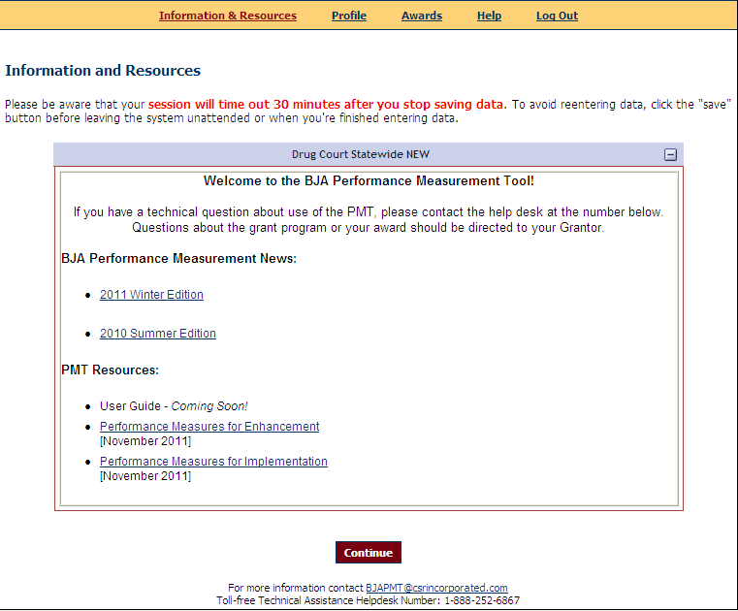
Step 3: Information and Resources
Use the navigation bar at the top to access different pages in the system.
Do not use the back arrow on your browser.
The system will time out after 30 minutes of inactivity.
You can find the following on the Information & Resources page:
PMT user guide
Performance measures
Other resources

Slide 32
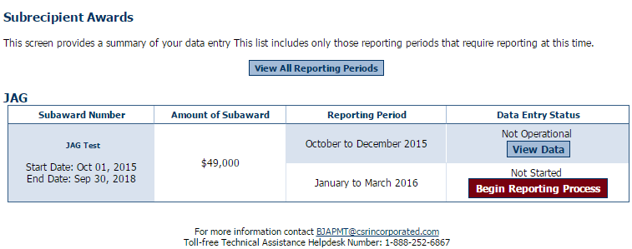
Step 4: Subrecipient Awards
The purpose of the Subrecipient Awards page is to give an overview of data entry for all awards.
Select the reporting period, and click Begin Reporting Process.
Each page has the contact information for the PMT Help Desk.

Slide 33
Step 4: Subrecipient Awards
Status on the Subrecipient Awards page:
Not Started: Subrecipient has NOT saved any data.
In Progress: Subrecipient has begun entering data but has not completed the data entry process.
Complete: Subrecipient has entered and saved data; the record is marked as complete.

Slide 34
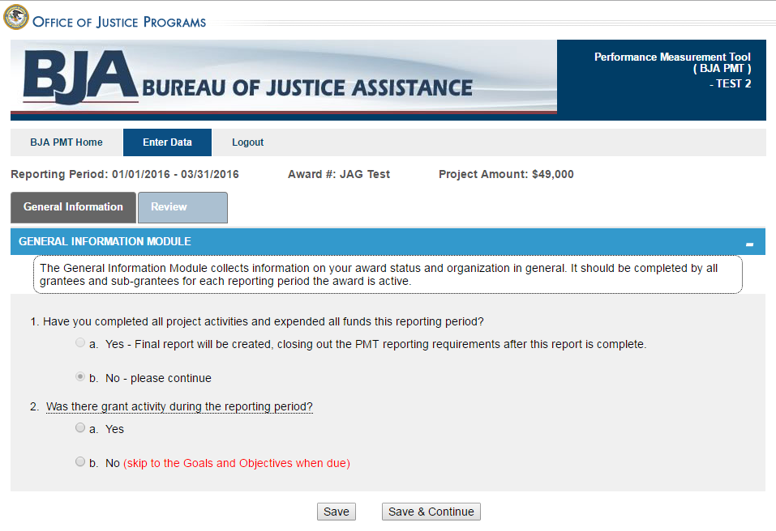
Step 5: General Award Information
The General Information page is intended to determine whether or not there was any grant activity during the reporting period.
Check Yes if there was grant activity.
Check No if no activity occurred and no funds were expended, and explain.
Click Save & Continue to continue reporting.

Slide 35
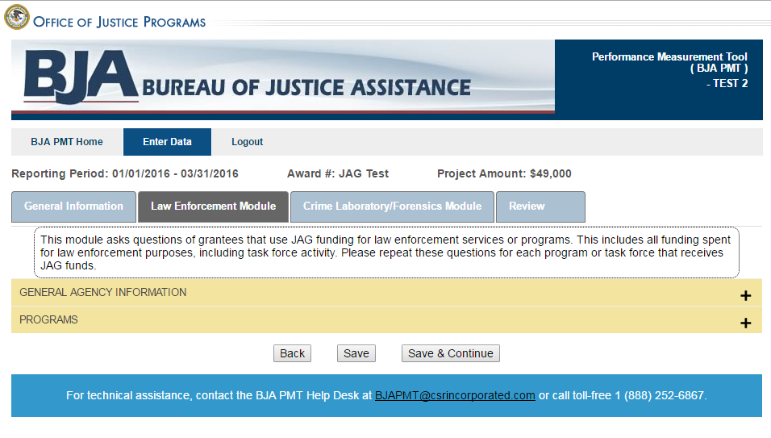
Step 6: Data Entry
Tabs allow you to move between different activity/program modules.
More tabs will appear based on your funding allocations.
Accordions expand to show the questions within the different sections in each module.
Enter data for all fields. When you are finished, click Save & Continue to move on to the next tab. Click Save if you need to save your data and continue working on the rest of the questions later.

Slide 36
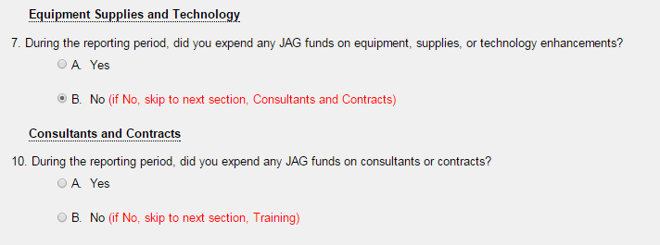
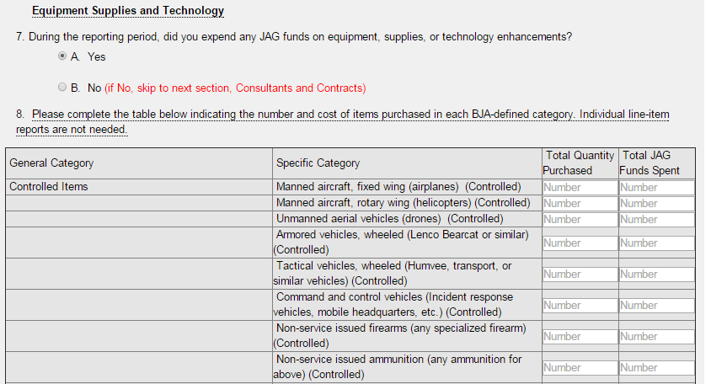
Step 6: Data Entry
Skip questions determine whether or not you need to answer additional questions related to a specific service or activity.
If you need to answer additional questions, the skip question will expand. If not, no questions appear.

Slide 37
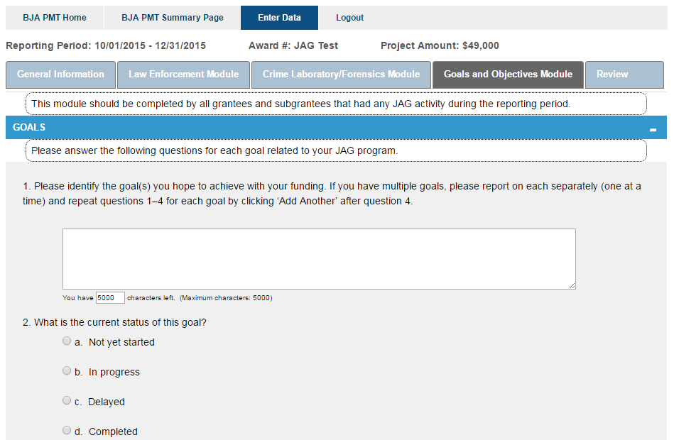
Step 6: Data Entry (Goals and Objectives)
During the April–June and October–December reporting periods, you will see the Goals and Objectives questions. Your response to these questions should reflect activity during the previous 6-month period (January–June or July–December), regardless of whether or not your award was “operational.”
If you’re closing out the award and this is the last reporting period of data submitted in the PMT, your response should reflect activity since your last submission of goals and objectives data in the PMT.

Slide 38
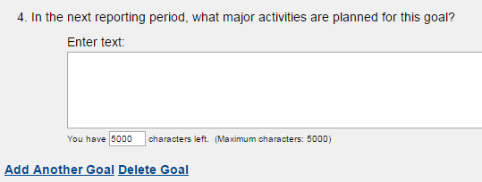
Step 6: Data Entry (Goals and Objectives)
On the Goals and Objectives tab, answer questions regarding each of your program’s goals. Click Add Another Goal or Delete Goal to add or delete a goal entry. Once you have answered all questions, click the Activity tab to finish answering questions for the section.

Slide 39
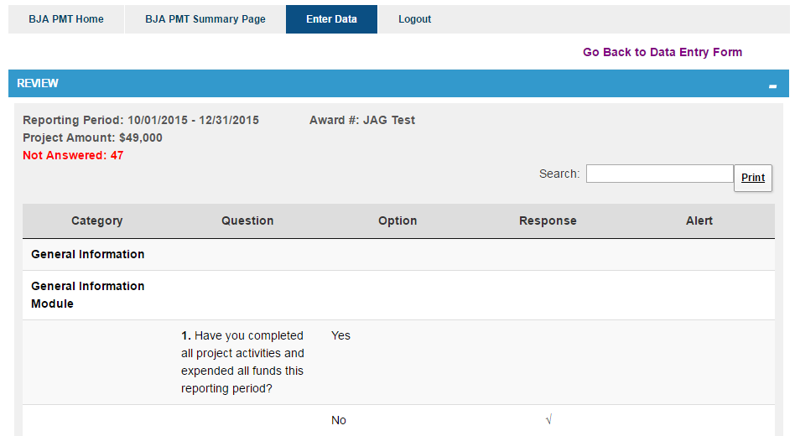
Step 6: Data Entry (Review)
This link allows you to return to previous pages to view and/or edit data.
The total number of alerts is listed here.
You can search and print from here.
The Review page allows you to view any required questions you need to answer. This page breaks down the measures by Category, Question, Option, Response, and Alert. If you have not answered a required response, this will appear in the Alert column.

Slide 40
Step 6: Data Entry (Complete)
Once you have completed and reviewed all data entry, check the Mark Data as Complete box and click Save. The saved data will then be submitted to your grantor.
This action will PREVENT you from further entering or editing data or information. Please be sure your data entry is final before checking the Mark Data as Complete box.
If you need to make changes to your data after you have submitted it, contact your grantor and request that your data be unlocked.
If you want to explain the data you reported, enter text in the Additional Comments box.

Slide 41
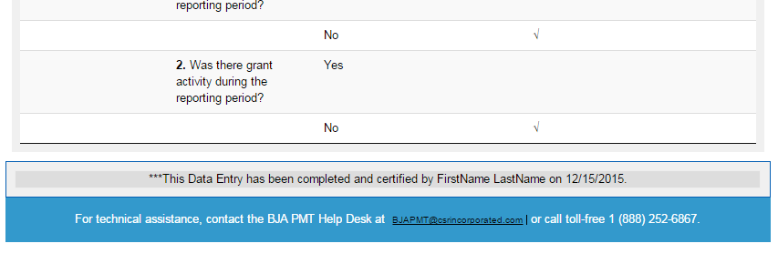
Step 6: Data Entry (Complete)
The system will now show data entry as complete and certified at the bottom of the Review tab.

Slide 42
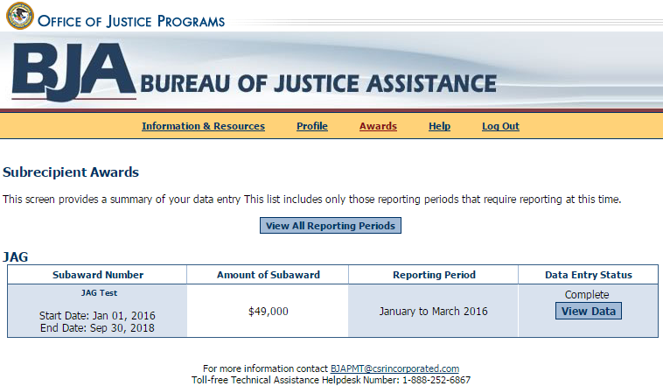
Step 6: Data Entry (Complete)
View of Data Entry Status and Report Status
You can confirm data entry has been successfully completed and created by the Data Entry Status (Complete) column.

Slide 43
Helpful Hints
What If . . .
My award is not operational?
An award is ‟not operationalˮ when activities proposed in the BJA-accepted grant application have not been implemented or executed with the BJA grant.
I get an error message?
Follow the instructions to correct any errors or discrepancies.
If you have questions, contact the PMT Help Desk.
I need to edit data that I submitted, and I already created a report?
Contact your grantor and request that the report be unlocked or returned to you for revisions.
The award point of contact information on the profile page in the PMT is not correct?
Contact your grantor to ensure it is aware of any changes.
I lost my data!
Please be aware that your session in the PMT will time out 30 minutes after you stop saving data. To avoid losing and having to reenter data, click Save periodically, before leaving the system unattended, or when you have finished entering data.

Slide 44
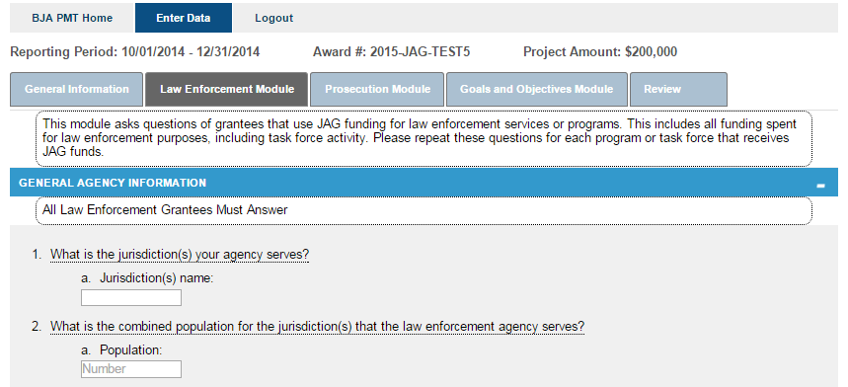
Helpful Hints
If you have a question about what a question means . . . Hover the mouse over the underlined question to see the instructions.

Slide 45
Resources
BJA PMT Web Site: https://bjapmt.ojp.gov/
For questions about your program performance measures data reporting requirements and deadlines, contact your grantee.
For questions about the PMT, contact the BJA PMT Help Desk:
Monday–Friday 8:30 a.m.–5:30 p.m. ET
Toll-free number: 1-888-252-6867
E-mail: bjapmt@usdoj.gov

Slide 46
Seven Purpose Areas
Law Enforcement and Task Forces
Prosecution and Court, Defense & Indigent Defense
Prevention and Education
Corrections and Community Corrections
Drug Treatment and Enforcement Programs
Planning, Evaluation and Technology Improvement
Crime Victim and Witness Protection (other than compensation)
Notes:
JAG funds have seven broad purpose areas under which all funds may be awarded and for which data needs to be collected….
1. Law Enforcement
2. Prosecution and Court, Defense & Indigent Defense
3. Prevention and Education
4. Corrections and Community Corrections
5. Drug Treatment and Enforcement
6. Planning, Evaluation and Technology Improvement
7. Crime Victim and Witness Protection

Slide 47
Purpose Area Data
Purpose Areas are assigned by GCC Planning Staff
Questions are determined based on the assigned purpose area. Therefore, some questions will not apply specifically to your project.
Answer questions that apply to your project - and answer with a “N/A” or 0 (zero) to the questions that do not apply.
Notes:
Your specific grant may fall under more than one Purpose Area, so GCC staff will assign them according to purposes identified in the grant application.
These purpose areas determine which questions you will be asked. If there is a question that does not apply to your grant, answer either a “NA” or “zero”.
All questions must be answered.

Slide 48
Reporting Status
Not Started – No data has gone into the PMT system for this reporting period.
In Progress – Data has been entered, but not completed and submitted. Please note that you there may be several pages of data to enter before the process is complete.
Complete – All questions have been answered error free and submitted to grantor.
Notes:
The only time your grant should appear NOT STARTED should be when you first begin each quarter’s report.
NOT OPERATIONAL - means no funds were expended and no activities occurred during the reporting period. If you had activities, but expended no money, your grant was operational ..
IN PROGRESS – means that information has been entered but not completed – AND Submitted. PLEASE REMEMBER TO SUBMIT the Report.
COMPLETE --- Means you have answered everything and submitted your PMT Report.

Slide 49
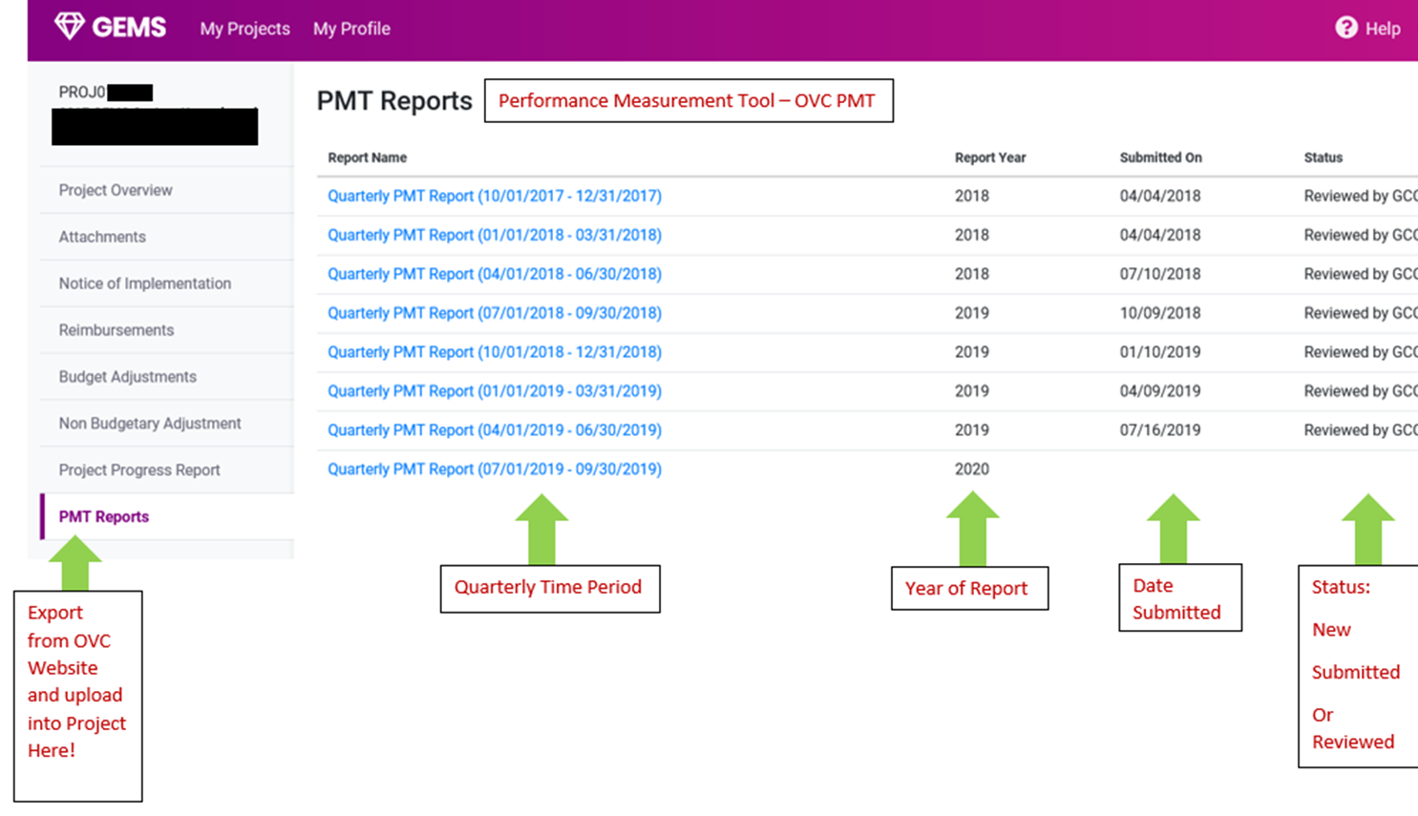
PMT REPORT SUBMISSION – PDF ONLY
Notes:
With a start date of July 1, your first report will be due by October 10th.
They are REQUIRED Quarterly on the 10 day of the month following the close of the quarter.
We make every effort to notify all JAG grantees by the end of each quarter by email about the upcoming PMT due dates…
We expect the same from our grantees in responding by the due dates of the PMT Report.

Slide 50
PMT REPORT SUBMISSION
Notes:
With a start date of July 1, your first report will be due by October 10th.
They are REQUIRED Quarterly on the 10 day of the month following the close of the quarter.
We make every effort to notify all JAG grantees by the end of each quarter by email about the upcoming PMT due dates…
We expect the same from our grantees in responding by the due dates of the PMT Report.

Slide 51
PMT Reporting Requirements
A copy must be provided to your assigned Grant Administrator. Upload your PMT report to GEMS using the PMT report tab in your active project.
It is YOUR responsibility to ensure the Grant Administrator has a copy of the report.
PLEASE NOTE these reports are in addition to GCC reports.
It will be a permanent part of your file.
Notes:
There are two more things you MUST do for your grant to be in compliance…
1—Print a hard copy for your own records…and…
2---A copy MUST be provided to your Grants Manager…not to
me… This may be faxed, emailed or uploaded in GEMS.
This is entirely your RESPONSIBILTY as a grantee to see that the Grants Manager has this information…..
It is not the Grants Manager's’ responsibility to track you down to get it.

Slide 52
PMT Reporting Periods
PMT Reports are REQUIRED Quarterly!
…and are due the 10th of the month following the close of a quarter.
October 1 – December 31 (due January 10)
January 1 – March 31 (due April 10)
April 1 - June 30 (due July 10)
July 1 – September 31 (due October 10)
By the 10th of the month that these reports are due, the BJA PMT Report must be completed in the PMT Website and that report must be uploaded to the corresponding PMT Quarter tab in the GEMS system.
Notes:
With a start date of July 1, your first report will be due by October 10th.
They are REQUIRED Quarterly on the 10 day of the month following the close of the quarter.
We make every effort to notify all JAG grantees by the end of each quarter by email about the upcoming PMT due dates…
We expect the same from our grantees in responding by the due dates of the PMT Report.

Slide 53
Additional Information
If the Project Director changes, please make sure you update the contact information in Grants Management Enterprise (GEMS) and notify GCC staff so that we may make the change with the Bureau of Justice Assistance (BJA). ALL CORRESPONDENCE REGARDING PMTS ARE SENT TO THE PROJECT DIRECTOR. IT IS IMPERATIVE THIS CONTACT INFORMATION IS ACCURATE.
If your grant closes prior to the original end date, a PMT report will still be required for all quarters the grant was active. (ex. PROJXXXX received reimbursement for purchases on January 7 and the grant was closed Jan 8. A PMT report will still be required for the January- March quarter due on April 10th). BJA does not permit early submission of quarterly reports. Therefore, the grantee may have to wait until BJA opens the quarter for reporting.
Unfortunately, BJA and GEMS are NOT linked. Therefore, you MUST copy and paste a copy to a PDF document to upload to GEMS.
Courtesy email reminders used to be mailed to Project Directors. Unfortunately due to workloads and staffing issues, we are unable to do this any longer. It will be the Project Director’s responsibility to ensure that all PMT Reports are submitted in the https://bjapmt.ojp.gov/ website by the 10th day of the month following the quarter end.

Slide 54
Criminal Justice Planning Team
Navin K. Puri, Navin.Puri1@ncdps.gov
Keyon Ashe, Keyon.Ashe1@ncdps.gov
…Please contact the Criminal Justice Planning Team
for PMT reporting assistance.
If no one is available, please contact
The BJA PMT Help Desk at 1-888-252-6867

