Slide 1
Juvenile Justice Grant Reporting
Grant Award Breakout
September 2022

Slide 2
Federal Funding Sources
Juvenile Justice Planning Committee funds programs through two Federal grant programs:
U.S. Department of Health and Human Services – Child Abuse Prevention and Treatment Act (CAPTA)
Children’s Justice Act funding priority ONLY
Office of Juvenile Justice and Delinquency Prevention – Title II Formula Grant Program
Juvenile Justice funding priorities

Slide 3
Required Reports
All projects approved for funding by the Juvenile Justice Planning Committee are required to submit regular performance reports as a condition of the grant award.
Reports must be submitted by their respective deadlines.
Non-submission of reports will impact your ability to receive reimbursements for project-related expenses!

Slide 4
Purpose of Juvenile Justice Reports
Grantees report to Governor’s Crime Commission
GCC reports the data for the State to Federal partners (OJJDP, US DHHS)
Federal partners report nationwide data to Congress, & the Office of Management and Budget (OMB)

Slide 5
Reports by Award Type
All projects funded by the GCC are required to provide an annual Project Progress Report that aligns with the specific goals and objectives of the project
Both Children’s Justice Act and Juvenile Justice projects must submit a Mid-Year and Final Report
Please note that extensions to the award period may require additional reporting

Slide 6
Report Types and Deadlines
Grant Type | Report Name | Activity Period | Due Date
ALL GCC Grants | Project Progress Report | October – September | October 30
Children’s Justice Act Grants | JJ Mid-Year | October – March | April 30
 | JJ Final | April - September | October 30
Juvenile Justice Grants | JJ Mid-Year | October – March | April 15
 | JJ Final | April - September | October 15

Slide 7
Accessing Reports in GEMS

Slide 8
Accessing Reports
All projects performance reports must be submitted in the GEMS system
The Project Director for the project will receive all correspondence regarding the project, including all automated reminders from the GEMS system

Slide 9
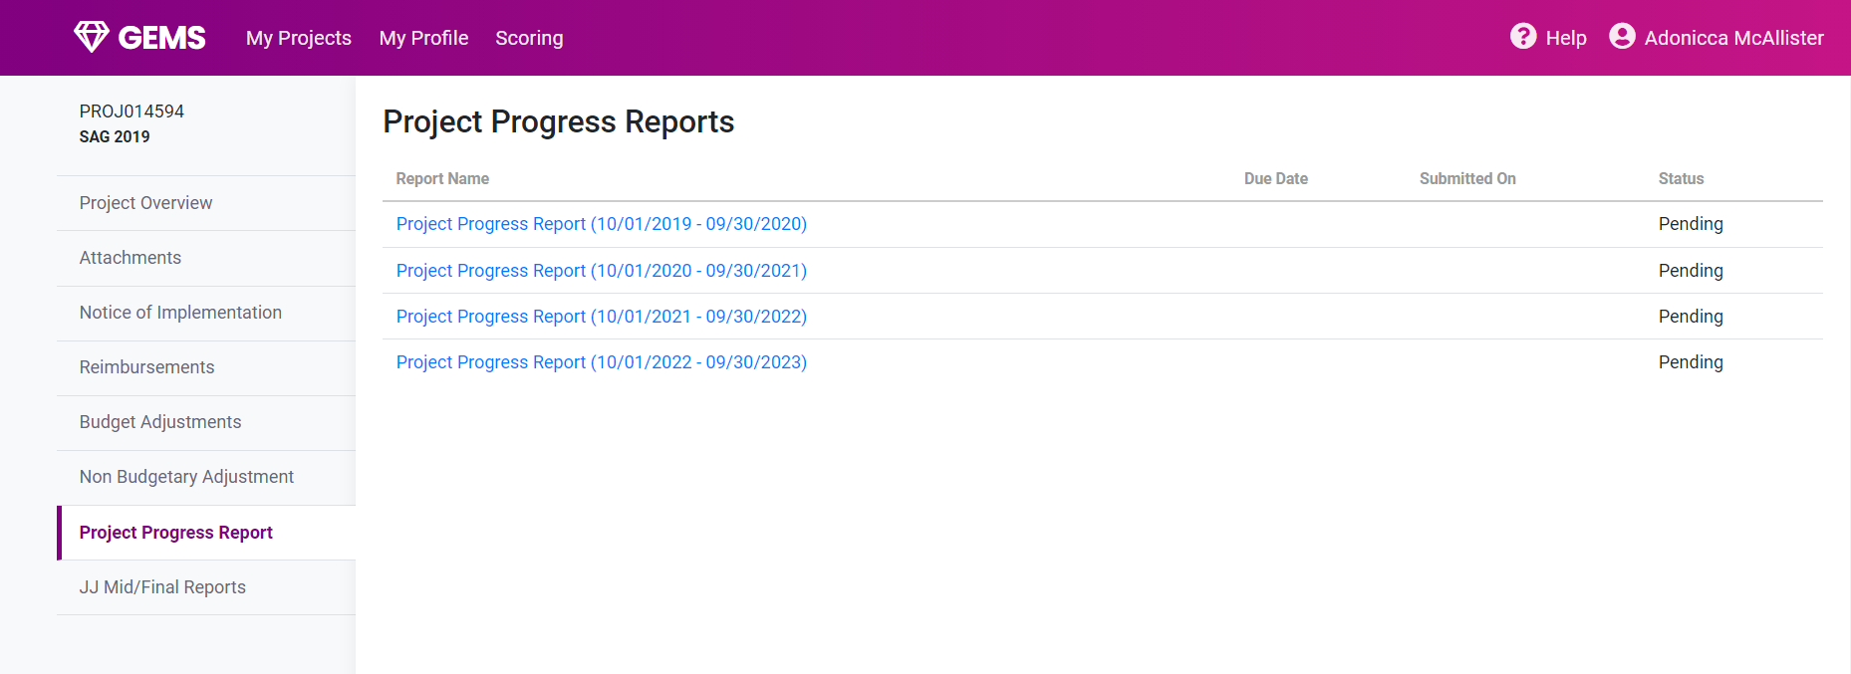
Accessing Reports
Both types of reports are listed on the bottom left menu.
Click on the proper report type and reporting period to submit reports by their respective deadlines.
Report period for each report
}
}
Required report types

Slide 10
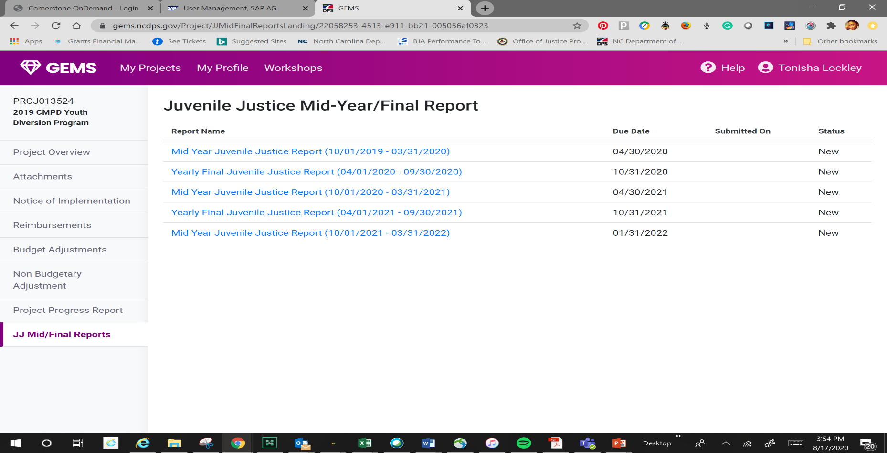
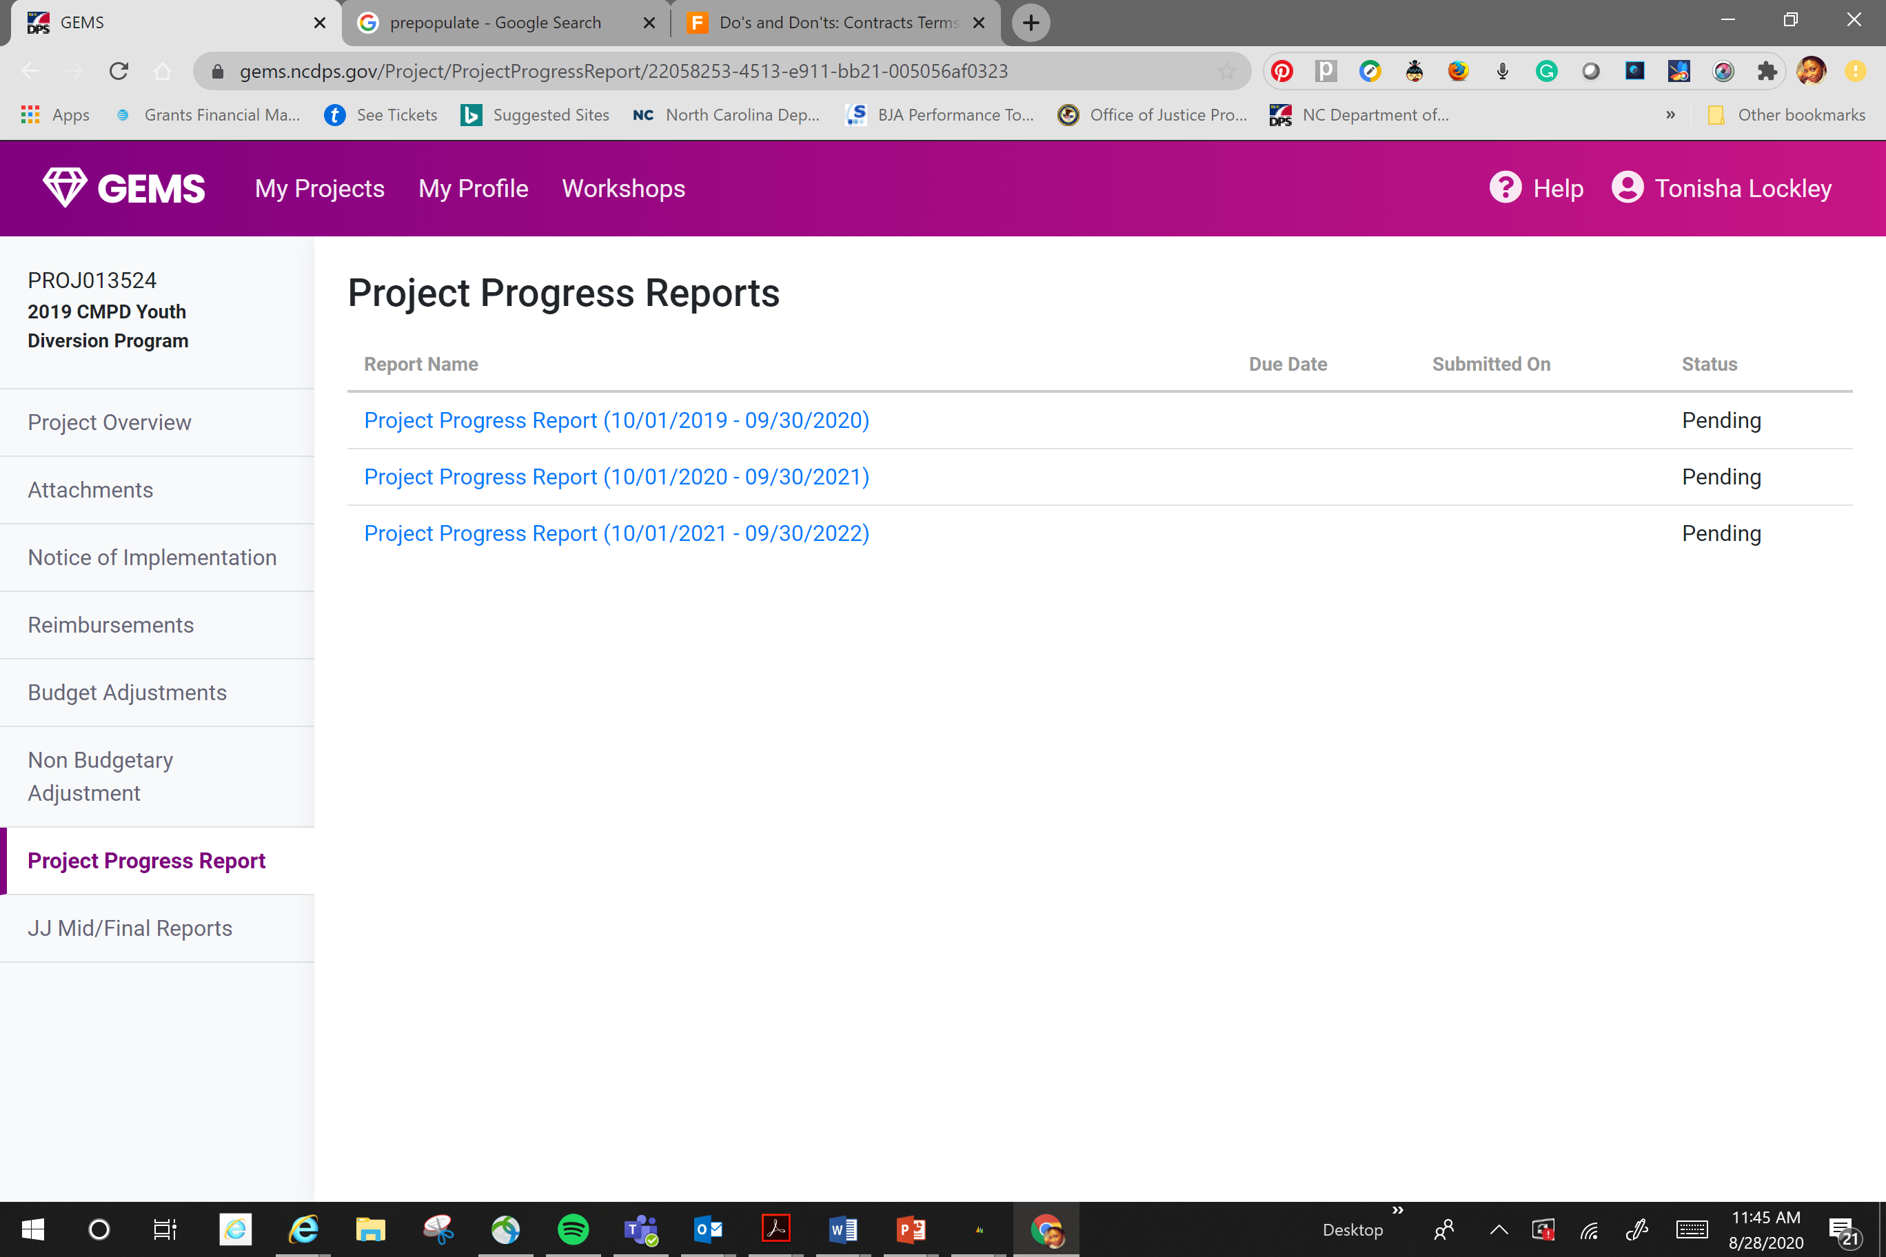

Slide 11
Project Progress Reports
Required for ALL GCC-funded Projects

Slide 12
Project Progress Reports
All projects funded by the GCC must provide an annual report
Progress Reports align with the stated goals and objectives of your grant application
Grant Type | Report Name | Activity Period | Due Date
All GCC Funded Projects | Project Progress Report | October – September | October 30

Slide 13
Children’s Justice Act Reporting
Mid-Year/Final Reports

Slide 14
Please note that the CJA Mid-Year and Final reports are listed in GEMS as JJ Mid/Final Report
Grant Type | Report Name | Activity Period | Due Date
Children’s Justice Act Grants | JJ Mid-Year | October – March | April 30
 | JJ Final | April - September | October 30

Slide 15
Report Questions
Activities/Outputs:
Describe your project activities as they relate to the needs identified in your project application, including the implementation of evidence-based trainings and programming.
Goals/Accomplishments:
Describe your project progress and include any innovative programming or success stories. Describe whether project activity resulted in expected changes.
Outcomes/Impact of Project on System:
Describe the impact of this project on systems. Assess any changes in program participants. Describe any problems or barriers that you may have encountered during the report period. Include the results of program evaluation efforts.

Slide 16
CJA Reporting Tips
Even though these are narrative questions, please provide quantitative data wherever possible
Be detailed about how you collect and measure data specific to your project
Share success stories from service providers and program participants

Slide 17
Juvenile Justice Reporting
Mid-Year/Final Reports

Slide 18
Juvenile Justice Mid-Year and Final reports are listed in GEMS as JJ Mid/Final Report
Grant Type | Report Name | Activity Period | Due Date
Juvenile Justice Grants | JJ Mid-Year | October – March* | April 15
 | JJ Final | April - September | October 15
*NOTE: Juvenile Justice priority grants begin 1/1 – the mid-year report for Year 1 of funding will cover activities occurring from January - March

Slide 19
JJ Mid/Final Reports
Currently 24 report questions covering both quantitative and qualitative report data
Report due dates align with Federal reporting requirements
Report criteria may change due to transitioning to new Federal grant management system

Slide 20
JJ Mid/Final Report Questions
Quantitative report data may include:
Frequency, Capacity
Program Activities
Referral Sources (to and from the program)
Outputs/Outcomes

Slide 21
JJ Mid/Final Report Questions
Qualitative report questions may include:
What were your accomplishments within this reporting period?
What goals were accomplished as they relate to your grant application?
What problems/barriers did you encounter, if any, within the reporting period that prevented you from reaching your program goals or milestones?
Please share a success story detailing your impact.

Slide 22
JJ Mid/Final Reports
Notes:
Disaggregate their data by race and ethnicity
Explain how their project aims to reduce disparities and/or promote racial equity
Assess and provide measures of their program’s impact on youth of color to determine if disparate outputs/outcomes were improved

Slide 23
JJ Reporting Tips
Establish a recordkeeping system and collect data based on the required reporting elements
Be honest about barriers, realistic about successes
Contact the GCC if you experience any difficulty executing the work of your project – we want to support you!

Slide 24
Questions?
If you need assistance with required reports, contact a member for the Juvenile Justice Planning Team:
(919)733-4564
Adonicca McAllister, Lead Planner | adonicca.mcallister@ncdps.gov
Toni Lockley, JJ Planner | toni.lockley1@ncdps.gov

