Slide 1
BYRNE/JAG CESF Administering Byrne-JAG & CESF Grants

Slide 2
GCC Grant Management Staff
Jason Wimmer – Director of GCC
Grant Management
Byrne/JAG & CESF Grant Managers
Keith Bugner, 919-829-9221
Matt Stuart, 919-741-5979
LaShanya Richardson, 919-647-4572
Notes:
(Jason or Keith) Introduce Staff – Jason will be moderating.

Slide 3
Byrne JAG/CESF Break-Out Agenda
Grant Enterprise Management System
Grant Opening Process
Adjustments
Reimbursements
Reporting
Questions
Notes:
Agenda – please hold questions to the end.

Slide 4
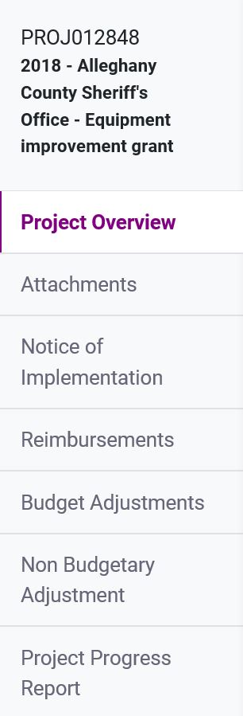
GEMS
Grant Enterprise Management System
Project Attachments & Notice of Implementation
Requests for Reimbursements & Adjustments
Grant Reporting
Notes:
GEMS ( the Grant Enterprise Management) is the online portal where you will administer your GCC grant. This system allows you to track the status of your Grant. This is where you will upload documentation and make requests to your Grant Manager.
Most of your work will be accessed through the menu on the left-hand side of GEMS, this is where you will find the Notice of Grant Implementation, Adjustments, and Reimbursement request sections. There are also sections to enter Grant Reporting.
If you need technical assistance on using GEMS, please contact your Grant Manager. Additionally, there is another break-out session to this conference happening now that is going over the details of GEMS. A recording of that session will be made available on the GCC website.

Slide 5
Grant Opening Process
Signed
Grant Package
Returned to GCC
GCC
Grant
Manager
Required Documentation
Organizational Roles
Notice of Implementation
Notes:
Once your signed Grant Package is returned to GCC, your GM will start the Grant Opening process. This includes checking for required documentation and ensuring your organization roles are assigned. You will be required to submit a Notice of Implementation.

Slide 6
Required Documentation
APPLICATION MANDATORY FILES
Required documentation included in Grant Package/Modifications Letter. Some are required before we can open the Project in GEMS.
COUNTY, TOWN, OR CITY POLICIES
Conflict of Interest
Procurement/Purchasing
Unlawful Discrimination
Whistleblower
Byrne/JAG SPECIFIC POLICIES
Use of Force (both lethal and less-lethal)
Body armor – “must wear”
Body/In-car Cameras – Usage and File Maintenance
Custodial Interrogation Recording Equipment
Notes:
There are also organization policies that are required for all GCC Projects.
- Procurement or Purchasing – note that if your policy is vague, we will default to NC Purchasing Policies
- Conflict of Interest – how do you handle actual or implied conflicts of interest?
- Whistleblower – how do you handle those who come forward with information on violations?
- Unlawful Discrimination – how do you handle discrimination complaints?
There are specific policies that we will look for with Byrne/JAG Projects, based on what is being purchased:
Firearms – Use of Force
Tasers & Other Non-Lethal Arms – Usage Policy
Body Cameras – Usage and File Maintenance
BWC Policy and practices at minimum must reinforce appropriate agency Use of Force policies and training and address technology usage, evidence acquisition, data storage and retention, as well as privacy issues, accountability and discipline.
There may be other policies required due to your specific purchases, please work with your Grant Manager to confirm what is required.

Slide 7
Organizational Roles
Authorizing Official (AO)
Signatory to grant award
Chief point of oversight for the project
Financial Officer (FO)
Provides financial oversight to project
Agency financial policies and procedures
Federal financial policies and procedures
Project Director (PD)
Signatory to grant award
Responsible for the execution of the project
The primary point of contact with GCC
Notes:
It is important that your Organization Roles are assigned. These three positions are required and must be Organization Staff. Each Project can only have one of each of these roles.
Authorizing Official – Signs the Grant Award and is the ultimate point of oversight for the Project
Financial Officer – provides Financial Oversight and compliance with financial policies and procedures
Project Director –
Responsible for the execution of the Project and serves as the Primary Point of Contact for GCC
Project Director also responsible for submitting all grant reports, whether at Federal site, or strictly within DPS.

Slide 8
Organizational Roles (2)
Organization Administrator (Two or more)
Submits all SAM updates to GEMS.
Approves all requests for organization roles (AO, FO, PD)
Assigns AO, FO, and PD to open projects.
Approves/Denies requests for project access
Deactivates access/roles, if needed
Project Editor (Optional Role)
Access to project details
Updates to budget adjustments
Can create and submit reimbursements
IF Financial Officer, OBSERVE ONLY. DO NOT create or submit adjustment or reimbursement. Loss of control.
Notes:
There can be multiple of these roles.
Organization Administrator – Updates SAM Registration in GEMS and manages organizational Roles. A Project Director can also serve as Organization Administrator.
Note that individuals who are not staff members who need access to the Project in GEMS must be assigned as a Project Editor.
Organization’s Financial Officer may be allowed Project Editor role, however, as such they may not create or submit adjustments or reimbursements.
This is a loss of financial control because they will be checking and approving their own work.

Slide 9
Organization Roles (3)
Changes to Organization Roles
Requires prior notice (request from AO, addressed to GCC on letterhead) change of AO and PD
All contacts must have valid NCID
Contact must log into GEMS
Associate with organization
Request project role
AFTER GCC approval received -- Request processed in GEMS by Organization Administrator (approval and assignment)
Notes:
During your Project, you may need to make updates or changes to your Organization Roles.
These updates require prior notice from GCC. Why? You are requesting to amend your contract with the GCC. Much like your mortgage or vehicle contract, you cannot change a contract unilaterally.
Send a request from the Authorizing Official, on organization letterhead to your GM.
Once approved, your new contact must obtain an NCID and request the Organization Role in GEMs.
Then, the Organization Administrator must approve and assign this new contact. Work with your GM on this process.

Slide 10
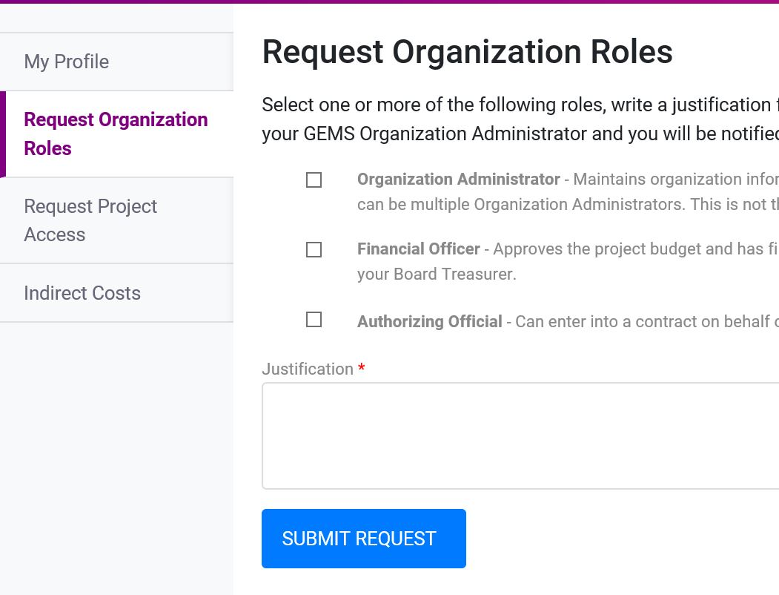
Organization Roles (4)
Found in GEMS > My Profile > Request Organization Roles
Notes:
This is what the Request Page looks like in GEMS.

Slide 11
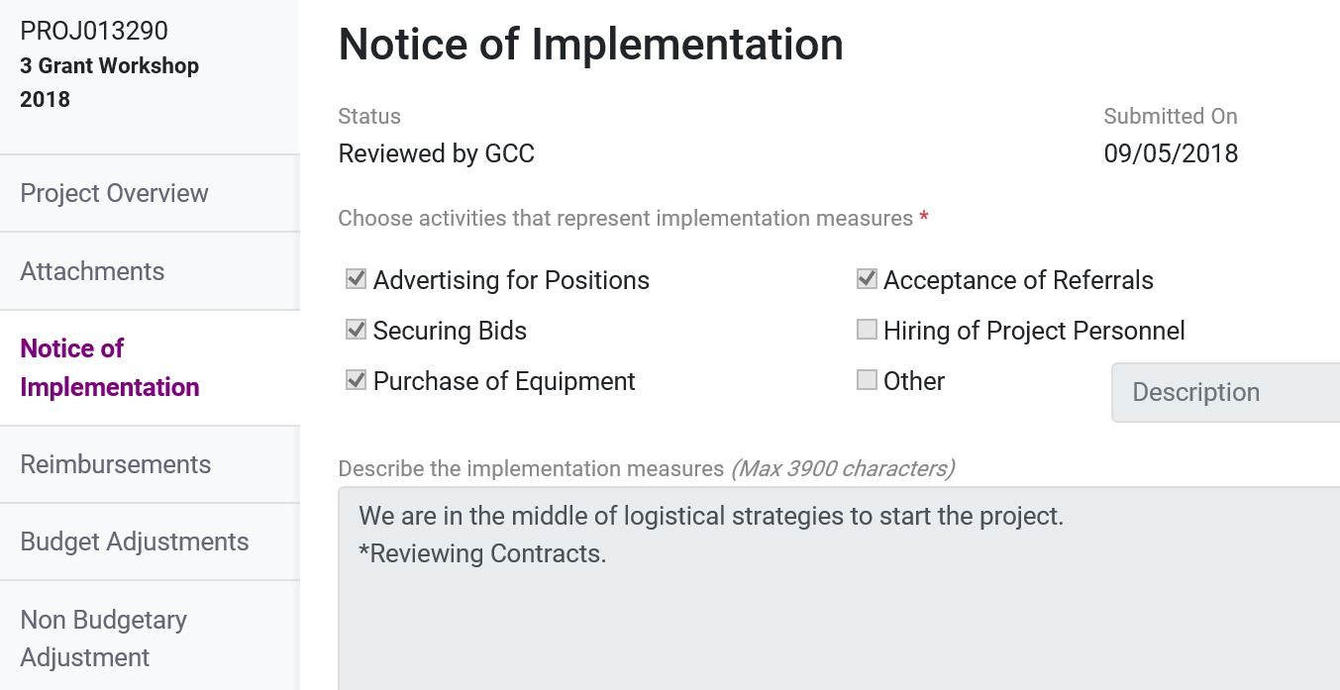
Notice of Grant Implementation
Must be submitted within 60 Days of Opening / GM Introduction
Notes:
The last part of the Grant Opening Process is for you to complete the Notice of Implementation. This must be done before you can request any Adjustments or Reimbursements. You will be notified that it is time to complete this via an introduction email from your GM.
The Notice of Grant Implementation (NOGI) is a short narrative of how Grant funds will be implemented. It explains the steps your organization will take to ensure the Project is administered according to Federal and State regulations. Please be sure to include details on procurement, documentation, and financial reporting.

Slide 12
Grant Adjustments
A Grant Adjustment is the means to change certain portions of terms or conditions previously issued Grant Agreement.
Grant Adjustments occur during the Grant’s Period of Performance. Budgetary adjustments must be submitted prior to 90-days before Grant End Date.
Notes:
Once the Grant is opened and your NOGI is approved, you can start submitting adjustments and reimbursements.
Adjustments are changes to certain portions of terms and conditions previously issued in the Grant Agreement. These must be submitted via GEMS, prior to 90-days before the Grant End Date. NOTE: This is a change from previous years to comply with NC Administrative Code.

Slide 13
Grant Adjustments
Non-Budgetary Adjustments
Grant Period Extensions
Project Adjustments
Personnel Adjustments
Budget Adjustments
Budgeted Items
Quantities and Unit Costs
Last request due 90 days prior to grant end
Notes:
There are two types of Grant Adjustments:
Non-Budgetary, this includes
- Grant Period Adjustments
- Changes/Updates to your Project (including scope changes)
- Job Information Updates (this is to change information related to any positions that are included in the Project Budget)
Budgetary Adjustments – these are common for Byrne/JAG and CESF Projects because there are often changes to costs of supplies and equipment. In a Budget Adjustment, you can:
- Update, Add, or Delete Budgeted Items
- Make Changes to Quantities and Unit Costs

Slide 14
Grant Adjustments
Provide details in justification, must be in line with Project scope
Do not request more funds than you have available. Will cause Project to be out of balance.
Notes:
Additionally, keep in mind the following when entering a budget adjustment:
Provide details in your justification – remember that the change you are requesting must be in line with the Project Scope.
Do not request more funds that you have available – this will cause the Project to be out of balance. Discuss these situations with your Grant Manager. We have a process to follow when additional funds are requested.

Slide 15
Grant Adjustments
Overestimate costs where possible
Equipment vs. Supplies – follow your policy if more restrictive than Federal rule ($5,000 and one/more year service life)
Use generic budget line-item names
Specific Models/Brands will limit you
Mirror quotes/invoices as closely as possible
Note that quantities must match
Notes:
Byrne JAG and CESF subrecipients submit Budgetary Adjustments frequently to make changes to their Project Budget. Here are a few tips when putting together a budget adjustment:
Overestimate costs where possible – build in some overage to cover unexpected price increases
When determining whether to enter an item as Equipment or Supplies – first, look to your local purchasing policy.
Use Generic Budget Line-Item Names – including a specific Model or Brand will limit you to those specifics, unless you submit another adjustment
Make sure your budget mirrors the quotes or invoices that you are working with – quantities should match.

Slide 16
Reimbursement Overview
Payment via Reimbursement. Funding provided after approved Project expenses are incurred
Requests and documentation are submitted via GEMS
Requests are reviewed by your GCC Grant Manager and payments are dispersed on a set schedule
Notes:
Grant Reimbursements occur after you have incurred expenses that were included in your Project Budget. Requests are submitted via GEMS, with certain required documentation. Once approved, payouts occur on Tuesdays, except the last week of the month.

Slide 17
Reimbursement Overview (2)
Submit by end of month following transaction
Reimburse as you go
You are proving the purchase to your GM
Think of this as an investigation
Supporting documents
Use .pdf format
Place in reimbursement attachments section
Conduct a debarment check on selected vendor(s) BEFORE ORDERING
Notes:
Here are several important items to keep in mind with regards to Grant Reimbursements:
Submit reimbursements as you go – when you receive items and they are paid for, submit the reimbursement request. Do not wait on all items to be received, or for one large reimbursement at the end of the Project Period. There are several reasons for this – if you submit as you go, the transactions are recent, so you can get any needed documentation easier. It also keeps us from being in a rush at the end of the Project period.
Think of reimbursement requests as an investigation. You are proving to your Grant Manager that this purchase occurred. You are proving that the items you put into your Notice of Grant Implementation actually occurred. The policies and procedures you said would be followed were followed, and that the items you purchased actually arrived and were put into use.
All required documentation should be submitted in .pdf format
Next, we will talk about the documentation required for reimbursements.

Slide 18
Vendor Debarment Check (IMPORTANT)
Debarment checks ensure we can pay you!
Must complete check at SAM.gov and NC Dept of Admin
Check each vendor before you purchase. Debarred vendors are NOT eligible
Document on State list that your vendor(s) are not included
Notes:
Vendor Debarment Checks – this is the process to prove that the vendor(s) you have selected are not barred from doing business with either the Federal or North Carolina Government.
Please make these checks prior to your purchase. We can not reimburse expenses with vendors that have been debarred.
The federal debarment check is done on SAM.gov – the State check is done through a spreadsheet maintained by the NC Department of Administration.

Slide 19
Vendor Debarment Check (SAM)
Vendor must be ACTIVE or “not found”
EXCLUDED status entities make your reimbursement NOT ALLOWABLE
Federal
https://www.sam.gov
Notes:
Vendor Debarment Checks – this is the process to prove that the vendor(s) you have selected are not barred from doing business with either the Federal or North Carolina Government.
Please make these checks prior to your purchase. We can not reimburse expenses with vendors that have been debarred.
The federal debarment check is done on SAM.gov – the State check is done through a spreadsheet maintained by the NC Department of Administration.

Slide 20
Vendor Debarment Check (NC)
NC list shows ONLY EXCLUDED VENDORS.
Document on State list that your vendor(s) are not included.
State
https://ncadmin.nc.gov/documents/nc-debarred-vendors
Notes:
Vendor Debarment Checks – this is the process to prove that the vendor(s) you have selected are not barred from doing business with either the Federal or North Carolina Government.
Please make these checks prior to your purchase. We can not reimburse expenses with vendors that have been debarred.
The federal debarment check is done on SAM.gov – the State check is done through a spreadsheet maintained by the NC Department of Administration.

Slide 21
Bids and Quotes
Three (3) Bids/Quotes or Sole Source Requests for purchases > $10K
Split procurement is not allowable
Sole Source Requests should be approved prior to purchase – prevents problems if disallowed.
Notes:
You also need to include quotes, or an approved Sole Source Request, for all purchases over $10K. Please note this is a GCC requirement. If your local purchasing policy is more stringent, you must follow that. Your local policy may require multiple quotes for purchases at another price point – maybe $5K and above.
Note that split procurement is not allowed, you may not split your purchase into smaller purchases to avoid the threshold required for quotes.
The GCC Sole Source Request form is available on our website. To use this, please complete it and return to your Grant Manager. You must give details on why you are seeking a Sole Source.
- Provider is continuing services previously engaged
- Research reveals no other service providers are available to us (attach details of effort)
- Other (provide explanation)
Once your Sole Source Request is approved, it will be returned to you via e-mail. Please make sure it is included in your reimbursement submission.

Slide 22
Procurement Documents
Date Expense Incurred
Date of signed purchase order or vendor’s “ordered on” date
Invoices
Quotes / Acknowledgements are not invoices
Proof of Payment
Processed Check (Both Sides, or clearance details)
Bank Statements
Check vouchers are not payment proof
$0 Vendor invoice or receipt
Notes:
Invoices and Proof of Payment are Important proof for your reimbursement requests.
Invoices – Please note that Quotes and Order Acknowledgements are not the same as Invoices. We need an invoice, complete with invoice number and invoice date, showing the products you have ordered. If there are multiple items on the invoice, please highlight those that you are requesting reimbursement for.
Proof of Payment – We accept the following as proof of payment:
- Processed Check, please provide a copy of both sides, showing that it was endorsed and processed
- Bank Statements showing cleared check electronic transfer
- Please note that Check Vouchers are not payment proof – they prove that a check was written, but not processed. Check vouchers are helpful if you are paying multiple invoices with a check, to show us which invoices were paid.
- A paid in full invoice showing a $0 balance due will also prove that payment was made.

Slide 23
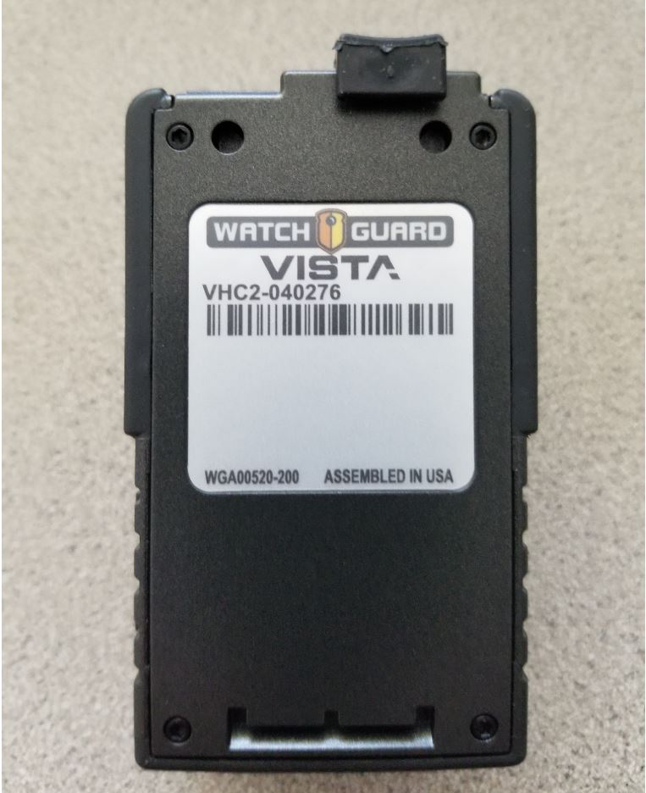
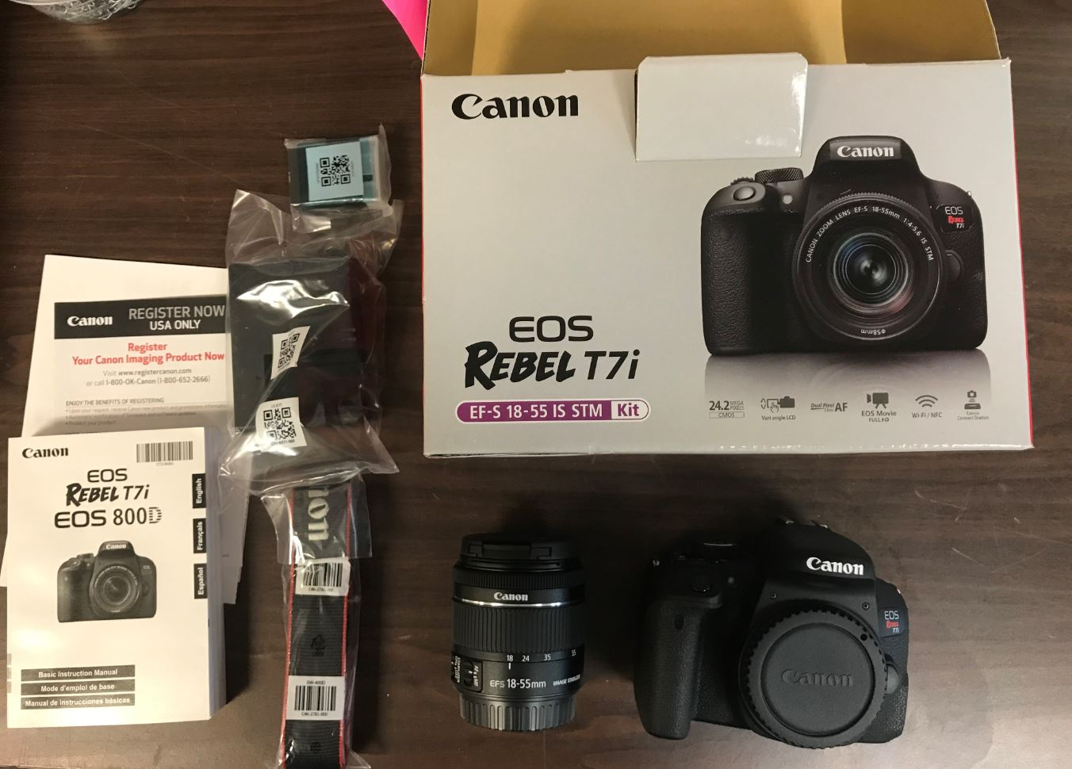
Photo Evidence
Photos of all items (take as you receive items)
Notes:
Let’s start with photographic evidence – this is important for equipment purchases.
Take photos of all items as you receive them.
Don’t wait until the items are assigned, and potentially in use before photographing.
Provide clear photos, of all items.
The photo on the left shows a body camera with the serial number visible. Always get a picture of the data plate.
The photo on the right is a good example of showing all items included in a package – this example is a camera that includes multiple lenses, documentation, etc.
Insert photos in Word document, add headings and info text, if needed.
SAVE WORD DOC WITH PHOTOS AS PDF. Give PDF descriptive name and include in reimbursement package.

Slide 24
Property Control
Property Control Documentation
Federal Requirement
Serial Numbers / Asset Tags
Items susceptible to repurposing
GCC Property Control Record & Equipment Certification
Check with GM if you have local forms
Must be signed & .pdf format
Notes:
Property Control Records are a Federal requirement for Equipment purchases. Any items that have a serial number or you are provided an asset tag for, should be documented on a Property Control Record. Also, any items that are susceptible to repurposing within your agency should have be listed on a Property Control Record. An example of this is networking equipment. Although they may be lower dollar items, they could be repurposed for other projects and we want to maintain documentation that they should only be used for your approved GCC project.
GCC maintains a Property Control Record & Equipment Certification Form on our website. If your agency has another method for Property Control, please check with your Grant Manager to confirm whether it is sufficient for your reimbursement documentation.
Please note that all Property Control forms must be signed and submitted in .pdf format.
We have discussed the major documentation requirements for Grant Reimbursements. Once they are submitted in GEMS, your Grant Manager will review. Please be available for discussion, or for further documentation submission, once you have submitted the request.

Slide 25
Reporting - PMT
Federal statutes REQUIRE PMT reports be submitted on-line directly to BJA, in a timely manner.
A copy must be uploaded to GEMS (PMT Reports
Section) by 10th of month following report period
GCC Planning Staff must then compile & enter its own
compilation report to BJA.
Failure to observe these conditions and deadlines may
result in an immediate hold of grant funds and may
prevent your organization from applying for funds.
Notes:
Now, we will discuss reporting. Federal statutes require that PMT reports be submitted online to the Bureau of Justice Assistance in a timely manner. These are reports showing the Performance of your project. Once you have submitted your report, GCC staff compiles the information and provides a summary to the Federal Government on the progress of all projects. Failure to submit these reports on time will result in a GEMS hold, and will prevent any reimbursements or adjustments from being submitted.

Slide 26
Reporting – Annual Progress Report
Due annually by September 30th or 30 days after grant end date
Completed in GEMS
Notes:
Annual Progress reports are due on September 30th of each year - OR – 30 days after the official end date for your grant, whichever is sooner. For grants ending 30 September, this date is fast approaching.
This is completed in GEMS. To completed, you must give notes on each Objective and the Activities that were outlined in the planning phase of your Grant. There is also a place to give comments on the process. Please include measurable statistics on the Project, where possible.

Slide 27
Questions?

Slide 28
GCC Contact Information
Main Switchboard: 919-733-4564
US Postal: 1201 Front St, Raleigh, NC 27609
Notes:
.

Slide 29
Reporting – PMT Important Dates
Reporting Period | Subrecipient Due Date | GCC Federal Due Date | GEMS Hold Starts
January – March | April 10th | April 30th | May 1st
April – June | July 10th | July 30th | August 1st
July - September | October 10th | October 30th | November 1st
October - December | January 10th | January 30th | February 1st
Notes:
Your PMT reports are due by the 10th day of the month following the reporting period. This is noted in the green box on the slide.

