Slide 1
WELCOME TO GEMS
GCC WORKSHOP 2022
Notes:
Hello, Everyone. Thank you for joining us today. My name is Starr Jones. I’m a Grant Administrator and I’d like to welcome you to GCC’s 2022 Workshop Breakout Session on GEMS…

Slide 2
GEMS TRAINING 101
Notes:
…GEMS Training 101.
Information provided in this session will help you navigate GEMS as you perform basic functions in managing your grant.

Slide 3
GEMS TRAINING CONTENTS and
PRESENTERS
My Projects Overview and My Profile – Allyson Teem
Organization Roles – Arienne Cheek
Reimbursement Requests – Arienne Cheek
Budget Adjustments – Sam Conyers
Non-Budgetary Adjustments – Sam Conyers
Reporting – Harriet Lunsford
Notes:
Our training contents and presenters are:
My Projects Overview and My Profile – Allyson Teem
Organization Roles – Arienne Cheek
Reimbursement Requests – Arienne Cheek
Budget Adjustments – Sam Conyers
Non-Budgetary Adjustments – Sam Conyers
Reporting – Harriet Lunsford

Slide 4
QUESTIONS
Please enter your questions in the Chat box.
Notes:
As you think of questions related to each topic, please enter them in the chat box. We will answer as many of them as we can during the breakout session. Answers to all questions will be posted on the GCC website under Resources/ Workshop 2022.
So, let’s get started with Allyson’s presentation of the GEMS My Profile Overview.

Slide 5
MY PROJECTS OVERVIEW and
MY PROFILE
PRESENTED BY: Allyson Teem
Notes:
Hello. I’m Allyson and I’m going to orient you to tabs under My Projects and My Profile in GEMS.

Slide 6
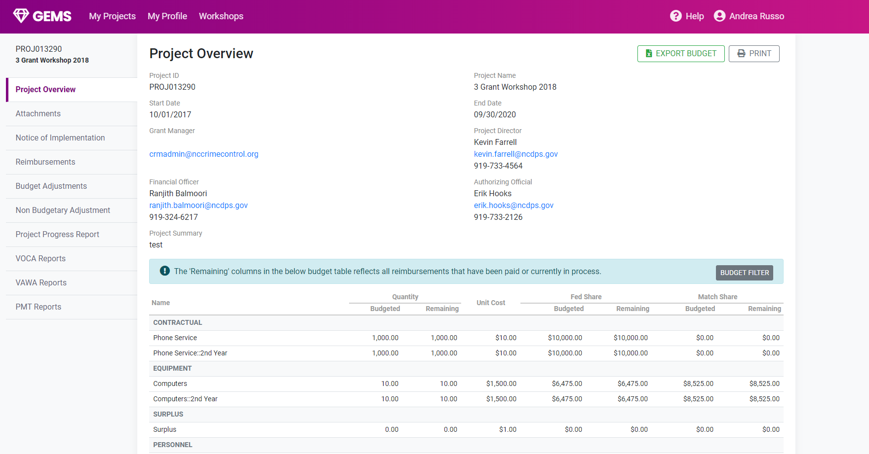


MY PROJECTS – PROJECT OVERVIEW
Export/Print
Filter Option
Quantity
Unit Cost
Federal Share
Notes:
Let’s start by looking at the Project Overview tab. Under My Projects, click on the left-hand tab to view your project information, roles, and budget. This is considered the general page.
Quick note - you can see on the top right corner you have Export Budget and Print options available for your convenience.
On this tab you will find your project number, start and end date, and project name. You’ll also find the assigned Project Director and Financial Officer, and the contact information for your Grant Administrator.
Below that is your budget where you’ll see how much quantities and funds were budgeted compared your spent and remaining quantity and fund balances for federal and match share.

Slide 7
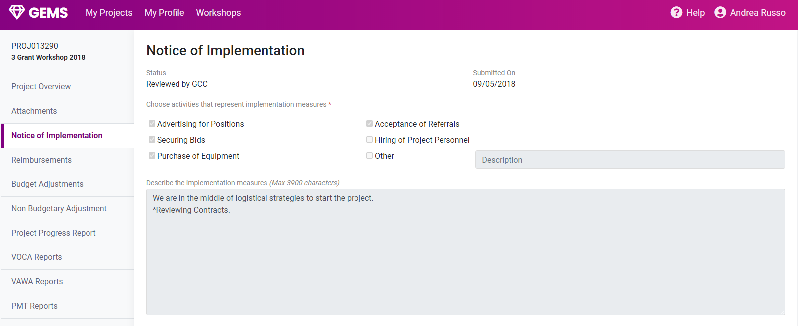
NOTICE OF IMPLEMENTATION
Select all boxes that apply
Enter description of next steps for project to proceed/begin
Notes:
After the Project Overview tab is the Attachments tab. This tab is a hold-over from a previous version of GEMS many of you are still using. I’m going to skip my discussion of this for now and will circle back to it in the next few slides.
Notice of Grant Implementation (NOGI): This must be completed in order to open your project and begin activity in GEMS on your grant. You will make the selection appropriate for your project and enter the description of your next tasks for opening and running your program for your grant. Then you would click the blue save button for submission and your Grant Administrator will review it.
Again, this must be done first before anything else can be completed for your new project.
In the next slide I’ll move on to an overview of tasks that can be managed under the My Profile tab. After that our presentation will proceed with explanations of the other tabs under My Projects.

Slide 8
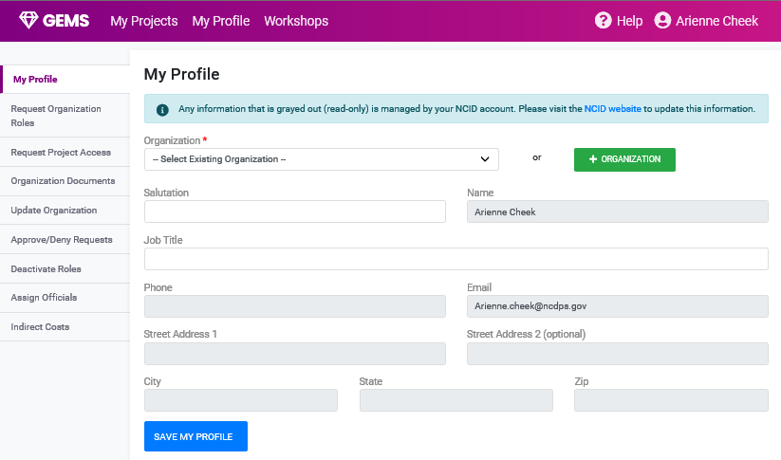

MY PROFILE OVERVIEW
Notes:
Okay, let’s look at information under My Profile.
There are three main categories of information accessible under My Profile:
Organization Information
Organization Documents
Indirect Cost Information
and your Organizational Roles Information. Arienne will follow me shortly with a presentation about Key Roles.
At the time of opening a new project, the My Profile tab allows you to select your organization and complete your profile. During the life of your project, if you need to make changes to information like your agency’s address, phone number, DUNS number, etc., click on the Update Organization tab.

Slide 9
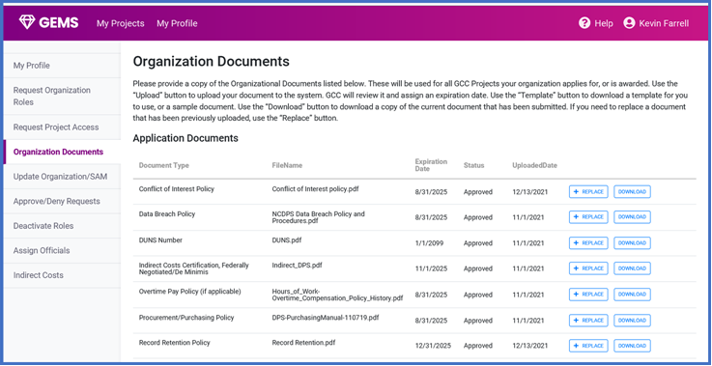


ORGANIZATION DOCUMENTS
Notes:
The Organization Documents tab takes you to what we call your Document Locker.
To load new required documents or to update expired documents, your Organization Administrator must go into the Document locker, click the “+Replace” button to upload a new document for review. Document status will change from “Expired” to “Submitted” and then to “Approved” after GCC’s review and approval. You’ll also see the new expiration date.
So for example, with SAM registrations, your Organization Administrator will receive notifications about upcoming expiration dates. This is the process now for replacing old registration proof documentation with new documentation.

Slide 10
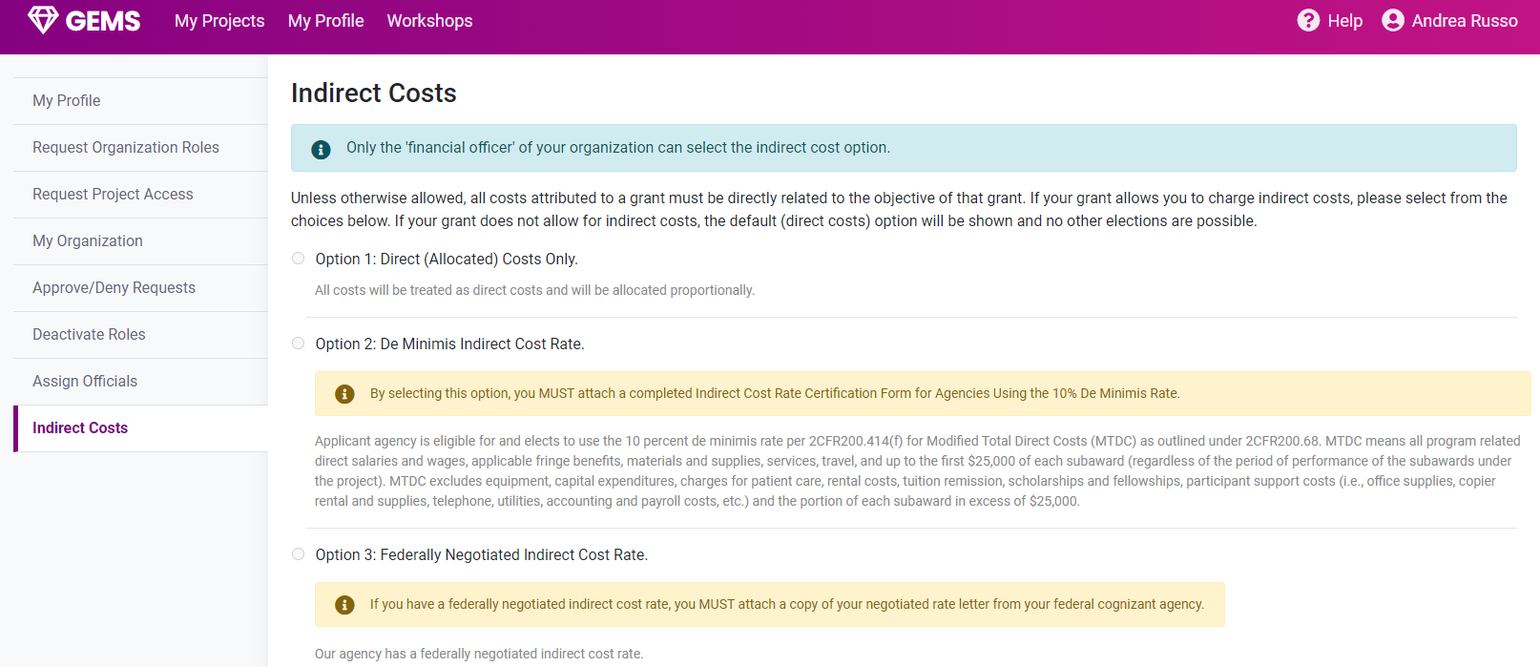
MY PROFILE – INDIRECT COSTS
Select appropriate Option
Notes:
Here you will find your indirect cost information if you have chosen and have been approved to have indirect costs allocated onto your project.
Now Arienne will discuss Organization Roles.

Slide 11
Organization Roles
PRESENTED BY: Arienne Cheek

Slide 12
TRAINING CONTENTS
MY PROFILE
  Organization Roles
  SAMs
Notes:
My Profile – Organization roles & SAMs
Opening a Project – Attachments & NOGI
Project Reporting – VOCA - VAWA – Progress Reports
Non- budgetary Adjustments - Grant Periods Extension – Personnel Adjustment – Project Adjustment
Adjustment Rules & Tips
Budget Adjustments

Slide 13
NEED TO KNOW
Always notify Grant Administrator via email of any key role staff changes.

Slide 14
ORGANIZATION ROLES
**(All persons needing GEMS access must obtain an NCID through https://ncid.nc.gov):
Authorizing Official (AO).
  Signatory to grant award.
  Chief point of oversight for project.
Financial Officer (FO).
  Provides financial oversight to project
  Agency financial policies and procedures
  Federal financial policies and procedures
Project Director (PD).
  Signatory to grant award.
  Responsible for execution of project.
  Primary point of contact with GCC.
Organization Administrator.
  Submits all SAM updates to GEMS.
  Approves all requests for organization roles (AO, FD, PD)
  Assigns AO, FO and PD to open projects.
  Approves/Denies requests for project access
  Deactivates access/roles, if needed.
Notes:
The organization roles include:
The Authorizing official – the person who signs the award and is the chief point of oversight for the duration of the project.
The Financial Officer - Provides financial oversight to project & Agency financial and federal policies and procedures.
Project Director – Second to sign Grant Award. Responsible for execution of project. Primary point of contact with GCC.
Organization Administrator - Submits all SAM updates to GEMS. Approves all requests for organization roles & Assigns Roles to open projects. Approves/Denies requests for project access. Deactivates access to roles, if needed.

Slide 15
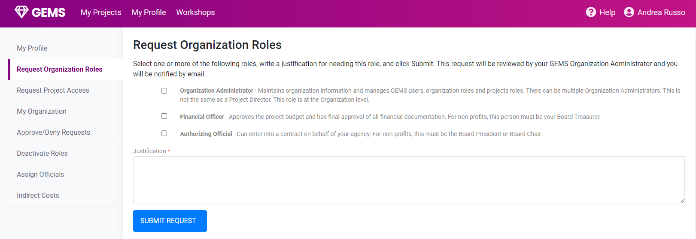
MY PROFILE – REQUEST ORGANIZATION ROLES
Notes:
To request an organization role, you will select the appropriate tab and select the box which applies to you. You will then enter a description in the justification box of the reasons you are requesting this role. You will then submit the request for the Organization Administrator to review.

Slide 16
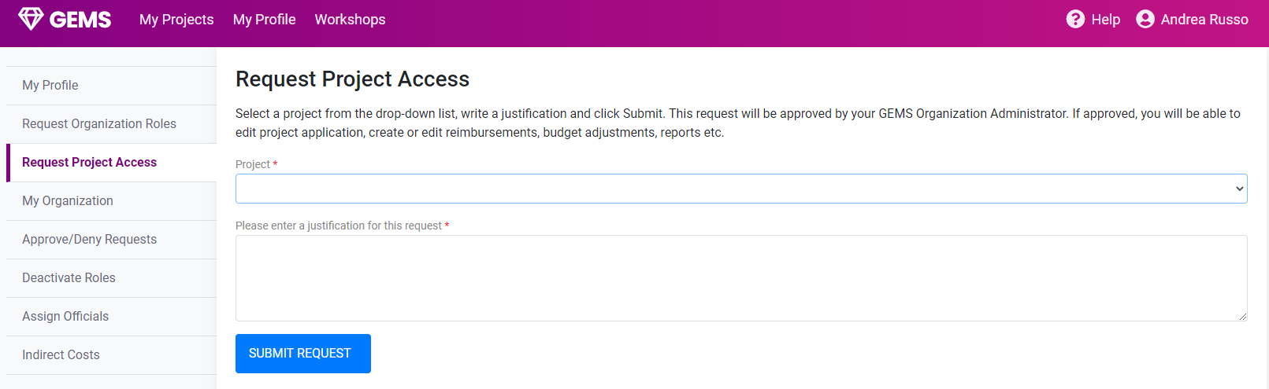
MY PROFILE – REQUEST PROJECT ACCESS
Select appropriate project.
Enter justification here.
Notes:
To request project access, you will select the project you need access to and then complete the justification in the box below to verify the reasoning for your request. Then you will submit this request for your Organization Administrator for review.

Slide 17
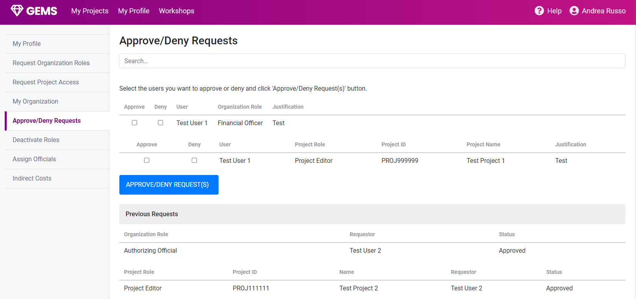
MY ORGANIZATION – APPROVE/DENY ROLE REQUESTS
Select
Select
Click
Notes:
The Organization Administrator will have access to approve or deny any submitted roles for request. There can, and should, be more than one person in your agency in this role.
On this page the Organization Administrator may either approve or deny role requests and requests for access to projects. They will make a selection and then click the blue button for finalization.

Slide 18
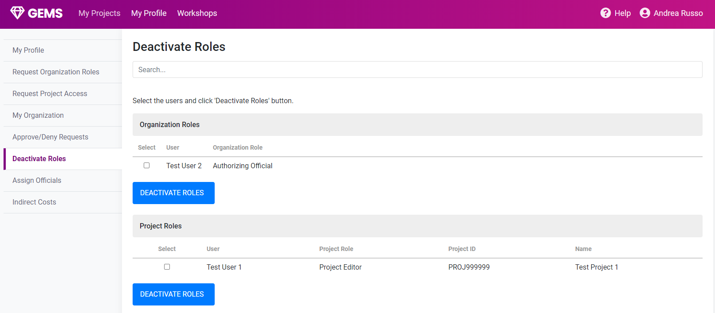
MY PROFILE – DEACTIVATE ROLES
Search for Person/Role to Deactivate
Select
Click
Click
Notes:
The Organization Administrator can deactivate roles of personnel no longer working on the project or with the agency.
Please keep in mind if there are changes to the key roles in your agency, your Grant Administrator MUST be informed so they can better assist you with any related changes to the project.
Prior to any employee leaving a key position, make sure the roles are properly allocated to new personnel to assure there is no loss of access during the transition period. (For example, automatic system-generated emails will continue to be sent to an old email address until the role-change is processed.)
In GEMS, you will select the user to be deactivated and click the blue button for submission.

Slide 19
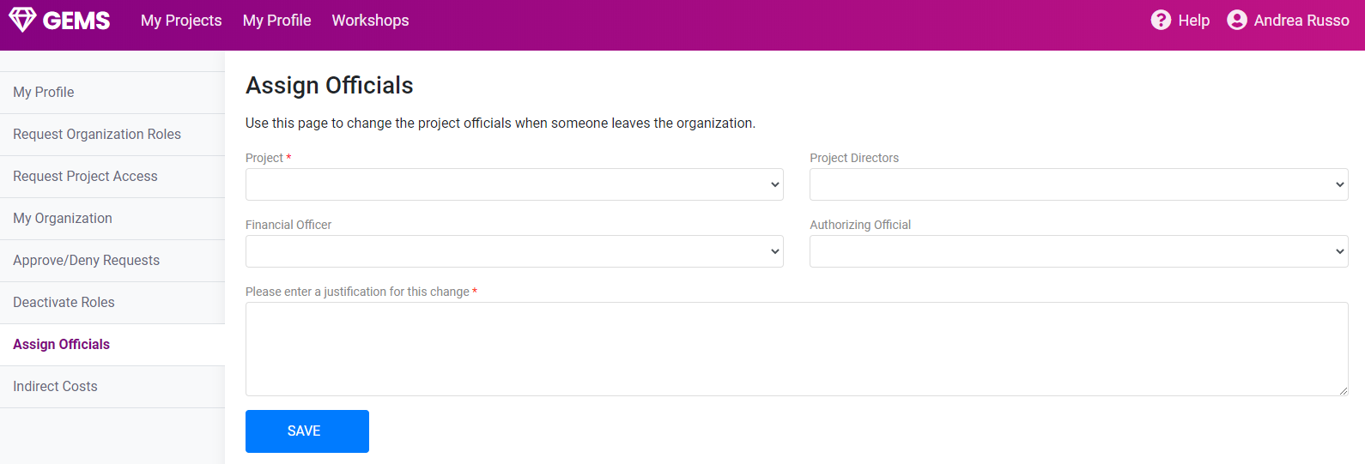
MY PROFILE – ASSIGN OFFICIALS
Select Project
Select Director
Select Category
Select Official
Click
Click
Notes:
The Organization Administrator may assign officials of a project to a specific role by selecting the appropriate categories and clicking the blue save button.

Slide 20
REIMBURSEMENT REQUESTS
PRESENTED BY: Arienne Cheek

Slide 21
NEED TO KNOW:
All reimbursements must be submitted monthly from the 1st to the last day of the month.
Reimbursements are submitted based on actuals not budgeted.
Submit reimbursements in the month the expense was incurred. (Wait till the expense has been paid and the payment has cleared the bank to submit.)
Make sure to select yes for final reimbursement
NEW! Last request due 60 days after closing of project.

Slide 22
BYRNE JAG AWARDS ONLY:
Reimbursements Rules for specific grants:
Period Start/End Dates – since equipment grants typically are not submitting monthly reimbursements, the subrecipient should enter the period of time the purchases occurred (from quote gathering to payment). It’s ok if the period is longer or shorter than one month.
Importance of Photos – photos are very important for equipment grants – best practice is to photograph equipment as it arrives. Be sure to include photos of serial numbers or asset tags for larger purchase and all firearms.

Slide 23
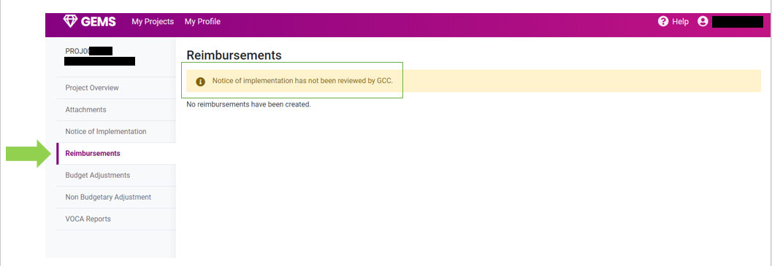
REIMBURSEMENT REQUESTS
Notes:
You will find the reimbursements tab on the left-hand side of your project screen in GEMS.
Select the reimbursements tab.
This is a perfect example of what happens when you have not yet completed your Notice of Grant Implementation for your project. Otherwise a green Create Reimbursement button will be available.

Slide 24
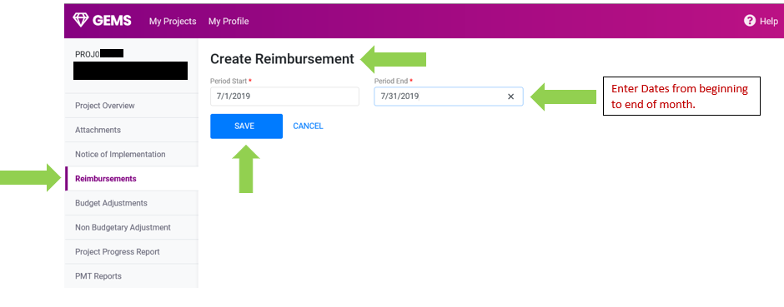
CREATE REIMBURSEMENT
Enter time period by month
Click
Notes:
To create a reimbursement, you will select the green create tab and enter the time period of the request.
Ex. July 1st, 2019 – July 31st, 2019
You will then click the blue save button to continue.

Slide 25
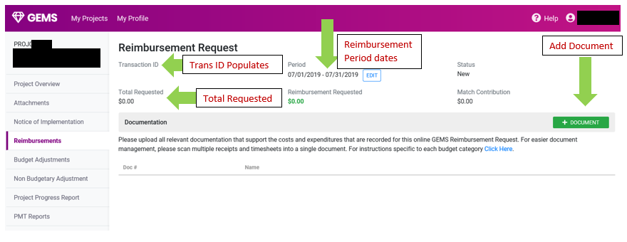
REIMBURSEMENT FUNCTIONS
Edit reimbursement Dates
Transaction ID
Add Document
Total requested
Notes:
GEMS will automate a Transaction ID and you will see an overview of the dates you requested. Make sure the dates are correct. You can select edit to correct the dates if needed.
Select add document:
Documentation should be submitted as PDF files only, and a separate PDF should be submitted for each budget category, such as Personnel and Supplies.
You may upload all the documents needed prior to selecting your line items for reimbursements.
1 Pdf for personnel, 1 for supplies, 1 for bank statements, 1 for equipment, etc.
Please make sure to label your page numbers and enter the appropriate page numbers for each line item to help your Grant Administrator find documents efficiently and avoid longer reviewing time frames.

Slide 26
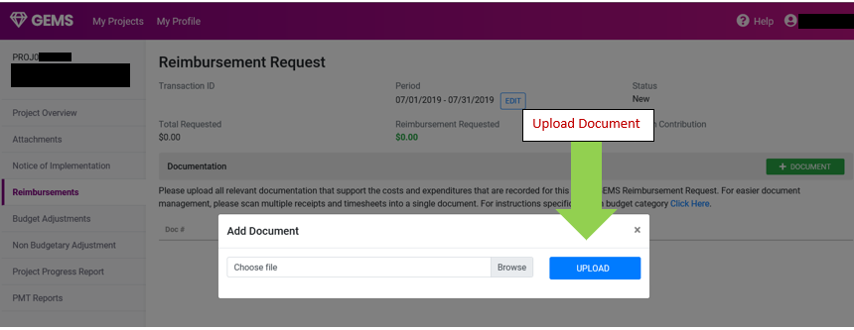
UPLOAD REIMBURSEMENT FILE
Upload PDF file document only
LABEL DOCUMENT AS PERSONNEL, SUPPLIES, ETC. LABEL PAGE NUMBERS. ENTER PAGE NUMBERS INTO DOC # BOX AFTER UPLOAD.
Notes:
Select the pdf file and Click the blue upload button.

Slide 27
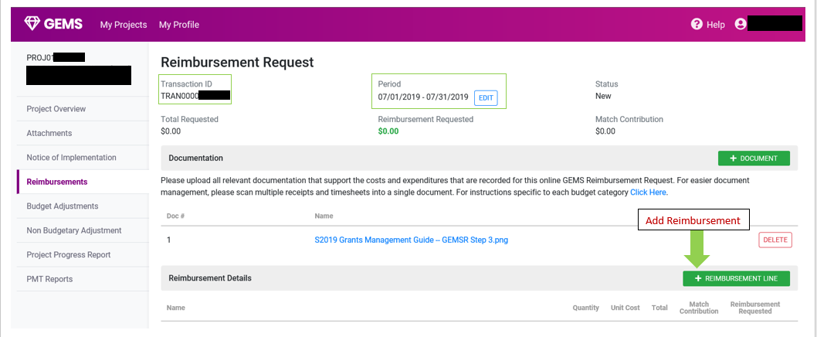
ADD REIMBURSEMENT LINE ITEM
MATCH & FEDERAL SHARE
FEDERAL SHARE ONLY
MATCH ONLY
Add Document/s
Add Reimbursement
.
Notes:
Once all files are uploaded you will then click the green add reimbursement line button.

Slide 28
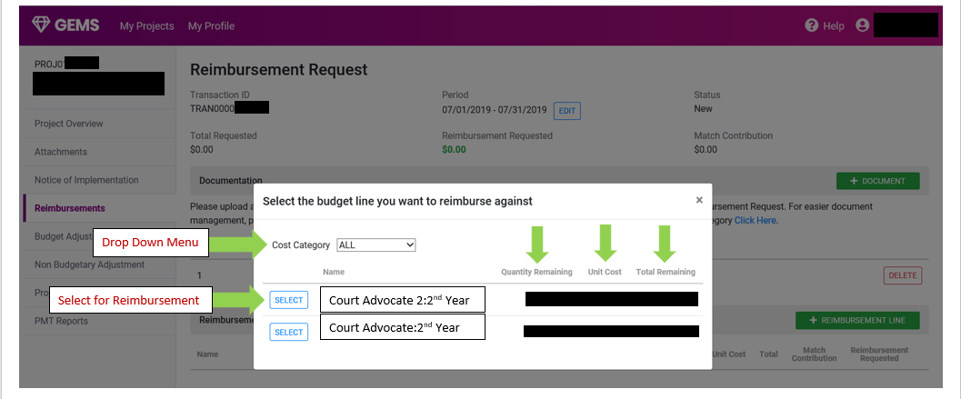
DROP DOWN AND SELECT LINE ITEM
Select cost category
Select lines for reimbursement
Notes:
Select the appropriate cost category and line item.

Slide 29
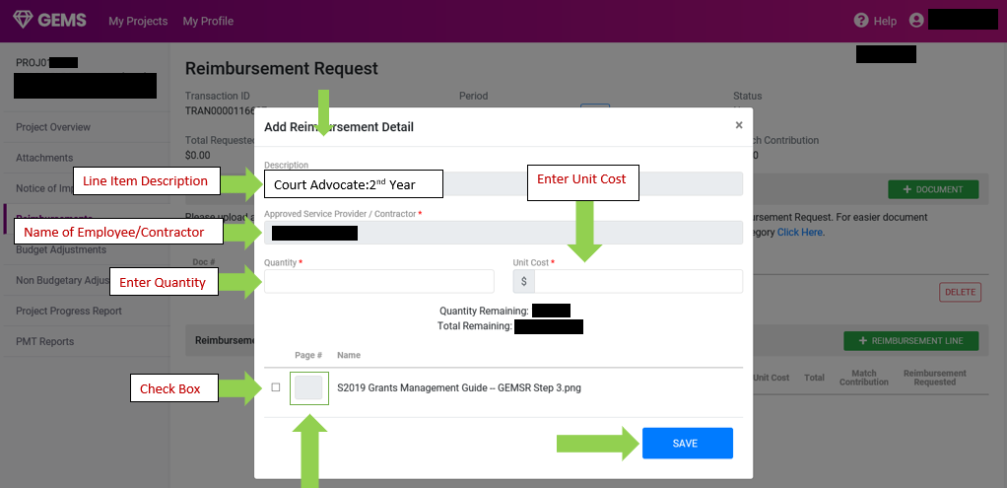
FOLLOW INSTRUCTIONS BELOW
Enter description Title
Name of Employee/Contractor
Enter Quantity = 1
Enter page #. EX: P1-P3
Click
Notes:
Enter the quantity and the amount needed for reimbursements. Make sure cover sheet and documentation match all given amounts.
Enter the page numbers for this line item. EX P1-P3 for personnel. You may enter letter and number characters in the Page# box. This assists Grant Administrators with efficiently finding the appropriate documentation for each line item.
Once complete, click the blue save button.

Slide 30
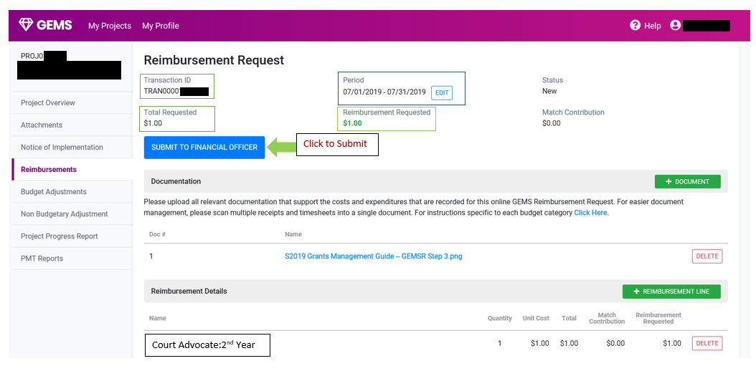
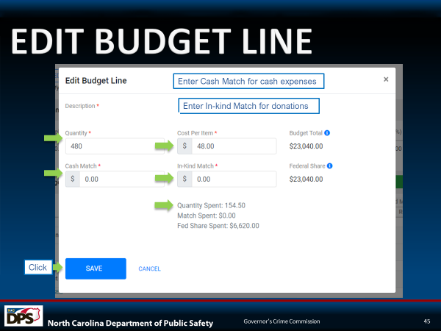
SUBMIT TO FINANCIAL OFFICER
Click to submit
Notes:
Once you have completed all of your requested line items and added documentation you will click the blue submit to financial officer button.
Once your financial officer thoroughly reviews your reimbursement request, they will then submit it for your Grant Administrator’s approval. Then your Grant Administrator will review the submitted documentation.
Modifications required: If any signature, documentation or proof of payment information are missing, your Grant Administrator will send your request back for modifications. You will then complete these modifications and re-upload the correct documentation in PDF format only and submit back to GCC for review.

Slide 31
BUDGET ADJUSTMENTS
PRESENTED BY: Sam Conyers

Slide 32
NEED TO KNOW
Always notify your Grant Administrator (GA) of any budget changes in a detailed email prior to submitting an adjustment.
Always notify Grant Administrator via email of any key role staff changes.
Always ask you Grant Administrator when in question of allowability.
Notes:
COMMUNICATION:
Communication is key and of paramount importance with your grant administrator. GAs need to be made aware of key changes within your project such as staff changes or budget changes. (Give details in justification in your request.) Also, if you are unsure about what items are allowable, your grant administrator can advise you.

Slide 33
BYRNE JAG AWARDS ONLY:
Budget Adjustment Rules for specific grants:
EQUIPMENT ONLY:
When adding new budget line items for equipment, it is preferable to give general names in the budget.
An example is to list “Radios” as the budget line name, instead of “Kenwood Radio Model XTS.” The more specific you are, the greater of a chance you’ll have to submit another budget adjustment if that model is not available, or if needs or prices change.
Notes:
BYRNE JAG AWARDS ONLY: These rules apply only to equipment for two grant programs. It is better to be general with naming equipment items in the budget than specific. If you give specific brand names and they are not available, you don’t want to be required to submit another budget amendment.

Slide 34
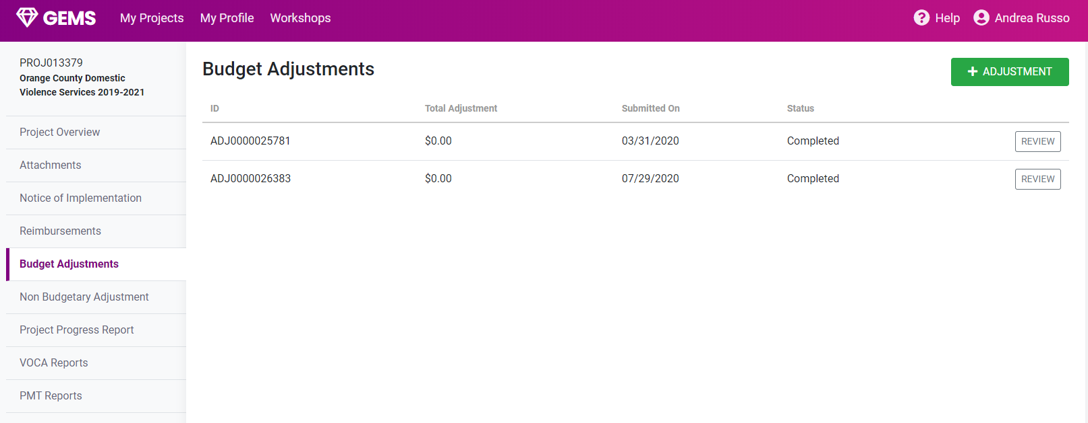
BUDGET ADJUSTMENTS
Click
Notes:
BUDGET ADJUSTMENTS: Budget Adjustments are entered by the Subrecipient into the GEMS System. GCC Grant Administrators are restricted from making changes in GEMS. GEMS is the input system for Subrecipients - only.
* The Budget Adjustment tab is located on the left side of the GEMS Project page.
* Click the green arrow located on the top right side of the page in order to move forward with creating the request.

Slide 35
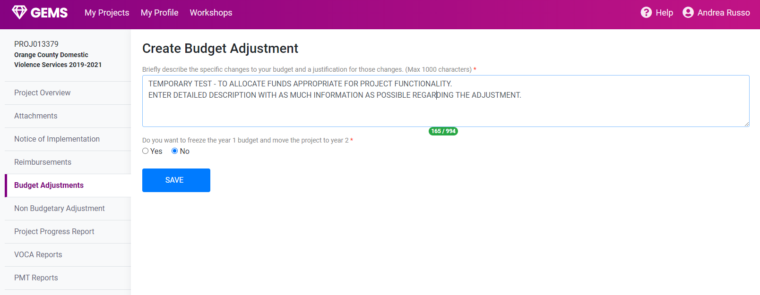
CREATING A BUDGET ADJUSTMENT
Enter detailed description to describe reasoning for submitting the budget adjustment request.
Select Option
Are you switching from year 1 to year 2?
Click Save
Notes:
CREATING A BUDGET ADJUSTMENT: It is the Subrecipient’s responsibility to justify the Budget Adjustment request. This is where the Grant Administrator needs to see the, “meat and potatoes” of the desired outcome. This is the Subrecipient’s opportunity in narrative form to demonstrate that the costs are allowable, allocable, reasonable, and necessary.
* A complete justification describing the adjustment request in detail and documenting the reasoning behind it must be entered.
* The subrecipient has the option to select yes or no. Yes should only be selected if the need is to freeze all Year 1 lines in order to move all remaining funds over to Year 2. The blue save button must be clicked in order to continue.

Slide 36
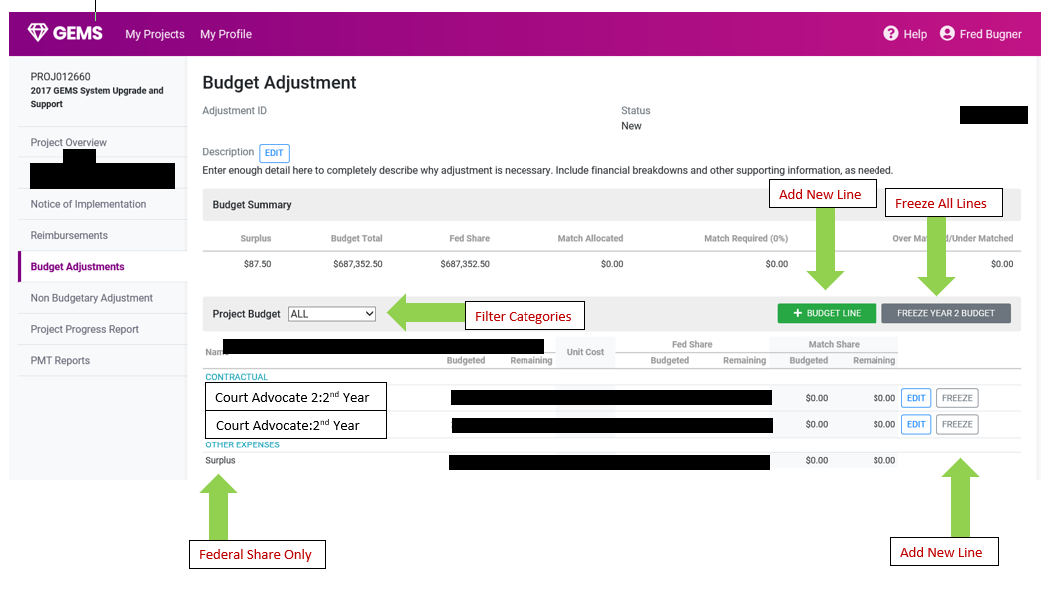
BUDGET ADJUSTMENT FUNCTIONS
Click to add new line
Click to freeze entire year/All lines at once
Sort categories
Notes:
BUDGET ADJUSTMENT FUNCTIONS:
GEMS creates an Adjustment ID and provides an option to add a budget line item or freeze an entire budget year. If you are adding a budget line, the add budget line form is straight forward.

Slide 37
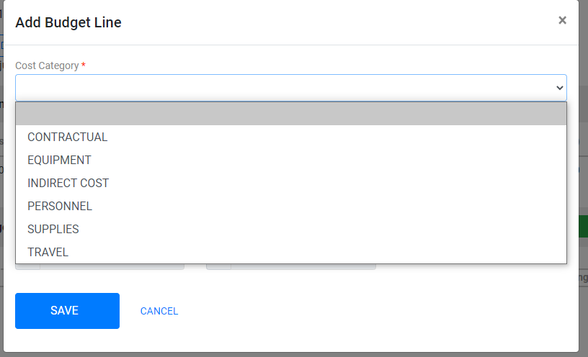
ADD A BUDGET LINE ITEM
Select appropriate category
Click
Notes:
ADD A BUDGET LINE ITEM:
Once you have selected your course of action, you move to the next screen. Adding a budget line item is a potential option. In adding a budget line item, you will be utilizing a dropdown menu. When you select, “add budget line item”, a new screen will pop up. Select the appropriate category for your line item.

Slide 38
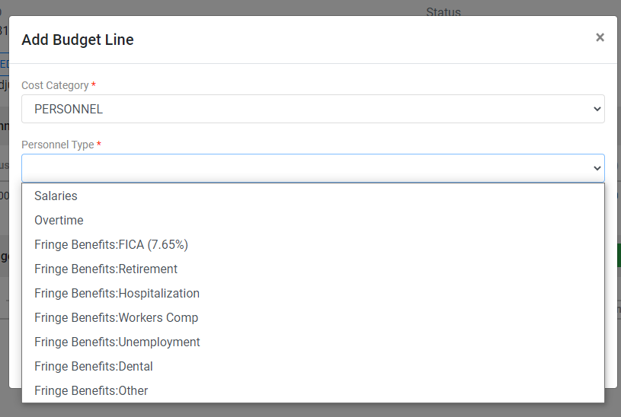
ADD BUDGET LINE – CATEGORY SELECTIONS
Select personnel type
Notes:
ADD BUDGET LINE – CATEGORY SELECTIONS:
After you have chosen to add the budget line item, you will be able to select the Category type that you are adding as a line item (if you are dealing with a new fringe line item, you must select “fringe other” and label it manually).
The system only allows fringe line once.

Slide 39
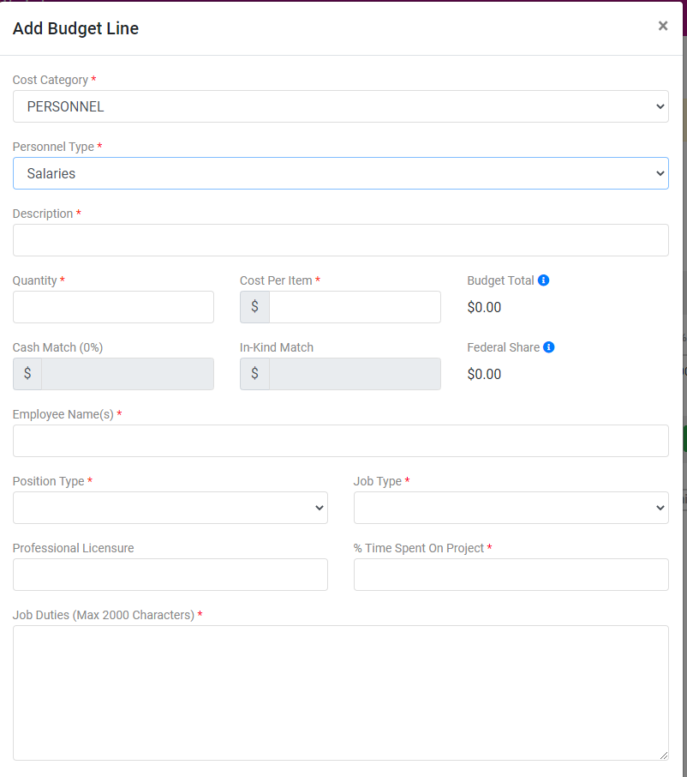
ADD BUDGET LINE ITEM - SALARY
Enter Position Title
Quantity in months
Enter name/s
Select position type
Select job type
Enter accurate percentage of time worked on project
Enter detailed job duties obtaining to personnel position
Notes:
ADD BUDGET LINE ITEM – SALARY:
In adding the Budget Line Item, you will be prompted to enter a description and select whether or not your organization is eligible for indirect cost payments. Once you have entered these, you will proceed to putting in your quantity data:
* Enter the quantity of the request. All reimbursements are submitted monthly. 5months = 5 quantity (no decimal points).
* Enter the cost per item and any match required for the line item.
* Complete the remaining boxes and appropriate selections.

Slide 40
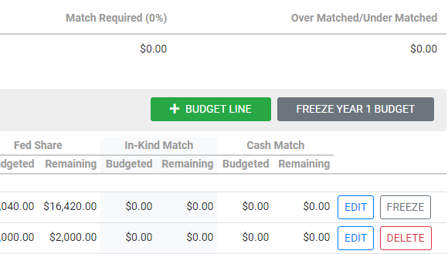
FREEZE/EDIT OPTIONS
Funds spent = Freeze Option
Funds not spent = Delete Option
Notes:
FREEZE/EDIT OPTIONS:
The freeze button is a big, gray button located on the right side of the GEMS project page screen. The edit buttons are located on the right side of the screen at the end of the appropriate line item and will only show for a line item where no funds have been drawn down. After locating these buttons, you will:
* Proceed to select the next line item (select freeze or edit).
* If adding new funds to a line item, select freeze and create the new line item.
* If removing funds from a line item, select edit.

Slide 41
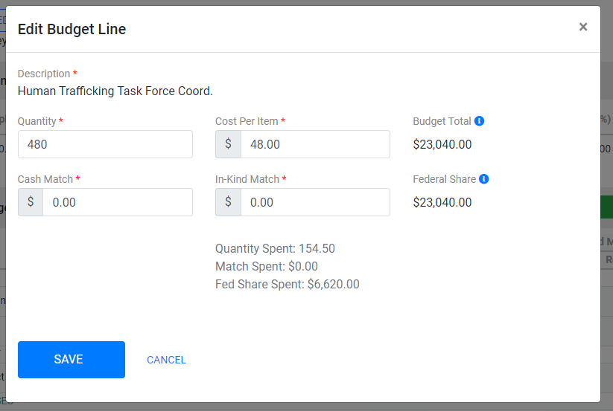
EDIT BUDGET LINE
Enter Cash Match for cash expenses
Enter In-kind Match for donations
Click
Notes:
EDIT BUDGET LINE:
Editing the budget line is simple with everything put in one box. Entering the data is done in an easy-to-use format. Make sure to hit the blue save button when your entry is complete.
* To edit a line item, enter the match and federal share amounts. You are able to reduce the quantity of the amounts, but not allowed to increase the quantity.

Slide 42
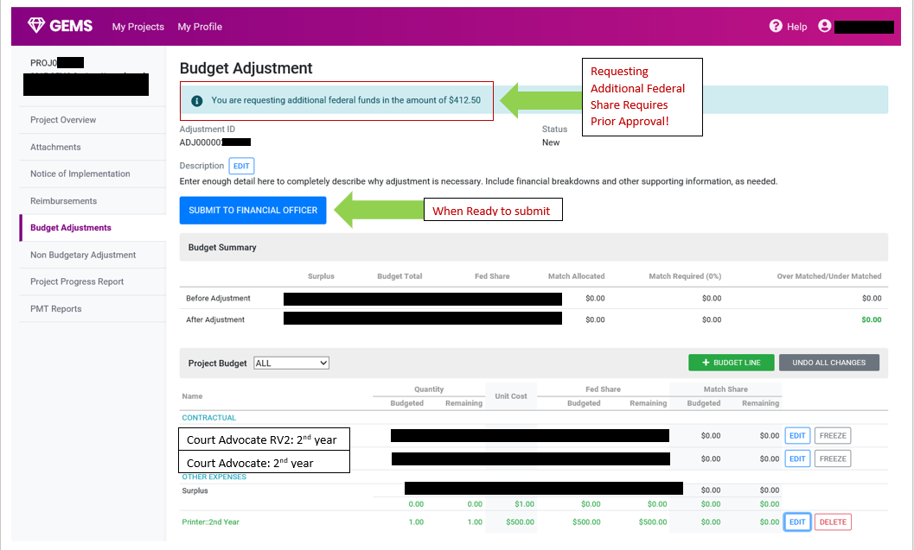
REQUESTING ADDITIONAL FEDERAL SHARE
Notes:
REQUESTING ADDITIONAL FEDERAL SHARE:
Requesting additional Federal Share MUST be done via formal request. The Federal award cannot increase or decrease without formal Federal approval. The Federal sum column most be zero. It is possible for a greater amount to be put in than the Subrecipient was awarded.
* If approved for requesting additional federal share, you will be prompted with a message on the budget screen informing you that you have requested additional funds according to your budget edits.
* If you are prompted with an error message, you must recalculate expenses and find the error prior to submission.
* Contact your grant administrator if you require additional assistance.
* If you are short on your program match, you will see a message. Make sure you are submitting the required match for your projects.
* Once the budget adjustment is complete, click the blue “submit to financial officer” button.
* The Financial Officer will review the request. Following a thorough review and approval by your Financial Officer, your Grant Administrator receives the request for review.

Slide 43
NON- BUDGETARY ADJUSTMENTS
PRESENTED BY: Samuel Conyers
Notes:
This portion of the presentation deals with Non-Budgetary Adjustments.

Slide 44
NEED TO KNOW
Non-Budgetary Adjustments are submitted to make non-financial changes to a federal award.
Non-Budgetary Adjustments are frequently, but not exclusively, personnel adjustments and grant period extensions.
Notes:
Non-Budgetary Adjustments are submitted to make non-financial changes to a federal award.
Non-Budgetary Adjustments are frequently, but not exclusively, personnel adjustments and occasionally grant period extensions.

Slide 45
BYRNE JAG AWARDS ONLY:
Non-Budgetary Adjustment Rules for specific grants:
Grant Period Extensions – may be needed for equipment grants when items are on backorder, or have not arrived by the project end date. Work with your Grant Admin to determine if additional time is needed.
Project Changes – Scope changes for equipment grants should be discussed with your Grant Admin to make sure the change still meets the funding priority and is allowable under the federal award.
Notes:
Rules that apply to specific types of grants include:
Grant Period Extensions – may be needed for equipment grants when items are on backorder or have not arrived by the project end date. Work with your Grant Admin to determine if additional time is needed.
Project Changes – Scope changes for equipment grants should be discussed with your Grant Admin to make sure the change still meets the funding priority and is allowable under the federal award.

Slide 46
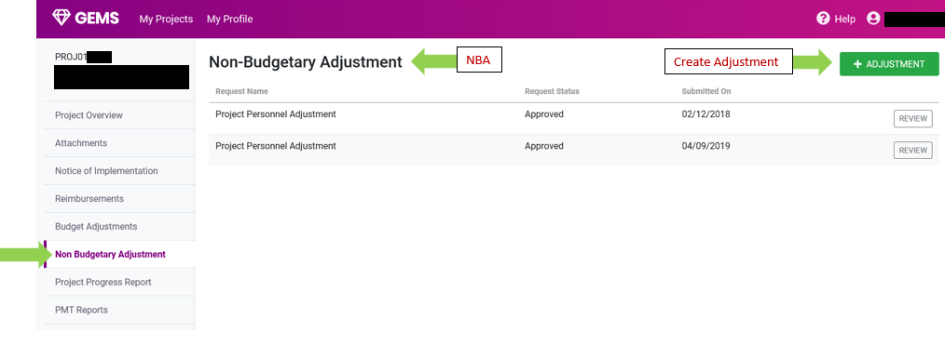
NON – BUDGETARY ADJUSTMENT
Click
Select Option
Notes:
Select the Non-Budgetary Adjustment tab on the left of the screen. Select the tab and then at the top right-hand corner you will see the green + (Add) Adjustment button.

Slide 47
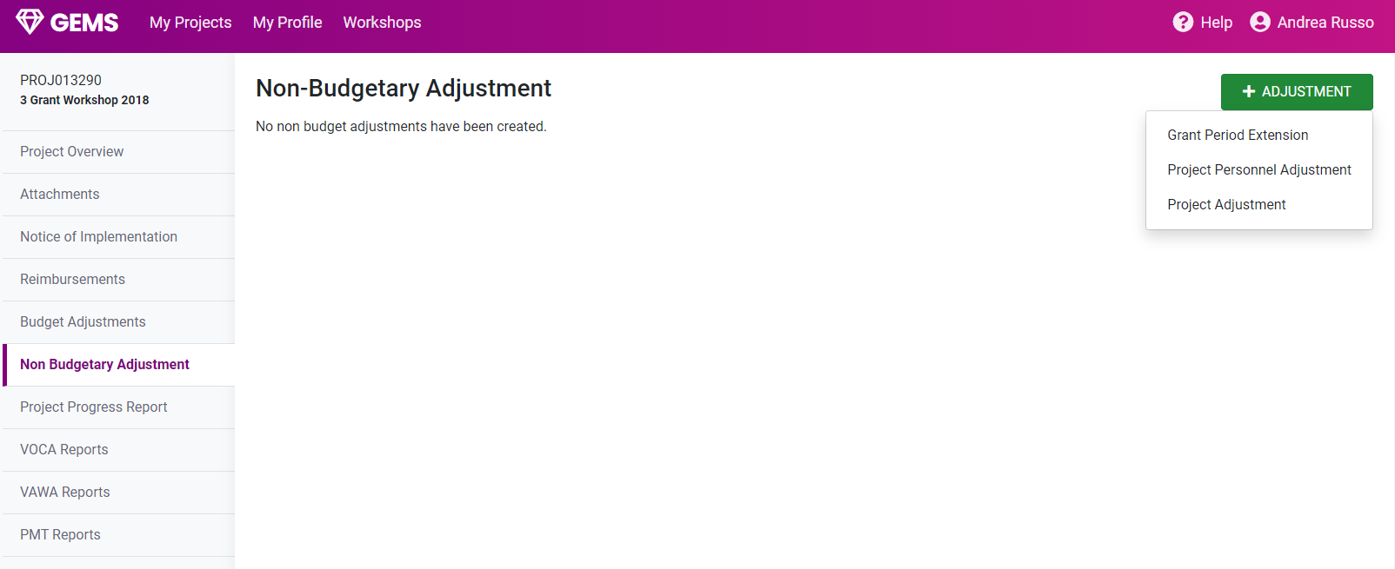
NON – BUDGETARY ADJUSTMENT
Click
Requires prior Approval
Select Option
Notes:
You will then see 3 options:
Grant Period Extension .
Project Personnel Adjustment .
Project Adjustment (Rare) This Changes of scope of project and is only used for special situations.

Slide 48
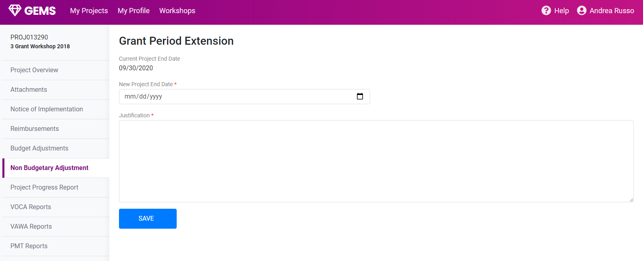
GRANT PERIOD EXTENSION
Enter “New” proposed Extension date
Enter a detailed justification for the grant extension
Make sure to save!
Notes:
Please keep in mind you must notify your Grant Administrator prior to submitting a Grant Period Extension request. If you have a new project opening for the next grant cycle, an extension request cannot be granted. If your Grant Administrator approves an extension with your justification you will then submit a request.
Make sure to ENTER the NEW future date in the date file that you need the project to end.
Then you will enter the justification for the request.
Click the blue save button and your Grant Administrator will review your submission.
GCC Grant Period Extensions are for VAWA and VOCA grants and are allowable only when you don’t have another grant opening and you have a justifiable reason.

Slide 49
NON-BUDGETARY ADJUSTMENT
Click
Select Option
Notes:
Personnel Adjustment - To complete a personnel adjustment, you will select personnel adjustment tab at the top right of the screen.

Slide 50
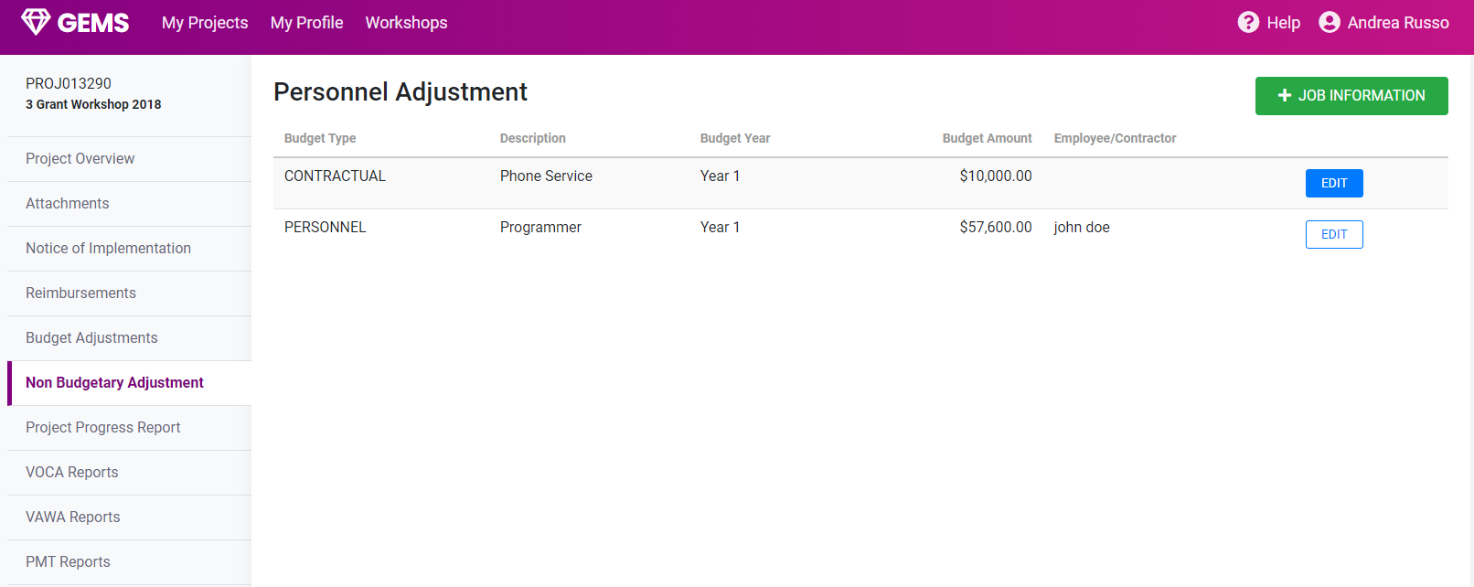
PERSONNEL ADJUSTMENT
Click
Notes:
To edit job information, select the position you need and then select the edit button.

Slide 51
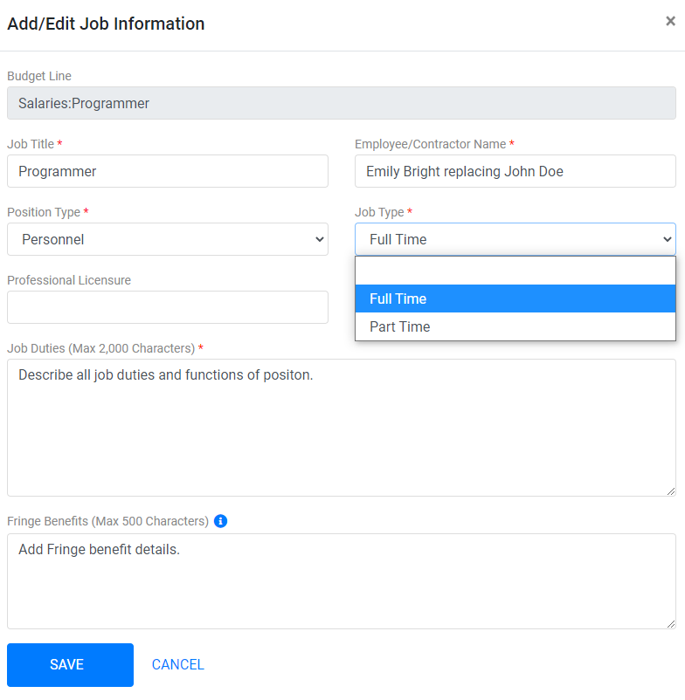
PERSONNEL ADJUSTMENT – EDIT JOB INFORMATION
Enter Position title
Enter Employee/s name/s
Select Position Type
Select Appropriate option
Detailed job functions
Add Fringe Information
Click
Notes:
Select the budget line item and enter the job title and type of line item.
Enter the name of the new employee.
If a previous employee still needs to be reimbursed and a new employee is coming in, you will need to add both names to the name line in order for all names to match documentation submitted for that position.
Once the previous person is fully paid, remove that name from the position line with another non-budgetary adjustment.
Keep in mind that all budget adjustment auto-generate a non-budgetary adjustment for each submission.

Slide 52
PROJECT ADJUSTMENT
Click
Select Option
Notes:
Personnel Adjustment - To make a Project Adjustment, you must receive prior approval from your Grant Administrator to make changes to your project and this function is primarily used for the BYRNE JAG grants. (PROJECT ADJUSTMENTS ARE RARELY ALLOWED UNDER THE VOCA AND VAWA GRANTS)

Slide 53
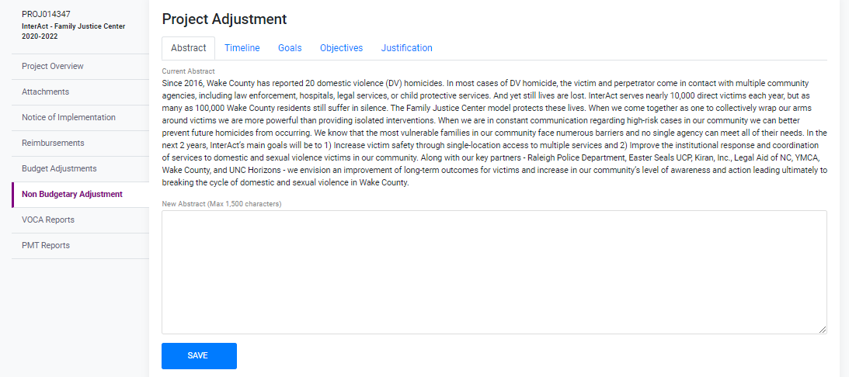
PROJECT ADJUSTMENT
Current abstract of project
New proposed abstract of project
Notes:
You will enter the current project abstract, then enter the proposed project abstract indicating how the project will change per the requested adjustments.

Slide 54
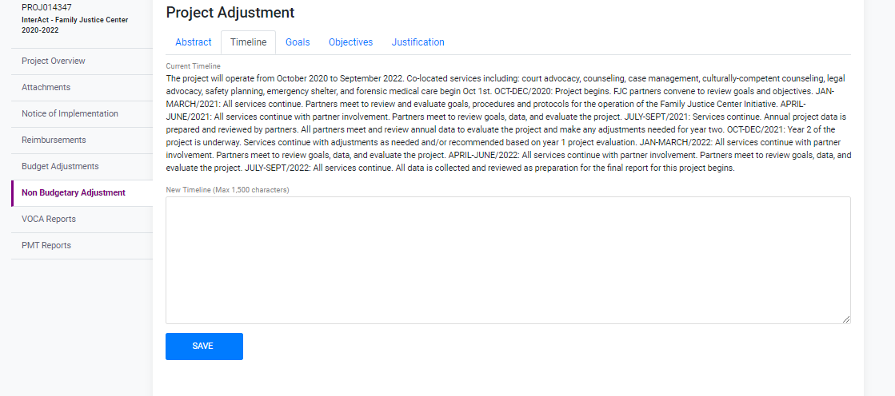
PROJECT ADJUSTMENT
Current Timeline information
New proposed Timeline of project
Notes:
On the Timeline tab, enter the current timeline and then you will enter the new proposed timeline for the project.

Slide 55
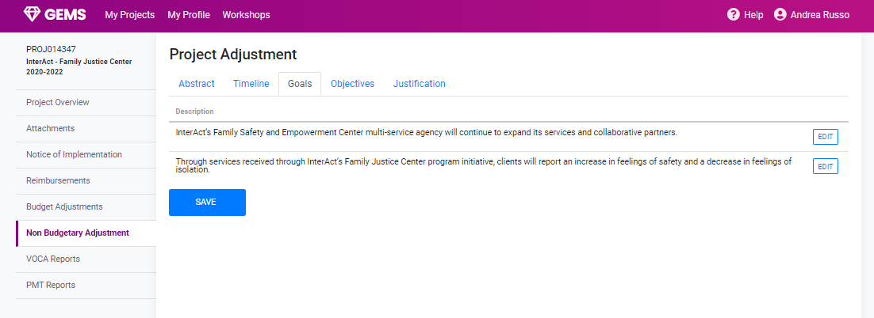
PROJECT ADJUSTMENT
Current Goals of project
Notes:
Here you will click edit and enter the new goals of the project.

Slide 56
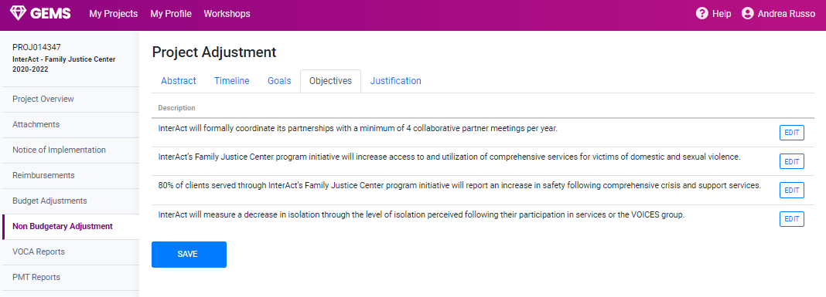
PROJECT ADJUSTMENT
Current objectives of project
Notes:
On the Objectives tab you will be able to enter the new objectives of the project.

Slide 57
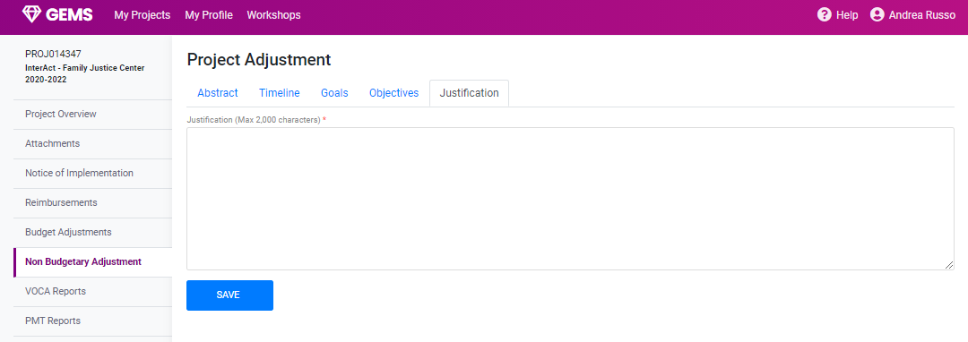
PROJECT ADJUSTMENT
Enter the NEW justification of proposed changes for the project.
Notes:
On the Justification tab enter your explanation for how the project will benefit from these changes and why these changes are necessary for the project. Then click the blue Save button.
Next we will hear from Harriet Lunsford about Project Reporting.

Slide 58
PROJECT REPORTING
PRESENTED BY: Harriet Lunsford
Notes:
Hello, my name is Harriet Lunsford. I’m a Grant Administrator with GCC and I will take you through the required reporting for your grant awards.

Slide 59
REPORTING
PMT
Initial Subaward Report(VOCA ONLY)
  VOCA – Victims of Crime
  BYRNE JAG
  JUVENILE JUSTICE
VAWA – STOP – Violence Against Women
PROJECT PROGRESS REPORT
Notes:
We will look at:
•The quarterly Performance Management Tool, commonly referred to as the PMT,
•The Initial Subaward Report, or ISAR, used for VOCA, Byrne JAG, and Juvenile Justice projects,
•The VAWA STOP report,
•And the annual Project Progress Report

Slide 60
REPORTING SCHEDULE
ACROYNMS | Due Dates | Report Names
NOGI | October - Grant Opening | Notice of Grant Implementation
ISAR/SAR | October - Grant Opening | Initial Sub-Grant Award Report
BJA PMT | Quarterly - October/January/April/July | Bureau of Justice Assistance PMT
PMT | Quarterly - October/January/April/July | Performance Measurement Tool Reports
PPR | Annually - October | Project Progress Report
STOP | Annually - October | VAWA Annual Progress Report
BA | 60 days prior to grant expiration | Budget Adjustments
NBA | Before grant expires | Non-Budgetary Adjustments
Notes:
Here is a detailed review of various reports, some of which were previously discussed in other sections of our workshop presentation. As a quick review, note that at the top of the chart the NOGI and SAR/ISAR are to be completed as soon as possible after the opening of the grant. And at the bottom of the chart, Budget Adjustments are due 60 days prior to the end of the grant, whereas Non-Budgetary Adjustments can be done up to the final day of the grant.

Slide 61
NEED TO KNOW
If your reports are late your agency will be put on hold.
Submit your reports in a timely manner
If you have any issues submitting your reports, contact your Grant Administrator
Notes:
One important thing to know is that timeliness is critical with all required reports. You will receive a detailed list of dates for each type of report so please check it carefully to ensure that you stay on schedule. If you don’t submit a report on time, your agency will be put on hold, not just the individual project. Therefore, multiple projects run by different Project Directors may result in your project being placed on hold because another PD was late with one of their reports.

Slide 62
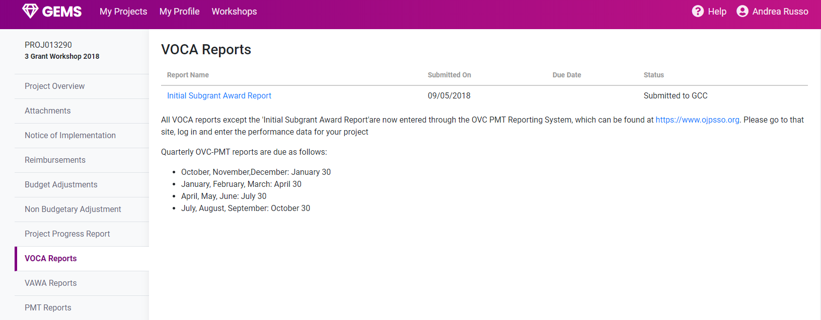
VOCA REPORTING – INITIAL SUBAWARD REPORT
FOR VOCA PROJECTS ONLY - Complete when opening project
Click link to compete part 2 of SAR – Sub-Award Report
Notes:
Now to the details of the Initial Subgrant Award Report, or ISAR. In GEMS, click on the VOCA Reports link on the left side of the screen. This will open a new page that has a blue link at the top left of the screen for the ISAR. Click on that link and complete the requested information. When you’ve completed and submitted the ISAR, GEMS will notify your GA that the ISAR is ready to be reviewed. Please note the blue Dept of Justice OJP link near the middle of the page, which we will discuss later.

Slide 63
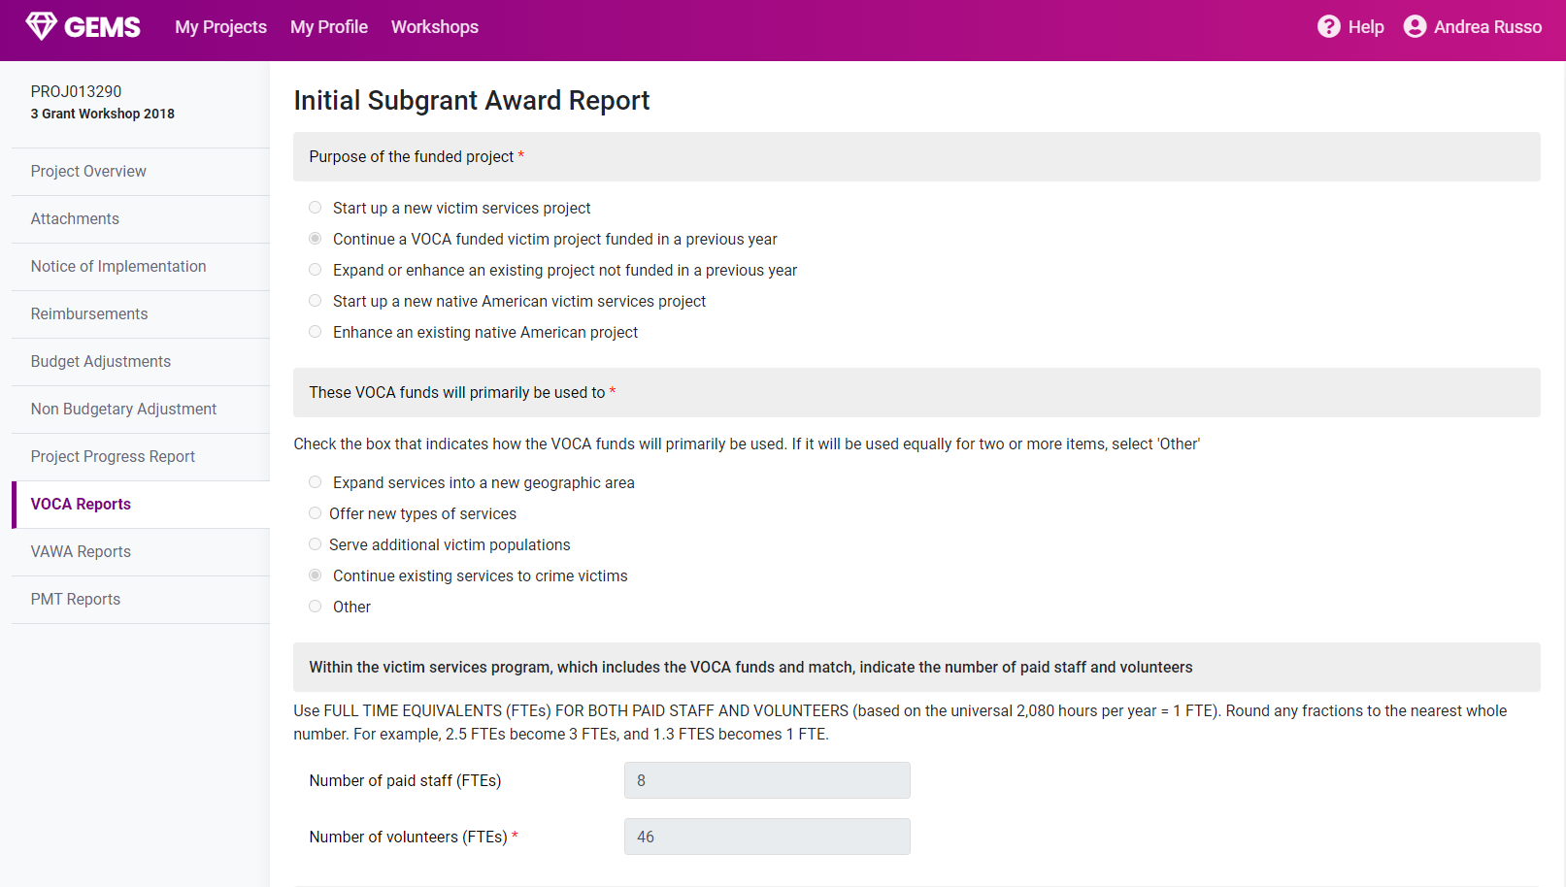
INITIAL SUBAWARD REPORT FORM 1
Sample Pages: Select each option appropriate to your project and submit
Notes:
Here is a view of the ISAR report content. On this and the next two slides are views from GEMS of various sections of the ISAR that you will complete.

Slide 64
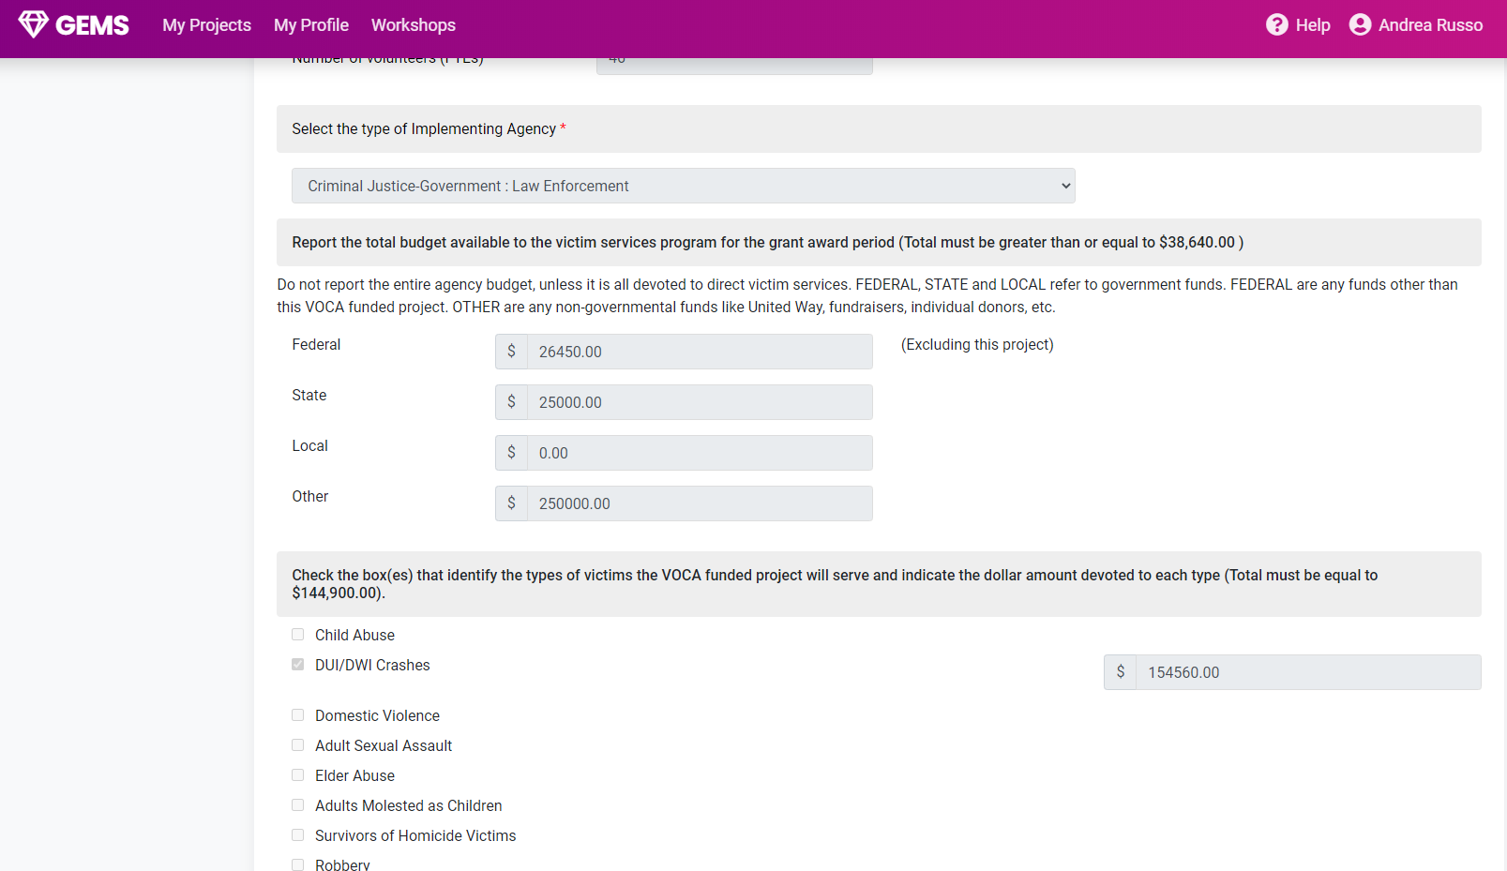
INITIAL SUBAWARD REPORT FORM 2
Sample Pages: Select each option appropriate to your project and submit
Notes:
This is a look at another section of that ISAR.

Slide 65
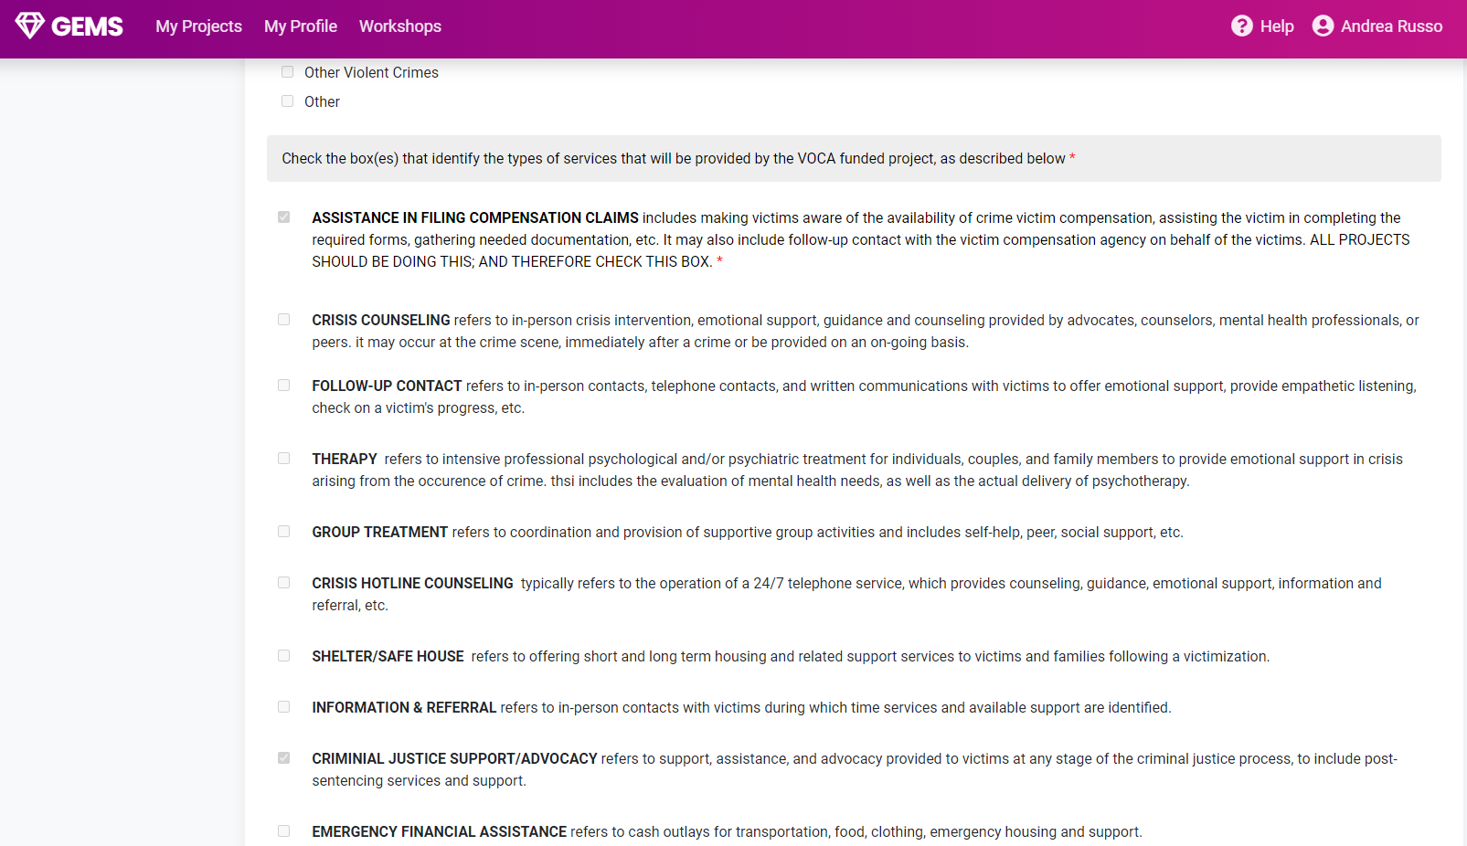
INITIAL SUBAWARD REPORT FORM 3
Sample Pages: Select each option appropriate to your project and submit
Notes:
And here is a third view of the ISAR in GEMS.

Slide 66
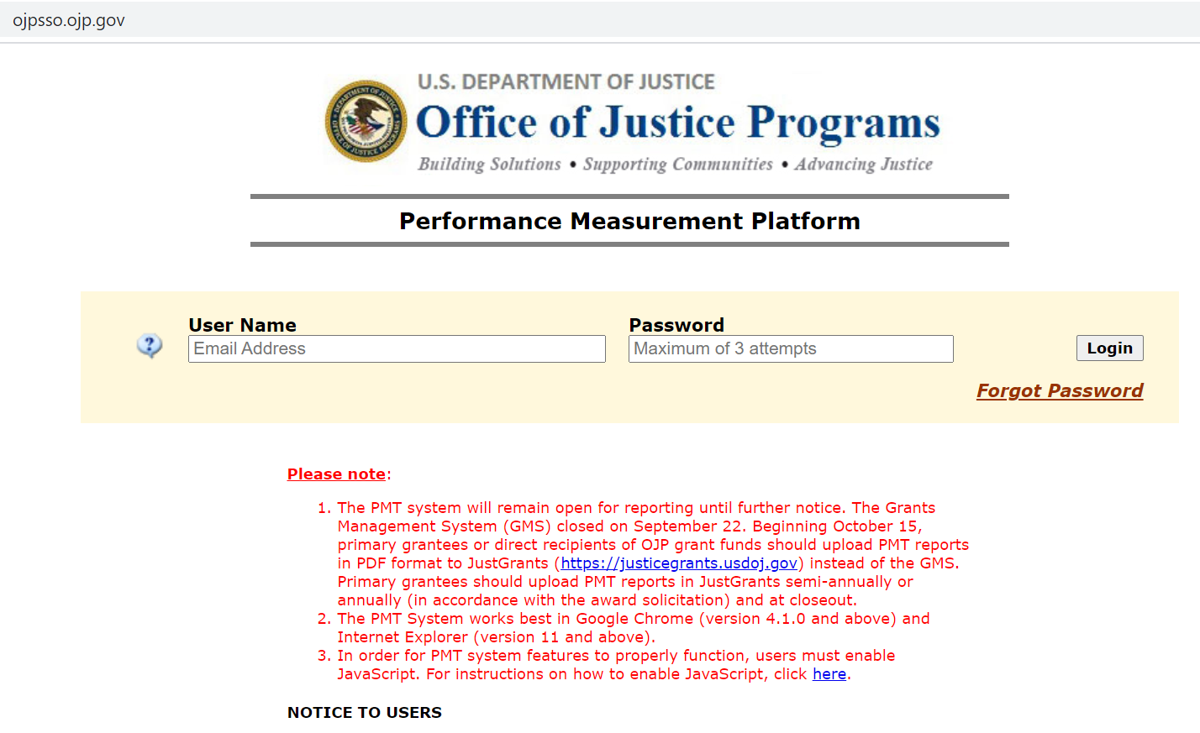
INITIAL SUBAWARD REPORT
Notes:
After your GA reviews the ISAR, he or she will then go to the US Dept of Justice OJP website to set up your project in their system. You can access this system by clicking on the link in the VOCA Reports section of GEMS that was on the same page as the ISAR link, as mentioned earlier. This site is operated by the Dept of Justice, not GCC or the State of North Carolina. Therefore, if you experience any technical issues you will have to address them though the Dept of Justice OJP helpdesk. After your GA sets up your project in the OJP website, they will also complete the first page of the Subgrant Award Report, or SAR, questions 1 through 6. Your GA will then notify you that the second half of the SAR, questions 7 through 11, are awaiting completion by you.

Slide 67
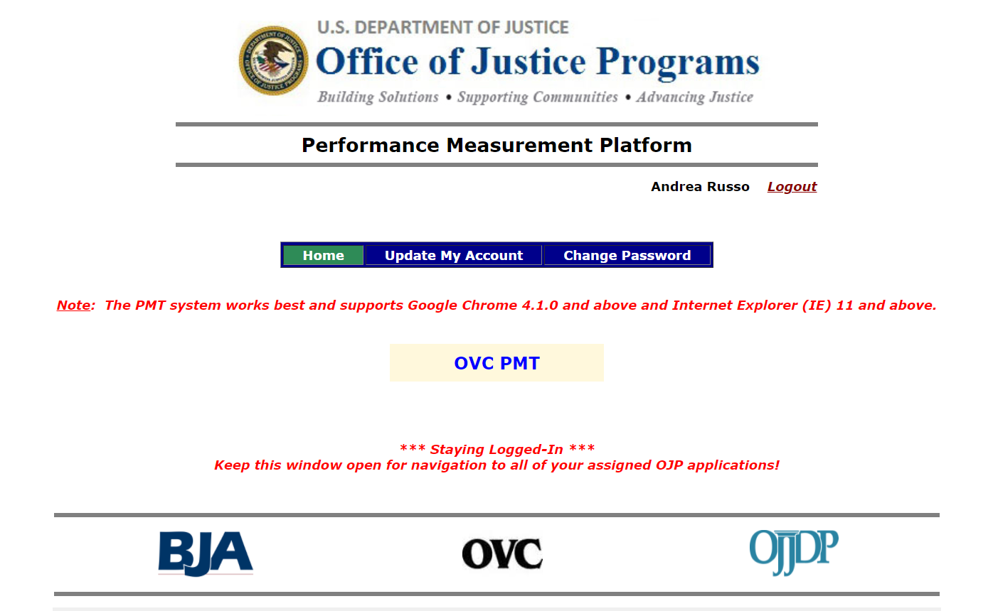
INITIAL SUBAWARD REPORT
Notes:
After you log on, you will come to the next screen for OVC PMT access by clicking the yellow button. The acronyms OJP and OVC are frequently used interchangeable so don’t let this confuse you by thinking that they are different sites.

Slide 68
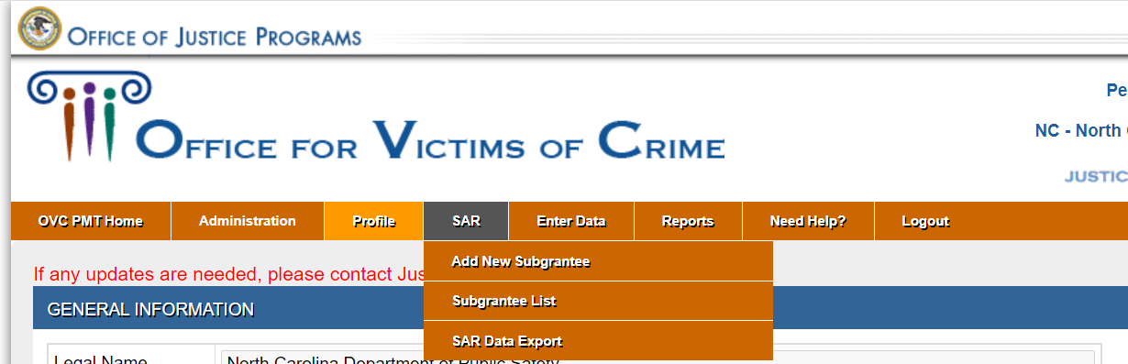
INITIAL SUBAWARD REPORT
Notes:
When you click on the yellow OVC button, you will end up on the page shown here. On the menu at the top of the page, go to the SAR selection near the middle and then click on the Subgrantee List in the pull-down menu.

Slide 69
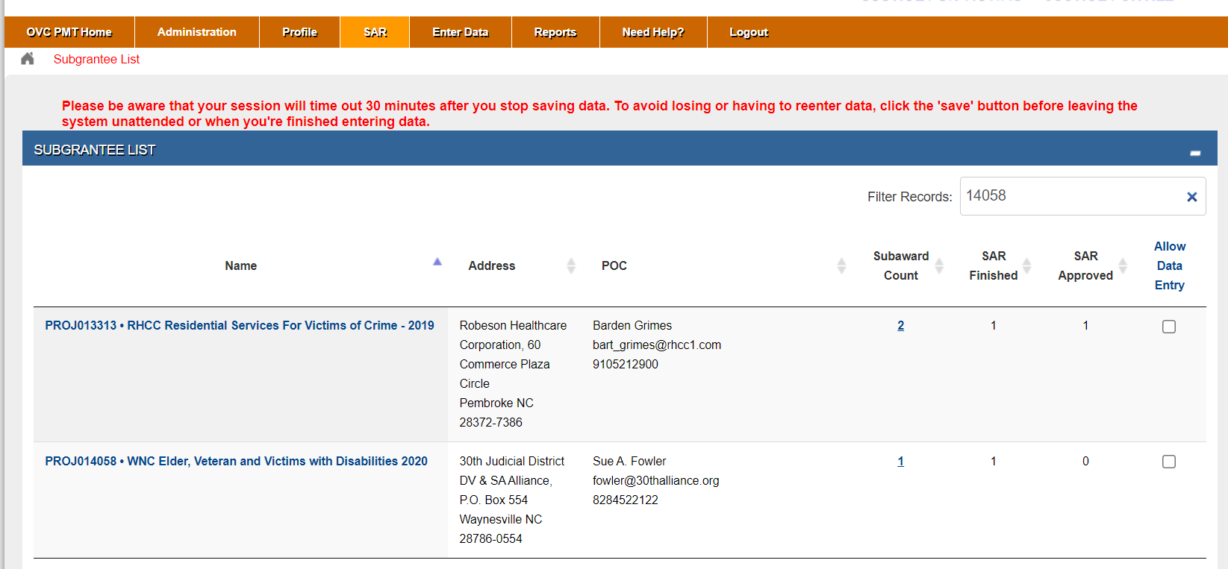
INITIAL SUBAWARD REPORT
Notes:
On the next page, look for the Filter Records box near the top right of the screen and enter your project number. This will call up your specific project. Click on the blue number in the Subaward Count column, which will open your project’s SAR.

Slide 70
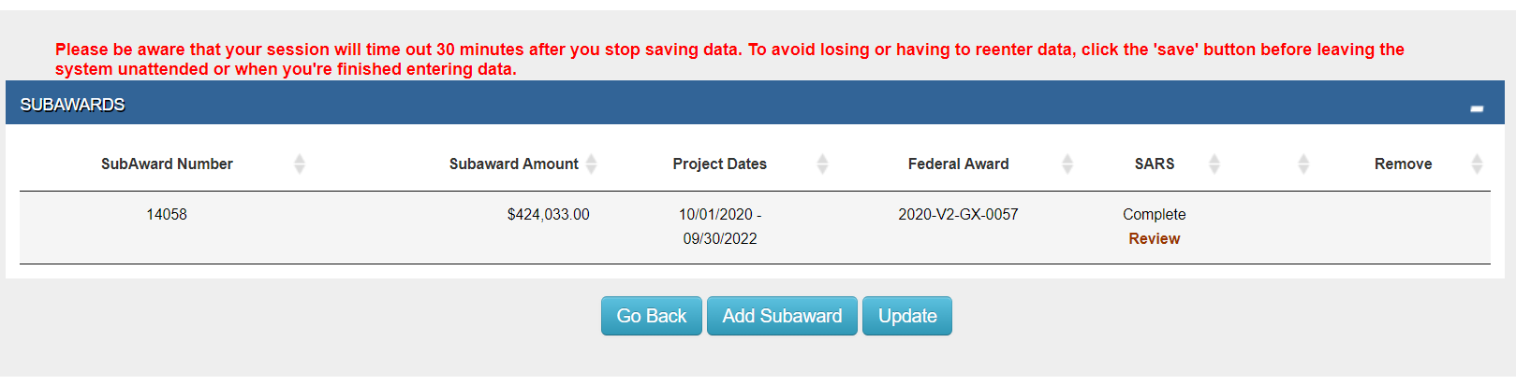
INITIAL SUBAWARD REPORT
Notes:
Now click on the words “Enter/Edit Data” under the SAR column (not shown on this slide) and complete page 2, questions 7 through 11, then save. If you do not complete the entire questionnaire, the SAR will be listed as In Progress. If you do complete everything, it will be listed as Complete and the Review button will be accessible, as shown on the slide. At that time, notify your GA that you have completed the second half of the SAR and your GA will then review/approve to finalize the SAR and open the system for PMT entries.

Slide 71
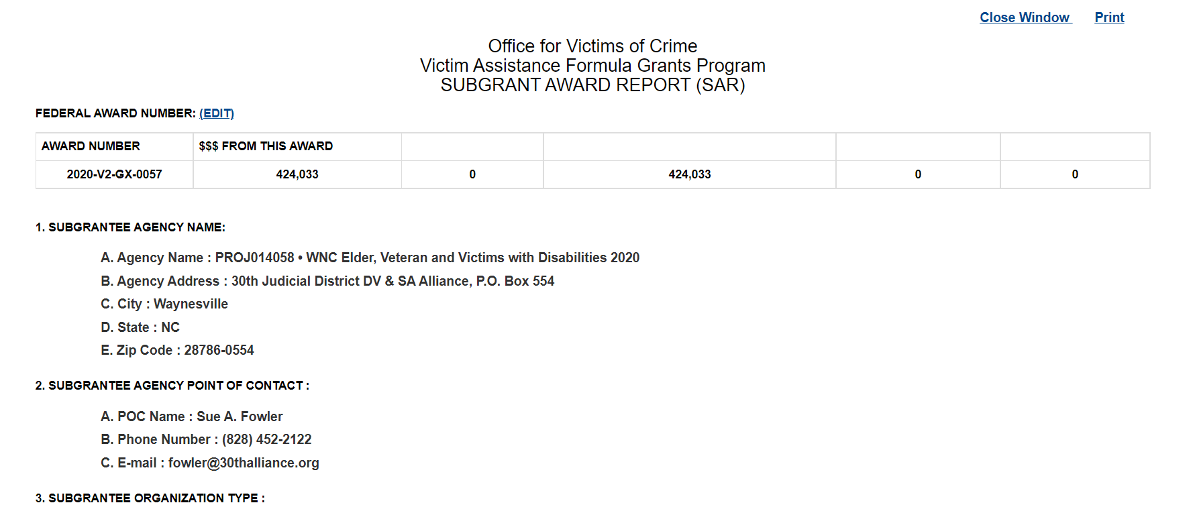
INITIAL SUBAWARD REPORT
Notes:
This next slide is a view of what the SAR looks like, the first section of which will have been completed by your GA.

Slide 72
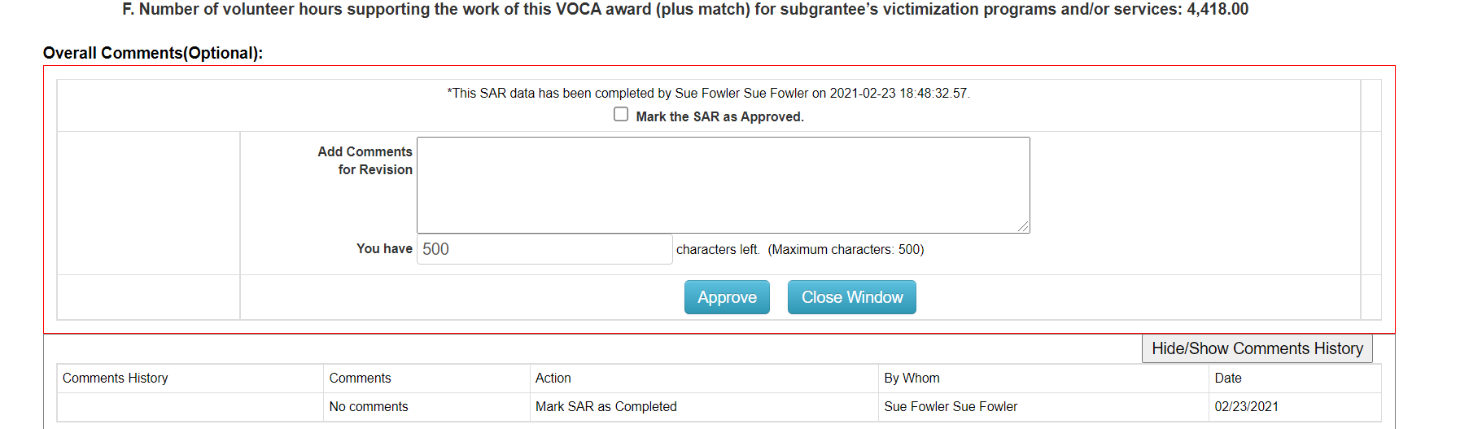
INITIAL SUBAWARD REPORT
Notes:
And this next slide is the end of the SAR, which will be reviewed and approved by your GA after you complete questions 7 through 11.

Slide 73
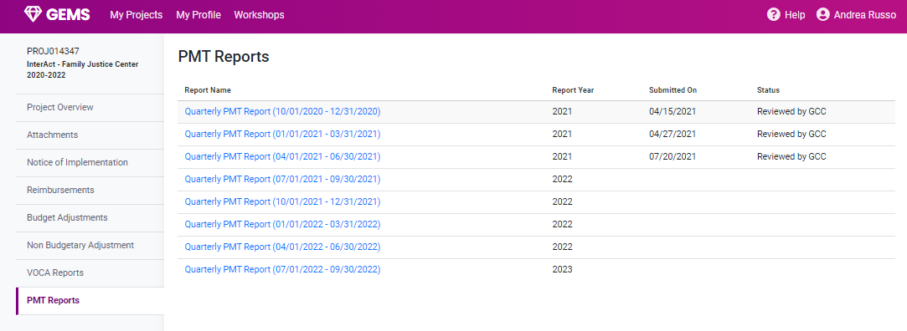
VOCA REPORTING
Notes:
After the end of each quarter you will then go back into the OJP OVC website and complete a PMT. Once completed, save that file as a PDF only, then in GEMS under the PMT Reports menu on the left side of the screen, select the appropriate timeframe.

Slide 74

SUBMITTING PMT REPORT
Notes:
When the new screen in GEMS opens, download the PDF of the PMT, then click the blue Save Attachment button. This will send and automatic notification to your GA that your PMT is ready for review.

Slide 75

VAWA REPORTS
Click to download VAWA Report
Notes:
To complete the VAWA STOP report, click on the VAWA Reports menu on the left side of the screen in GEMS. This will take you to the report section where there are two blue links; VAWA Report and Reporting Instructions. The first link takes you directly to the report to be completed and the second takes you to instructions, but from the instructions you can also access the report itself.

Slide 76

VAWA REPORT INSTRUCTIONS
Governor’s Crime Commission
Notes:
The next slide shows the VAWA page where the report links land.

Slide 77

VAWA REPORT PDF DOWNLOAD
Sample VAWA REPORT
Make sure to Validate report in Adobe Prior to Submission into GEMs
Notes:
And the following slide is the beginning of the online report that you will need to complete.

Slide 78

VAWA REPORT PDF DOWNLOAD
Sample VAWA REPORT
Make sure to Validate report in Adobe Prior to Submission into GEMs
Notes:
The report is approximately 60 pages long. When you get to the very end, click on the Validation button.

Slide 79

VAWA REPORT PDF DOWNLOAD
Sample VAWA REPORT
Make sure to Validate report in Adobe Prior to Submission into GEMs
Notes:
If validation is successful, you will see a message that your form has passed and is now ready for submission in GEMS.

Slide 80

UPLOAD VAWA REPORT
Upload Validated PDF Version
Click
Notes:
Save the report as a PDF, then go back into GEMS and select the appropriate time period. Once the time period is selected, you will be able to upload the report to GEMS and then click the blue Save Attachments button. When done, an automatic notification will be sent to your GA to review the report.

Slide 81

PROJECT PROGRESS REPORT
Notes:
Now we come to the last report that we’ll discuss today, the Annual Project Progress Report, which is found on the left-hand side menu options in GEMS. You will select the appropriate time period, which will take you directly into the report.

Slide 82

PROJECT PROGRESS REPORT – OBJECTIVE
Enter detailed description for project results
Click
Notes:
The Project Progress Report will have three sections comprised of Objectives,

Slide 83

PROJECT PROGRESS REPORT - ACTIVITIES
Enter detailed description for project activity results
Click
Governor’s Crime Commission
Notes:
Then Activities,

Slide 84

PROJECT PROGRESS REPORT - COMMENTS
Enter detailed comments regarding project.
Click
Notes:
And finally, Comments. When you have finished the report, click the blue Save button and an automatic notification will be sent to your GA to review the report.
This concludes the Reporting section of the GCC Workshop.
Thank you.

Slide 85
Answers to questions posted in the chat -
GCC Website
Resources > 2022 Workshop Materials
Notes:
Thank you for your questions. Answers to your questions will be posted on the GCC website under Resources > 2022 Workshop Materials.

Slide 86
THANK YOU FOR ATTENDING THE 2022 GOVERNOR’S CRIME COMMISSION ANNUAL GRANT WORKSHOP
GCC Point of Contact email:
GCC_Grants_Management@ncdps.gov
Notes:
If you have questions after the workshop please email the GCC Point of Contact.
Thank you for joining the GEMS Breakout Session. This concludes the GCC Annual Grant Workshop.

