Slide 1
Civil Rights for DOJ Subrecipients
GCC Grant Award Workshop
Diane Barber, GCC Deputy Director and Civil Rights Coordinator
September 19, 2024

Slide 2
This presentation was prepared by the North Carolina Governor’s Crime Commission to provide information to subrecipients and their staff (employees and volunteers) concerning their civil rights responsibilities. Upon acceptance of federal funds, subrecipients are required to comply with federal civil rights laws. We also hope this will be a useful tool in the successful administration of your agency’s mission.

Slide 3
Civil Rights
Laws, Acts, and Statutes

Slide 4
The DOJ Office for Civil Rights Enforces
Title VI of the Civil Rights Act of 1964
  (re: race, color, national origin)
Section 504 of the Rehabilitation Act of 1973
  (re: disabilities)
Title II of the Americans with Disabilities Act of 1990
  (re: disabilities)
Age Discrimination Act of 1975
  (re: age)
Title IX of the Education Amendments of 1972
  (re: sex discrimination in educational programs)
Exec. Order 13559, Partnerships with Faith-Based Organizations
  (re: religion)
Individual Program Statutes (e.g. Safe Streets Act, Victims of Crime Act, JJDPA)
  (re: race, color, national origin, sex, religion, disability

Slide 5
Protected Classes
Race
Color
National Origin
Religion
Sex /Gender
Disability
Age

Slide 6
NC Anti-discrimination laws and provisions
Including but not limited to:
North Carolina General Statute § 75B-2, which prohibits discrimination in business that is based on race, color, creed, religion, sex, national origin, or foreign trade relationships;
North Carolina General Statute § 95-28.1, which prohibits discrimination that is based on a person’s possession of a sickle cell or hemoglobin C trait;
North Carolina General Statute § 95-28.1A, which prohibits discrimination that is based on genetic testing or genetic information;
North Carolina General Statute § 95-28.2, which prohibits discrimination that is based on a person’s lawful use of lawful products during nonworking hours;
North Carolina General Statute § 95-270, which prohibits employment discrimination against persons who take time off from work to seek Chapter 50B or Chapter 50C [pertaining to Domestic Violence and Civil No-Contact Orders, respectively] relief;
North Carolina General Statute § 7B-2705, which prohibits employment discrimination against persons who are complying with Article 27 of the Juvenile Code;
North Carolina General Statute § 128-15.3, which prohibits some discrimination in hiring that is relative to persons with physical impairments or disabilities;
The Persons with Disabilities Protection Act, which identifies discriminatory practices relative to persons with disabilities (N.C.G.S. Chapter 168A); AND
Article 2 of Chapter 127B of the General Statutes of North Carolina, which prohibits public discrimination against military personnel in North Carolina

Slide 7
Title VI of the Civil Rights Act of 1964
(re: race, color, national origin)
No person in the United States shall, on the ground of race, color, or national origin, be excluded from participation in, be denied the benefits of, or be subjected to discrimination under any program or activity receiving Federal financial assistance.

Slide 8
Defining a “program or activity”
A program or activity is the whole organization that receives federal funding – generally the entire department or office within a state or local government.
Examples:
  If a division of the NC Department of Public Safety receives a grant, the entire Department of Public Safety is covered.
  If a section of a county sheriff’s department receives federal funds, the entire sheriff’s department is covered, but not the other departments in the county government.
  If a state Department of Corrections receives funding, and then sub-awards the funding to local agencies or organizations, all of the operations of the Department of Corrections are covered, along with the operations of the local subrecipients

Slide 9
Question 1:
Fayetteville Police Department receives a VAWA grant to provide Sexual Assault services, does the Fayetteville Water and Sewer Authority have to comply with the federal civil rights requirements – as a result of the DOJ federal grant funding received by the police department?
Please type “Yes” or “No” in the chat

Slide 10
NO
The Water and Sewer Department is not within the same department as the Police Department

Slide 11
Question 2
Does the Homicide Division within the Fayetteville Police Department need to comply with federal civil rights requirements – as a result of the sexual assault federal grant funding received by the police department?
Please type “Yes” or “No” in the chat

Slide 12
YES
The Homicide Division is within the Police Department

Slide 13
Title VI Prohibitions
Providing different services to individuals
  Based not on different needs, but because of inclusion in a protected class
Denying the opportunity to participate as a member of a planning or advisory body
Selecting the location of a facility with the purpose or effect of excluding individuals

Slide 14
Section 504 of the Rehabilitation
Act of 1973
(re: disabilities)
No otherwise qualified individual with a disability in the United States, as defined in section 705 (20) of this title, shall, solely by reason of his or her disability, be excluded from the participation in, be denied the benefits of, or be subjected to discrimination under any program or activity receiving Federal financial assistance or under any program or activity conducted by any Executive agency or by the United States Postal Service.

Slide 15
Title II of the Americans with
Disabilities Act of 1990
(re: disabilities)
Title II prohibits discrimination by state and local government agencies. This Title covers all public agencies regardless of whether they receive federal assistance. This Title guarantees access to all programs, services, and activities provided by a public agency, including public education, employment, recreation, health care, social services, courts, voting, and town meetings. State and local government-funded colleges and universities and other post-secondary educational programs must not discriminate under Title II.

Slide 16
Section 504 and Title II of the ADA Definitions
A handicapped (disabled) person means any person who: • has a physical or mental impairment which substantially limits one or more major life activities;
• has a record of such an impairment, or
• is regarded as having such an impairment

Slide 17
Other Requirements: Section 504 of the Rehabilitation Act of 1973
50 or more employees and receives federal financial assistance of $25,000 or more
  Designated Section 504 Compliance Coordinator (may be/usually is someone in HR)
  Adopt grievance procedures
  Notify program participants, applicants, beneficiaries, unions, and organizations with collective bargaining agreements, that recipient does not discriminate on the basis of disability

Slide 18
Question
A federally-funded domestic violence shelter has a blanket policy that residents cannot be taking any prescribed psychotropic medication while staying at the shelter.
Does this policy violate Section 504 of the 1973 Rehabilitation Act?
Please type “Yes” or “No” in the chat

Slide 19
YES
By having a blanket exclusionary policy, the shelter discriminates against persons who have a mental disability that may have to be controlled by medication, and who are qualified to receive services

Slide 20
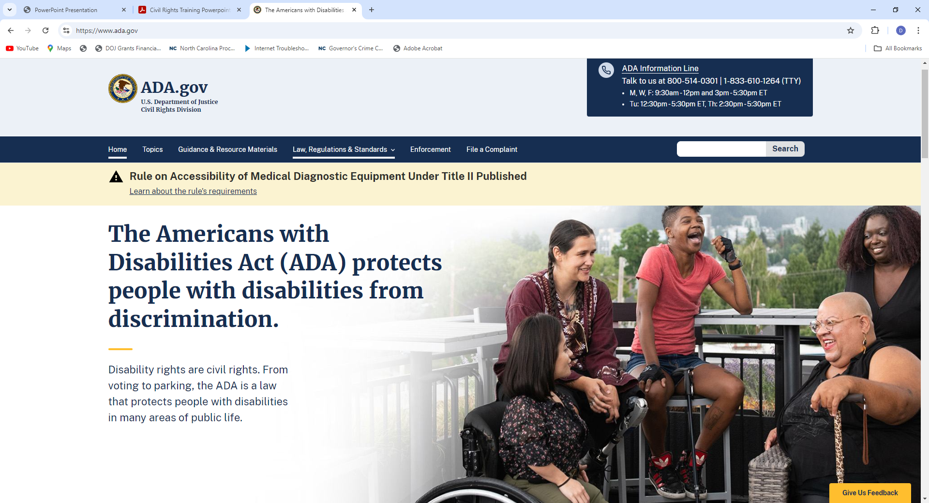
To Learn More:

Slide 21
Limited English Proficiency (LEP)

Slide 22
Limited English Proficiency (LEP)
National Origin Discrimination includes:
  Discrimination on the basis of LEP, defined as a person who has a first language other than English, and has a limited ability to read, speak, write, or understand English.

Slide 23
LEP Violations
To avoid risking discrimination against persons with LEP, recipients must
  Take reasonable steps to ensure meaningful access to the programs, services, and information the recipients provide, free of charge.
  Establish and implement policies and procedures for language assistance services that provide persons with LEP with meaningful access to programs, services, and information.

Slide 24
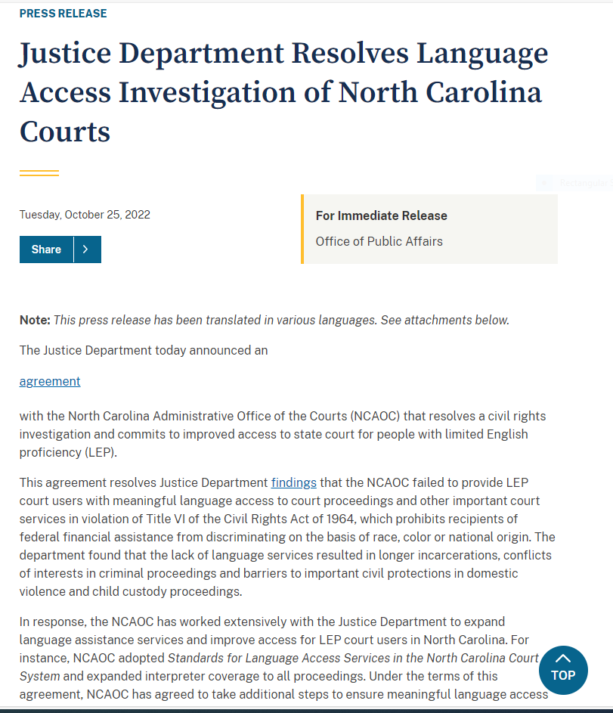

Slide 25
LEP Discrimination Prongs
The number or proportion of persons with LEP served or encountered in the eligible service population.
The frequency with which individuals with LEP come in contact with the program.
The nature and importance of the program, activity, or service provided by the program.
Other resources available to the recipient.

Slide 26
Definitions of Language Services
For oral language services, the provider must ensure interpreter competency
Family members, friends, uncertified co-workers and especially children are not appropriate.
For written language services, the provider must adhere to the Safe Harbor Provision, ensure interpreter competency
If 5% or 1,000 (whichever is less) of the service population has LEP, vital documents must be translated
However, if 5% represents fewer than 50, then written notice of free written translation upon request must be provided (in the predominant languages)

Slide 27
Question
Which of these is an LEP violation?
On admission to a community shelter, a Spanish-speaking victim of abuse with LEP is interviewed in English (with interpretation provided by her 13 year old daughter)
A law enforcement officer attempts to question a Korean-speaking, individual with LEP regarding the individual’s alleged involvement in a crime using hand gestures and having the individual speak in English (without interpretation).
An advocate attempts to provide Order of Protection assistance to a Russian-speaking victim with LEP without benefit of an interpreter or interpretation services.
All of the above

Slide 28
D
All of the listed choices were violations

Slide 29


Slide 30
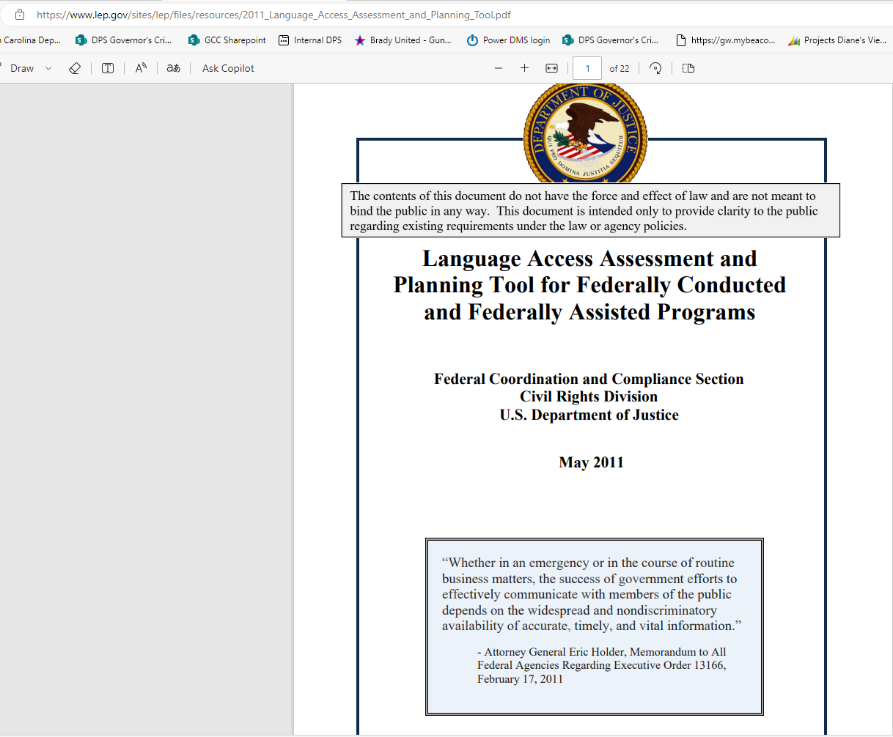

Slide 31
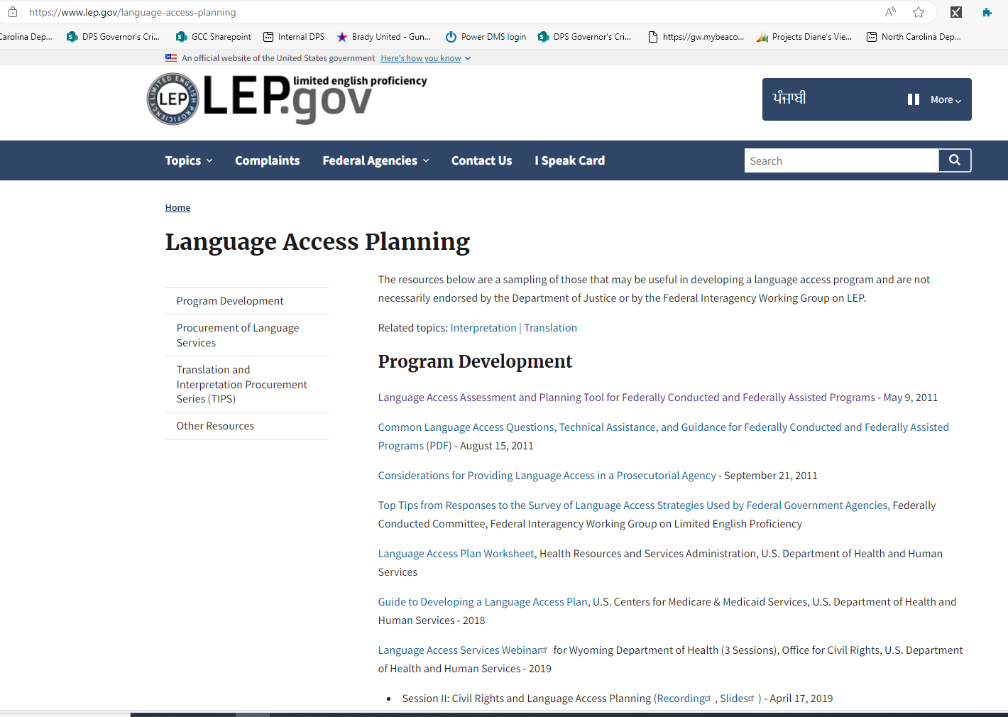

Slide 32
Faith Based Organizations (FBO)

Slide 33
DOJ Regulations for FBO Guidance (revised April 4, 2016)
FBOs must not use federal funding to advance inherently religious activities
Explicitly religious activities must be separate in time or location from federally-funded activities, and must be voluntary for those participating in the federal- funded activities.
FBOs may not discriminate against beneficiaries based on religion, a religious beliefs, a refusal to hold a religious belief, or a refusal to participate in a religious practice.

Slide 34
Question
Which of these are an example of a violation of DOJ Regulations for FBO Guidance?
A subrecipient’s federally-funded life skills training program contains an opening prayer session that all participants are required to engage in as part of the training program.
A subrecipient Catholic church that uses federal funds to provide counseling to domestic violence victims will only provide counseling to Catholic individuals.
A faith-based sexual assault program’s brochures contain scripture.
A staff member asks a seemingly distressed client privately if she wants to join her for prayer services held at the church sanctuary on Wednesday night.
All of the above

Slide 35
A, B, and C
In choice D, the prayer service is at a different time (and presumably, a different location – church sanctuary) than the federally-funded activity and the choice to attend is voluntary.
There should be no penalty, implied or otherwise, if the client chooses not to attend.

Slide 36
Certificate of Exemption
DOJ has determined that, on a case-by-case basis, the Religious Freedom Restoration Act may allow Grantee FBOs to hire based on religion.
  An FBO must certify:  It will offer all federally-funded services to all qualified beneficiaries;
  Inherently religious activities will be voluntary and kept separate from federally-funded activities; and
  It is a religious organization that sincerely believes that abandoning its religious hiring practice in order to receive federal funding would substantially burden its religious exercise

Slide 37
Civil Rights
SAA Requirements and Obligations

Slide 38
State Administering Agency Requirements
Monitoring
It is the obligation of the State Administering Agency (SAA) --in North Carolina, the North Carolina Department of Public Safety is the SAA for USDOJ grants -- to ensure that its subgrantees comply with all applicable federal civil rights laws.
The federal Office for Civil Rights ensures that the SAA complies with the very same laws.

Slide 39
GCC Obligations to monitor subrecipients
A State Administering Agency must monitor sub recipients’ compliance with civil rights laws.
Ensure that sub recipients complete an EEOP Certification Form (as applicable) and submit certification form or EEOP (if required) to the OCR.
Ensure that the sub recipient provides notification to employees and beneficiaries that the sub recipient does not discriminate, and that employees and beneficiaries have a right to file a complaint with the SAA or the OCR.
Ensure that the subrecipient submits to the OCR any Findings of Discrimination from a court or administrative agency within the previous three years.
Ensure that the sub recipient has a Section 504 Coordinator if it meets the employee and funding threshold.

Slide 40
Civil Rights
Subrecipient Requirements and Obligations

Slide 41
GCC Subrecipient Requirements
Responding to Discrimination Complaints
Civil Rights Notice of Nondiscrimination Display
Civil Rights Employee Training (DOJ video certification)
Limited English Proficiency Plan and Access
Grant Monitoring Checklist (as part of GCC site visits)
EEOP Reporting and Proof of Submission
Requiring your contractors and subgrantees to comply

Slide 42
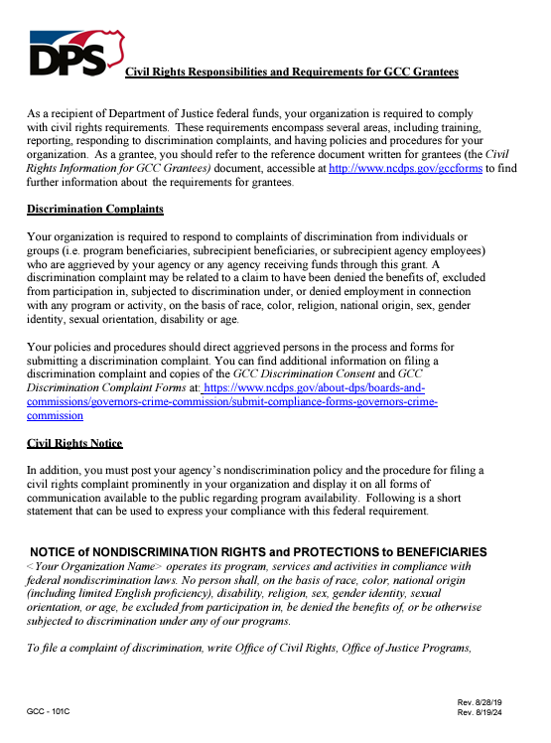

Slide 43
Civil Rights Protection for Employees
Retaliation against an employee for opposing an unlawful employment practice or participating in an investigation, proceeding, or hearing under the following statutes is prohibited:
Title VI of the Civil Rights Act
The Americans With Disabilities Act
The Omnibus Crime Control and Safe Streets Act
Title IX of the Education Amendments
The Rehabilitation Act
The Age Discrimination Act

Slide 44
Protection for Employees
As long as an employee had a reasonable and good faith belief that the employer’s conduct was illegal, even if the employee turns out to be wrong, the employee is protected.
However, if the way the individual chooses to protest perceived discrimination is unreasonable or if the opposition is false and malicious, the anti-retaliation provisions will not apply

Slide 45
Subrecipient Requirements – Discrimination Complaints
When a subrecipient’s employee, client, customer, or program participant files a discrimination complaint directly with them, the subrecipient shall have procedures in place to either investigate the complaint or forward the complaint to the proper investigative entity.
Subrecipients must notify GCC Discrimination Coordinator of any complaint that is being investigated by the subrecipient or forward the complaint (being investigated) to GCC for processing within five business days of receiving the complaint.
Subrecipients must notify all employees, clients, customers, and program participants that discrimination is prohibited and of the subrecipient’s procedures for filing a complaint of discrimination.

Slide 46
Subrecipient Requirements
In the event a Federal or State court or Federal or State administrative agency makes a FINDING OF DISCRIMINATION after a due process hearing on:
  the grounds of race, color, religion, national origin, sex or disability against a recipient of funds, the recipient will forward a copy of the finding to the Federal Office for Civil Rights, Office of Justice Programs.

Slide 47
Subrecipient Requirements
EEOP
The recipient will provide an EQUAL EMPLOYMENT OPPORTUNITY PLAN (EEOP) if required to maintain one, where the award is for $25,000 or more.

Slide 48
An EEOP
An EEOP is a comprehensive document which analyzes:
an agency’s workforce in comparison to its relevant labor market data
all agency employment practices to determine their impact on the basis of race, sex, or national origin
AND becomes a proactive tool to identify possible problem areas where discrimination may be occurring, or could occur

Slide 49
Preparing an EEOP
Step-by-step instructions for preparing an EEOP Short Form are online at www.ojp.usdoj.gov/ocr
For technical assistance:
  OCR Main Telephone Line: 202-307-0690
  Fax: 202-354-4380 TDD/TTY: 202-307-2027
  OCR E-mail: askOCR@ojp.usdoj.gov
Completed EEOPs should be submitted electronically through OCR’s EEO Reporting Tool, at https://ojp.gov/about/ocr/eeop.htm
Follow GCC guidelines to submit proof of reporting

Slide 50

THANK YOU!!!

