Slide 1
Criminal Justice Analysis Center
Michelle Beck, Director
Michelle.Beck@ncdps.gov

Slide 2
What is the Criminal Justice Analysis Center?
CJAC was reestablished in 2018 to:
create and maintain a data warehouse of criminal justice data in North Carolina
produce data-informed publications for policymakers and the public
support the CJ data needs of the Governor’s Crime Commission
carry out federal data collection requirements (DCRA)
Notes:
CJAC is housed in North Carolina’s State Administering Agency, the Governor’s Crime Commission
The Analysis Center was re-established as a part of the GCC in summer/fall of 2018; has 5 positions within it
The Commission itself serves as the chief advisory body to the Governor and to the Secretary of Public Safety on crime and justice issues and it made up of commission members including the heads of statewide CJ agencies, appointed state and local government officials, and private citizens
Commission staff includes grant planners, who assist the commission in setting annual investment priorities, and grant administrators, who provide technical support and monitoring to grant recipients
Federal data requirements have increased recently; SAAs are required to report more data to the federal government as a condition of federal funding:
-Byrne JAG Strategic Plan (June 2019)
-DCRA (Began in October 2019)

Slide 3
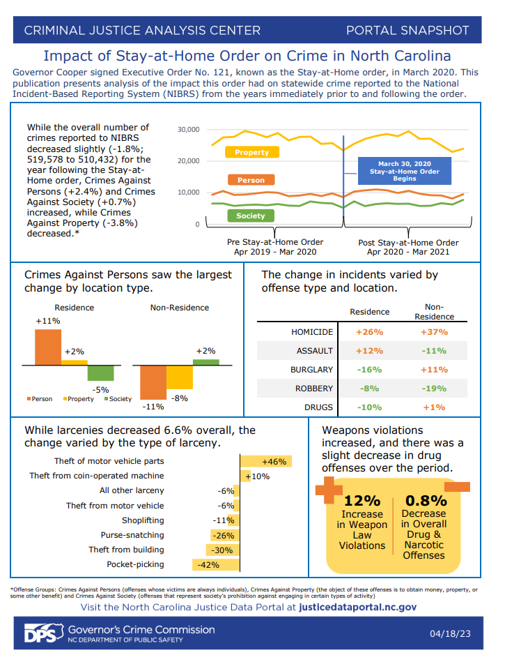
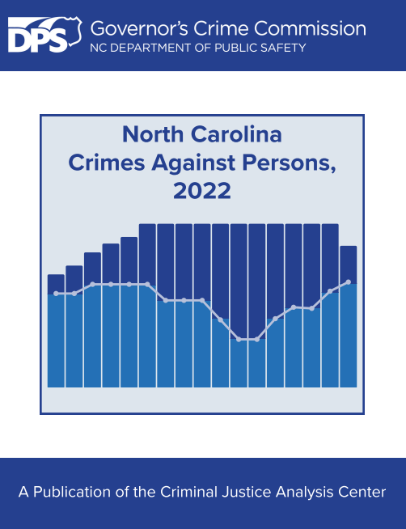
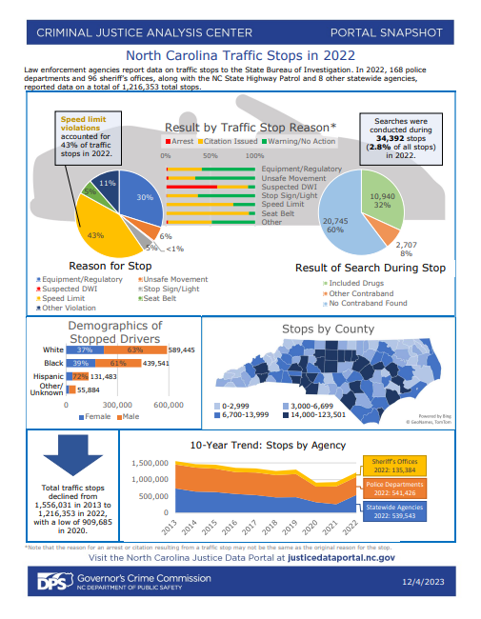
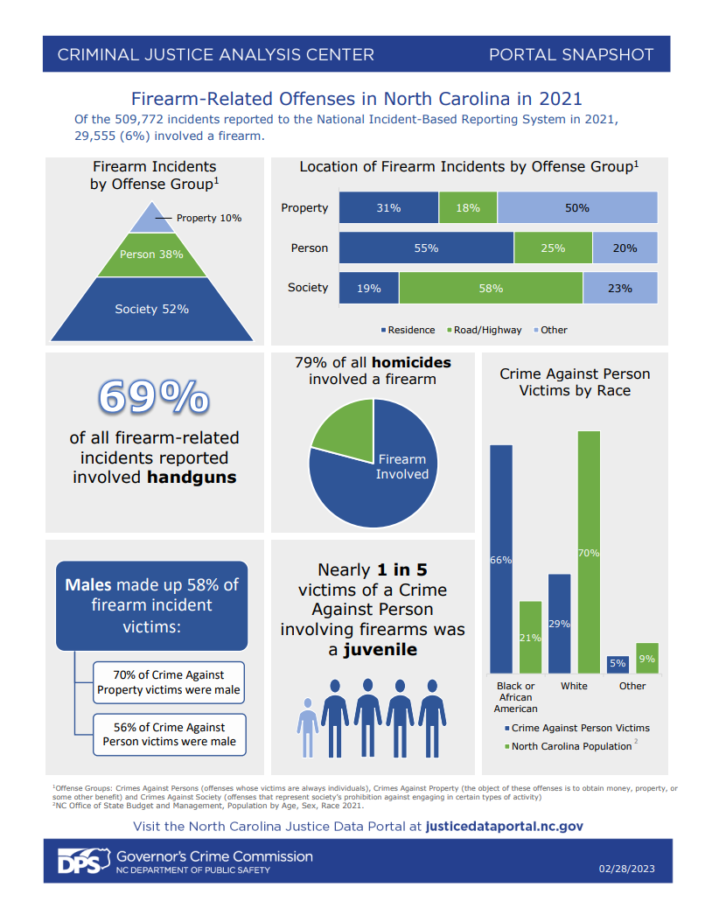
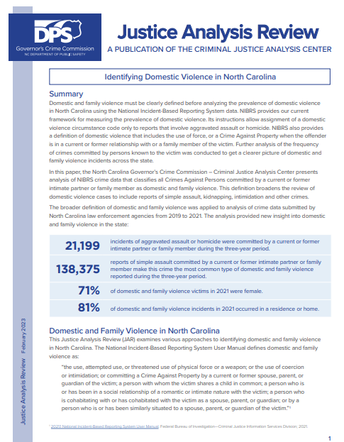
What does CJAC do?
Notes:
Here are a few examples of publications that we’ve created this year so far:
JAR - Identifying Domestic Violence in NC
Portal Snapshots
Firearm-related offenses in NC in 2021
NC Domestic Violence reported in 2021
Impact of Stay-at-home Order on Crime Reports

Slide 4
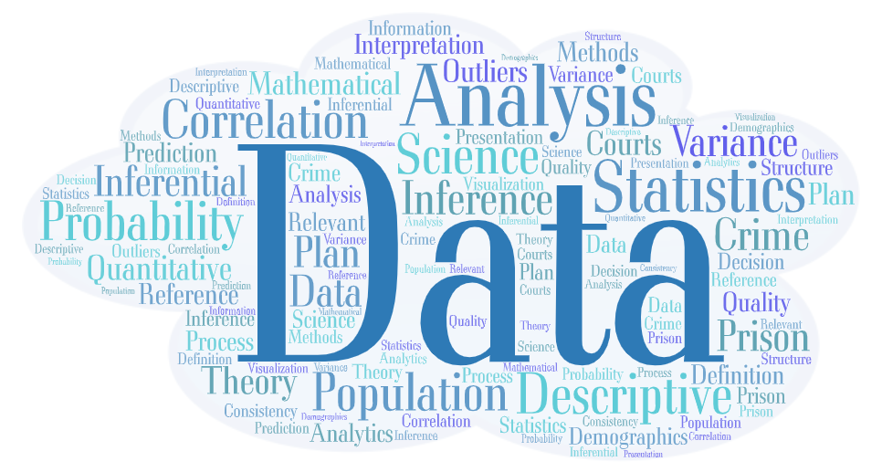
Notes:
What is a Statistical Analysis Center?
The main goal of a statistical analysis center is to collect, analyze, and report statistics on crime and the criminal justice system to federal, state and local levels of government, and to share state-level information nationally
Every state in the US except one has an active SAC, the majority of which are housed in a State Administering Agency

Slide 5
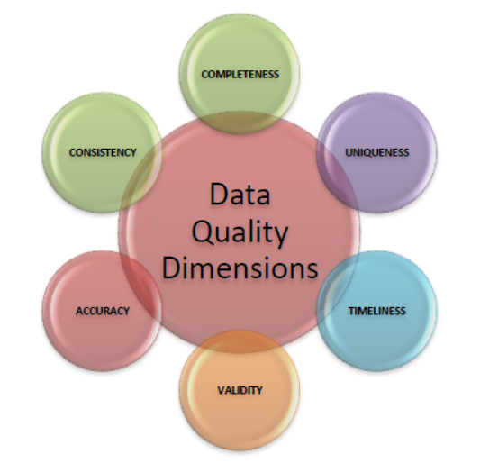

Slide 6
Justice Data Portal - SAS® Visual Analytics

Slide 7
JusticeDataPortal.nc.gov

