Slide 1
Use data to make someone fall in love with your program
Michelle Beck
Director, Criminal Justice Analysis Center
Michelle.Beck@ncdps.gov

Slide 2
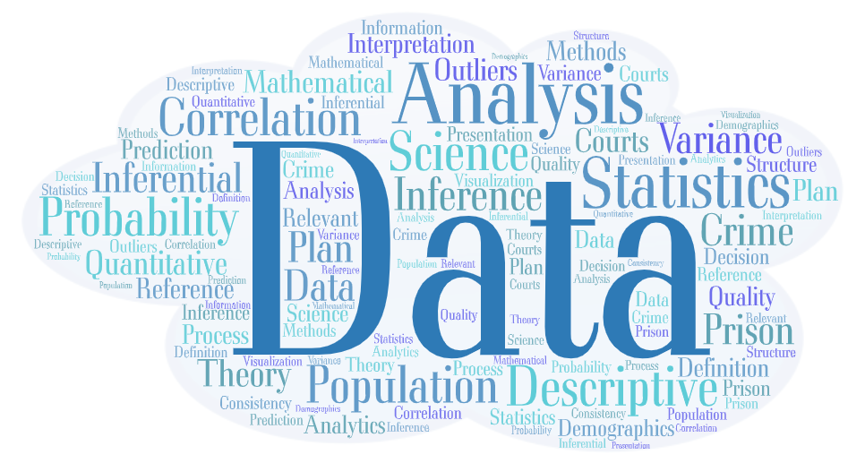
Notes:
What is a Statistical Analysis Center?
The main goal of a statistical analysis center is to collect, analyze, and report statistics on crime and the criminal justice system to federal, state and local levels of government, and to share state-level information nationally
Every state in the US except one has an active SAC, the majority of which are housed in a State Administering Agency

Slide 3
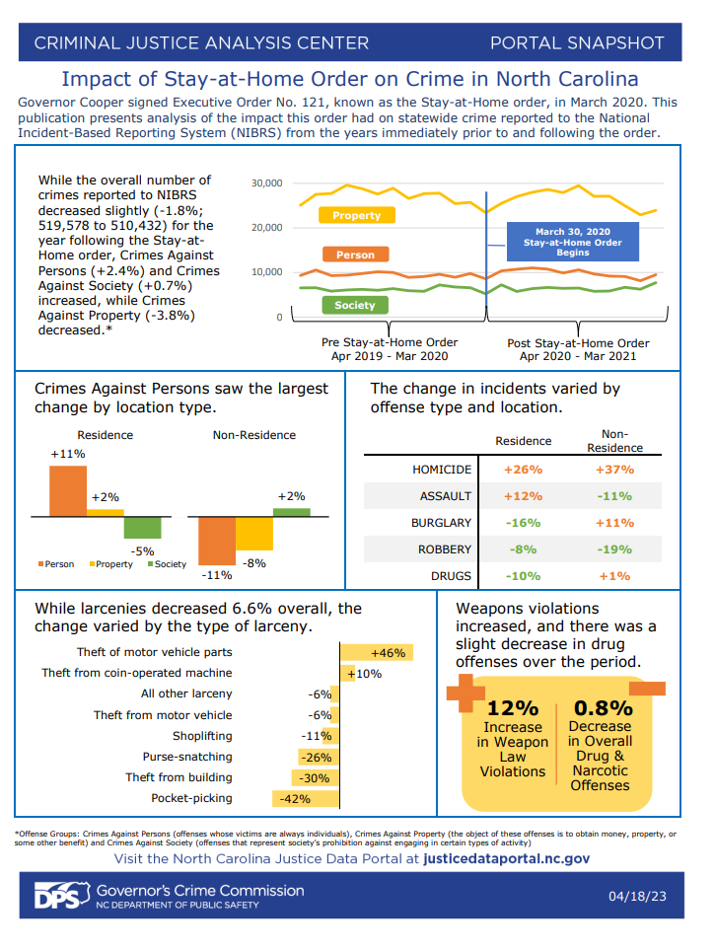
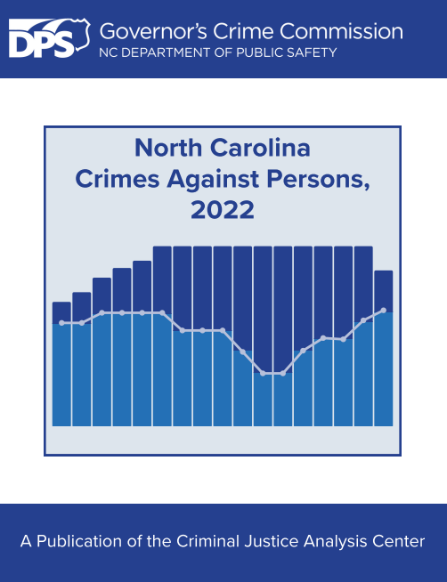
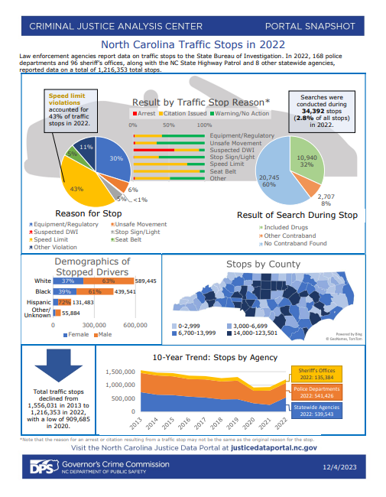
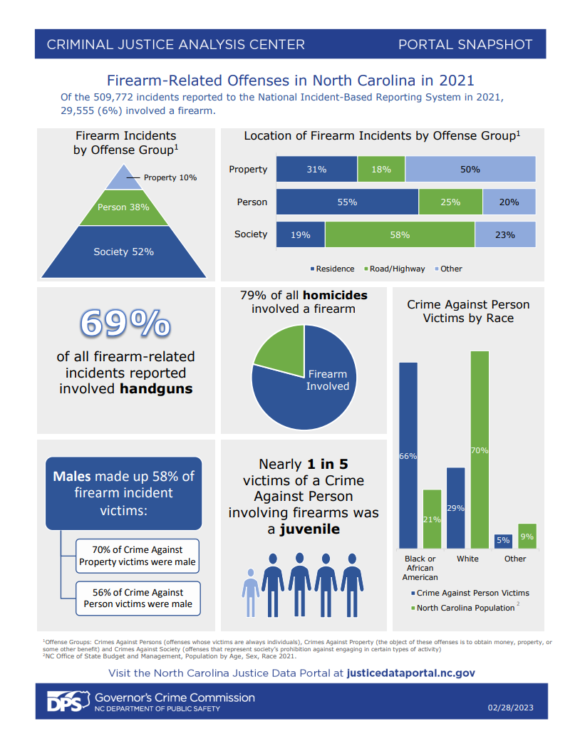
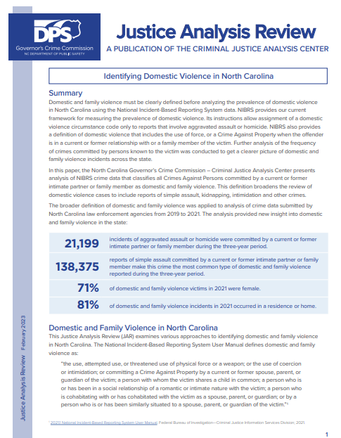
What does CJAC do?
Notes:
Here are a few examples of publications that we’ve created this year so far:
JAR - Identifying Domestic Violence in NC
Portal Snapshots
Firearm-related offenses in NC in 2021
NC Domestic Violence reported in 2021
Impact of Stay-at-home Order on Crime Reports

Slide 4
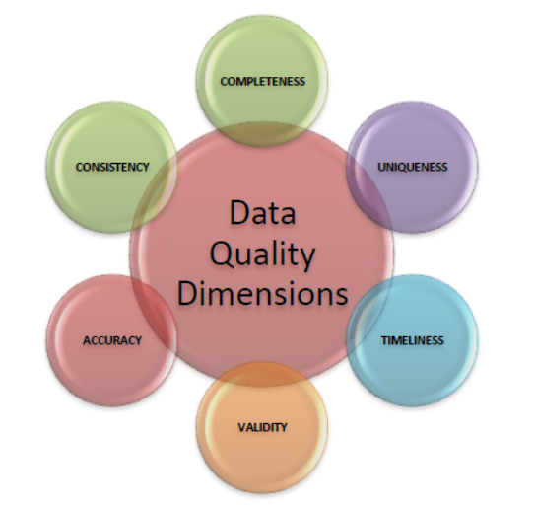

Slide 5
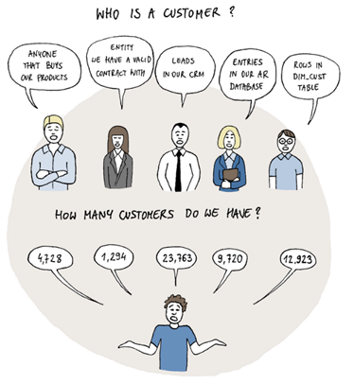
Well-Defined Parameters

Slide 6
Purpose, or Goals, of the Program
A goal is a broad, general statement that identifies the purpose of the program and the desired result or outcome.
  The first questions to ask are: “What are the victim’s needs?” “What is the intended impact of this service?” “What do we want to achieve through our services?”
  Without this information, it is impossible to know what to measure.
  For example, “to assist victims in healing from and coping with a traumatic experience.”
Objectives are the activities performed to achieve the goal.
  From a logic model:
    Activities: Mental health counseling, crisis line services, shelter, community awareness and education
    Outputs: Number of people receiving counseling, calls answered, overnight stays
  Outcomes stem from objectives - For X population in need, provide access to services; safe emergency housing; reliable transportation
Notes:
a visual representation of how a program, project, or policy is intended to achieve its goals
help with planning, managing, communicating, and evaluating a program.
Logic model has five main components:
Inputs: The resources, investments, and contributions that go into the program
Funding, staff, supplies, bus passes
Activities: What the program does with the inputs
Mental health counseling, crisis line services, shelter, transportation, community awareness and education
Outputs: The direct products of the program's activities
Number of people receiving counseling, calls answered, overnight stays, bus passes given to clients
Outcomes: The benefits or changes for the target population or participants
For X population in need, provide access to services; safe emergency housing; reliable transportation

Slide 7
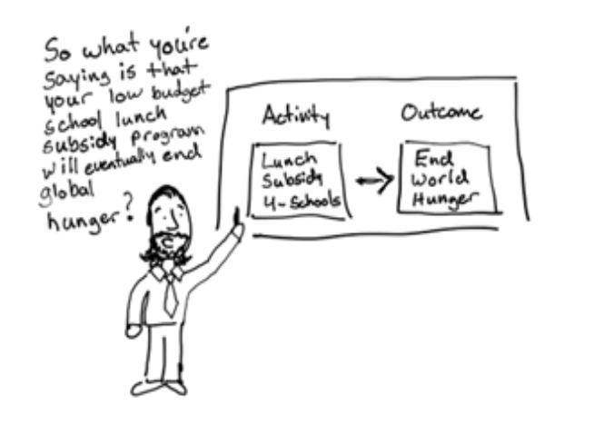
Objectives and Outcomes
SMART =
Specific
Measurable
Achievable
Relevant
Time framed

Slide 8
Justice Data Portal - SAS® Visual Analytics

Slide 9
JusticeDataPortal.nc.gov

