Slide 1
Criminal Justice Improvement Committee
GRANT WRITING WORKSHOP
keyon ashe, keyon.ashe1@ncdps.gov
Matt stuart, matthew.A.stuart@ncdps.gov
Keith bugner, keith.bugner@ncdps.gov
Navin puri, Navin.puri1@ncdps.gov
m.k. smith, mary.kathryn.smith@ncdps.gov

Slide 2
Mission Statement
“The mission of the Criminal Justice Improvement Committee is to encourage proactive and innovative programming and methodologies that improve the criminal justice system. Desired improvements include reducing and discouraging violent crime and associated problems, enhancing all aspects of criminal justice processing to include the incarceration and treatment of offenders and advancing justice system operations”

Slide 3
2025 Funding Priorities
Statewide/Regional Infrastructure
Statewide Accreditation
Community Outreach and Training
Community Mental Health Initiative

Slide 4
Statewide/Regional Infrastructure
Federal Funding Maximum: $200,000 per year (up to 2 years)
State infrastructure initiative
This is for STATE AGENCIES ONLY and will include agencies housed under the North Carolina Department of Public Safety, the North Carolina Administrative Office of the Courts, the North Carolina Department of Justice, and individual Law Enforcement Agencies in the University of North Carolina System.
These applications will not be submitted for Committee review until communications have occurred between the lead CEO of the above mentioned agencies, GCC Staff and the Chair of the CJI Committee. This will help all parties in making the application process a more efficient and less labor-intensive process.
Regional infrastructure initiative
This is for local governmental agencies that are working to fund a regional project that service a minimum of 5 counties in North Carolina or a minimum combined population of 400,000 in the service region. These could include regional crime labs, regional joint infrastructure projects, or regional violence reduction initiatives.

Slide 5
Community Outreach and Training Initiative
Federal Funding Maximum: $200,000 per year (up to 2 years)
The Criminal Justice Improvement Team is seeking applications from Agencies seeking funding for Law Enforcement training and programs in the areas of ACES informed (Adverse Childhood Experiences; Adverse Childhood Environments), de-escalation, duty to intervene, mass violence prevention, recruitment & retention best practices, crisis response, drug suppression, financial fraud, and other public safety scenarios. These applications will be reviewed by the members of the Committee for content and evaluated based on impact of training, including number of persons trained, location of persons trained, geographic footprint, and number of agencies that are collaborating on this proposal. Examples of this could include, but are not limited to Crisis Intervention Teams, Emergency Response Training Exercises, and Mobile Field Force Training.
To ensure that officers and other staff (e.g. dispatchers, advocates, and other staff interacting with the public) can partake in training, applicants may apply for
Trainers
Registration Costs
Supplies
Travel
Overtime to achieve training which must be documented by time and activity sheet

Slide 6
Statewide Accreditation
The Criminal Justice Improvement Committee realizes the importance of both the National Commission on Law Enforcement Accreditation (CALEA) standards and the importance of the statewide North Carolina Law Enforcement Accreditation (NCLEA) standards for all law enforcement officials.
It is imperative that law enforcement officers, regardless of agency size and community wealth, be trained in sound criminal justice policies, procedures, and live training scenarios. National and Statewide accreditation standards are one practical way to help ensure that local law enforcement staff are trained to the highest standards.
Criminal Justice Improvement Committee is seeking applications for statewide training for law enforcement officials, as well as, applications for establishing accreditation standards and ensuring those standards are met by every law enforcement agency in our state.
State Agencies who are tasked with ensuring that these standards are met on a statewide basis may apply for up to $200,000 a year.
Local Law Enforcement Agencies may apply for up to $ 75,000 a year to help support their agency achieve either or both the National and the State Standards.
Funds can be used to pay for the accreditation fees, support for officer overtime to allow release time - which must be documented by time and activity sheets, supplies needed to support the accreditation efforts for assistance in reviewing and improving agency policies and procedures

Slide 7
Community Mental Health Initiative
Up to 2 Years
Projects will be categorized into three types:
Small Category (Population 50,000 or Less): Up to $ 75,000/year
Middle Category (Population 50,001 – 200,000): Up to $ 120,000/year
Large Category (Population 200,001 or higher): Up to $ 225,000/year

Slide 8
Community Mental Health Initiative (Continued)
Criminal Justice Improvement Committee is soliciting applications to fund a small number of projects in this priority.
Applicants can apply for up to two years of funding in accordance with the stated federal funding maximum for their jurisdiction.
The Committee is seeking to fund no more than one or two in each category for mental health diversion and co-responder projects.
Agencies are asked to demonstrate a collaborative and unified effort in their community approach to the growing problem of mental health.
Models that can be used include those that are promoted by the National Alliance on Mental Illness and these pilot projects must show an association between local law enforcement agencies, mental health service providers, and local government support.

Slide 9
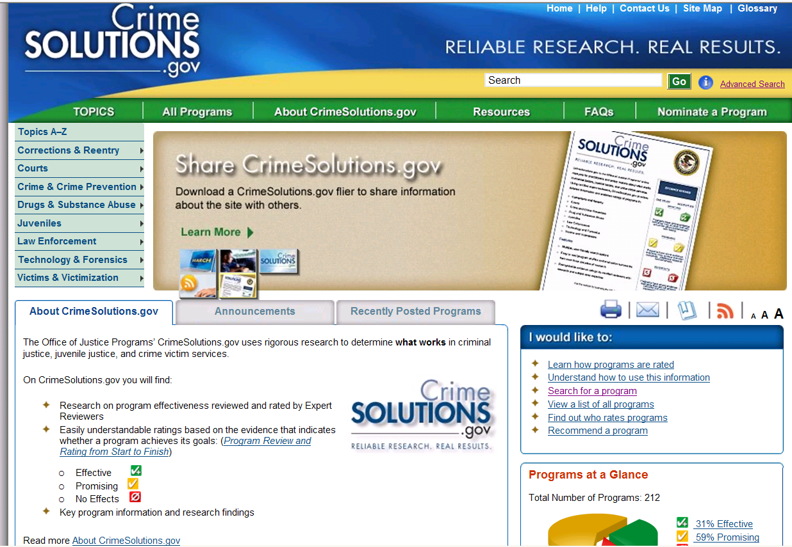
Resource

Slide 10
General Information
To be included in all Project Narratives:
Explanation of budget items should be provided in the Project Narrative.
Provide an estimation of the number of participants for the Training projects and the impact that it will have statewide.

Slide 11
General Information for Non-Profits
Must verify Non-Profit Status when submitting their application. (i.e. a current 501(C)(3) certification and have a valid federal tax identification number).
Required to provide a copy of the agency’s general accounting procedures, operating oversight structure and current financial statement with the application.

Slide 12
Sustainability
The funds awarded by the Governor's Crime Commission are mostly intended for seed money.
All applicants must submit viable and detailed long-term sustainably plans.
They must clearly explain how and from whom they plan to secure funding - and program continuation - after the end of the project’s grant period.
And the answer is…
To find an alternative funding source, other than grant funds.

Slide 13
Sustainability
Name three specific activities that will be accomplished during the first year of grant to financially sustain project once grant ends.
Name community resources that have the potential to partially sustain your project in the future.
Provide a brief description of your plan to financially sustain this project after the one or two year grant period.

Slide 14
Why Seek Alternative Funding?
NEXT YEAR IS NOT CLEAR BY A LONG SHOT.
JAG is shifting priorities and types of subgrant projects.
The decreasing number of Federal JAG dollars to NC each year.
CJI funding priorities change from year-to-year.
CJI funding is intended to seed new programs.
CJI funding may not be available to grantees after two or three grant cycles. Grantees are expected to have independent funding.
Funding is competitive, not all applications are funded.

Slide 15
Thank You.

