Slide 1
Crime Victim Services
VOCA Victim Assistance and VAWA STOP
2025 Funding Priorities
Application Period: 12/1/2024 – 1/31/2025

Slide 2
Crime Victim Services Planning Team
919-733-4564
CVS Supervisor/Program Assistant
Sandy Dixon, Lead CVS Planner, sandy.dixon@ncdps.gov
Grace Clougherty, CVS CVS Program Assistant, grace.clougherty@ncdps.gov
VOCA Team
Lindsay Bohan, Lead VOCA Planner, lindsay.bohan@ncdps.gov
Jordan Mayer, VOCA Planner, jordan.mayer@ncdps.gov
VAWA Team
Daun Brown-Hairston, Lead VAWA Planner, daun.brown-hairston@ncdps.gov
Amanda Endicott, VAWA Planner, amanda.m.endicott@ncdps.gov

Slide 3
Crime Victims Services Committee
The mission of the Crime Victims' Services (CVS) Committee is to advocate for victims by promoting the development of effective programs that improve the response of human service professionals and the criminal justice system to crime victims.

Slide 4
CVS Funding Priority Development
Staff Input
  Information to estimate the upcoming federal award amounts
  Review prior priorities, applications and amounts
  Historical information about performance of prior projects/agencies
  Research from the field and other states, in particularly the GCC Crime Victim Needs Assessment
CVS Advisory Group and the VAWA Implementation Workgroup
  Input from across the state in the victim services providers
  Innovations in the field
CVS Committee
  Reviews all information
  Makes final recommendations to the Commission
An important factor for 2025 funds was the amount of federal funds estimated to be available.
  VAWA STOP – estimate is it will be similar to 2024
  VOCA Victim Assistance – estimated is anywhere between $3M and $30M

Slide 5
Important Items for 2025
All projects are not allowed to roll Year 1 surplus (unspent) funds from Year 1 to to the next year.
Certain attachments will now be uploaded to the agency’s Organization Documents section in EBS rather than uploaded to the project.
  Organization Documents section in EBS allows for upload of certain documents at the subrecipient level that can then be used for multiple applications
  Other attachments to the project will now only be those that are specific to the application project.

Slide 6
Changes for 2025 CVS Applications
Application Period of Performance (POP) will be for 3 years.
  VOCA POPs will move from 2 years to 3 years
  VAWA POPs will move from 1 year to 3 years
Each budget year will be submitted annually.
Each subsequent budget year will be added through a continuation budget as federal funds allow.
Depending on federal funding levels, each subsequent year may be increased, decreased or stay the same.
For this application, you will only enter your year 1 budget lines.

Slide 7
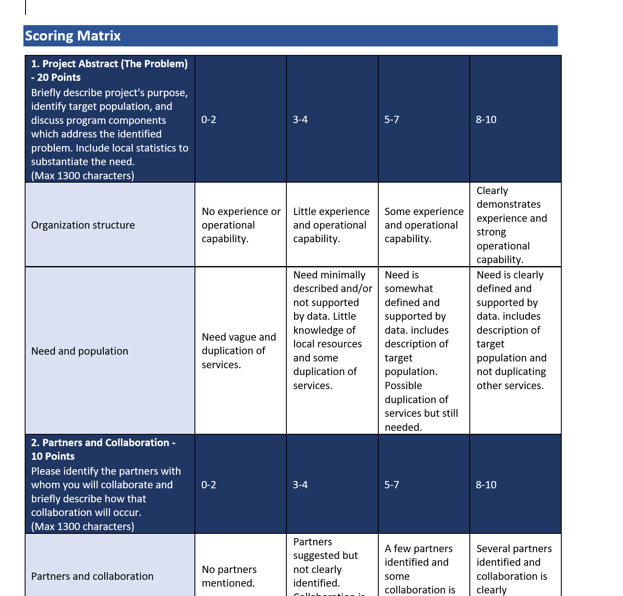
Application Review
See the RFA for the **NEW** Scoring Matrix

Slide 8
Crime Victim Services
2024 Grant Writing Workshop
Victims of Crime Act – Victim Assistance
VOCA
Notes:
Narrator: My name is Daun Brown Hairston, and I will be presenting on the Governor’s Crime Commissions VAWA funding source.

Slide 9


Goal of VOCA Victim Assistance funding:
To improve the treatment of victims of crime by providing victims with the assistance, support, and services necessary to aid their restoration and healing after a criminal act.

Slide 10
Services under this grant program are defined as those efforts that:
  Respond to the emotional and physical needs of crime victims;
  Assist primary and secondary victims of crime to stabilize their lives after victimization;
  Assist victims to understand and participate in the criminal justice system;
  Provide victims of crime with a measure of safety and security as appropriate to their victimization

Slide 11

GCC is federally mandated to allocate VOCA funding to the following
Minimum Allocations | Allocation Category | Definition/Clarification
10% | Sexual Assault | No specific definition provided, due to varying definitions in jurisdictions.
10% | Domestic and Family Violence | A crime in which there is a past or present familial, household, or other intimate relationship between the victim and the offender, including spouses, ex-spouses, boyfriends and girlfriends, ex-boyfriends and ex-girlfriends, and any family members or persons residing in the same household as the victim. Involves a pattern of abusive behavior in any relationship that is used by one partner to gain or maintain power and control over another intimate partner. Domestic violence can be physical, sexual, emotional, economic, or psychological actions or threats of actions that influence another person.
10% | Child Abuse | Victim of child abuse means a victim of crime, where such crime involved an act or omission considered to be child abuse under North Carolina law. In addition, victims of child abuse may include, but are not limited to, child victims of: physical, sexual, or emotional abuse; child pornography related offenses; neglect; commercial sexual exploitation; bullying; and/or exposure to violence.
10% | Underserved | Identify such services for previously underserved victims of violent crime by the type of crime they experience, the characteristics of the victim or both.

Slide 12

Agencies must demonstrate a record of effective services by having a history of providing direct services
Agencies must provide documentation of substantial financial support from sources other than the Crime Victims Fund
New victim services organizations must show financial capacity with at least 25% of the agency’s funding comes from other sources
 May include other federal funds
 May include state funding
 Non-federal funding support may be used towards the match requirement

Slide 13

VOCA
Noncompetitive (Basic) Based on formulas (DV, SA, CACs) | Competitive only 1 application will be accepted per Implementing Agency
Domestic Violence/Sexual Assault Victims’ Services - designated agencies only Child Advocacy Centers - designated agencies only All current Basic grants ending 9/30/2025 will be extended until 9/30/2026. Only newly designated agencies with no current Basic grant will apply in 2025 cycle. | Underserved Crime Victim Services No other priority will accept applications this cycle.

Slide 14
Application Submission Limits: Agencies may submit no more than ONE (1) competitive application per program priority
      Additional applications will not be considered for funding
  This total is not inclusive of any DV/SA or CAC Basic Services projects
Caps: There are now caps in place for each priority. You must apply for no more than the cap amount.
Awards under the VOCA program will be made for a funding period not to exceed three years per funded project. Each budget year will be applied for annually.

Slide 15
The following priority categories are funded to designated agencies only:
  Sexual Assault/Domestic Violence Victims Services
  Child Advocacy Centers
If you do not receive notification from GCC establishing that you should receive a basic services funding allocation, you are not eligible to apply for funding in these priority categories
ALL basic grants currently active will NOT reapply this year. Additional instructions for extensions will be sent.

Slide 16
NEWLY DESIGNATED AGENCIES ONLY – who have not received VOCA Basic services funding.
Proposals submitted should address the needs of victims of sexual assault or domestic/intimate partner violence by providing direct services to victims of crime in designated counties.
Proposals should include a plan of action to provide core crisis intervention services to victims

Slide 17
Examples include:
  Client Outreach Services
  Crisis Line Operations
  Evidence-based Mental Health Services
  Counseling and Support Services
  Information and Referral Services
  Language Crisis Line Services
  Legal Assistance
  Relocation Expenses
  Shelter and Transitional Housing Services
  Hospital Accompaniment

Slide 18

Proposals should describe services provided by a fully or provisionally accredited Child Advocacy Center (CAC)
Each organization must upload a verification letter from Children’s Advocacy Centers of North Carolina (CACNC) that states their accreditation status.

Slide 19
Proposals may include costs to cover direct services personnel for the following services:
  Advocacy
  Evidence-based Mental Health Services
  Child Medical Evaluation
  Forensic Interviews
  Forensic Medical Evidence Collection Exams

Slide 20

The following priority categories are competitive, and voted on by the members of the Governor’s Crime Commission:
Underserved Crime Victims –
UPDATED
VOCA requires a minimum of 10% funding be allocated to projects serving “previously underserved populations of victims of violent crime”. Underserved populations may be distinguished by crime type or by demographic characterizations. Under this funding priority, programs should look to develop and/or continue implementing programs that address underserved crime victim groups by providing an array of direct services.
GCC highly encourages culturally specific agencies to apply under this priority, as well as agencies who are able to meaningfully address the needs of victims of crime under these crime types and populations, including but not limited to having personnel that reflects the communities served within this priority.

Slide 21

1.
Underserved: Only one application in the Underserved Priority is allowed. For example, an
agency cannot apply for an Underserved 1.A. and 1.B. project.
Local: 1-4 counties – $125,000
Regional: 5-50 counties – $250,000
Statewide: 51+ counties – $375,000
A. Underserved - Crime Type (select one)
Human Trafficking Victims
Co-Victims of Homicide
Services for Victims of Financial Fraud and/or Identity Theft
Drunk driving
B. Underserved – Demographic Type/Special Population (select up to three)
African/African American/Black communities
American Indian/Tribal Communities
Latinx
Asian/Pacific Islander
Middle Eastern
Immigrant (Undocumented and Documented)
LGBTQ+
Males
Elderly
Rural
Disabled
Veterans/Military Personnel
Formerly incarcerated individuals
Persons with Limited English Proficiency
Deaf or Hard of Hearing individuals
Persons who are homeless

Slide 22
Proposals may include costs for direct service personnel, volunteers and services and goods needed to support direct services prorated to the portion of the project.
Allowable direct services include:
  Client outreach services
  Crisis line operations
  Evidence-based mental health services
  Counseling and support services
  Information and referral services
  Language crisis line services
  Legal assistance
  Relocation expenses
  Shelter and transitional housing Services
  Hospital accompaniment
  Child medical evaluations
  Forensic interviews
  Forensic medical evidence collection exams
  Training for project and agency personnel and volunteers

Slide 23
Lobbying/advocacy with respect to legislation or administrative changes to regulations or administrative policy;
Research and studies, except for project evaluation within the limits established by GCC;
Active investigation and prosecution of criminal activities, except for the provision of victim assistance services to crime victims;
Fundraising activities;
Capital expenses, including capital improvements; property losses and expenses; real estate purchases; mortgage payments; and construction;

Slide 24
Reimbursement of crime victims for expenses incurred because of a crime, except as otherwise allowed by other provisions herein;
Medical care, except as otherwise allowed by other provisions herein;
Salaries and expenses of management, board members, and other administrators, except as specifically allowed elsewhere herein;
Trinkets (items such as hats, mugs, portfolios, t-shirts, coins, gift bags, etc., regardless of whether they include the conference name or OJP/DOJ logo) must not be purchased with DOJ funds as giveaways for conferences. Basic supplies that are necessary for use during the conference (e.g., folders, name tags) may be purchased.

Slide 25
Read the RFA – there has been a significant reduction in documentation that is required in your application at the time of submission.
The items listed in the RFA must be included in the application at the time of submission, named as instructed.
Samples of most attachments can be found on the GCC website: www.ncdps.gov/gccforms

Slide 26
NOTICE OF UNIQUE CIRCUMSTANCES MATCH WAIVER
For VOCA applications and extensions between
November 1, 2024 through September 30, 2025
The GCC Executive Director has determined that Unique Circumstances exist warranting the waiver of match for all applications submitted this grant cycle.

Slide 27
Crime Victim Services
2024 Grant Writing Workshop
Violence Against Women Act
VAWA
Notes:
Narrator: My name is Daun Brown Hairston, and I will be presenting on the Governor’s Crime Commissions VAWA funding source.

Slide 28
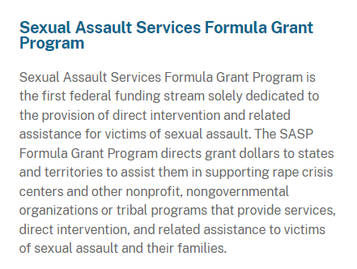
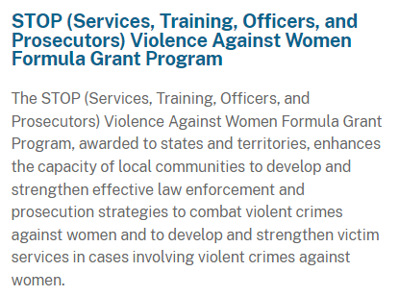
GCC VAWA Programs
Pass-through
North Carolina Coalition Against Sexual Assault who administers sexual assault funds to NC organizations on a separate funding cycle
Notes:
(Summarize Slide)
The GCC VAWA Funding source administers 2 Federal grants.

Slide 29
VAWA-STOP Program Background
The Violence Against Women Act (VAWA) of 1994 was passed by Congress and created the Office on Violence against Women (OVW) in the United States Department of Justice. Since its inception, OVW has supported a multifaceted approach to responding to crimes against women through the implementation of grant programs authorized through VAWA. VAWA supports communities and was designed to improve the criminal justice systems responses to adult, youth and child victims of domestic violence, sexual assault and stalking by forming partnerships between state and local communities. For additional information about this program and related performance measures, including how awards contribute to the achievement of program goals and objectives, see:
•OVW grant program information:
Office on Violence Against Women (OVW) | Grant Programs | United States Department of Justice
•Program performance measures under the Measuring Effectiveness Initiative: Grant Programs (vawamei.org)
•Program-specific sections in OVW’s most recent report to Congress on the effectiveness of VAWA grant programs: Office on Violence Against Women (OVW) | Reports to Congress (justice.gov)
Notes:
(Summarize Slide)
To give you some background, read slide
We have also provided some helpful resources below to assist you in learning more about the effectiveness of VAWA and how the program has evolved over the years. (Summarize)

Slide 30

VAWA Application Overview
The S.T.O.P (Services, Training, Officers, and Prosecutors) Violence Against Women Formula Grant Program promotes a coordinated, multidisciplinary approach to improving the criminal justice system’s response to violent crimes against women. STOP encourages the development and strengthening of effective law enforcement, prosecution strategies and victim services in cases involving violent crimes against women.
OVW grants help and provides victims with the protection and services they need to pursue safe and healthy lives, while improving communities’ capacity to hold offenders accountable for their crimes.
Services - Training – Officers - Prosecutors
Notes:
(Summarize slide)
We want to support applicants as you navigate this funding opportunity. We encourage you to READ and RE-READ the RFA and have it close to you when working on your application. We have provided specific program information and resources to support you along the way. The STOP acrynm stands for…..’
We have provided

Slide 31
VAWA Application Overview
STOP Funding Priorities - supported by the NC Governor’s Office
The GCC encourages programs that involve partnerships, collaborations, and best practices to meet the needs of crime victims and others across the state. We encourage applicants to develop projects that:
Support victims of domestic violence, sexual assault and stalking by ensuring that the stigma of reporting is no longer a barrier for victims.
2. Providing resources for training to help law enforcement better understand victims and ultimately reduce any stigma around reporting.
3. Utilize best practices and/or evidence-based interventions.
Notes:
Before you begin your application, you want to review the…(Read Slide)

Slide 32
STOP Priority Service Areas
STOP funding is restricted to developing and strengthening effective law enforcement and prosecution strategies to address violent crimes against women and the development and strengthening of victim services in cases involving violent crimes against women in the following areas: 1) domestic violence; 2) dating violence; 3) sexual assault; and 4) stalking. Human trafficking victims who have been sexually assaulted or battered by an intimate partner can be served with STOP funds.
First, you will need to identify in your application one priority service area for your proposed project
VAWA Application Overview
Victim Services
Law Enforcement
Prosecutors
State and Local Courts
Discretionary
Notes:
Before you begin your application, you want to review the…(Read Slide)

Slide 33
VAWA Application Overview
STOP Focus Areas
Second, you will need to identify IF your proposed project plans to serve one of the two STOP Focus Areas below. (Not Mandatory)
Sexual Assault Projects in the Victim Services, Law Enforcement, Prosecution and/or Courts Priority Service Area are eligible to choose this Focus Area. Discretionary projects are not eligible for this focus area. Projects must have a sole and legitimate focus on sexual assault and personnel funded under the projects must have sufficient expertise and experience in the field of sexual assault response.
Culturally Specific Only projects in the Victim Services Priority Service Area are eligible to choose this Focus Area. In order to be eligible, projects must be focused on working with racial and ethnic minorities as defined in section 1707(g) of the Public Health Service Act, which means:
Notes:
Before you begin your application, you want to review the…(Read Slide)

Slide 34
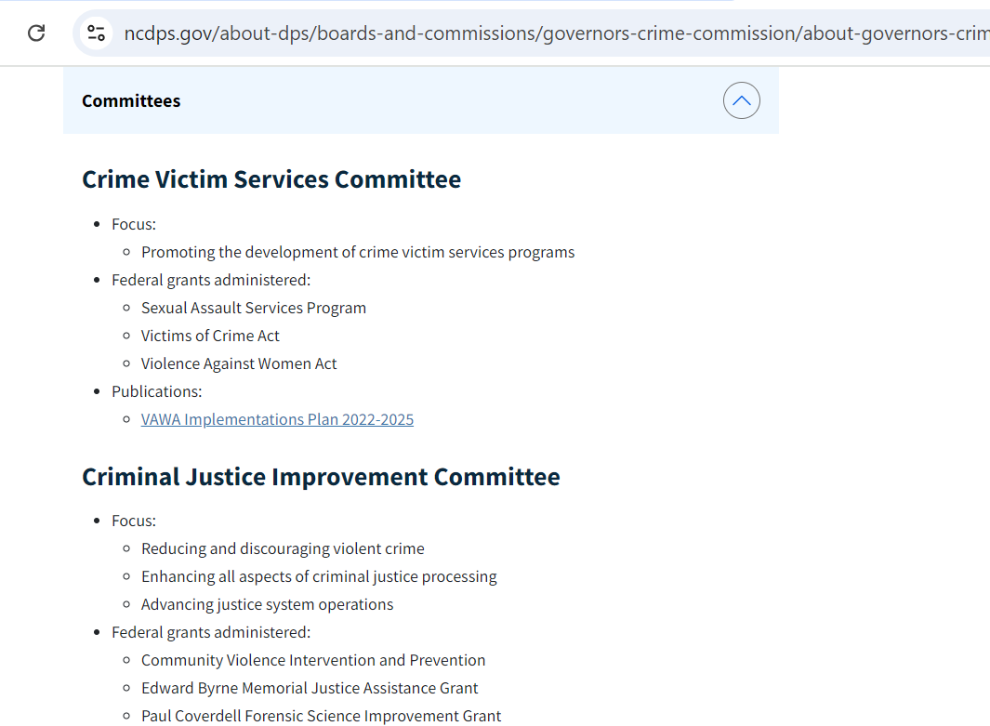

Statutory Purpose Areas:
Third, you must meet one or more of the VAWA’s statutory purpose areas. GCC has identified thirteen (13) purpose areas that align with the State of North Carolina’s VAWA Implementation Plan and that fill in funding and service gaps for the State (see items A-M in your RFA).
You will need to identify in your application at least one purpose area with which your proposed project aligns.
https://www.ncdps.gov/nc-vawa-implementation-plan-2022-2025/download?attachment
Notes:
Third read slide

Slide 35
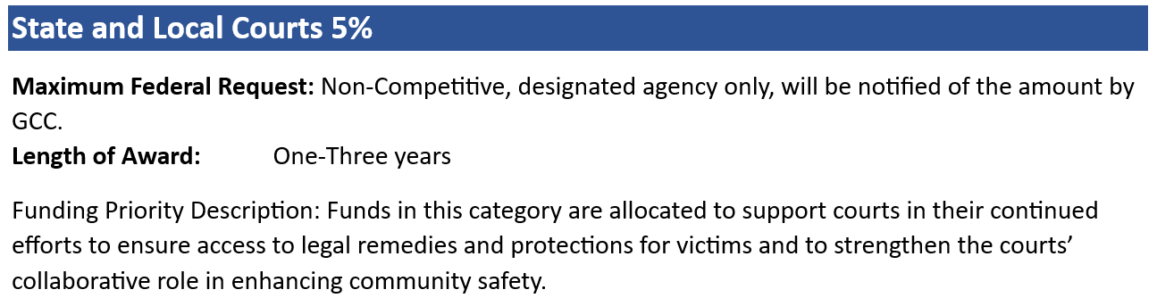
STOP Priorities:

Slide 36
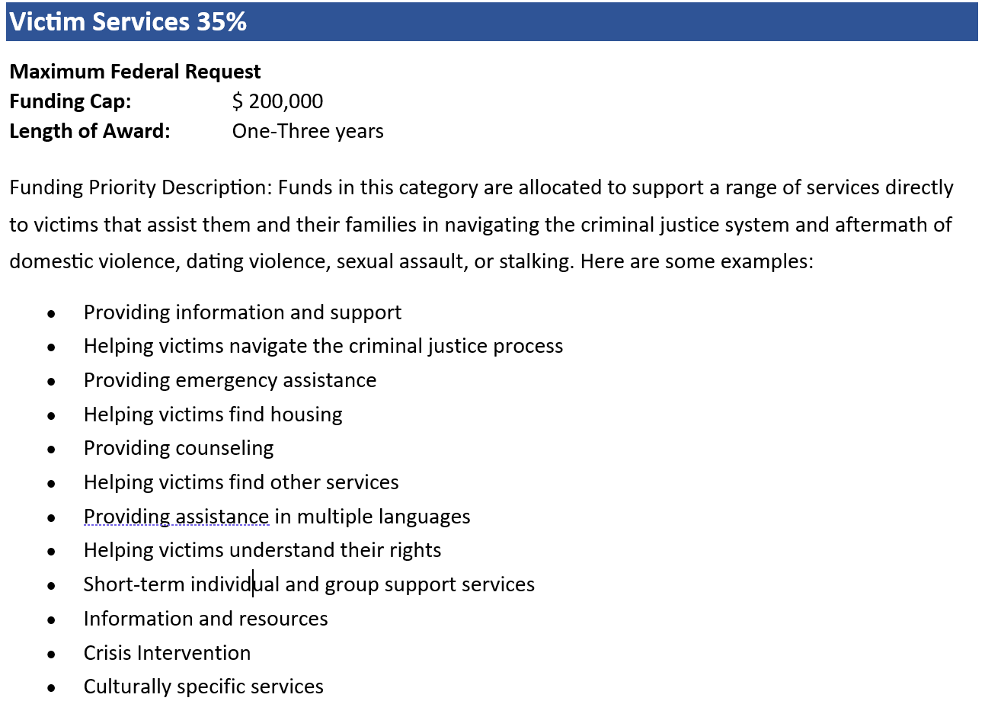
STOP Priorities:

Slide 37
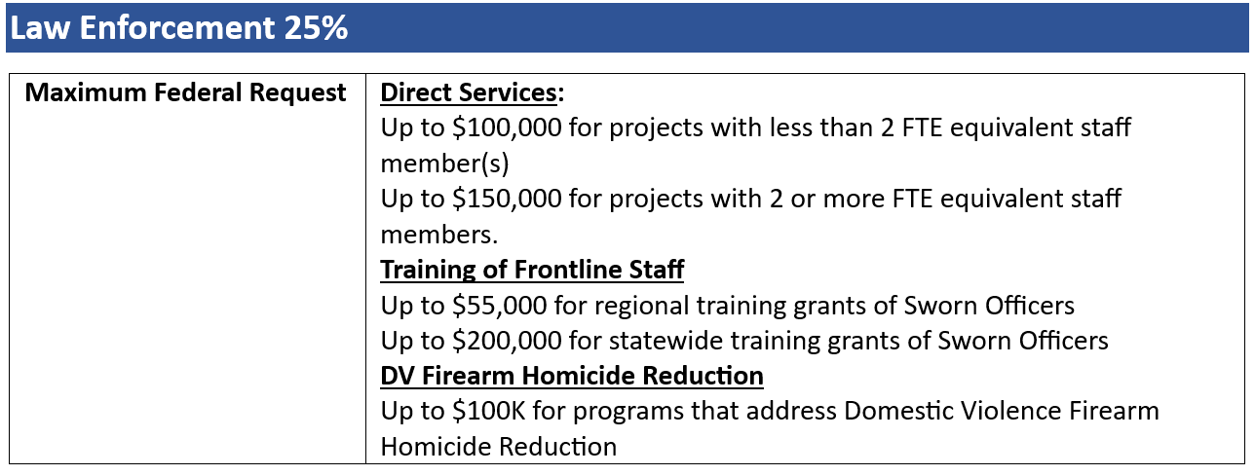
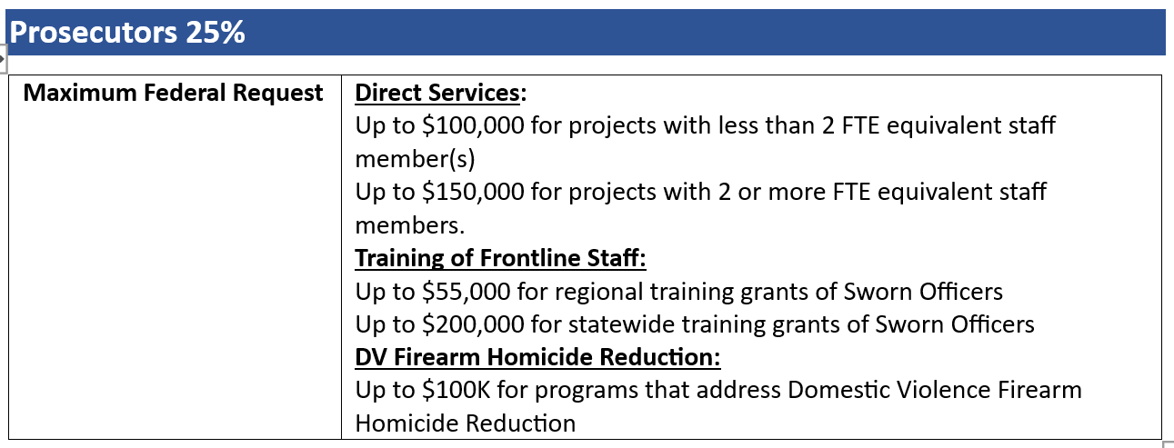
STOP Priorities:

Slide 38
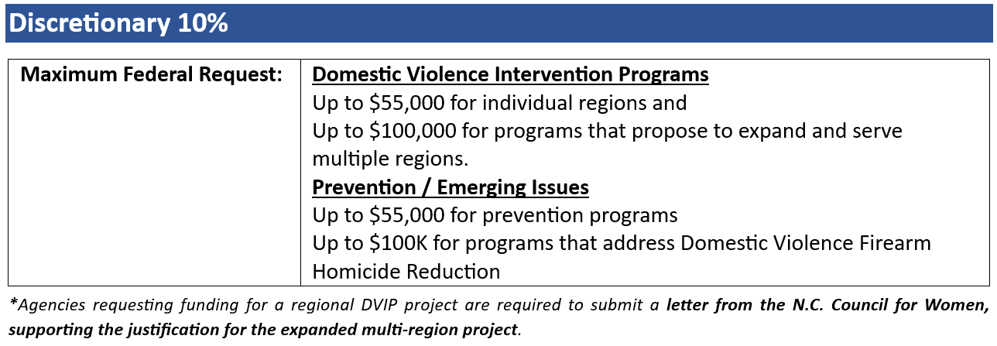
STOP Priorities:

Slide 39
VAWA STOP Match Requirement
There is a 25 percent match requirement imposed on grant funds provided to state or local government agencies under this program. Pursuant to 34 U.S.C. § 10446(f), a grant made under this program may not cover more than 75 percent of the total costs of projects awarded to these type organizations.
Notes:
(Read Slide)

Slide 40
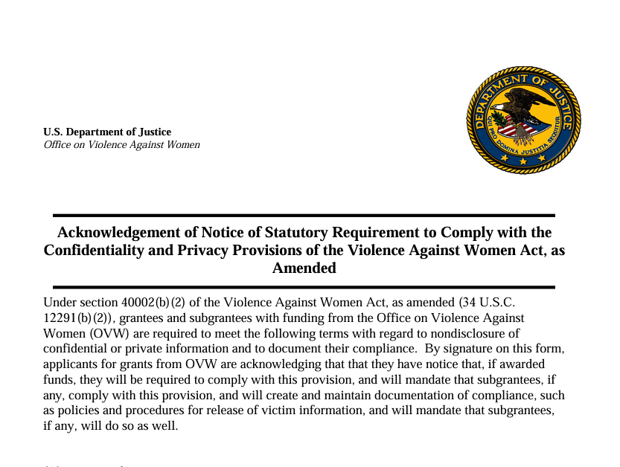
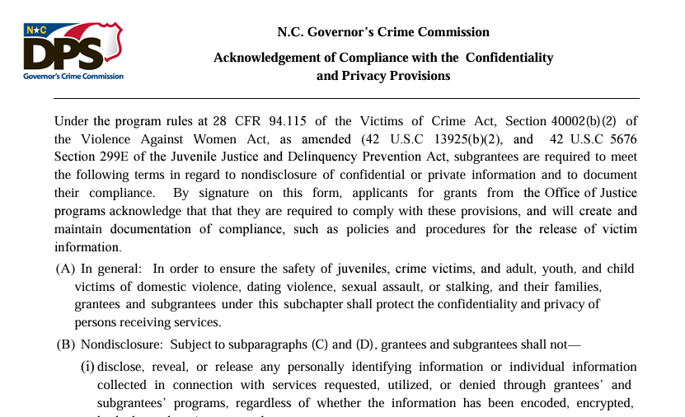
VAWA specific Program Documents
Compliance with the statutory eligibility requirements of the VAWA as amended, STOP grant program
Confidentiality Assurances - Victim Services ONLY
(law enforcement and prosecution-related activities are not covered by confidentiality; in these categories we look for and encourage the use of best practices, policies, and processes that protect victims' privacy)
Culturally Specific Organization Verification
(Culturally Specific applicants)
Legal Services Certification
(Prosecutors / Legal Services applicants)
Assurance Concerning Polygraph Testing Prohibition
(Prosecutors / Legal Services & Law Enforcement applicants)
Certification & Letter of Support* from N.C. Council for Women and Youth Involvement
(Domestic Violence Intervention Programs)
Notes:
Finally, we wanted to point out some VAWA specific documents for VAWA STOP applicants.

Slide 41
Thank you!

