Slide 1
EBS Update & Demo
Kevin Farrell
GCC Business Operations

Slide 2
EBS Update Topics
Requesting Access to EBS
Demo / Navigating the EBS System
  Accessing your Grant Application / Award
  Submitting Changes or Updates to your Grant
  Submitting Reports or other Documentation to GCC
  Submitting Reimbursement Requests
  EBS Resources
  Preview of what’s next in EBS

Slide 3
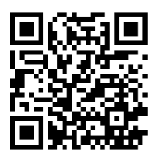
Requesting Access to EBS
Each user must submit an application for access
Application available at: https://www.ebs.nc.gov/sap/crmaccess/
Select “DPS – Governor’s Crime Commission” as Agency
Must have an NCID first

Slide 4
Requesting Access to EBS - NCID
NCID or MyNCID
  State and local government = ncid.nc.gov
  Other Organizations = myncid.nc.gov
The name and email address you enter on the EBS access request form must match exactly the name and email in your NCID Account.
GCC approves first, then sends to EBS Security – allow 48-72 hours per request.

Slide 5
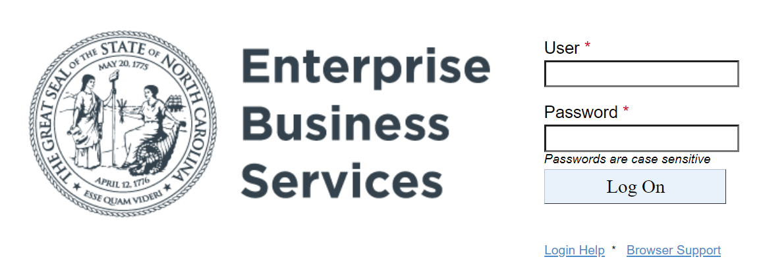
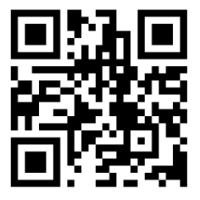
EBS Login
https://www.ebs.nc.gov/

Slide 6
EBS Demo
Navigating the EBS System
  Accessing your Grant Application / Award
  Submitting Changes or Updates to your Grant
  Submitting Reports or other Documentation to GCC
  Submitting Reimbursement Requests

Slide 7
EBS Demo
Change Request Tips
  Always enter Justification, explain what it is you are requesting to change and why the change is necessary.
  For Budget Adjustments, you are unable to update employee name and % effort on budget lines.
    In those cases, you must create a new budget line and move the total amount of remaining funds from the old line to the new line
  Use Description in the Budget section to let GCC know details (quantity, is the amount prorated, etc)

Slide 8
EBS Demo
Reimbursement Request Tips
  Sub 990 Form – must be completed and submitted to create account in North Carolina Financial System.
      Must be completed if changing address of where check is mailed
  Electronic Payment Form – must be completed to receive electronic payment
  Discuss with your GCC Grant Administrator

Slide 9
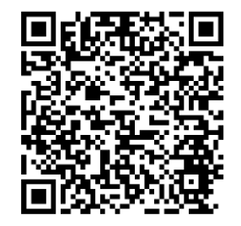
EBS Resources
Your GCC Grants Administrator
Online Documentation
  EBS Users Guide
EBS Help Desk – EBSSupport@ncdot.gov

Slide 10
EBS Preview – What’s Coming Next
Updates to the GCC Application
Subrecipient Profile
  Organization Info and Officials
  Organization Document Submission
Ability to Print Application

Slide 11
EBS Preview – What’s Coming Next
Updates to the GCC Application
Subrecipient Profile
  Organization Info and Officials
  Organization Document Submission
Ability to Print Application

