Slide 1
EBS Update & Demo
Kevin Farrell
GCC Business Operations

Slide 2
EBS Update Topics
Requesting Access to EBS
Demo / Navigating the EBS System
  Subrecipient Profile
  Application
  EBS Resources
  EBS for Grant Management

Slide 3
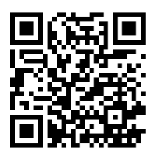
Requesting Access to EBS
Each user must submit an application for access
Application available at: https://www.ebs.nc.gov/sap/crmaccess/
Select “DPS – Governor’s Crime Commission” as Agency
Must have an NCID or MyNCID first

Slide 4
Requesting Access to EBS - NCID
NCID or MyNCID
  State and local government = ncid.nc.gov
  Other Organizations = myncid.nc.gov
The name and email address you enter on the EBS access request form must match exactly the name and email in your NCID Account.
GCC approves first, then sends to EBS Security – allow 48-72 hours per request.

Slide 5
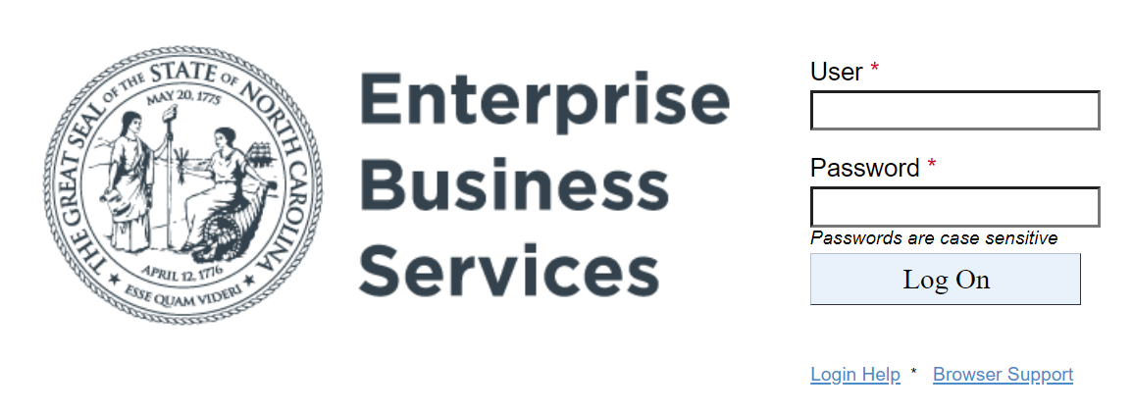
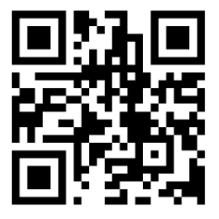
EBS Login
https://www.ebs.nc.gov/

Slide 6
EBS Demo
EBS GCC Subrecipient Profile
  Adding Organization Details
  Uploading Organization Documents
  Submitting Changes or Updates to your Profile
EBS GCC Application (2025 Program Priorities)
  Completing Application Details
  Creating the Project Budget
  Submitting the Application

Slide 7
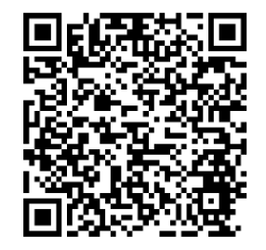
EBS Resources
Your GCC Grants Administrator
Online Documentation
  EBS Users Guide
EBS Help Desk – EBSSupport@ncdot.gov

