Slide 1
Governor’s Crime Commission
2024 Grant Award Workshop

Slide 2
Grants Management and
Documentation
2

Slide 3
Grants Administrators
Allyson Teem
Arienne Cheek
Brenda Washington
Burley Spinks
Jacqueline Ray
Jennifer Johnston
Keith Bugner
LaShanya Richardson
Matt Stuart
Medwin Metzger
Roxana Zelada-Lewis
Tanya Ogburn
Your friend and go to for questions.
Technical assistance on policy and procedures.
Review and process reimbursements and budget modifications.
Provides site visits and can help on local policies.

Slide 4
How Do I Get Reimbursed?
Step 1
Reference the budget line items that were approved on the grant for which you are requesting reimbursement.
Step 2
Complete the reimbursement for those approved line items for expenditures made during the (monthly) reporting period.
4

Slide 5
How Do I Get Reimbursed?
Step 3
Include the GCC required “Coversheets” for each expense category and all documentation supporting the expenditures on the reimbursement.
Step 4
Submit your reimbursement to GCC through EBS.
5

Slide 6
Reimbursements
6

Slide 7
Checklist for Reimbursements
Required Cover Sheets for Expenditures:
Personnel – Coversheet A
Supplies – Coversheet B
Contractual – Coversheet C
Travel -Coversheet D
Equipment – Coversheet E
Operating Expenses – Coversheet F
Orientation of Scanned Documents Uploaded in EBS – PDF, Portrait mode.
Specific Coversheet AND supporting documentation that reflect page numbers (to ensure all documentation uploaded are complete – this will avoid delays of the processing of your reimbursement)
  First Example: Personnel Coversheet on the top and the timesheets, payroll register, proof of payment for fringe benefits will be under one packet
  Second Example: Supplies Coversheet on the top, and the vendor invoice, copy of proof of payment (receipts, credit card statements, allocation policy, procurement requests, etc.)
7

Slide 8
Checklist for Reimbursements
Supporting documentation should reflect page numbers – this is to ensure all documentation uploaded in EBS are complete. This will avoid any delays of processing your reimbursement or having the reimbursement sent back for modifications if there are missing pages.
  First Example: Personnel Coversheet will be labeled A-1. The timesheet following this coversheet will be labeled A-2, the payroll register following this timesheet will be labeled A-3, etc.
  Please ensure that all uploaded documents are scanned in upright for uniformity.
Each coversheet and related supporting documentation are scanned and uploaded separately from other coversheet and documentation.
You will have separate files uploaded in EBS for each type of expenditure (Personnel Coversheet and supporting documentation will be one PDF upload, Supplies Coversheet and supporting documentation will be another PDF upload)
Use below Terminology / Description for uploads to EBS
  PERSONNEL - October-2024 – (Agency Name & EBS Agreement number)
  EQUIPMENT - November 2024 – (Agency Name & EBS Agreement number)
8

Slide 9
Reimbursement
Reimbursements are to be submitted monthly, by the last day of the month, for actual expenses made during the previous month.
If submitted on time, it is the Grants Management Team’s goal to have the first touch of the reimbursement within 10 days of submitting. This means the reimbursement will be approved, require modifications, or be denied.
If these are submitted after the last day of the month the grant managers will have 30 days to provide the first touch the reimbursement request.
Final reimbursement is due 60 days after the end of the period of performance.
9

Slide 10
Remaining Funds
No remaining funds will be carried over from one year to another.
The Grant Administrator will change the Agreement to Year 2 once all Year 1 funds are submitted and paid.
The Subrecipient may now use Year 2 funds.
The Final Reimbursement must be marked as the Final Reimbursement in EBS.
GCC pays the final reimbursement, and the Agreement will be closed if all requirements have been met.
10

Slide 11
Change Requests
11

Slide 12
Non-Budgetary Change Requests
Non-Budgetary Change Requests
  Grant Agreement Extension Requests
  Scope of Work Changes - prior approval required by grant planner
  Personnel Update / Changes
  Officials Update - Project Director, Financial Officer, Authorizing Official. Board approval minutes required.
12

Slide 13
Budgetary Change Requests
Budget Change requests
  Reallocate Funds
  Increase Funds
  Add a budget category that did not previously exist on the grant
    Example- adding travel as a budget category that did not previously exist
  Move grant funds from one category to another
    Example- move funds from Personnel to Supplies
Discuss budget change requests with Grants Administrator to ensure reallocations and changes are allowable.
13

Slide 14
Budgetary Changes
Budgetary change requests are due 90 days prior to end of the Period of Performance of the grant Agreement. EBS requires a justification before it will allow the subrecipient to submit the change request.
Change requests can be discussed with the Grant Administrators to ensure allocations and changes are allowable, if the Subrecipient has any questions.
Board Minutes are required for budget adjustments associated with salary increases
      Salary increases must be approved by the organization Board of Directors for the entire staff and not only grant funded positions
14

Slide 15
Budget Change Request Cap - 10% Rule
Budget change requests are capped at 10% of award funds for total grant awards that are $250,000 and greater.
The need to re-purpose match requires a Budget Change Request, it does not count toward the 10%.
There is no limit to the number of Budget Change Request that can be submitted to GCC, with exception to last quarter of the grant Agreement’s period of performance.
15

Slide 16
Budget Modification Cap
10% rule Continued
Once the sub-recipient has been allowed to move 10% of the total grant award, subsequent budget change requests adjustments will be reviewed on a case-by case basis for approval or denial.
If you receive an approval of additional grant funds, you will need to submit a budget change request to increase your budget, then the cap is increased by 10% of the added funds.
16

Slide 17
Budget Change Request Denial
The budget change request will be denied if:
Exceeds 10% of the total grant award for those grants $250,000 and greater
Inconsistent with the grant purpose
Failure to support/further the program
Unallowable
Supplanting
Not submitted 90 days before the end of the period of performance.
17

Slide 18
Supporting Documentation
Personnel
and
Employee Benefits
18

Slide 19
Payroll Documentation
Pay stubs are required, only official documents are accepted
Pay stub must show:
    Name of the employee
    Gross wages earned per reporting period
    Total hours worked during the reporting period
    Hourly rate of pay or monthly salary
    Pay period begin and end dates
    Pay date
All deductions for taxes/benefits/etc.
19

Slide 20
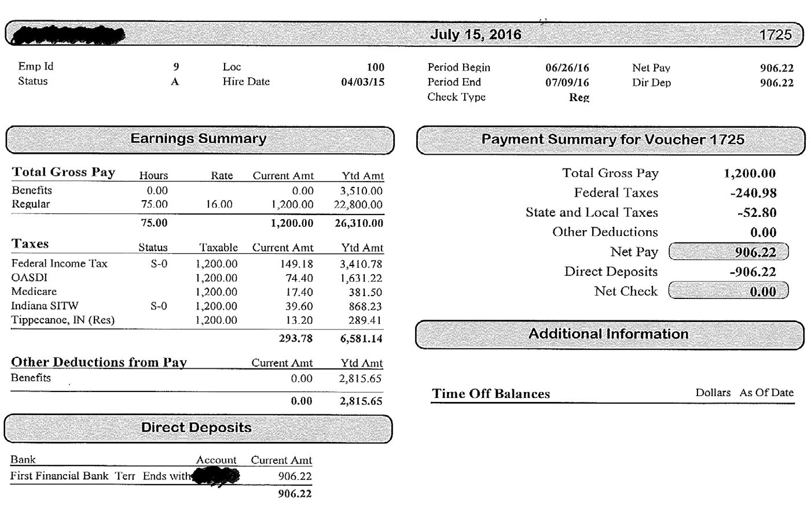
Pay Stub Example
0
20

Slide 21
Time & Activity Sheets
The GCC has two types of time & activity sheets:
One Funding Source Time and Activity Sheet
Multiple Funding Source Time and Activity Sheet
The Time & Activity Sheets must include all information as required on the form for each employee. See sample below.
The Time & Activity Sheets are GCC required documents to receive reimbursement requests
Most importantly, they must be Signed by the Employee and an Approving Official.
The Executive Director’s Time & Activity Sheet must be signed by the Board Chair or authorized Board member.
21

Slide 22
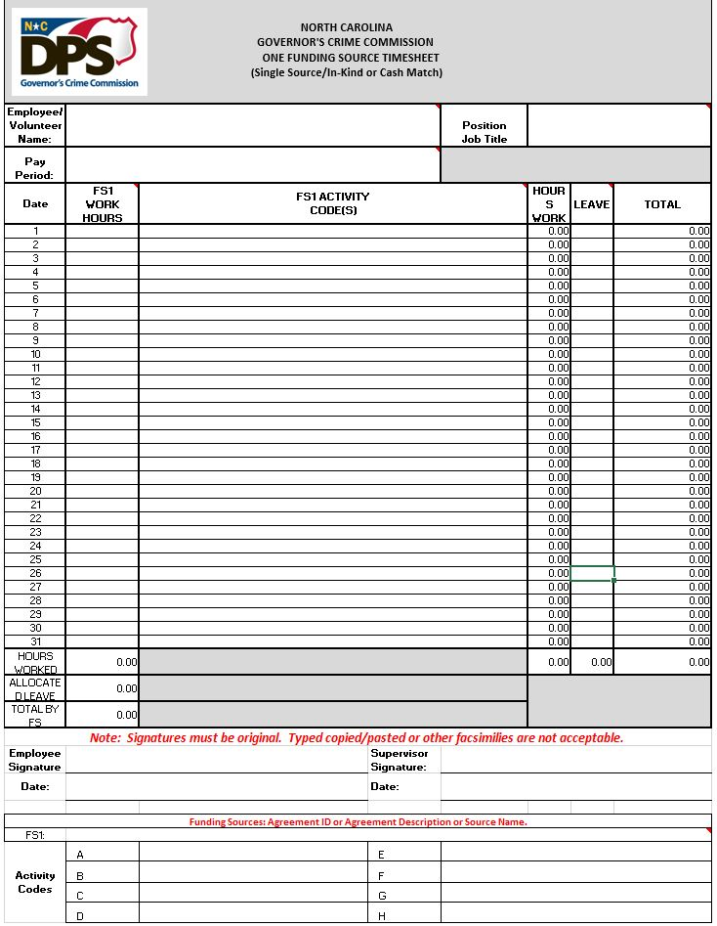
22

Slide 23
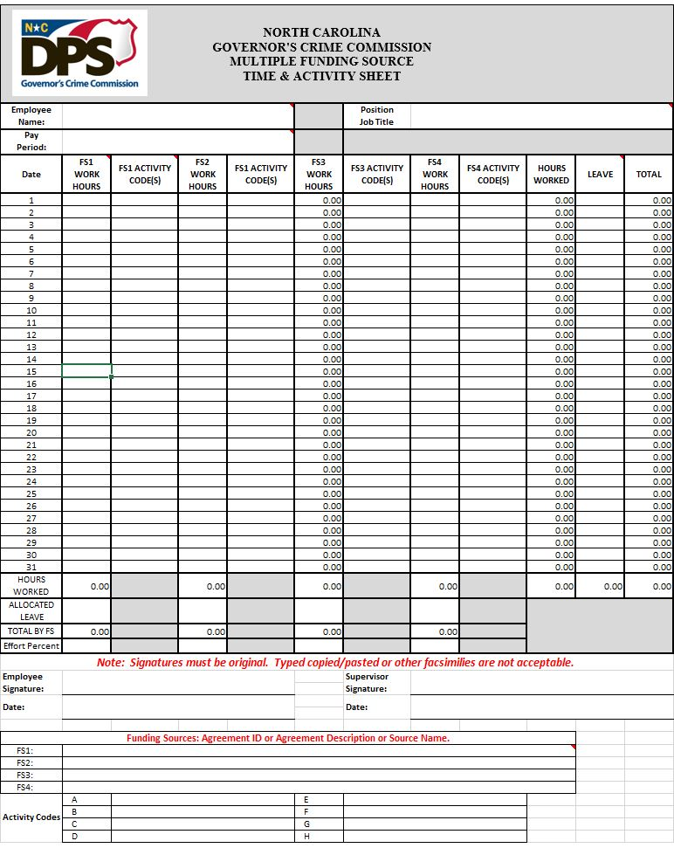

Slide 24
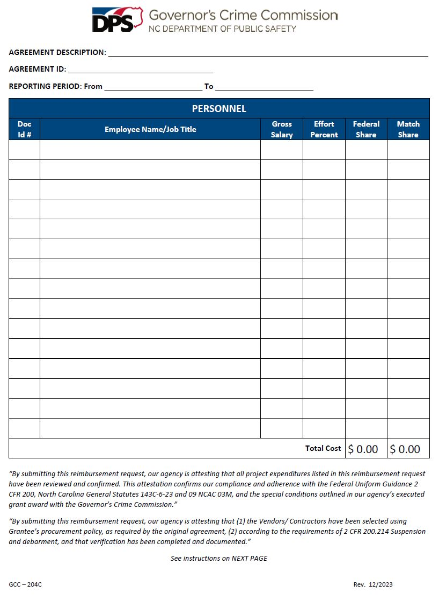
24

Slide 25
Supporting Documentation
Equipment
25

Slide 26
Supporting Documentation
Receipts, invoices, or any other documentation supporting the purchase
Copies of three bids from vendors if any piece of equipment is $10,000 or more.
If a particular supplier is the sole provider of goods and services, a completed Sole Source Provider form with justification must be submitted for prior approval.
Equipment purchased with grant funds and a value of $5,000 or more require property tags
Sub-recipient must maintain a “Property Control Record and Equipment Certification Form” for ALL equipment purchased through grant funds, per GCC Grant Management Guidelines and 2 CFR Part 200.313 (d).
Keep these documentation updated for site reviews and auditors
26

Slide 27
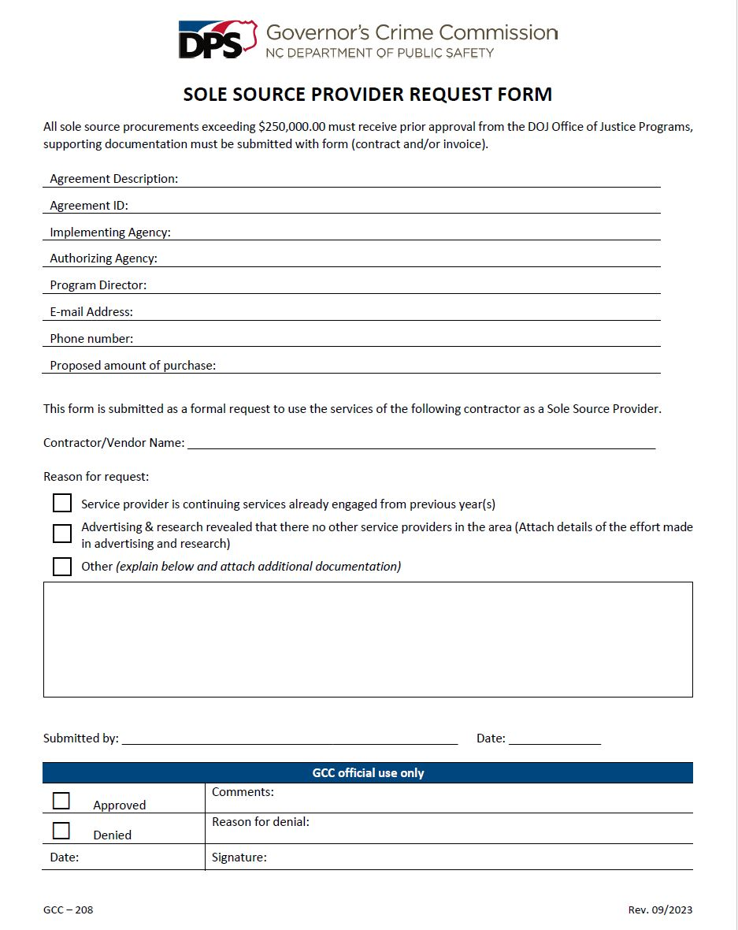
27

Slide 28
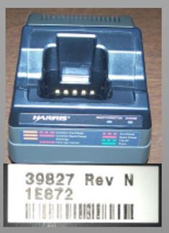
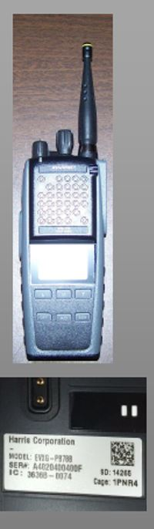

Equipment Must Have A Property Tag
28

Slide 29
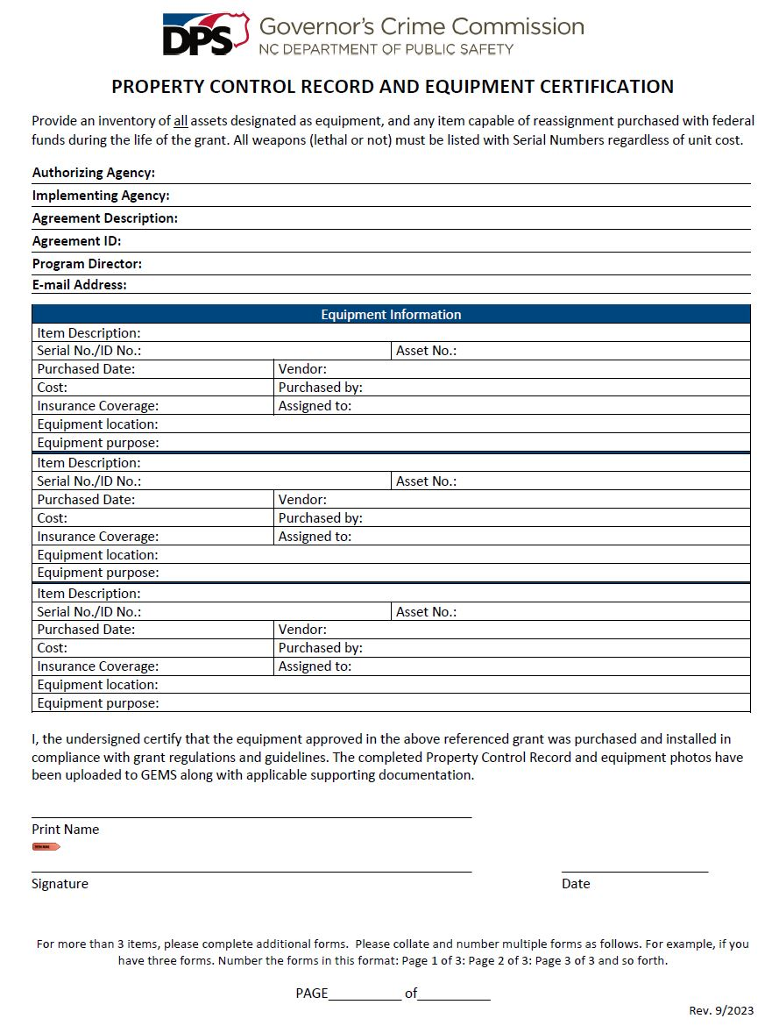
29
Notes:
This form has a second page for additional equipment

Slide 30
30
Notes:
Delete this slide

Slide 31
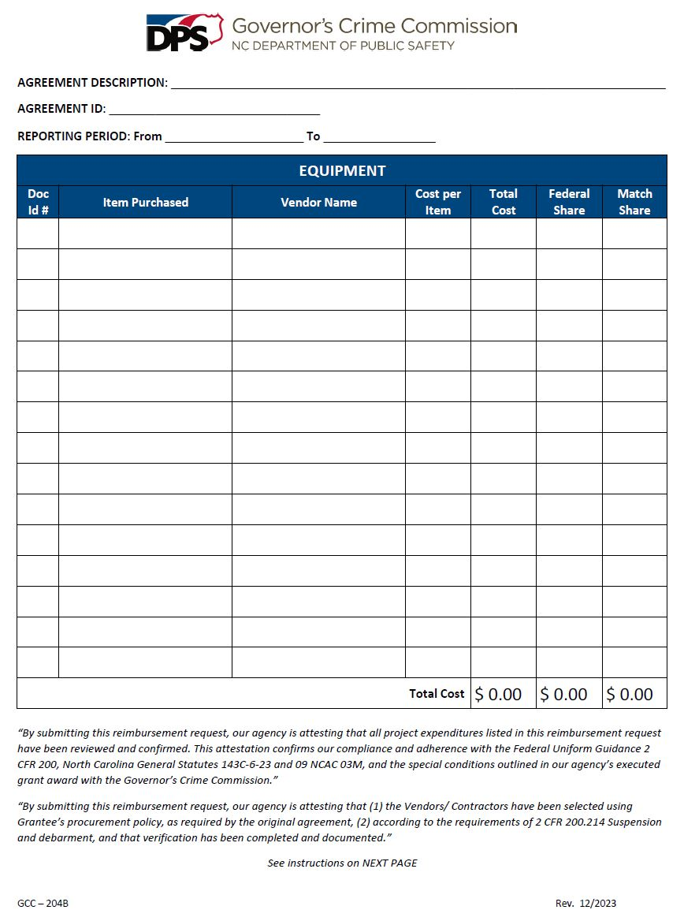
31

Slide 32
Equipment Updates
Disposition
  The disposition threshold has increased to $10,000 (from $5,000)
  Subrecipient may retain $1,000 to cover expenses associated with the selling and handling of the equipment.
  For additional information see 2 CFR 200.313
32

Slide 33
Equipment Updates
Special Purpose Equipment
  The adjusted dollar value for special purpose equipment requiring prior approval increased to $10,000 (from $5,000)
  For additional information see 2 CFR 200.439
33

Slide 34
Supporting Documentation
Consultants/Contractors
34

Slide 35
Consultants/Contractors
Pre-Contract Request Form and unexecuted contract must be approved by the Grant Administrator.
The executed contract must be submitted to the Grant Administrator for upload to EBS prior to requesting reimbursement.
35

Slide 36
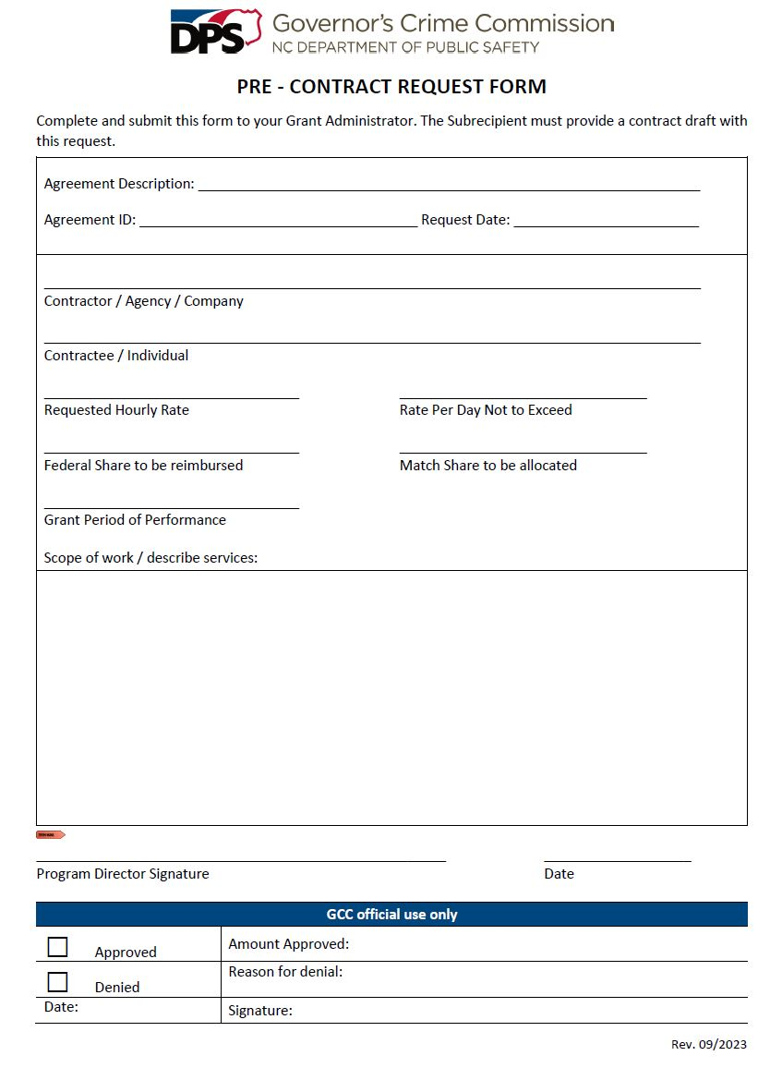
36

Slide 37
Consultants/Contractors
When submitting a reimbursement, a GCC Contractual Coversheet must be utilized.
Invoices from the consultant/contractor must clearly show:
  Vendor's name,
  Date(s) of services,
  Hours worked,
  Payment amount due for the services, and a
  List of what service(s) the contractor/consultant performed
The maximum rates for consultant/contractor is $81.25 per hour or $650.00 per day. If rates exceed these capped amounts a Contract Excess Rate Request Form must be submitted along with the Pre-Contract Request Form for GCC prior approval.
37

Slide 38
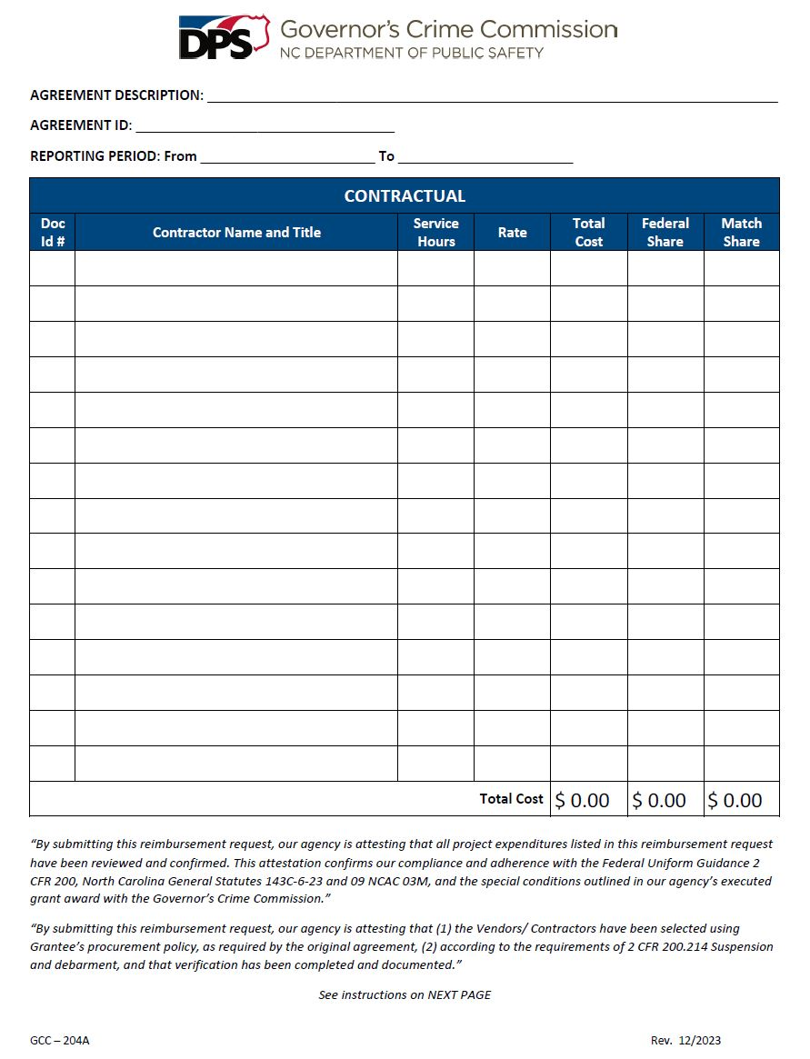
38

Slide 39
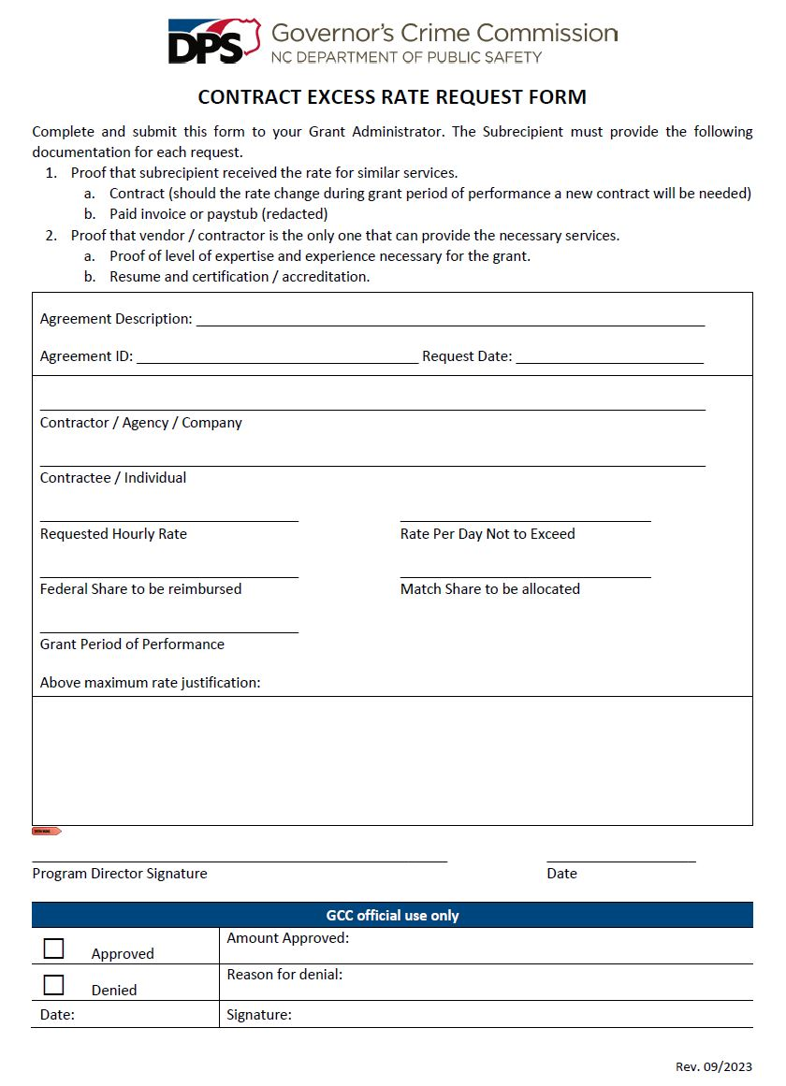
39

Slide 40
Consultants/Contractors
Examples of Consultants/Contractors:
Counselors
Lawyers
Software/hardware computer engineers
Therapists
Grounds maintenance staff
Improper Examples of Consultants/Contractors:
  Volunteers
  Board Members
  Employees
40

Slide 41
Supporting Documentation
Travel/Training
(Employees/Volunteers only)
41

Slide 42
Receipts
Conference registration
Conference agenda
Hotel, airline, taxi, rental car receipts
Meals and mileage based on agency’s travel policy, if the agency does not have a policy, then State per diem rates apply.
Employee mileage reimbursement forms and logs
Out of State Travel requires Prior Approval even though it may be approved in the budget. (A budget change request does not provide prior approval)
42

Slide 43
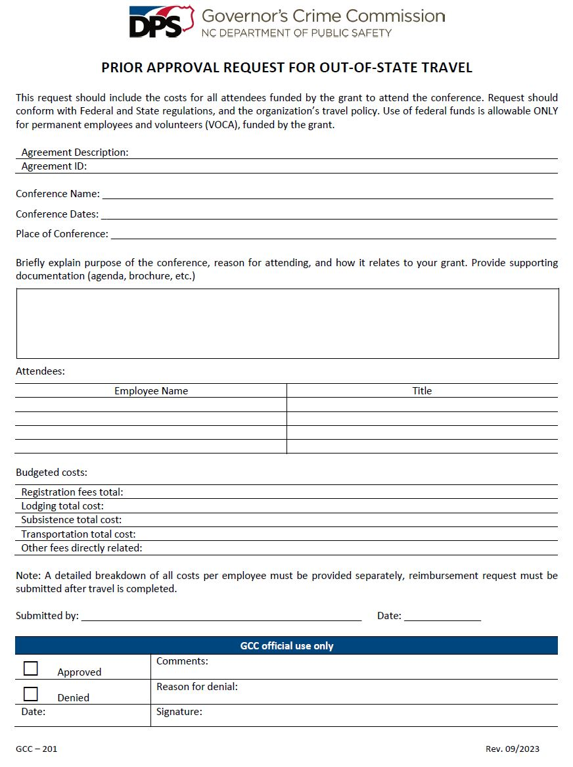
43

Slide 44
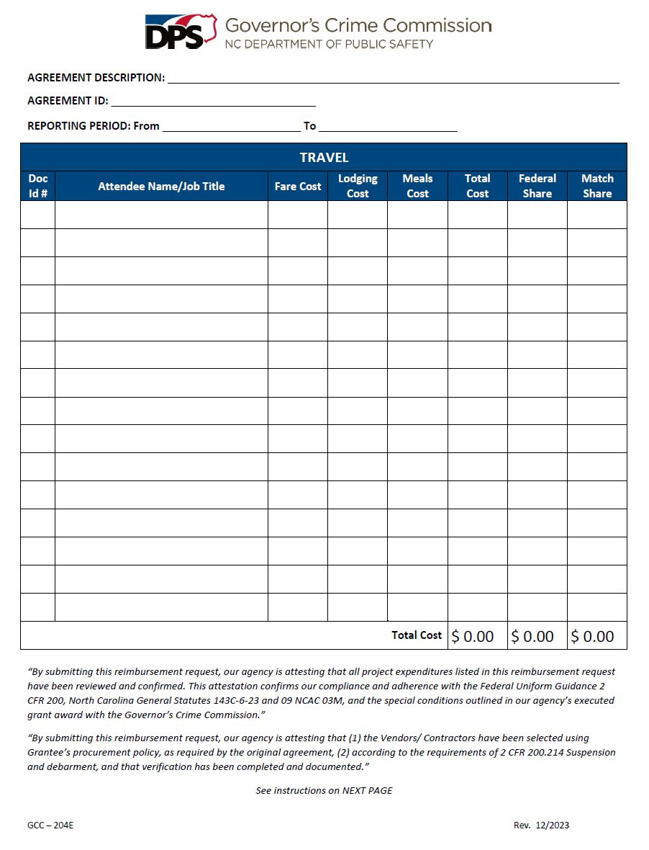
44

Slide 45
Supporting Documentation
Supplies
and
Operating Expenses
45

Slide 46
Supplies and Operating Expenses
Receipts, receipts, receipts
Vendor invoices, utility bills, proof of payment, payment receipts.
Rent receipts or copy of lease and proof of payment
Receipts and invoices must show the following:
Vendors name,
Date of service or purchase,
Amount due, and
List what services were performed or what was purchased
46

Slide 47
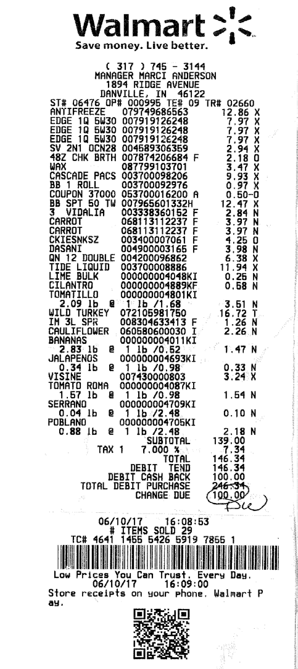
Receipts
There are three ways to allocate expenses from receipts across various grants:
  1. Make separate purchases for each grant and get separate receipts, one for each grant.
47

Slide 48
Receipts
2. Make a combined purchase and attach documentation explaining what items were purchased for each grant. Submit copies of the supporting documentation with all grant reimbursement claims.
Grant #xyz1
Grant # xyz2
The remaining items purchased.
Edge 1Q5W30 | 12.86
Edge 1Q5W30 | 7.97
Edge 1Q5W30 | 7.97
48

Slide 49
Receipts
3. Make a combined purchase and make a copy of the receipt for each grant highlighting the receipt showing which items were charged to that specific grant. Submit copies of the supporting documentation with all grant reimbursement claims.
Note: Sales tax is not allowable expense, exemptions apply.
Yellow | Grant # xyz3 | $39.34
Blue | Grant # xyz4 | $81.38
Green | Grant # xyz5 | $25.62
49

Slide 50
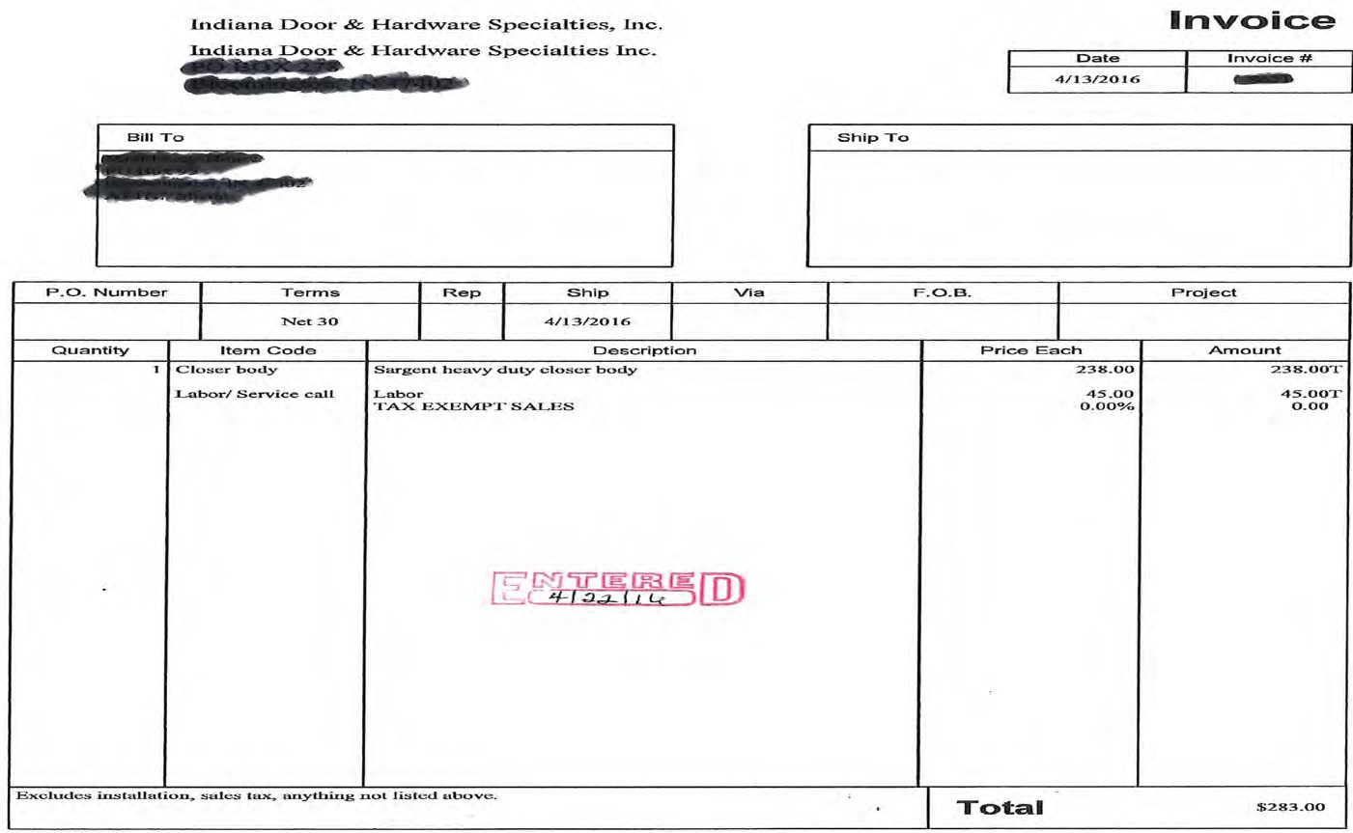
Vendor Invoice
MUST PROVIDE PROOF OF PAYMENT WITH THE INVOICE
0
50

Slide 51
Forms of Proof of Payment
Accepted proof of payment:
Cleared/cancelled check – Copies of check front and back, cleared checks are available as scanned images from the online bank account.
Credit card or Bank statement – Should contain cardholder address, purchase amount, credit card showing monthly payment and all other details relevant to the particular transaction for which reimbursement is requested.
51

Slide 52
Forms of Proof of Payment
Bank statement showing expense cleared
Cleared/cancelled checks front and back
Invoice showing balance paid
Receipts showing the expense was paid
52

Slide 53
Receipts
A receipt is any document that contains the following five IRS-required elements:
  Name of vendor (who: person or company that received payment)
  Transaction date (when: date of payment, purchase date)
  Detailed description of goods or services purchased (what: items purchased, or services received)
  Amount Paid
  Form of payment (how: cash, check, or last four digits of credit card)
53

Slide 54
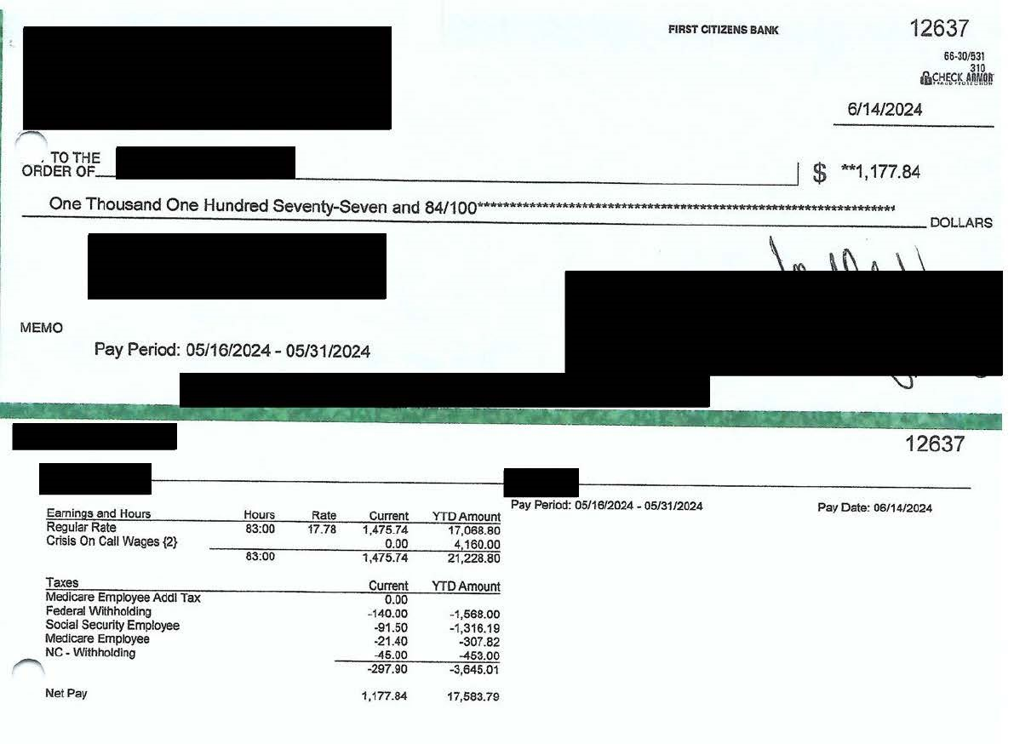
Proof of Payment Example
54

Slide 55
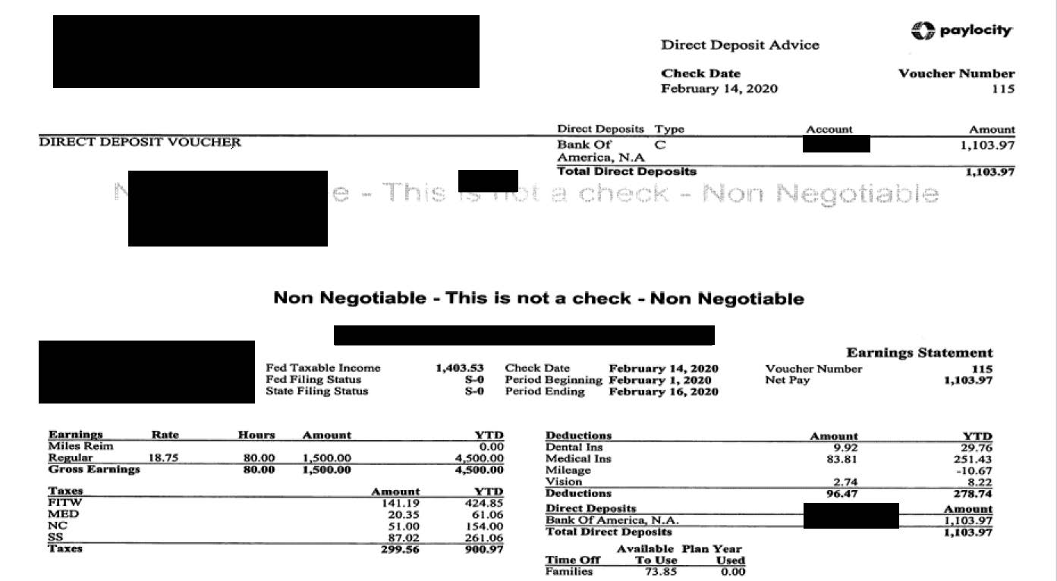
Proof of Payment Example
55
Notes:
Direct Deposit advice

Slide 56
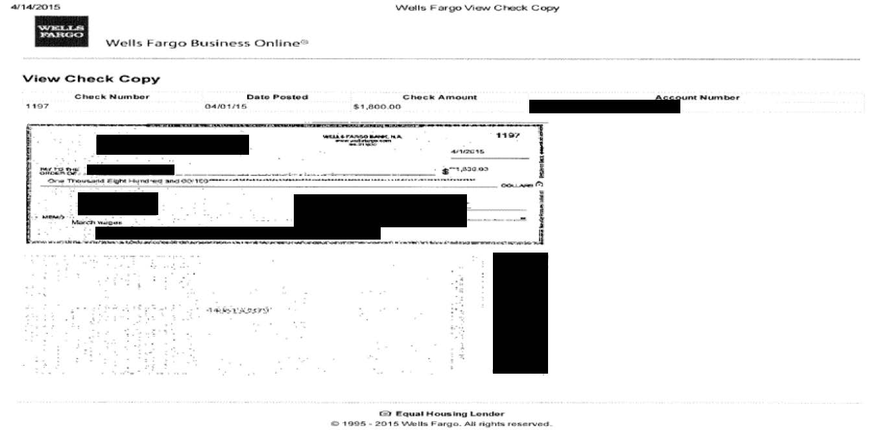
Proof of Payment Example
56
Notes:
Cleared check front and back.

Slide 57
Supplies expenses
Office supplies
  Equipment (cost under $5,000)
  Project specific office supplies
Program supplies
  Materials and other goods supplied for the execution of the program.
57

Slide 58
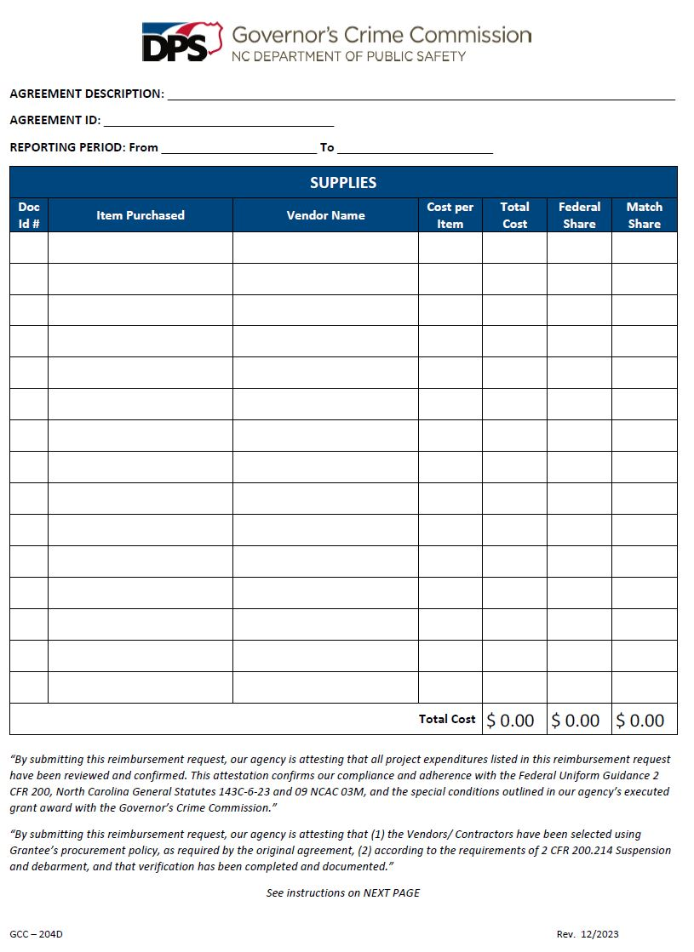
58

Slide 59
Operating Expenses
The normal cost of operating your agency.
Operating expenses may include:
  Rent (not mortgage)
  Payroll costs
  Insurance costs
  Utilities expenses
  Cleaning services
59
Notes:
New Slide inserted. RZL

Slide 60
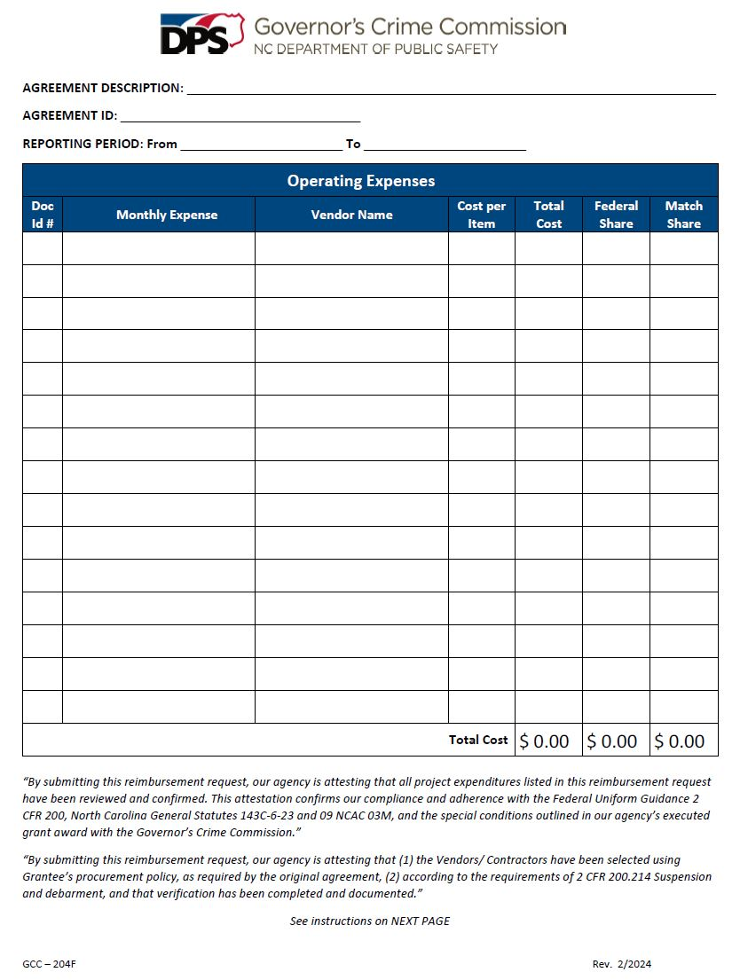
60
Notes:
New Slide inserted. RZL

Slide 61
Match
Cash Vs. In-Kind
61

Slide 62
What is Match?
Cost sharing or matching means the portion of a project costs not paid by the Federal funds. Also known as grantee share. As defined by 2 CFR 200.29
Costs incurred as match for the program's operations have the same restrictions and regulations as costs that will be reimbursed through Federal grant funds. If the cost is not allowable under the federal award, it is not allowable as match.
Unless a project’s match has been waived, a required match must be met according to Federal guidelines prior to the close of the grant.
62

Slide 63
What is Match?
Match requirements are always a specific percentage of the total project costs for an award.
For example: a 20% match on a $100,000 project would be $20,000, where $80,000 is provided by the Federal Government and $20,000 is provided by the sub-recipient.
63

Slide 64
Cash Match
Cash match (hard match) includes cash spent for project-related costs. Qualifying cash match contributions must come from approved sources as required by federal regulations, except acquisition of land, when applicable.
    Cash match is either the grantee’s own funds, general revenue, or cash donations from non-federal third parties or non-federal grants.
64

Slide 65
Cash Match
Budget Lines that can be utilized as cash match:
  Salaries/Benefits
  Travel
  Equipment
  Supplies and Operating Expenses
  Consultants/Contractors
If you do not achieve your cash match goal, you may be required to refund a portion of the Federal funds.
65
65

Slide 66
In-Kind Match
Third party in-kind match (soft match) includes, but is not limited to, the valuation of non-cash contributions. “In-kind” may be in the form of services, supplies, real property, and equipment.
      In-kind donations are non-cash donations of goods or services that can be given a cash value and are used in achieving your program objectives.
For example: If in-kind match is permitted by law, then the value of donated services can be used to comply with the match requirement; third party in-kind contributions may count toward satisfying match requirements, provided the recipient of the contributions expends them as allowable costs.
66

Slide 67
In-Kind Match
Donations of space, equipment, clothing, or items to be utilized to further the grant’s goals and objectives.
Must use fair market value to determine the allowable value of donated items.
Volunteer Hours must be documented and supported by the same methods as any other regular employee.
Requires time and attendance records similar to employees to show daily hours worked; timesheets must be signed by volunteer and an Approving Official. The timesheet must also include a short description of the work performed. The volunteer services must be used for the grant.
Hourly rate must be reasonable and similar to others performing the same job function.
67

Slide 68
2 C.F.R. Subpart D, 200.306
Match criteria
  Are verifiable from the sub-recipient’s records
  Are not included as contributions for any other federal grant
  Are necessary and reasonable for accomplishment of project or program objectives
  Are allowable costs
  Are not paid by Federal funds from another grant or award
  Are approved in the grant budget
  Conform to the provisions of 2 C.F.R. 200, Subpart D, 200.306 (b)
68

Slide 69
Match
Items / costs utilized for match are subject to the same supporting documentation rules previously reviewed for expenditures made with grant funds.
Recipients and sub-recipients must maintain records that clearly show the source, amount and timing of all match contributions.
Though matching contributions do not need to be applied at the exact time or in proportion to the obligation of the Federal funds; applying match contribution at the end of the project’s period of performance will negatively impact the project’s Utilization / Expenditure rate for both Federal and Match funds.
The full matching share must be contributed by the end of the award period.
69

Slide 70
Year End Match
In-kind match contributions must be documented. Subrecipients must ensure that the following information is clearly documented:
  Who is the source?
  What was donated?
  How was the value determined?
  Who verified the information?
70

Slide 71
Reporting
71

Slide 72
Reporting
Timely reporting is critical to GCC’s continued funding.
GCC needs the sub-recipients’ report to complete its own reports to the Federal awarding agencies in an accurate and timely fashion.
Sanctions will be imposed on sub-recipients who fail to report timely.
72

Slide 73
Required Reports
Due Dates
Required Reports | Due Dates
Contracts for Prior Approval with Pre-Contract request form | Immediately
Expense Reimbursements Report monthly expenses as they are incurred | Monthly
Performance Reports | Quarterly
Progress Reports | Annually
Note: You will hear more about these in the reporting presentation.
73

Slide 74

Project Progress Reports
All projects funded by the GCC must provide an annual report
Progress Reports align with the stated goals and objectives included in your grant application
74

Slide 75
Audit (Financial) Reporting
North Carolina state law requires every nongovernmental entity that receives State or Federal pass-through grant funds from a state agency to file annual reports on how those grant funds were used. See G.S. 143C-6-23: administration; oversight and reporting requirements.
Specific requirements for each funding level are as follows:
75
Notes:
Read from the slide.

Slide 76
Non-Governmental Entities
Required Reporting
Reporting Levels | Required Documents
Level I (Less than $25,000) A grantee receiving less than $25,000 (combined) in State or Federal pass- through funds must submit: | Certification Form State Grants Compliance Reporting for Receipts of Less than $25,000 Level I forms and reporting must be submitted to: DPS_GRANTCOMPLIANCEREPORTS@ncdps.gov
76

Slide 77
Non-Governmental Entities
Required Reporting
Reporting Levels | Required Documents
Level II ($25,000 - $499,999) A grantee that receives between $25,000 - $499,999 (combined) in State or Federal pass-through funding must submit: | Certification Form State Grants Compliance Reporting for Receipts of $25,000 or More Schedule of Receipts and Expenditures Program Activities and Accomplishments Reports Level II forms and reporting must be submitted to: DPS_GRANTCOMPLIANCEREPORTS@ncdps.gov
77

Slide 78
Non-Governmental Entities
Required Reporting
Reporting Levels | Required Documents
Level III ($500,000 - $1,000,000) A grantee that receives a combined $500,000 or more in North Carolina State funding or Federal funding passed through a State Agency must submit: | Certification Form State Grants Compliance Reporting for Receipts of $25,000 or More Program Activities and Accomplishments Reports Level III forms and reporting must be submitted to: DPS_GRANTCOMPLIANCEREPORTS@ncdps.gov Submit within nine months of the grantee's fiscal year end: Submit to DPS Internal Audit to: AuditGrantsReport@ncdps.gov A single audit prepared and completed in accordance with Generally Accepted Government Auditing Standards (GAGAS)
78

Slide 79
Non-Governmental Entities Required Reporting
Reporting Levels | Required Documents
Level III ($1,000,000+) A grantee that receives a combined $1,000,000 or more in funding from all federal funding sources, even those passed through a state agency must submit: | Certification Form State Grants Compliance Reporting for Receipts of $25,000 or More Program Activities and Accomplishments Reports Level III forms and reporting must be submitted to: DPS_GRANTCOMPLIANCEREPORTS@ncdps.gov. Submit within nine months of the grantee's fiscal year end: Submit to DPS Internal Audit to: AuditGrantsReport@ncdps.gov A single audit prepared and completed in accordance with Generally Accepted Government Auditing Standards (GAGAS) Post the single audit to the Federal Audit Clearinghouse (FAC). Submit to: FAC.gov Make copies of the single audit available to the public.
79

Slide 80
Additional Information
80

Slide 81
Resources
Grant Forms: https://www.ncdps.gov/about-dps/boards-and-commissions/governors-crime-commission/criminal-justice-grants/grant-forms
Grants Management Guidelines: Insert link
2 C.F.R. 200: https://www.ecfr.gov/current/title-2/subtitle-A/chapter-II/part-200?toc=1
Request Access to EBS (open with Chrome): https://www.ebs.nc.gov/sap/crmaccess/
U.S. General Services Administration:
https://www.gsa.gov/travel/plan-book/per-diem-rates
81

Slide 82
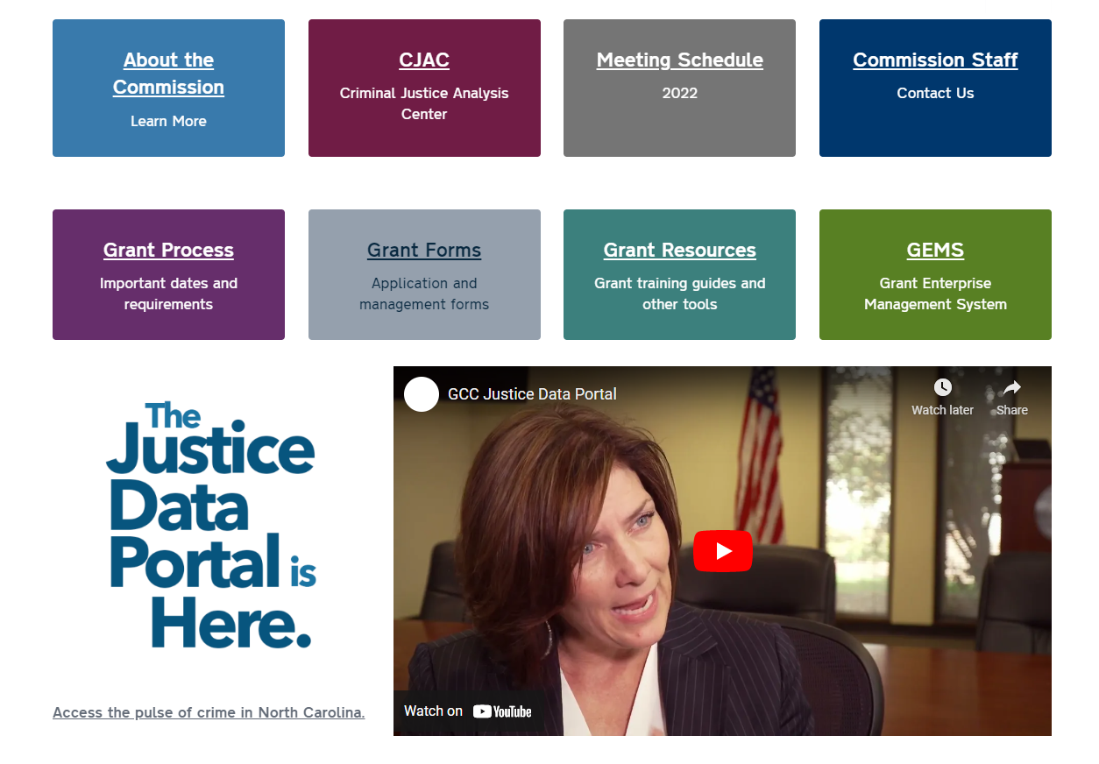
www.ncdps.gov/GCC
82

Slide 83
Technical Assistance
If you have any questions or concerns do not hesitate to contact your grants administrator. We are here to help!
83

Slide 84
Thank you!
84

