Slide 1
Grant Application Tips and Tricks
Governor’s Crime Commission
October 30, 2024

Slide 2
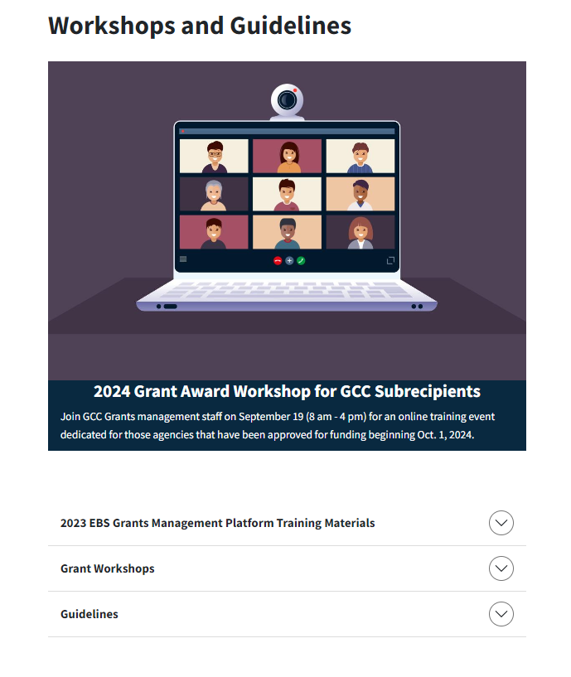
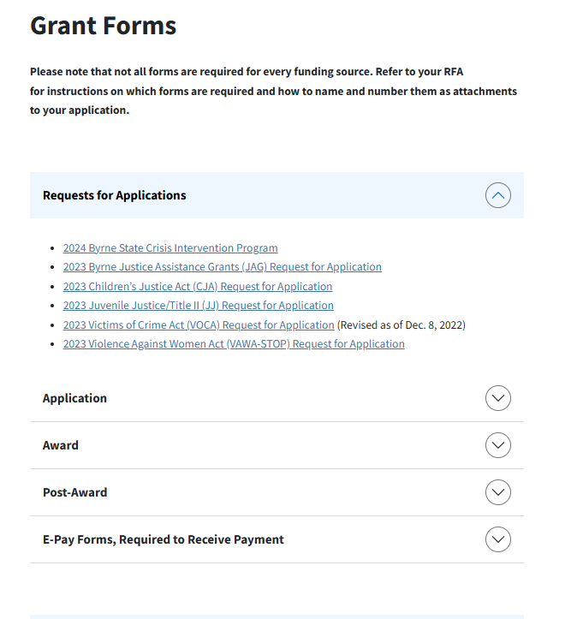
Tip: Prepare Early… Read (and re-read) the RFA!
Note Important Dates
Review Application Instructions
Gather Required Documents ASAP
Notes:
The RFA is a type of solicitation notice where we announce the availability of grant funds. It is important to note that each team has developed RFAs for each funding source administered. These funding sources have requirements that are specific to the program, so it is important to familiarize yourself with the respective requirements. This year, our application period has changed to December 1 – Jan 31st; however, the RFA will be posted and available for review on November 1st.

Slide 3
Summary of Key Dates
Activity | Tentative Date
Release Request for Applications | November 1, 2024
Applications Open in EBS | December 1, 2024
Application Deadline to the GCC No later than 11:59 p.m. | January 31, 2025
Commission Vote for Approved Applications | June 2025
Grant Award Workshop (mandatory for funded projects) | September 2025
New Award Start Date | October 1, 2025
Title II/Juvenile Justice Start Date | January 1, 2026
Notes:
The end of each RFA contains a Summary of Key Dates – mark your calendars early!

Slide 4
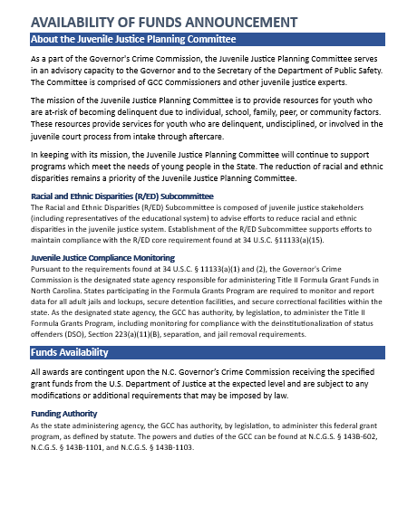
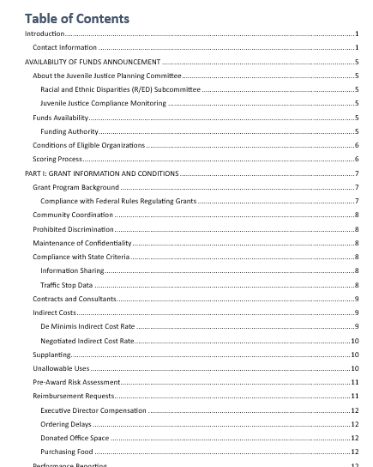
Navigating the RFA
Table of Contents
Grant Information and Conditions
Program Priorities
Application Access Requirements
Application Guide with Sample Screens
Resources
Notes:
Introduction has great information about the Committees for each funding source and standard eligibility guidelines.
I. Info about the specific grant program and the important general requirements and processes
II. Program Priorities for the specific funding source and any application submission rules
III. Application Access Requirements identifies system requirements, such as establishing an NCID and requesting access to the new grant management system
IV. Application guide provides sample screens for navigating the application in the new grants management system
V. Resources – a new addition to the RFA. We have identified various tools that may help shape your GCC grant proposal.

Slide 5
Required Documents and Certifications
501(c)(3) Verification (non-profit agencies)
IRS Form 990 (non-profit agencies) (must be the most recent fiscal year’s form)
Board of Directors List (non-profit agencies)
Single Audit Certification
No Overdue Taxes Certification (non-profit agencies)
Indirect Costs Certification, Federally Negotiated/De Minimis
Civil Rights Checklist & Certification
Lobbying, Debarment, and Suspension Certification
NCID Acceptable Use Policy Certification
Confidentiality Certification
Advance Determination of Suitability for Interacting with Minors
Conflict of Interest Policy
Data Breach Policy
Overtime Pay Policy
Procurement/Purchasing Policy
Record Retention Policy
Travel Policy
Unlawful Discrimination Policy
Whistleblower Policy
Notes:
There are a number of documents listed within the RFA that are required as part of your application submission. Submission of your application without the required documentation may disqualify you from consideration for funding. Some documents may take time to either develop or have approved by your agency’s standards, so it is important to gather this documentation early. Do note that each funding source has additional required documents called “project specific documents” – these vary based on funding source. Make sure that you are submitting the correct documentation!

Slide 6
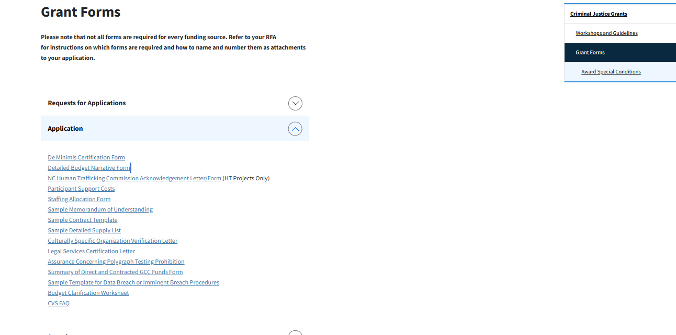
GCC Website: https://ncdps.gov/gcc
Notes:
Certification forms and sample documents can be found on the Forms section of the GCC’s website.

Slide 7
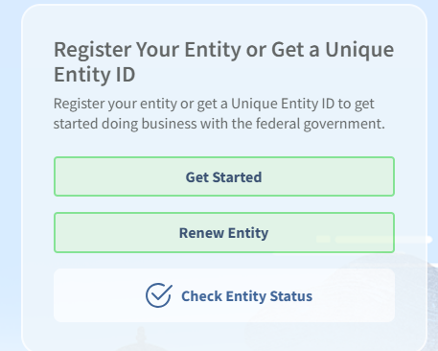
Tip: Make System Access a Priority
Gaining access to systems may take time – do not wait until the last minute
UEI Number
NCID
EBS Platform
Notes:
There are separate systems that you will need access to, and GCC does not control these systems. Instructions for accessing these systems can also be found within the RFA. We do have a new grants management system, which was discussed earlier today. NCID is still a requirement for accessing this system. Guidance for accessing each of these platforms can be found on the Grant Information section of the GCC website.

Slide 8
Enterprise Business Solutions (EBS) https://www.ebs.nc.gov/sap/crmaccess/
NCID is required for EBS access
Access to EBS must be requested – there may be a delay in approval
Officials must also have access to the system
Notes:
While GCC staff are here to support you, we cannot assist with system issues. Note that there is some guidance on navigating EBS in the RFA, there is a detailed EBS training manual online in the grant management system.

Slide 9
Identify the Correct Officials
OFFICIAL ROLE | REQUIRED AGENCY CONTACT
Authorizing Official | Nonprofits: Board Chair (must not be an employee of the agency) State Government: Department Secretary Local Government: Town, City, or County Manager Law Enforcement Agencies: County or City Manager
Financial Officer | Nonprofits: Board Treasurer (must not be an employee of the agency) State Government: Chief Financial Officer or Department Finance Officer Local Government: Finance Director Law Enforcement Agencies: Agency Finance Director
Project Director | Nonprofits: Executive Director or appointed project staff responsible for overseeing the work of the project State Government: Designee responsible for overseeing the work of the project Local Government: Designee responsible for overseeing the work of the project Law Enforcement Agencies: Designee responsible for overseeing the work of the project
Notes:
As with previous years, there are requirements for the roles of Officials associated with your application. Depending on the type of agency and your internal processes, it may take more work to communicate with the necessary parties. Note that the officials are also required to have established NCID accounts and access the EBS platform.

Slide 10
Tip: Use Available Resources to Benefit Your Program and Community
Collaboration is Key
Proposals Need Data
RFA Resources Section

Slide 11
Collaboration Benefits All
GCC supports comprehensive projects that include collaborative partnerships, including:
Partnerships with multiple agencies to leverage impact
Illustrate coordinated public and private efforts
Consider long term sustainability of initiatives
How will you use new or existing resources to continue this project after the grant ends?
Is there another source of funding?
How will you involve the community and engage decision makers in order to continue addressing community needs identified in your proposal?
Notes:
Including human service agencies, court and criminal justice agencies, nonprofit agencies, universities, etc.
There has been a lot of communication from the GCC related to decreases in federal funding. While scarce funding may increase competition for grants, it is more necessary to collaborate with partners in your community in order to continue the delivery of services and resources across the State
Partnership agreements, such as MOUs and sample contracts, should be uploaded with the submission of your proposal. That said, request documentation illustrating community partnerships early in the application process.

Slide 12
Include Data Wherever Possible
Use numbers, percentages, and ratios to strengthen your proposal
Use well-documented data from public databases, surveys, and internal or local/statewide/national research
Data should define the problem that your project seeks to address
Statistics
Local Information
Notes:
Michelle Beck from our Criminal Justice Analysis Center will be closing out the workshop with a presentation on utilizing data for stronger applications

Slide 13
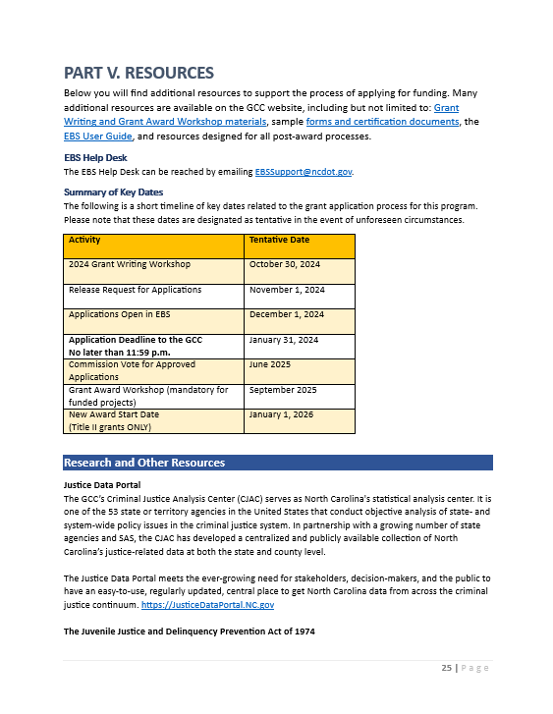
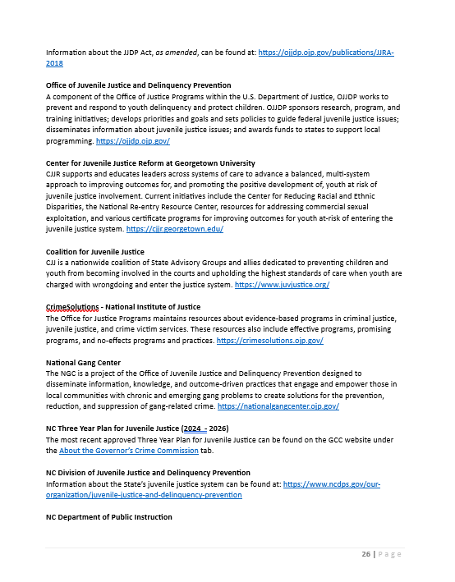
RFA Resources Section
Research and Other Resources
Glossary of Terms
Scoring Matrix
Notes:
The Resources section of the RFA includes many useful tools, including contact information for the EBS Help Desk, Information re: the FAQ, a Summary of Key Dates, Research and Other Resources, a glossary of common terms, and a scoring matrix.
Under “Research and Other Resources”, each RFA has included links to external resources specific to each funding source. These are designed to help strengthen the data and information included in your proposal and many highlight evidence-based and promising programs that may be implemented in your communities. In addition, there is information regarding the Justice Data Portal, which is maintained by the GCC’s Criminal Justice Analysis Center.

Slide 14
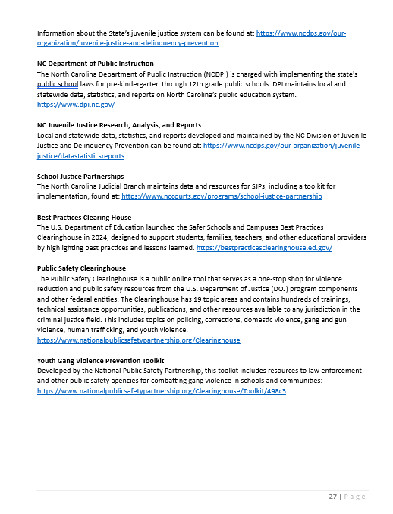
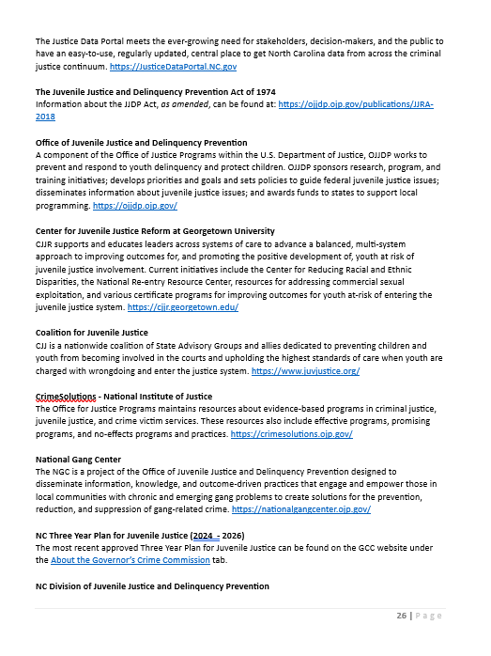
Research and Other Resources
Notes:
Under “Research and Other Resources”, each RFA has included links to external resources specific to each funding source. For example, the juvenile justice RFA has information regarding our State’s juvenile justice system and information related to youth gang prevention, which VOCA and VAWA may include resources specific to domestic violence response.
These resources are designed to help strengthen the data and information included in your proposal, and many highlight evidence-based and promising programs that may be implemented in your communities. In addition, there is information regarding the Justice Data Portal, which is maintained by the GCC’s Criminal Justice Analysis Center.

Slide 15
Tip: Scoring Matrix as a Tool for Success
Application Section | Limit | Potential Points
Project Abstract (The Problem) | 1300 characters | 20 points
Partners and Collaboration | 1300 characters | 10 points
Project Narrative | 1300 characters | 30 points
Project Timeline of Activities | n/a | 10 points
Goals and Objectives | n/a | 30 points
Notes:
Within the application is a scoring rubric that highlights the points potential for each section of the application. The matrix identifies scoring ranges to support your understanding for what makes a stronger application vs an application that may not score as high. Use this to your advantage and maximize the potential score of your application.

Slide 16
SMART Goals and Objectives
S | PECIFIC
M | EASUREABLE
A | CHIEVABLE
R | EALISTIC
T | IME-BOUND
Notes:
Goals and objectives must be specific, measurable, attainable, relevant, and time-bound (SMART).
In a broad sense, goals are general statements of what you seek to achieve. Objectives describe how you will achieve the goals of the project. Please also include how you intend to evaluate your progress.
Funded projects report on the progress of their goals and objectives annually in what is called the GCC Progress Report.

Slide 17
Application Deadline: January 31, 2025
GCC Website
RFA
Eligibility Conditions
Program Requirements
Important Dates
Supporting Documents
GCC Resources

