Slide 1
VAWA STOP
Reporting Requirements
September 19, 2024
Presented by:
Daun Brown-Hairston, Lead VAWA Planner
Amanda Endicott, VAWA Planner

Slide 2
Why do we REPORT?
Victim
Funder
Program
Community
A performance report can help us all collect, analyze, and report back information to guide us in decision-making. Measuring the impact of your program’s performance can help us understand whether you’re successfully meeting your mission and vision, and how you might adapt to be more successful.
The NC Governor’s Crime Commission (GCC) and Federal Funders like the Office on Violence Against Women (OVW), request performance measurement data as part of grant applications.
Effectiveness of VAWA funding statewide / nationwide
Supports continued funding to North Carolina
The data guides funding priorities and is available to public (2022)
Notes:
Share this link in chat.
A Conceptual Framework for Measuring Criminal Justice Success in Responding to Violence Against Women Act (VAWA) Crimes.
chrome-extension://efaidnbmnnnibpcajpcglclefindmkaj/https://www.vawamei.org/wp-content/uploads/2024/02/CJO_Dataset-Inventory_072022.pdf
Copy of Biennial Report to Congress-sometimes Subgrantees are quoted through out the report, and you can also see data specific to the state of North Carolina (2022 most updated).
chrome-extension://efaidnbmnnnibpcajpcglclefindmkaj/https://www.vawamei.org/wp-content/uploads/2024/05/2022-Biennial-Report-to-Congress_FINAL.pdf

Slide 3


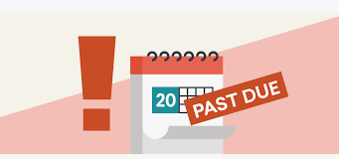

Missing
What happens if…
Incomplete/Inaccurate
Late
Decreased funding to North Carolina
Ineffectiveness of VAWA funded programs
Victims needs are lost/ignored/not accurately conveyed

Slide 4
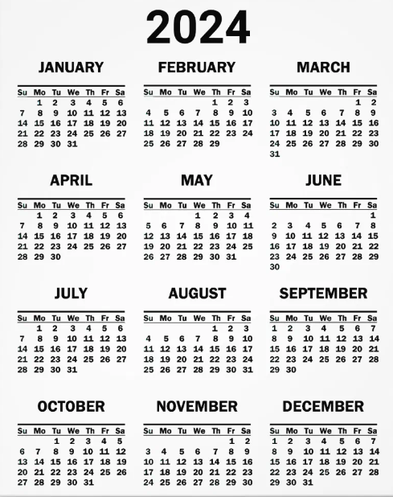
STOP Reporting Requirements
Reports are due annually at the beginning of the year, and again within 30 days of the agreement end date.
Grant Period of Performance:
10/1/24 – 9/30/25
1st Reporting Period : Oct 1 – Dec 31 (1st 3 months) Due Jan 30th
2nd Reporting Period: Jan 1 – Sept 30 (last 9 months) Due October 30th

Slide 5
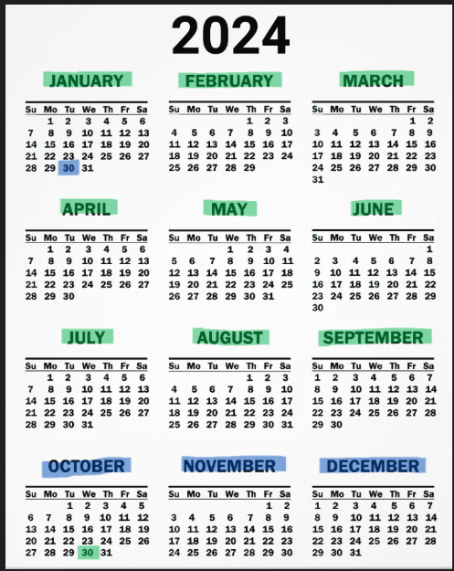
STOP Reporting Requirements
October 30th
January 30th

Slide 6

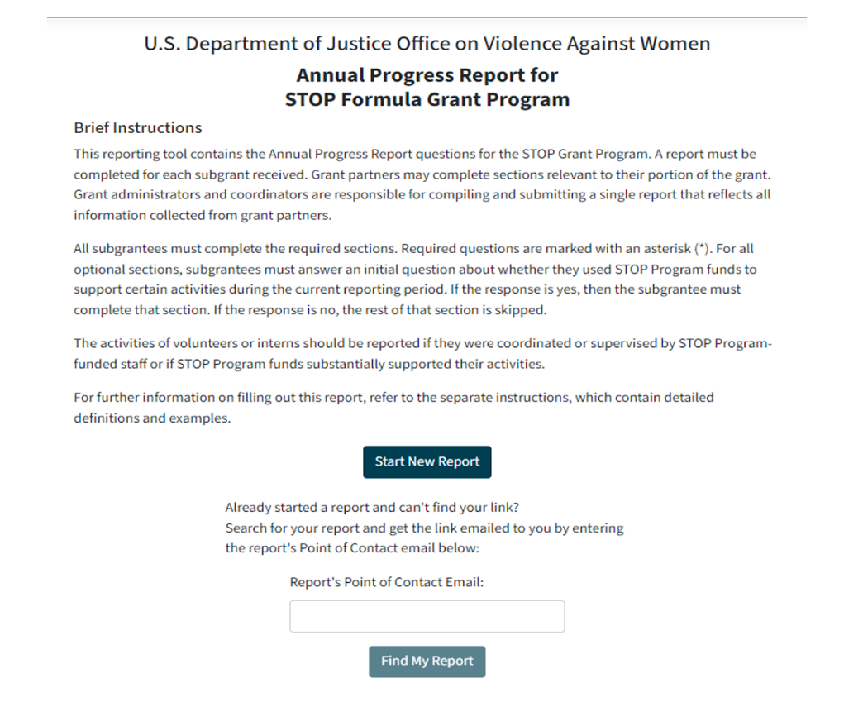

Accessing the STOP Report
1. New Reporting Tool : VAWA partners at the University of Maine and the Catherine Cutler Institute oversee the Measuring Effectiveness Initiative and have created a tool where all performance data will be submitted.
2. GCC VAWA Planner will have an account to create subrecipient report links and monitor submissions.
3. Subgrantees will use the link provided
by GCC VAWA Planner to access a blank
report and submit report data.

Slide 7
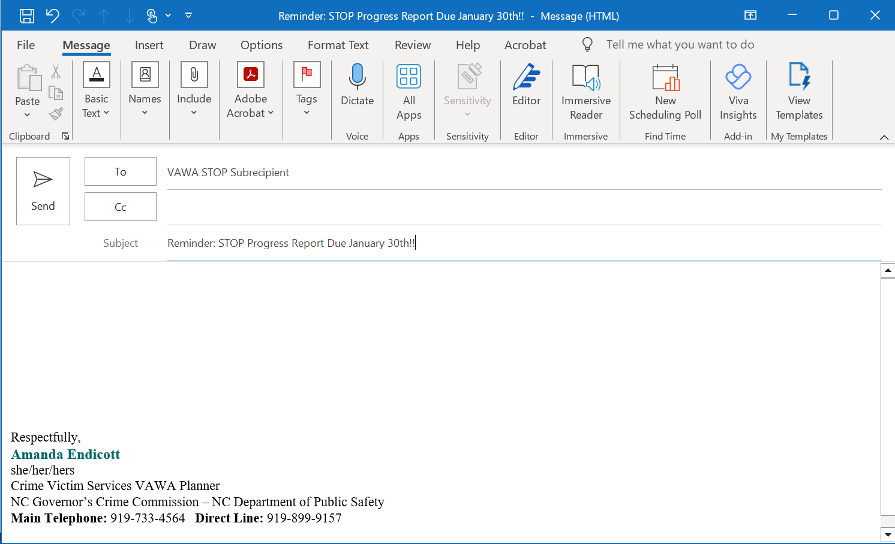
Accessing the STOP Report
Email Reminders
Grant Administrator
Greetings STOP Subrecipient,
Your VAWA STOP Progress Report for the period covering October 1, 2024-December 30th 2024 is due
No later than January 30th 2025. Use the link provided to access your Progress Report Form STOP Subgrantee Report Form_ee544w6
Helpful tools and resources to assist you with reporting:
If you have question, concerns, need assistance or do not think you will be able to submit your report on time, please contact me
as soon as possible.

Slide 8
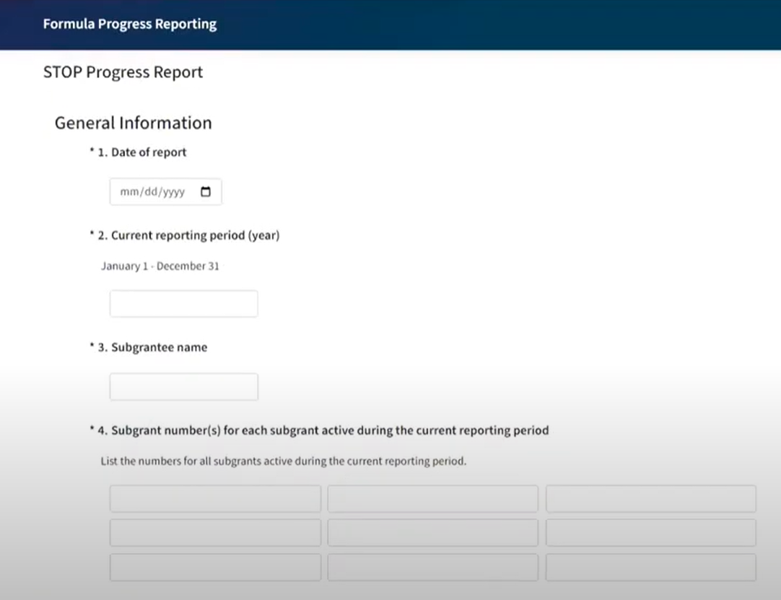
Completing the STOP Report
1st Reporting Period :
Oct 1, 2024 – Dec 31, 2024
2nd Reporting Period:
Jan 1, 2025– Sept 30, 2025
  Subgrant Number = Agreement ID (200007xxxx)-add all active grants
  *Read each question carefully, as some questions have changed, and some are new.

Slide 9
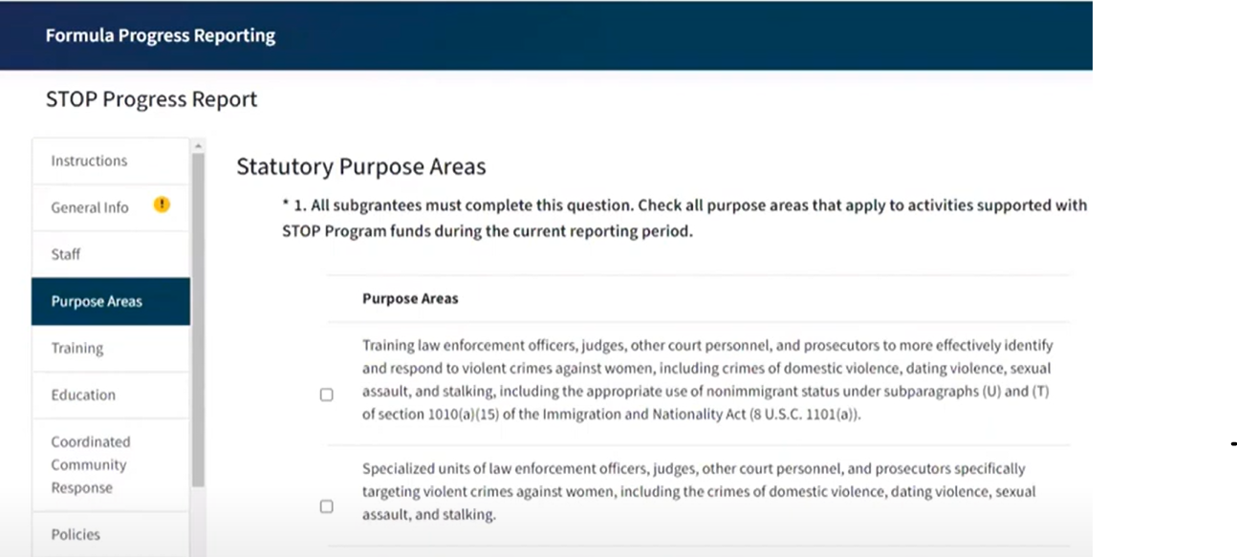
Completing the STOP Report
Purpose Areas
Be sure that the Statutory Purpose Area(s) that you select are consistent with those selected in your application.

Slide 10
Completing the STOP Report
Function Areas
TRAINING | VICTIM SERVICES
COMMUNITY EDUCATION/PUBLIC AWARENESS | LEGAL SERVICES
POLICIES & LEGISLATION | CASE INVESTIGATIONS
PRODUCTS | PROSECUTION
DATA COLLECTION & COMMUNICATION SYSTEMS | COURTS
SPECIALIZED UNITS | PROBATION & PAROLE
SYSTEM IMPROVEMENT | ABUSER INTERVENTION PROGRAM (DVIP)
If a section does not apply to your project agreement, click on the ‘No’ response and the tool will skip the question for you.

Slide 11
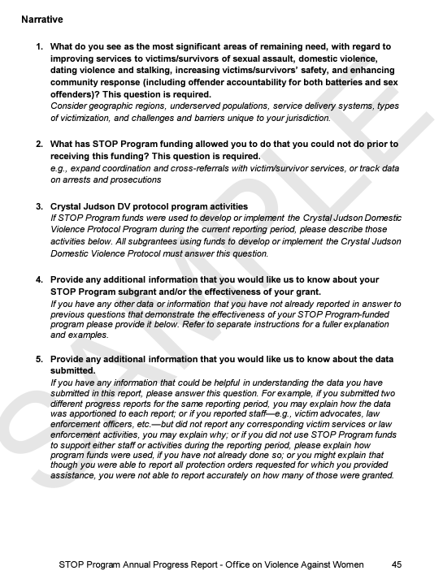
Completing the STOP Report
Narrative
All subrecipients must answer questions 1 and 2.
Subrecipients using funds to implement the Crystal Judson Domestic Violence Protocols must answer question 3.
Questions 4 and 5 are optional.

Slide 12
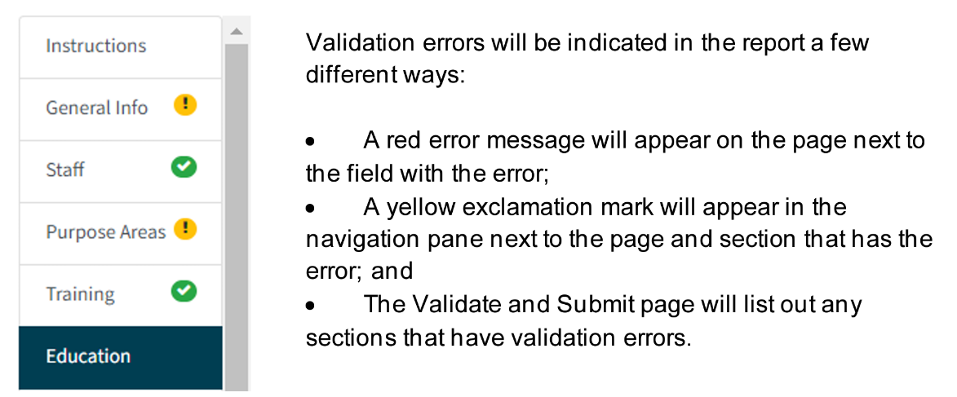
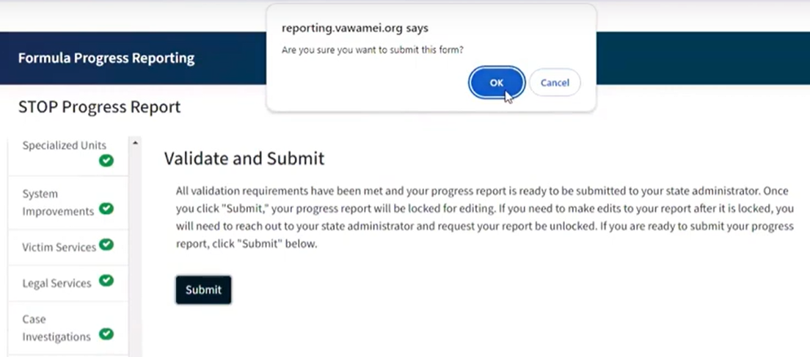
Completing the STOP Report
If you have errors or miss a question, the tool will notify you. You will not be able to submit your report until specified errors are corrected.
Once you have completed the STOP Report, press Submit . Your report will be validated and submitted to the VAWA team for review.

Slide 13

STOP Progress Report Requirements
You must upload a separate report in EBS for each STOP agreement.
Reports must be completed electronically.
Handwritten, scanned, incomplete and/or blank reports will not be accepted.
Information and data submitted should reflect the agreement’s grant funded activities completed during the specified time frame of the calendar year.
Keep a copy of all STOP reports for a minimum of 5 years.
Failure to submit the required report(s) could result in temporary or permanent suspension of funding.

Slide 14
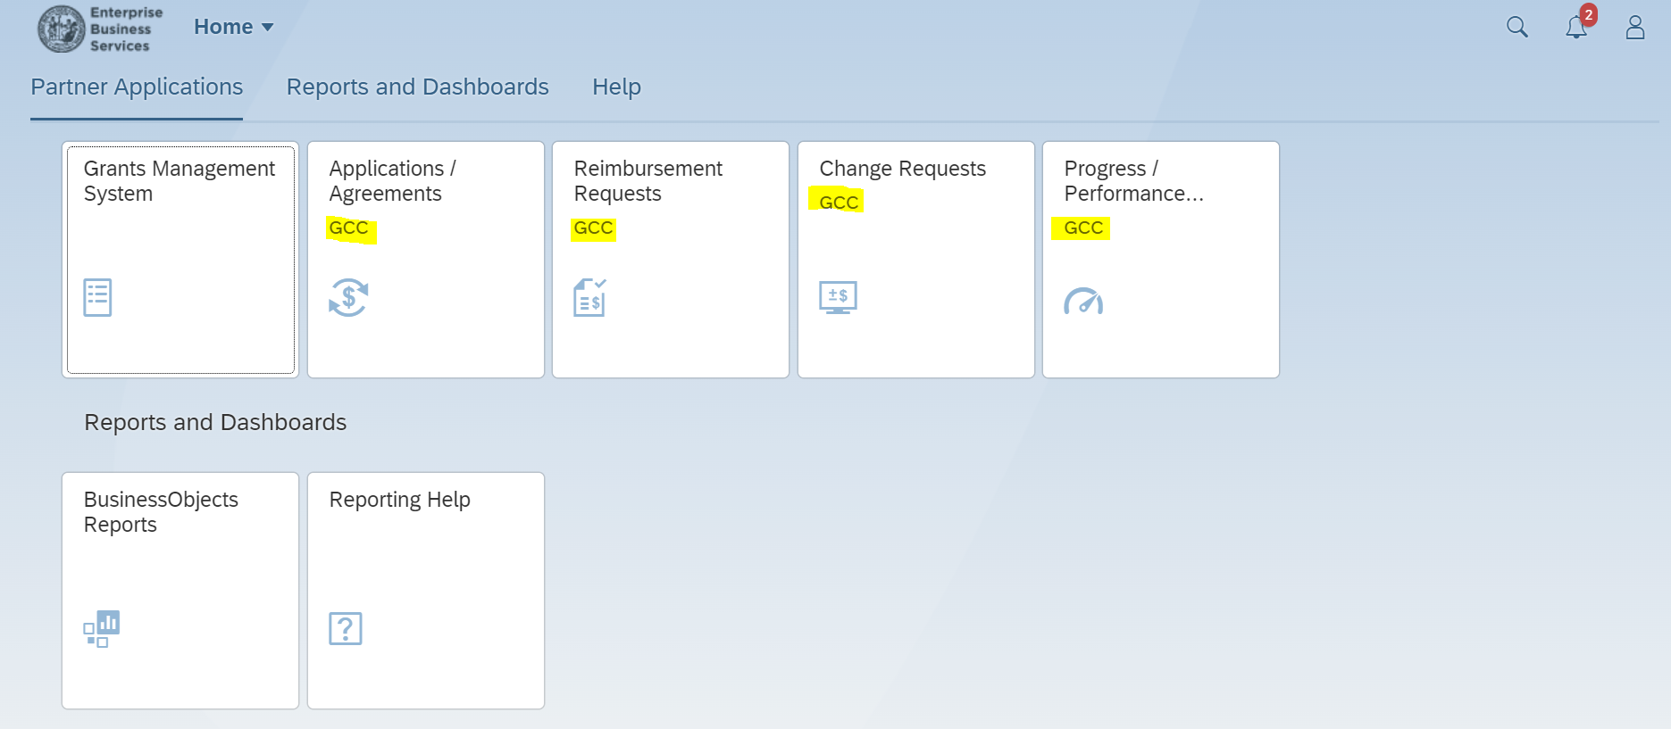
Access to GCC Grants Management System - EBS
Enterprise Business Services*
https://www.ebs.nc.gov/irj/portal
Upload a report for each agreement separately
NO Handwritten, scanned, incomplete and/or blank reports
Be sure that the report dates are accurate

Slide 15


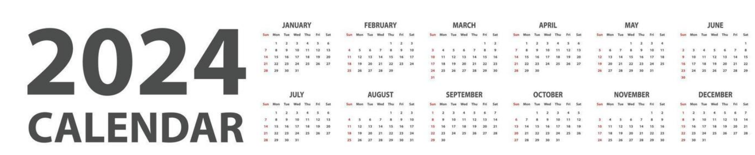
For those accepting extensions:
Next report due January 30th (to cover all of 2024)

Slide 16
Check that your program staff have access to EBS and that they are properly assigned to agreements so that they are can complete report activities.
Subrecipients MUST submit required reports in BOTH platforms as instructed (EBS and VAWA MEI Reporting Tool).
If you are unsure or have report questions, contact your Grant Administrator for guidance.
EBS and the VAWA Reporting tool are NOT connected!!

Slide 17
STOP/SASP Report Resources at VAWA MEI
Subgrantee Progress Reporting Form for NEW Tool coming soon
Completing Report Form - Training Video STOP and SASP Formula: Completing a Subgrantee Report (vawamei.org)
How to Guide
  How-To-Fill-Out-a-Formula-Subgrantee-Report-Guide.pdf (vawamei.org)
E-Learning Video: What’s an FTE?
https://www.vawamei.org/tools-resource/e-learning-video-whats-an-fte/
STOP Formula FTE Calculator
https://www.vawamei.org/tools-resource/fte-calculator/
Crafting Narratives
https://www.vawamei.org/tools-resource/crafting-narratives-training-video/
GCC Website
The Grant Process | NC DPS
Notes:
Add all of these links to chat

Slide 18
Reporting Questions
Contact:
Amanda Endicott, VAWA Planner
amanda.m.williams2@ncdps.gov
(919) 899-9157
Reporting Office Hours
1st & 3rd Tuesday of December - February
9:30AM – 10:30AM
(12/3/24)

Slide 19

QUESTIONS?

