Slide 1

Victims of Crime Act
Subrecipient Performance Reporting
Presented by:
Lindsay Bohan
Jordan Mayer
Grace Clougherty
Sept 19, 2024
1

Slide 2

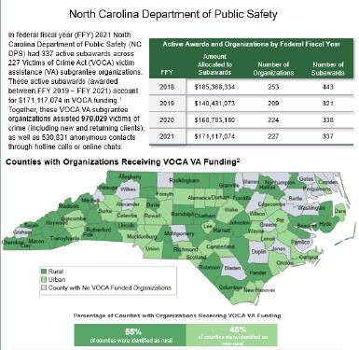
OVC Performance Measurement Data
VOCA performance reports (nat’l & state)
Demonstrate output of
grant funds
Emphasize progress made toward strategic & program goals
Reach target audience of grantees, subgrantees, and general public
2
Notes:
OVC *demonstrate the value and specific benefits of the program to government agencies, the victim services field, the general public, and other stakeholders
GCC*use data to monitor progress and determine whether the organization is on track to meet the project goals and objectives.
GCC*use data for strategic planning by evaluating past performance and setting reasonable goals, objectives, and targets for future awards.

Slide 3

OVC Performance Measurement Reporting
Initial Subgrant Award Report (SAR-Part I)
Subgrant Award Report (SAR-Part II)
OVC Quarterly Performance Reports (PMT)
Each report is required as a Special Condition of your VOCA award and must be submitted by their respective deadlines.
Subrecipients will not be able to receive reimbursements for project-related expenses if reports are not submitted by deadlines.

Slide 4
Resources to Use:
Suggested Questions to Review Data:
What is reasonable?
Does the data make sense in relation to the award objectives or categories of service?
What might signify a cause for concern?
What is the project timeline status?
How does an explanation line up with what was reported or the VOCA act?
Performance measures PDF
VOCA Terminology Resource
Agency or program goals and objectives
Past quarterly reports for comparison
4

Slide 5


You must submit ALL required reports
in order
Initial Subgrant Award Report (SAR-Part I)
Subgrant Award Report
(SAR-Part II)
Performance Reports (PMT)
Due: PRIOR to grant opening*
Due: within 30 days of grant opening*.
Due: Quarterly
Notes:
*Process is being updated and updated instructions will be provided.

Slide 6
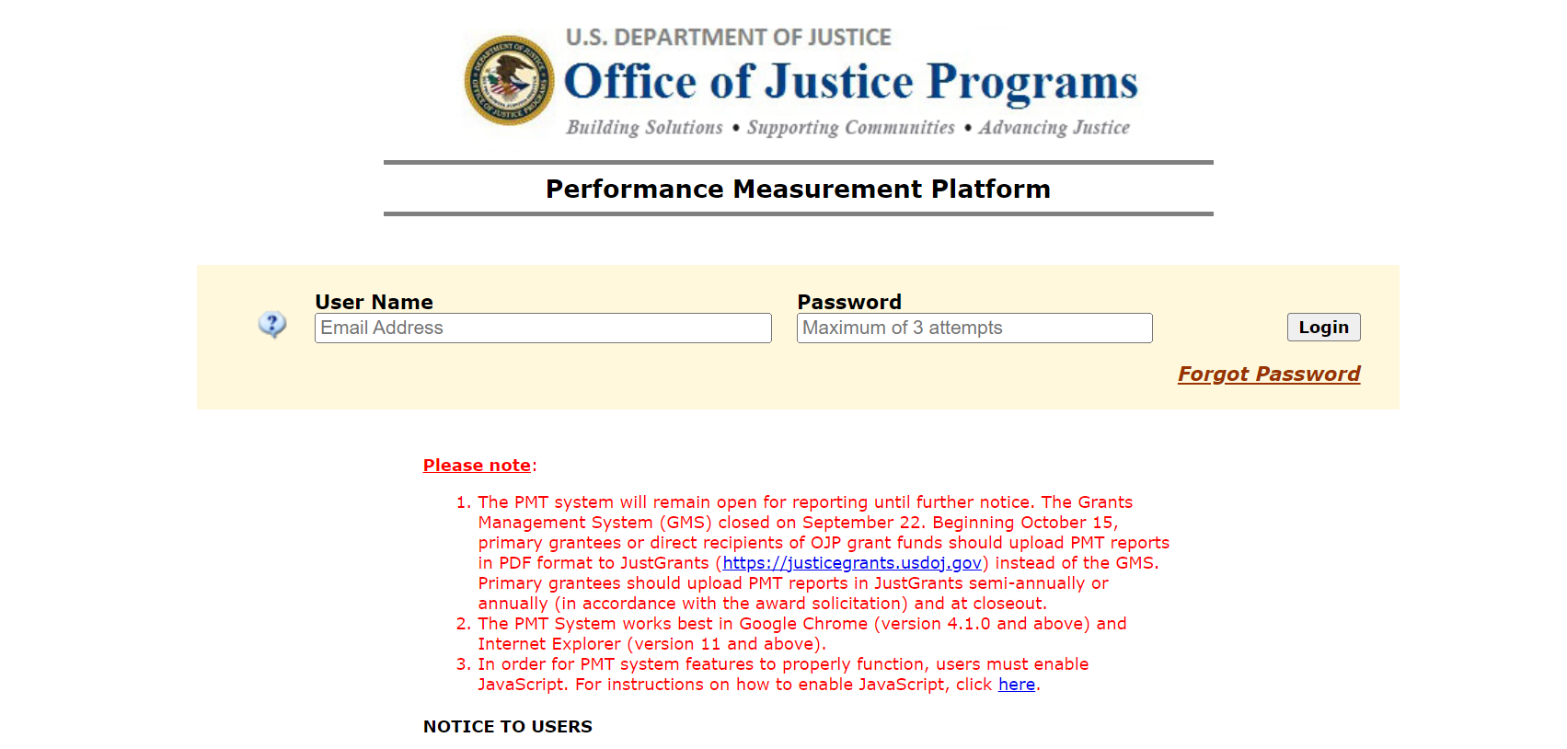
Access to Federal Reporting Website
Performance Measurement Platform https://ojpsso.ojp.gov/
6
Notes:
As a new grantee point of contact (POC), the OVC PMT Helpdesk or the existing grantee POC for your organization can add you to the PMT

Slide 7
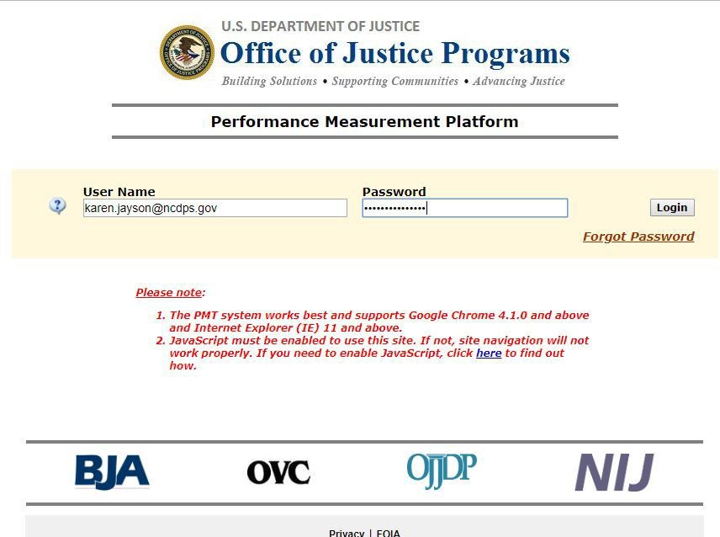
The OVC-PMT system works best with Google Chrome
JavaScript must also be enabled on the computer used to enter OVC-PMT data

Slide 8
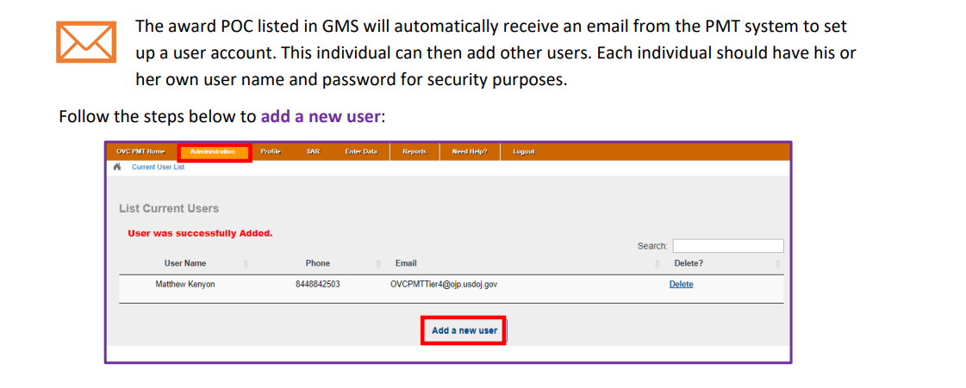
Agency users who have access can add additional OVC website users.
Recommend having multiple staff in agency with access, as there can only be one point of contact for each grant award.
GCC can update grant Point of Contact in OVC system but does not have the ability to add users for your agency.
8
Notes:
*Staff should only be accessing the platform via their own accounts and not other staff members.

Slide 9
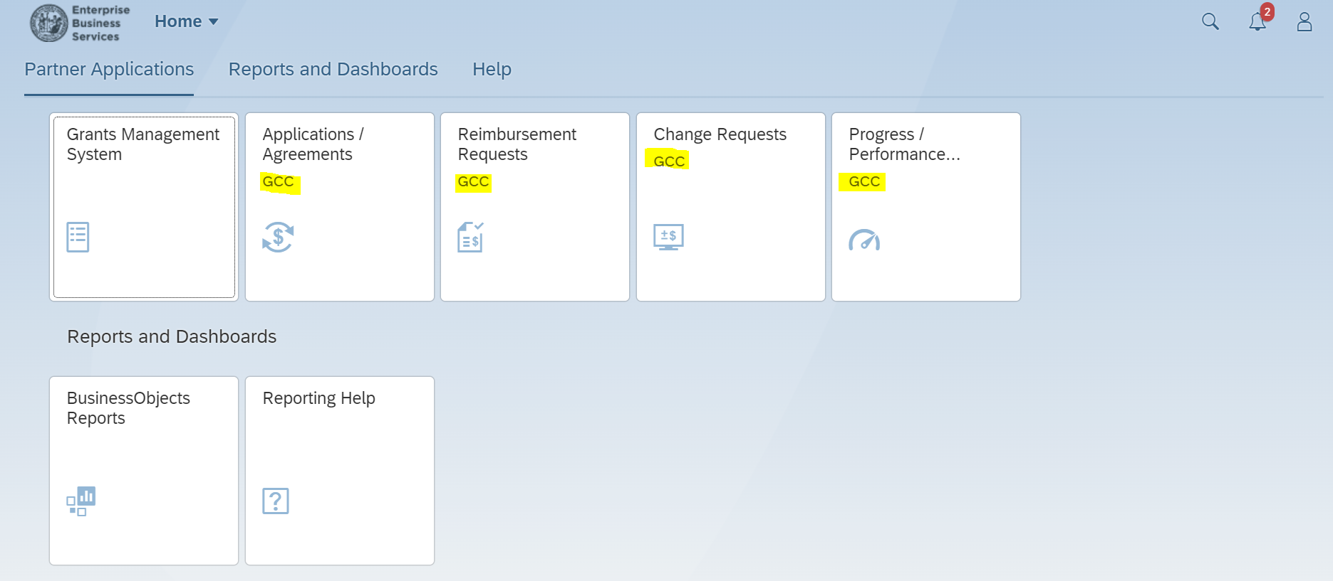
Access to GCC Grants Management System - EBS
Enterprise Business Services*
https://www.ebs.nc.gov/irj/portal
9

Slide 10

EBS and the OVC PMT System are NOT connected.
Subrecipients must ensure each individual necessary to access agreements and/or reporting, have access to appropriate systems.
Subrecipients MUST submit required reports in BOTH platforms as instructed.
If you are unsure, feel free to reach out to your Grant Planner or Grant Administrator
10

Slide 11
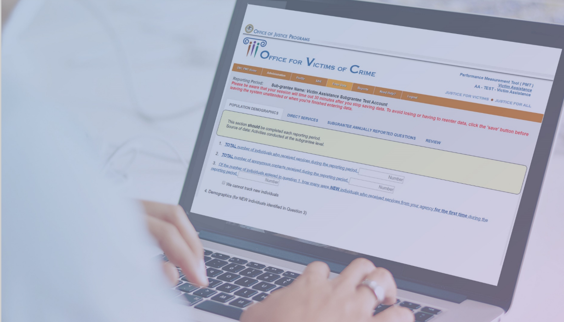
Subrecipient User Guides
GCC Website
The Grant Process | NC DPS
OVC Performance Measurement Platform
Victims of Crime Act Victim Assistance Performance Measurement Tool Resource User Guide (ojp.gov)

Slide 12


SAR-Part I

Slide 13
This intial report is the first reporting step in gaining access to required VOCA Quarterly Reports in the PMT system
Provided to you in spreadsheet form by Grant Planner during Modifications process (previously done with GA Welcome Letter)
The ISAR is due to GCC at the implementation of the grant (before grant opens).

Slide 14
The data submitted provides basic information on your organization and project that is required for federal tracking and alignment with priorities/purpose of funding
Updates are required for no-cost extensions, additional funding years/amounts and in other limited circumstances.
Ensure Part I information aligns with Priorities, Crime Types and Populations served under grant.* Enter 0 where not applicable.

Slide 15

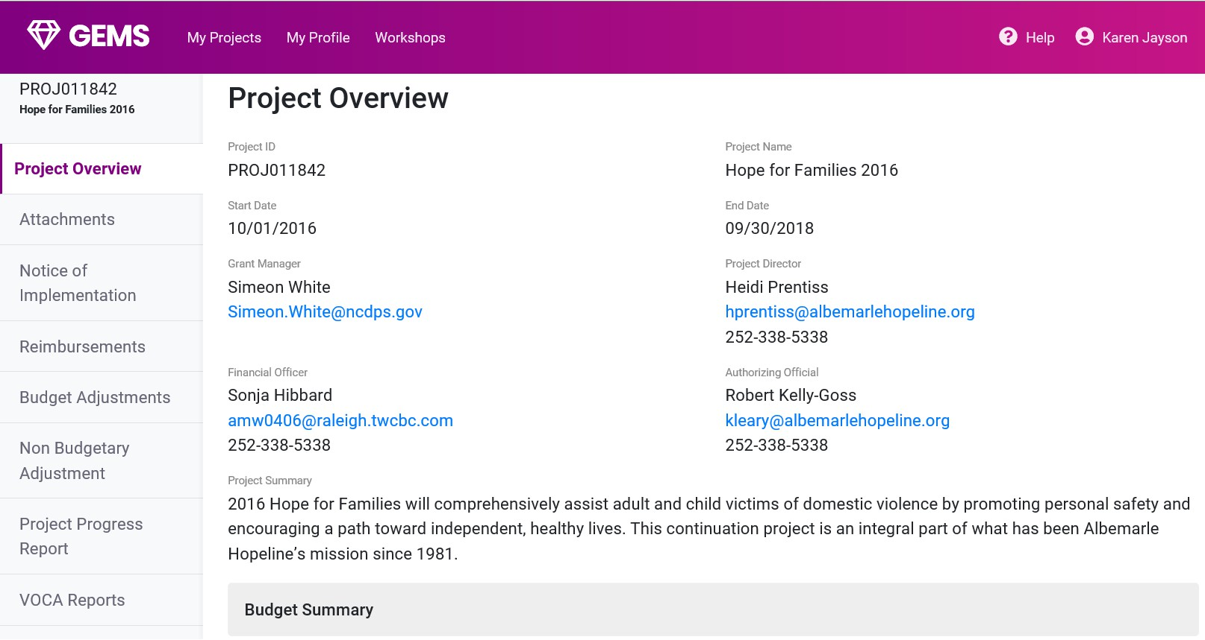
The Initial Subgrant Award Report, unlike in GEMS,
cannot be accessed through EBS

Slide 16
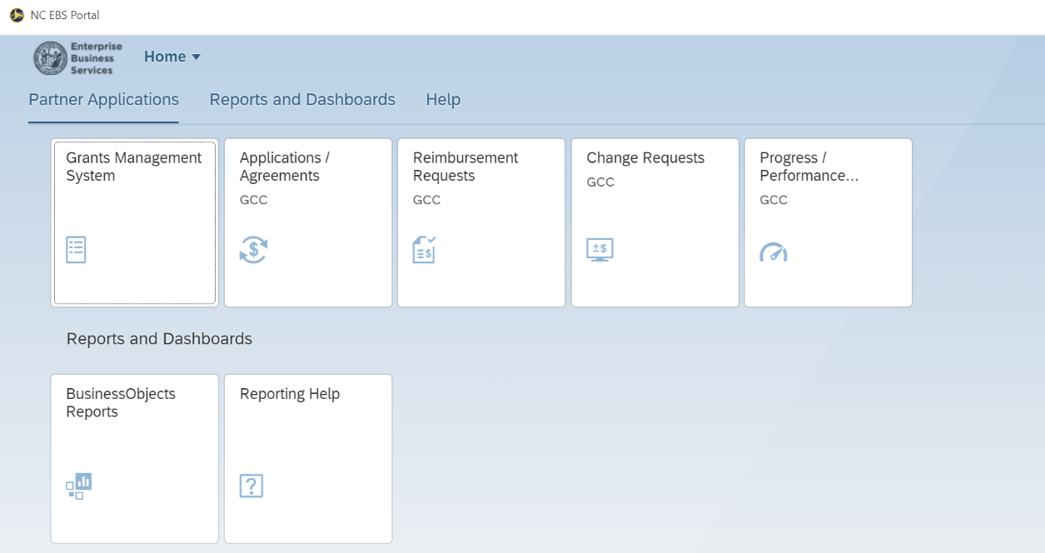
During modifications process, you must complete Part I of the SAR-the Initial Subgrant Award Report
Upload the Completed SAR Part I form, into the Progress/Performance Report tile in EBS and notify your Grant Planner
Notes:
This report is then reviewed and entered directly into the Performance Measurement Platform by your Grant Planner (check with Kevin, can Part I be uploaded prior to being in Ready for Reimbursement, ideally Pending Award status)

Slide 17
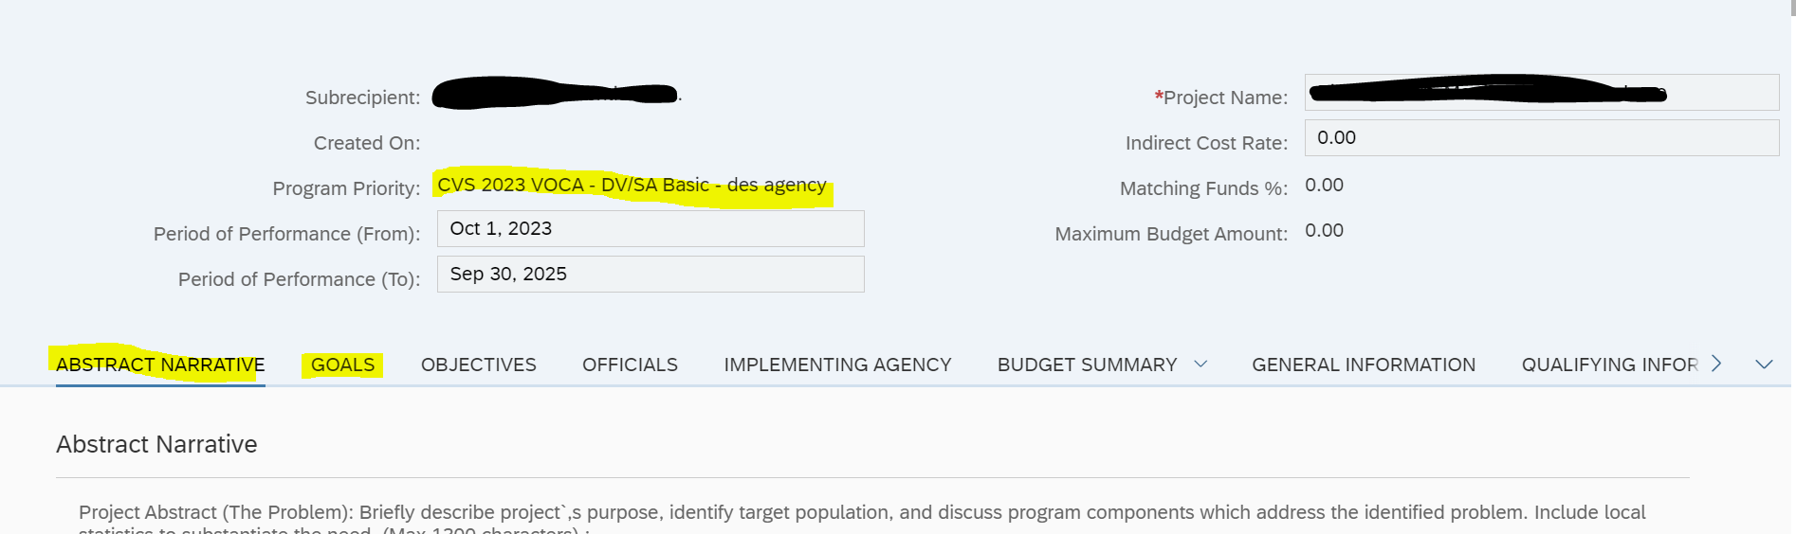
SAR Part I – Priority and Underserved
Requirements
Must first align with Program Priority
If DV Basic Grant, all funded amount must be shown under Domestic and Family Violence, same with SA Basic/CA Basic/Underserved Priorities
Must also align with Project Name and purpose of the grant as best as possible.
Application view in EBS:

Slide 18
Priority Selections in SAR Part I
CAC Basic
100% goes into Child Abuse priority
Split between subsections as needed
DV/SA Basic
100% goes into designated service area
Split between DV and SA sections as needed IF dual agency
Underserved
100% goes into Underserved Priority ONLY
Split between subsections to align with funded award
All Other Competitive Priorities
Split between program priorities aligning with funded award as needed.

Slide 19
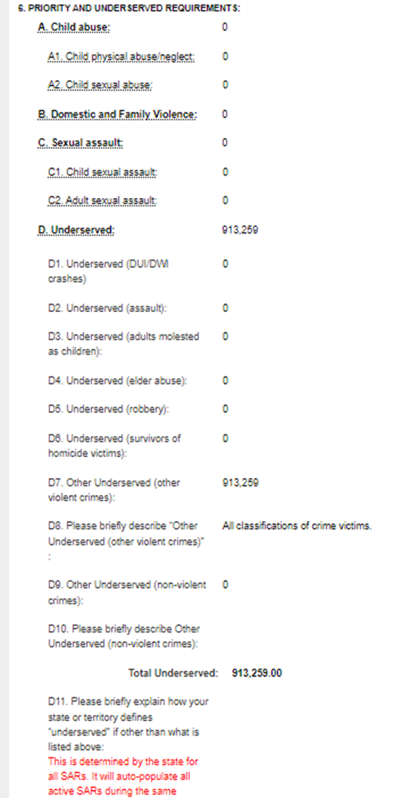
SAR Part I – Priority and Underserved
Requirements
SAR Part I view in OVC PMP System:

Slide 20

SAR-Part II

Slide 21
After the Initial Subgrant Award Report (SAR part I) is
in the PMT system, the subrecipient will be notified by Grant Planner of need to complete Part II directly in the PMT system.
Part II of the SAR begins at Question 7
Once Part II is completed and saved, your agency point of contact will have access to the quarterly reports for each of your organization’s VOCA-funded projects
Grant Planner will review Part II for accuracy and advise of any edits.

Slide 22

Quarterly Reporting

Slide 23
Quarterly VOCA PMT Reports
If you experience problems with the website, you must contact the OVC-PMT Help Desk at ovcpmt@usdoj.gov or 1-844-884-2503
The staff at the Governor’s Crime Commission cannot address any technical issues with the website.
 | REPORT WINDOW | DUE DATE
Q1 | OCTOBER – DECEMBER | January 30
Q2 | JANUARY – MARCH | April 30
Q3 | APRIL – JUNE | July 30
Q4 | JULY – SEPTEMBER | October 30
*Based on Federal Fiscal Year
All data entered in this system goes directly to the Office for Victims of Crime.
23

Slide 24

Once your award has been approved by the Commission, GCC staff will create a profile in the PMT system (Typically after funding notification letters are sent in the summer)
The POC listed when the profile is made will receive an email on how to access the system immediately following the profile being made. Be on the lookout for this email and save it for future use.
Again, note that the Project Director for the project will receive all correspondence from the GCC at that point.
If someone other than the Project Director is responsible for submitting the quarterly OVC-PMT data, note that GCC must be notified to change the Point of Contact in OVC Profile
Notes:
The Project Director is responsible for informing staff of due dates and ensuring that the reports are submitted by the respective deadlines

Slide 25

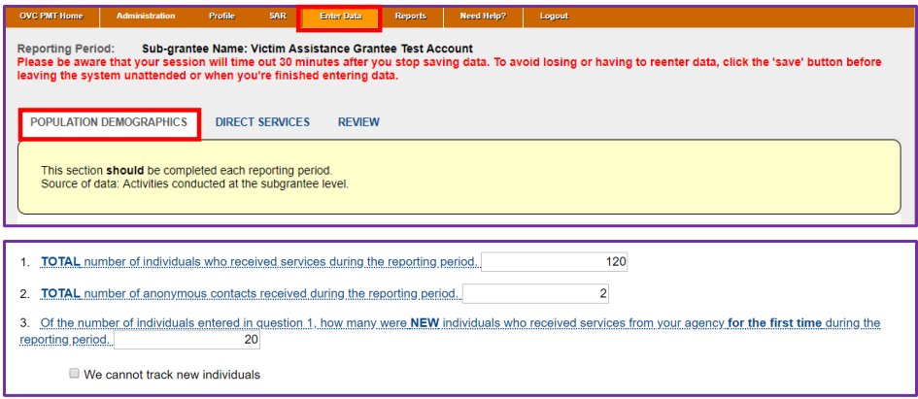
Must be submitted in OVC PMT System BEFORE uploading in EBS system under Progress/Performance tile.
Staff can see reports Not Started, In Progress, and Complete statuses

Slide 26
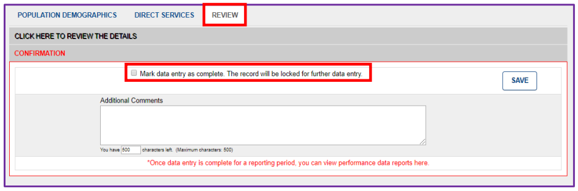
Sections of Quarterly Report:
Population Demographics: Demographics, Victimization Types, Special Classifications
Direct Services
Review
Not Reported – Indicates the subgrantee collects demographic data, but it was not provided by victim.
Not Tracked – Indicate to OVC that the subgrantee is unable to collect the data in the format requested during the reporting period due to the need to change the local data collection system. The state or subgrantee needs to have efforts underway to track and submit the data as requested, as soon as possible.
Completing Data Entry:

Slide 27
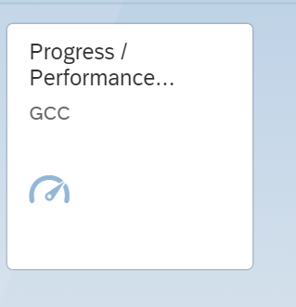
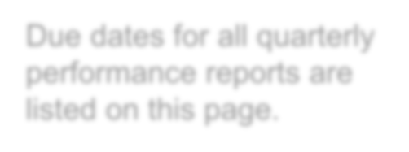

The completed and submitted VOCA Quarterly PMT Report must also be uploaded into the EBS site for review and approval by Grant Admins

Slide 28
Once you have submitted the report in EBS, Grant Admins will receive a notification of the EBS Submission
Your GCC Administrator will review and validate your report
  If there are errors with the report, it will be sent back for modifications
  You must correct these errors within the PMT system and provide an updated report as an upload in the EBS system
  A GCC planner will have to unlock the report in the PMT system before it can be corrected.
Notes:
*Also receive report from OVC regarding possible errors.

Slide 29

PMT Error Reports
Received approximately 2 months after each Quarterly report deadline from OVC PMT Helpdesk
VOCA Grant Planners unlock reports for review and correction (as necessary)
Grant Administrators coordinate with Point of Contact of the project
Most common PMT errors: Question 1, 2, and 8
  2nd most common; 3 and 5

Slide 30
Subrecipient Compliance and Monitoring
ISAR and Quarterly reporting are federally mandated and must be completed to continue receiving award money.
GCC compliance and monitoring includes tracking agencies with consistently late reports and unreported barriers.
GCC can increase monitoring, delay, reduce, or revoke awards because of continuing reporting compliance issues including but not limited to:
  Multiple late reports during a period of performance
  Lack of communication around barriers
  Lack of internal controls around staff turnover and completion of reports

Slide 31

How Can We Help?
Start EARLY and use PMT resources in the “Need Help” tab:
Look out for GCC reminder emails when the reports open each quarter (you will receive additional reminder emails along with late emails as the quarter continues).
Attend our Quarterly PMT TA Hours, link sent at beginning of federal fiscal year – October and will be re-sent in reminder emails
OVC Performance Measure Dictionary and Terminology Resource
Online pre-recorded trainings
Experiencing staff turnover? Ask about a “Welcome to OVC Performance Management” session

Slide 32


OVC PMT Helpdesk Contact Information
Monday–Friday, 8:30 a.m.–5:00 p.m. EST Toll free number: 1–844–884–2503** Email: ovcpmt@usdoj.gov
** Appointments available outside normal business hours by request

Slide 33
Reporting Questions
Contact Crime Victims Services Planning Staff
Grace Clougherty
CVS Program Assistant grace.clougherty@ncdps.gov
Jordan Mayer
VOCA Planner
Jordan.Mayer@ncdps.gov
Sandy Dixon, Lead CVS Planner
Lindsay Bohan, Lead VOCA Planner
Sandy.Dixon@ncdps.gov
Lindsay.Bohan@ncdps.gov

