Slide 1
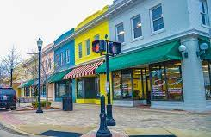
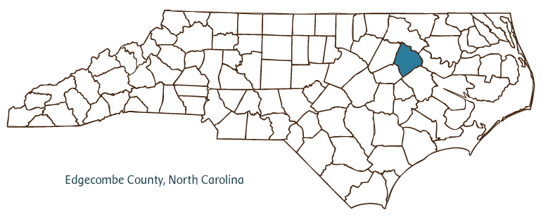
Downtown Drainage Project
Project #
Seeking $7,563,430 Total Project Cost $10,804,900
To upsize and realign downtown drainage system to reduce localized flooding during storm events.
EDGECOMBE
70%
City of Rocky Mount

Slide 2
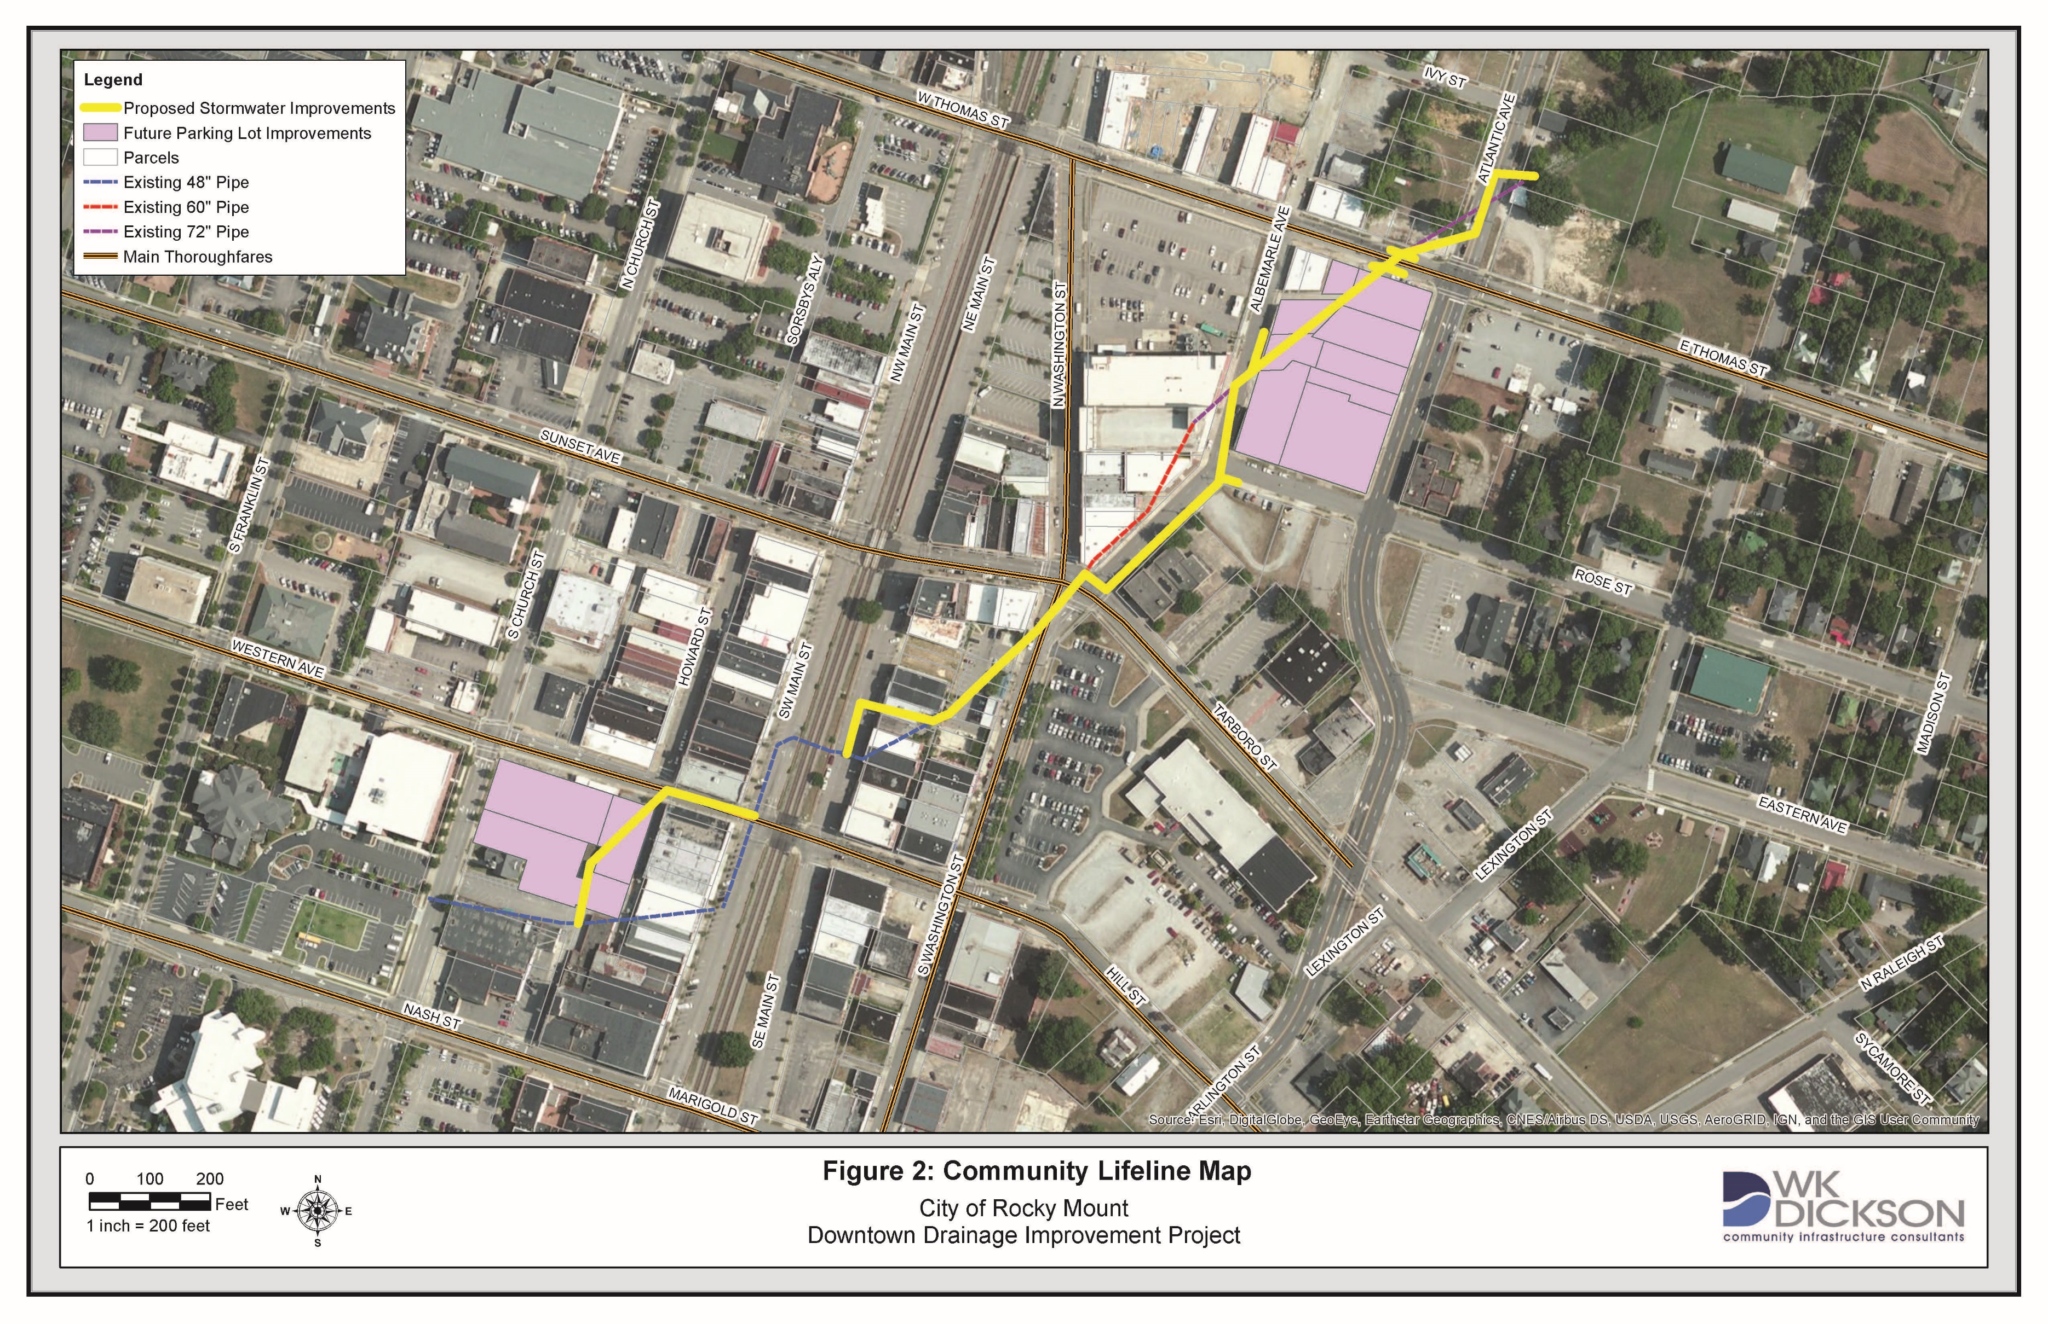
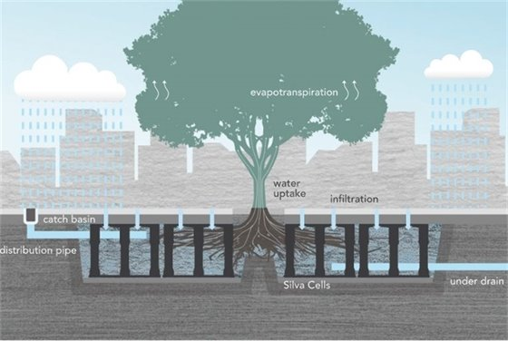
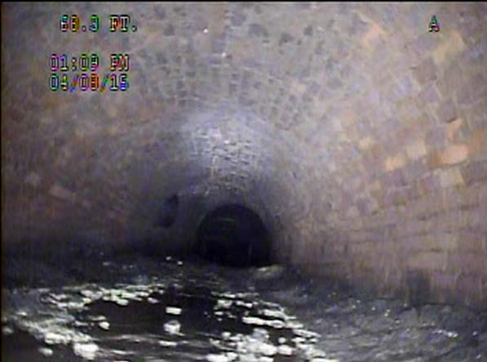
The Problem
Existing system cannot handle 10% annual chance events.
Creating access issues for city maintenance crews.
Safety issues related to sinkhole developments.

Slide 3
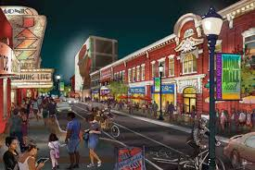
Downtown Drainage Project
Project #
Partners:
North Carolina Department of Transportation
Rocky Mount Area Chamber of Commerce
Rocky Mount Event Center
Rocky Mount Downtown Merchants’ Association
Central City Revitalization Panel
Golden LEAF Foundation
Legislative Delegations
Nature-based solutions:
Bioretention areas
Permeable pavers
Silva cells
Community-wide benefits or affects to disadvantaged communities:
Project area population is 88.1% minority and 28.7% live below the poverty line (Justice 40).
Nutrient runoff reduction in Tar River.
City of Rocky Mount

