Slide 1
Functional Assessment Support Team (FAST) Program in North Carolina

Slide 2
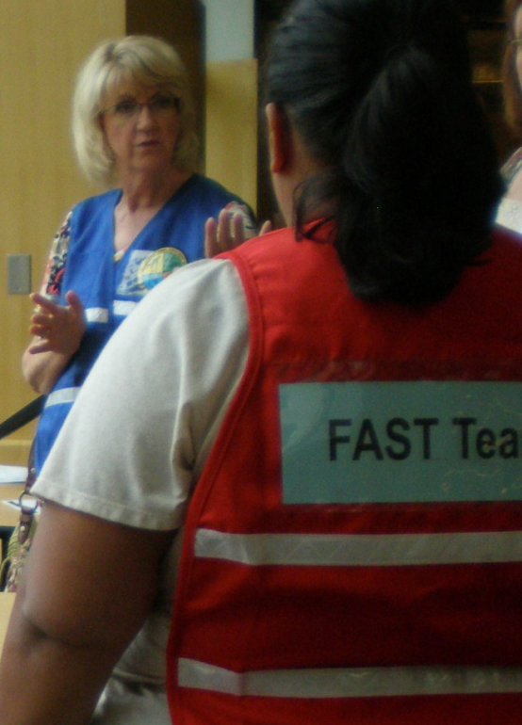
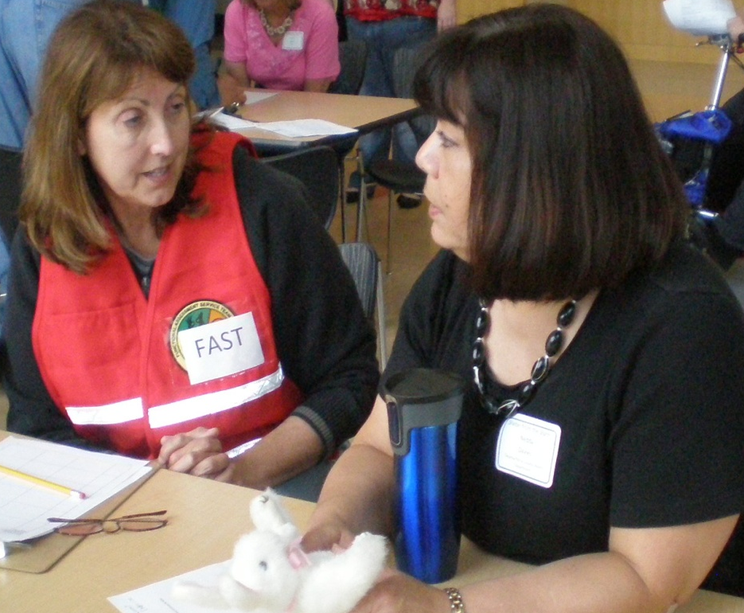
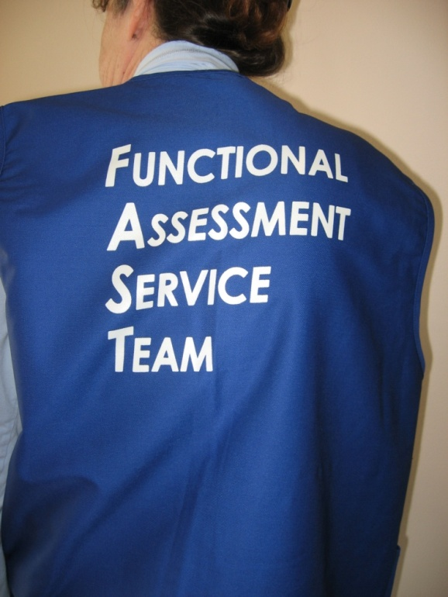
Functional Assessment Support
Team (FAST)
Trained social service professionals ready to respond to disaster shelters
Notes:
A FAST consists of trained government and non-government personnel ready to respond to disaster areas to work in disaster shelters.
FAST members work with shelter staff to conduct assessments of people with access and functional needs in emergency shelters.
FAST members facilitate the process of getting resources needed by the people with access and functional needs.
Operates under the principle that all people, except those people who are medically fragile, should be able to stay in general shelters during emergencies and disasters.

Slide 3
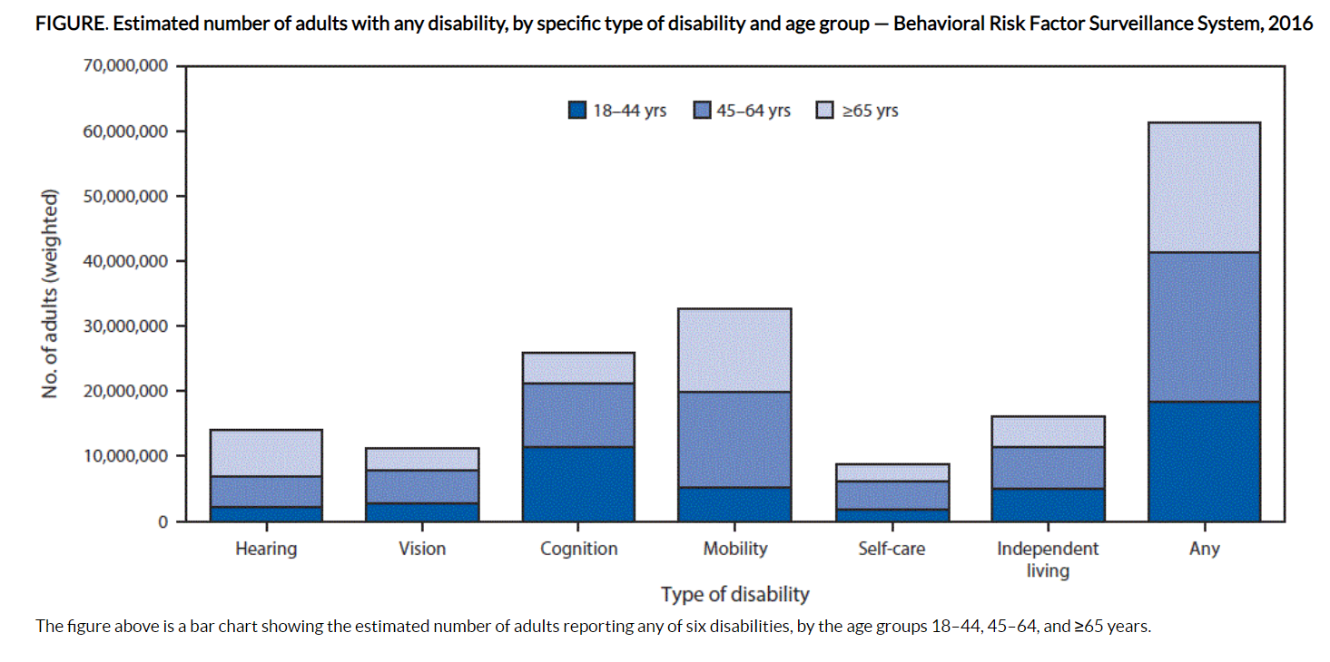
In the U.S., 61.4 million (non-institutionalized) people reported having some kind of disability.
That’s 25.7% of total population
Source: Center for Disease Control and Prevention (CDC 2018)
Notes:
This is not an all inclusive list. Does not account for people who do not self identify, the elderly, pregnant women, children, limited English, etc. (functional limitation in hearing, seeing, walking, learning, language, and/or understanding)

Slide 4
FAST Mission
To help maintain independence and inclusion of affected citizens
To strengthen a community’s disaster resilience
To allow all individuals to receive services needed at disaster service centers

Slide 5
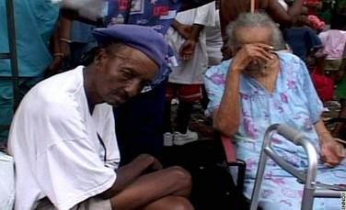
Hurricane Katrina (2005) was a wake-up call
38% did not evacuate because they had a disability or were caring for individuals with a disability. – CBS News
Notes:
According to CBS News following Katrina, of those who stayed behind:
38% did not evacuate because they had a disability or were caring for individuals with a disability.

Slide 6
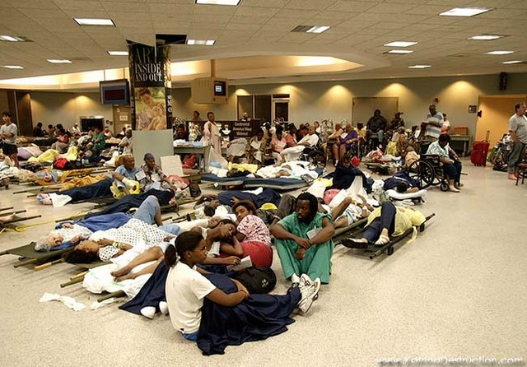
Lessons Learned from Katrina
Special Need Assessment of Katrina Evacuees (SNAKE)
Resulted in adoption of FEMA’s Whole Community Concept for disaster planning
Notes:
Katrina - Shelter staff not only were not prepared to support people with access and functional needs, but had no idea where to turn for help.

Slide 7

FEMA’s Whole Community Concept
Both the composition of the community and the individual needs of community members, regardless of age, economics or accessibility requirements, must be accounted
for when planning and implementing
disaster strategies
Notes:
Planning must embrace the commitment that everyone be included and served. Resources are out there coordination and planning are the issues. This is the foundation of what we are doing. We chose the inclusive planning model – “whole community” concept.
Resources to support People with Access and Functional Needs in shelters are available - we just needed to figure out how to do the coordination and build
relationships.
Understanding and meeting the true needs of the entire affected community.
Engaging all aspects of the community (public, private, and civic) in both defining those needs and devising ways to meet them.
Strengthening the processes that work well in communities on a daily basis to improve resilience and emergency management outcomes.

Slide 8
FAST and Functional Needs Support Services
Functional Needs Support Services (FNSS) enable individuals to maintain their independence in disaster service centers and includes:
reasonable modification to policies, practices, and procedures
durable medical equipment (DME)
consumable medical supplies
personal assistance services (PAS)
other goods and services as needed
Visual 1.11
Notes:
Participant Guide:
People requiring FNSS may have physical, sensory, mental health, and cognitive and/or intellectual disabilities affecting their ability to function independently without assistance. Others that may benefit from FNSS include children, pregnant women, those with pre-existing medical conditions, those who are temporarily injured, and the elderly.

Slide 9
From California to North Carolina
History of FAST

Slide 10
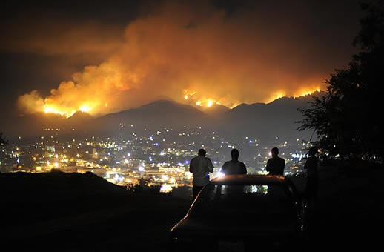
Where it All Began
California wild fires in 2003

Slide 11


As a result of the challenges of sheltering during the fires, the FAST program was developed by California Department of Social Services and Office of Emergency Services around the concept that general population shelters should be accessible to everyone.
Notes:
Participant Guide:
Programs and services must accommodate all.
While California was focused on shelters when they created the program, NCEM will provide services at any Disaster Service Center that our local emergency management agencies want a FAST at, including but not limited to: evacuation shelters, general population shelters, reunification centers, family assistance centers, and disaster recovery centers. A FAST could also assist local emergency managers with checking in on the welfare of shut-ins.
NCCDD has helped NCEM move forward with the FAST Program by funding the travel expenses to go to California to take FAST training.
Thank you to the California Department of Social Services and the California Office of Emergency Services for sharing their FAST training content.

Slide 12


FAST in North Carolina
NC Emergency Management was able to take the initial training in 2015 to help develop the FAST Program thanks to a grant from the North Carolina Council on Developmental Disabilities (NCCDD).
Notes:
Programs and services must accommodate all.
While California was focused on shelters when they created the program, NCEM will provide services at any Disaster Service Center that our local emergency management agencies want a FAST at, including but not limited to: evacuation shelters, general population shelters, reunification centers, family assistance centers, and disaster recovery centers. A FAST could also assist local emergency managers with checking in on the welfare of shut-ins.
NCCDD has helped NCEM move forward with the FAST Program by funding the travel expenses to go to California to take FAST training.
Thank you to the California Department of Social Services and the California Office of Emergency Services for sharing their FAST training content.

Slide 13

FAST beginnings in North Carolina
Fall 2015 – NC Advisory Committee formed to study FAST
December 2015 – Trained on FAST in CA
Developed NC version of FAST curriculum and program
January 2018 – Held first FAST training
Notes:
.

Slide 14
Assess, Request, Support
How FAST Works

Slide 15
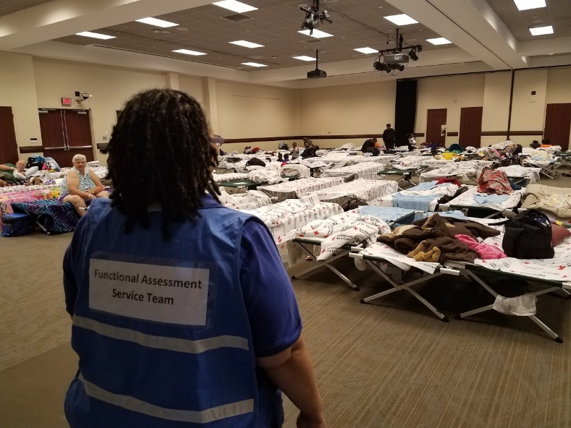
How does FAST help?
Supports general shelter staff
Preserves vital medical resources
Frees up other emergency resources
Notes:
FAST supports general shelter staff and preserves vital medical resources for those with the most severe needs.
FAST frees up other emergency resources to focus on emergency incidents rather than on mitigating complications.

Slide 16
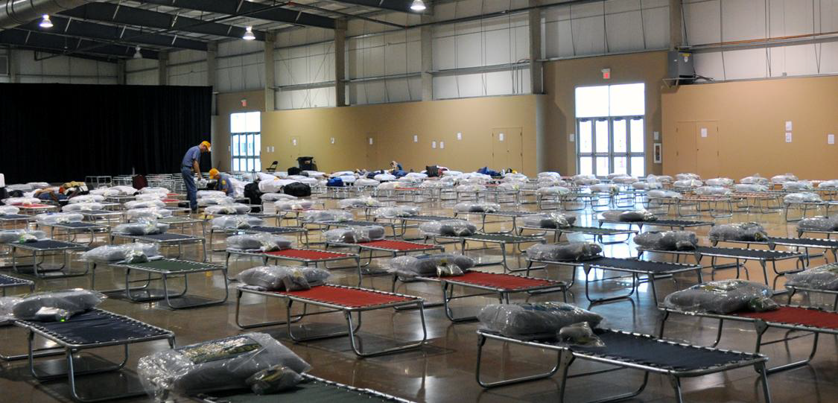
FAST will help assess people with accommodation needs and assist them by getting what they need to stay in a shelter.
Notes:
FAST will help assess people with accommodation needs and assist them by getting what they need to stay in a shelter.
FAST distinguishes among people who need assistance in maintaining their safety, health, mobility, independence and emotional stability from those who have acute medical needs.

Slide 17
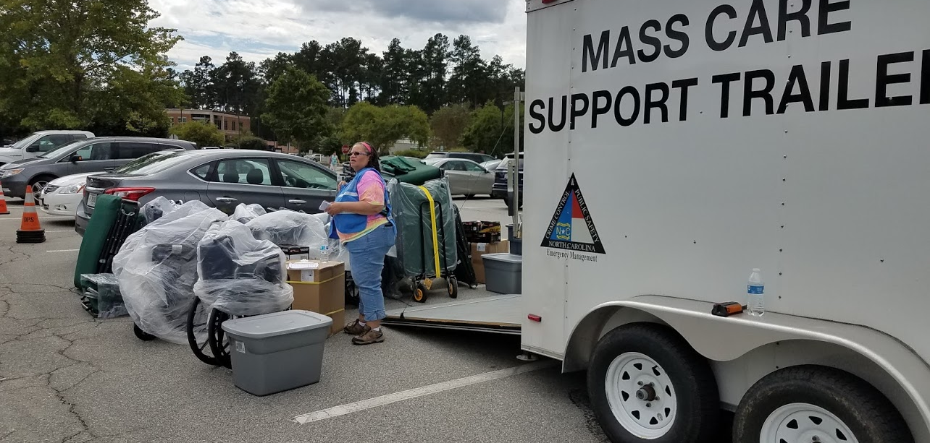
Notes:
Pennsylvania FAST member with the Mass Care Support Shelter trailer at UNC Chapel Hill shelter during Hurricane Florence.

Slide 18
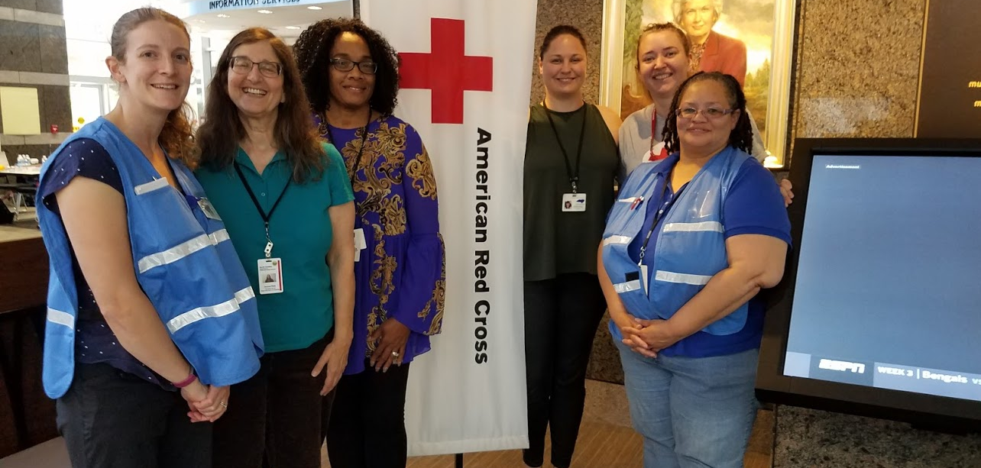
Notes:
Pennsylvania FAST members with staff from Division of Services for the Deaf and Hard of Hearing at the Friday Center, UNC Chapel Hill, during Hurricane Florence.

Slide 19
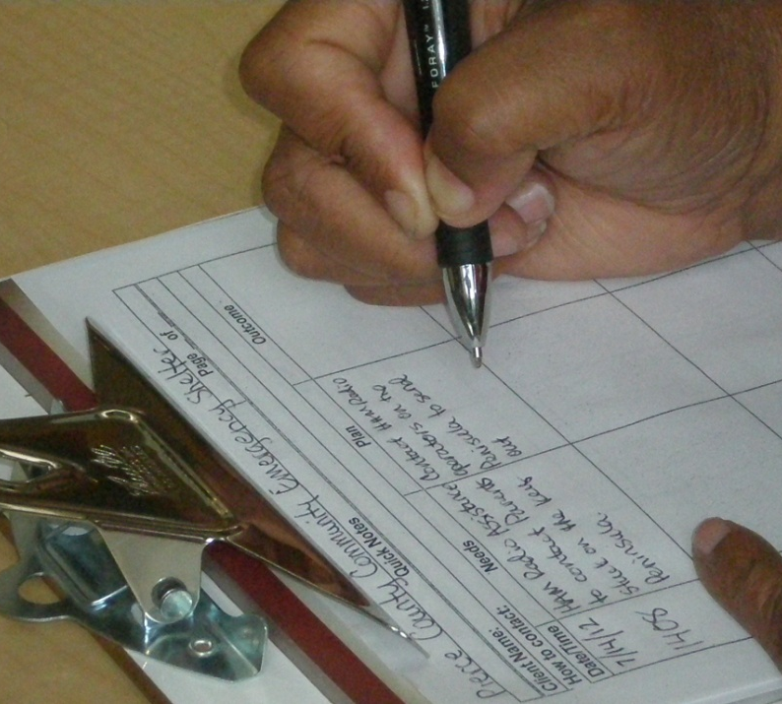
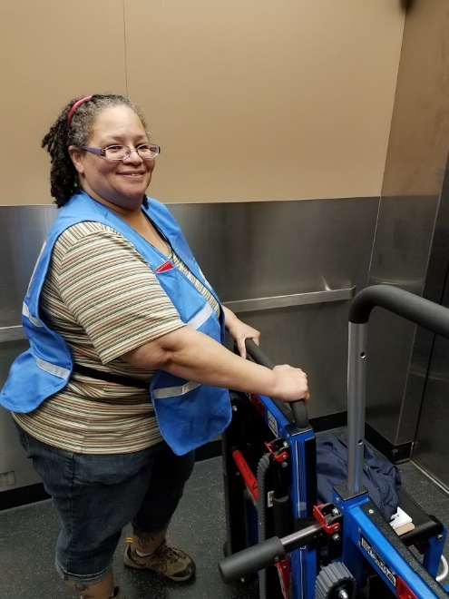
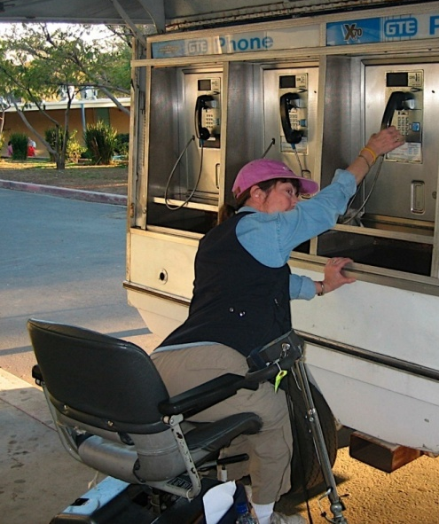
FAST Member Duties
Coordinate with shelter managers
Conduct assessments
Arrange for support
Request resources
Notes:
Conduct functional needs assessments of individuals at shelters and arrange for support with resources such as:
Durable medical equipment (DME) – wheelchairs, walkers, oxygen,
Consumable medical supplies (CMS) -bandages, pads
Essential medications
Communication access -– TTY, closed captioning, interpreters
Personal assistants (PAs) -family/relatives, volunteers, who attend to the needs of the person /assist with activities of daily living
FAST’s help shelter personnel distinguish between people who need assistance in maintaining their health, & mobility, independence, and emotional stability from those who need acute medical help. FAST members will work side by side with shelter personnel and other emergency response workers to assist in identifying and meeting essential functional needs so that People with Access and Functional Needs can maintain their health, safety and independence during disasters.
Effectively meeting these needs reduces use of scarce, expensive & intensive emergency medical services & institutionalization. FAST’s will determine who has needs which exceed capability of shelter & arrange for transfer [if possible] or move to medical area of shelter.
FAST will maintain ongoing coordination and collaboration with shelter management.
Develop and implement service plans for shelter residents to meet essential access & functional needs of those identified.

Slide 20
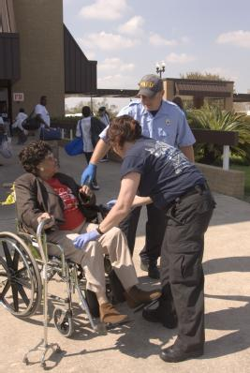
FAST Member Experience
Background and training in one or more social service discipline
Notes:
Members have a combined experience in one or more areas: (See slide)
Aging
Developmental Disabilities
Cognitive disabilities
Chronic health conditions
Hearing disabilities
Mental health disabilities
Physical disabilities
Substance abuse/alcoholism
Vision/blind disabilities
Knowledgeable disability & aging organizations can support shelter residents with needs more efficiently, freeing shelter management staff for other activities.
Can include:
Non-Governmental Organizations (NGO)
Examples: Salvation Army
Faith Based Organizations (FBO)
Examples: Local churches
Community Based Organizations (CBO)
Examples: Korean Women’s Association

Slide 21
FAST Training
One-day FAST class
American Red Cross Shelter training
Quarterly Sustainment trainings
Recommended on-line trainings

Slide 22
Next steps for FAST Program
Recruitment and training of new members
Development of deployment process template (local and state)
On-going sustainment training
Integration of program into EOC (standard operating guidelines, policies procedures)

Slide 23
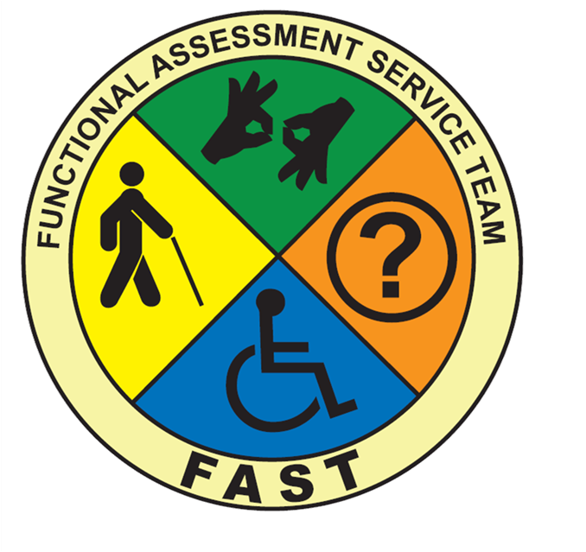
Contact information
Sheri Badger
Disability Integration Specialist, NCEM
sheri.badger@ncdps.gov
919-825-2568

