Slide 1
Governor’s Crime Commission
2022 Grant Award Workshop

Slide 2
Grants Management and
Documentation
2

Slide 3
Grants Administrators
Carolyn Locklear
Tanya Ogburn
Valarie Hunter
Burley Spinks
Allyson Teem
Keith Bugner
Jacqueline Ray
Samuel Conyers
Arienne Cheek
Matt Stuart
Brenda Washington
LaShanya Richardson
Star Jones
Harriet Lunsford
Paris Baker
Your friend and go to for questions.
Technical assistance on policy and procedures.
Review and process reimbursements and budget modifications.
Provides site visits and can help on local policies.

Slide 4
How Do I Get Reimbursed?
Step 1
Reference the budget line items that were approved on the grant for which you are requesting reimbursement.
Step 2
Complete the reimbursement for those approved line items for expenditures made during the (monthly) reporting period.
4

Slide 5
How Do I Get Reimbursed?
Step 3
Include the GCC required “Summary Pages” for each expense category and all documentation supporting the expenditures on the reimbursement.
Step 4
Submit your reimbursement through GEMS to GCC.
5

Slide 6
Checklist for Reimbursements
Required Cover Sheets for Expenditures:
Personnel – Coversheet A
Supplies – Coversheet B
Contractual – Coversheet C
Travel -Coversheet D
Equipment – Coversheet E
Orientation of Scanned Documents Uploaded in GEMS -Portrait
Specific Coversheet AND supporting documentation that reflect page numbers (to ensure all documentation uploaded are complete – this will avoid delays of the processing of your reimbursement)
  First Example: Personnel Coversheet on the top and the timesheets, payroll register, proof of payment for fringe benefits will be under one packet
  Second Example: Supplies Coversheet on the top, and the vendor invoice, copy of proof of payment (receipts, credit card statements, allocation policy, procurement requests, etc.)
6

Slide 7
Checklist for Reimbursements
Supporting documentation should reflect page numbers – this is to ensure all documentation uploaded in GEMS are complete. This will avoid any delays of processing your reimbursement or having the reimbursement sent back for modifications if there are missing pages.
  First Example: Personnel Coversheet will be labeled A-1. The timesheet following this coversheet will be labeled A-2, the payroll register following this timesheet will be labeled A-3, etc.
  Please ensure that all uploaded documents are scanned upright for uniformity.
Each coversheet and related supporting documentation are scanned and uploaded separately from other coversheet and documentation.
You will have separate files uploaded in GEMS for each kind of expenditure (Personnel Coversheet and supporting documentation will be one .pdf upload, Supplies Coversheet and supporting documentation will be another .pdf upload) Use below Nomenclature for uploads.
PERSONNEL-October-2022 – (AGENCY NAME & PROJECT: PROJ00000)
EQUIPMENT- November 2022 – (AGENCY NAME & PROJECT: PROJ00000)
7

Slide 8
Reimbursement
Reimbursements are to be submitted monthly, by the last day of the month, for actual expenses made during the previous month
If submitted on time, it is the Grants Management Team’s goal to have the first touch of the reimbursement within 10 days of submitting. This means the reimbursement will be approved, require modifications, or be denied.
If these are submitted after the last day of the month the grant managers will have 30 days to provide the first touch
Final reimbursement is due 60 days after the end of the period of performance
8

Slide 9
Changes made to the Guidelines
90 days prior to Period of Performance ending final budget adjustments are due.
SAM registration no longer required but a UEI is required to be received using the SAM.GOV site.
Year one unspent funds will be reverted as will unspent year 2 funds.
9

Slide 10
Year 1 Sweep Process
Subrecipient submits Final Reimbursement marked final in GEMS by November 15, 2022
GCC Pays final reimbursement
Subrecipient submits budget adjustment to freeze remaining year 1 funds and move to surplus.
Gems System sweeps funds back to recipient grant
Grant Manager will switch project to year 2
Subrecipient may now use year 2 funds.
10

Slide 11
Adjustments
11

Slide 12
Adjustments
Non-Budgetary Adjustment
  Grant Period Extension
  Project Scope Change- - prior approval required
  Personnel Changes - grant personnel excluding the Authorizing Official, Project Director, and Financial Officer
  Project Adjustment
    Abstract
    Timeline
    Goals
    Objectives
12

Slide 13
Adjustments
Monetary Budget Adjustment
  Reallocate Funds
  Increase Funds
  Quantity Change
13

Slide 14
Budget Adjustments
Subrecipients must initiate a monetary budget adjustment if the modification proposes to:
Add a budget category that did not previously exist on the grant
  Example- adding travel as a budget category that did not previously exist
Move grant funds from one category to another
  Example- move funds from Personnel to Supplies and Operating
Increase/decrease total cost or quantity to existing budget line
14

Slide 15
Submitting a Budget Adjustment
Non- Budgetary and Monetary Budget Adjustments must be submitted via GEMS
Submit adjustments within 48 hours of communicating with Grants Administrator
Board Minutes are required for budget adjustments associated with salary increases
  Salary increases must be approved by the organization Board of Directors for the entire staff and not only grant funded positions.
15

Slide 16
Budget Modification Cap- 10% rule
Budget modifications are capped at 10% of award funds for total grant awards that are $250,000 and greater.
The desire to re-purpose match requires a monetary budget adjustment but does not count toward the 10%.
There is no limit to the number of monetary budget adjustment that can be submitted to GCC.
16

Slide 17
Budget Modification Cap- 10% rule Continued
Once the sub-recipient has been allowed to move 10% of the total grant award, subsequent budget adjustments will be reviewed on a case-by case basis for approval or denial.
If you receive an approval of additional grant funds, you will need to submit a budget modification to increase your budget, then the cap is increased by 10% of the added funds.
17

Slide 18
Budget Modification/Adjustment Denial
The budget modification/adjustment will be denied IF:
Exceeds 10% of the total grant award for those grants $250,000 and greater
Inconsistent with the grant purpose
Unallowable
Failure to support/further the program
Supplanting
Not submitted 90 days before the end of the period of performance
18

Slide 19
Supporting Documentation
Personnel
and
Employee Benefits
19

Slide 20
Payroll Documentation
Pay stubs are required, we only accept official documents
The pay stub must show:
    Name of the employee
    Gross wages earned
    Total hours worked during the period
    Hourly rate of pay
    Pay period begin and end dates
    Pay date
All deductions for taxes/benefits/etc.
20

Slide 21
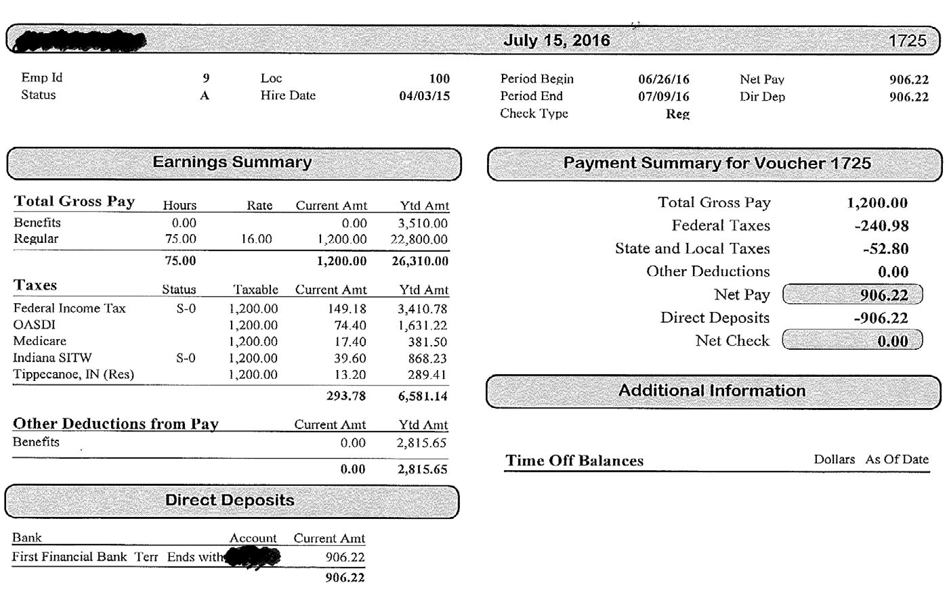
Pay Stub Example
0
21

Slide 22
Time & Activity Sheets
Time & Activity Sheets can be a…
One Funding Source Timesheet, a Multiple Funding Source Timesheet or a combination of both depending on personnel requirements for the Project.
They must include all information as required on the form below for each employee.
The Time & Activity Sheets are GCC required documents in order to receive reimbursement requests.
  Most importantly, they must be Signed by the Employee and an Approving Official.
22

Slide 23
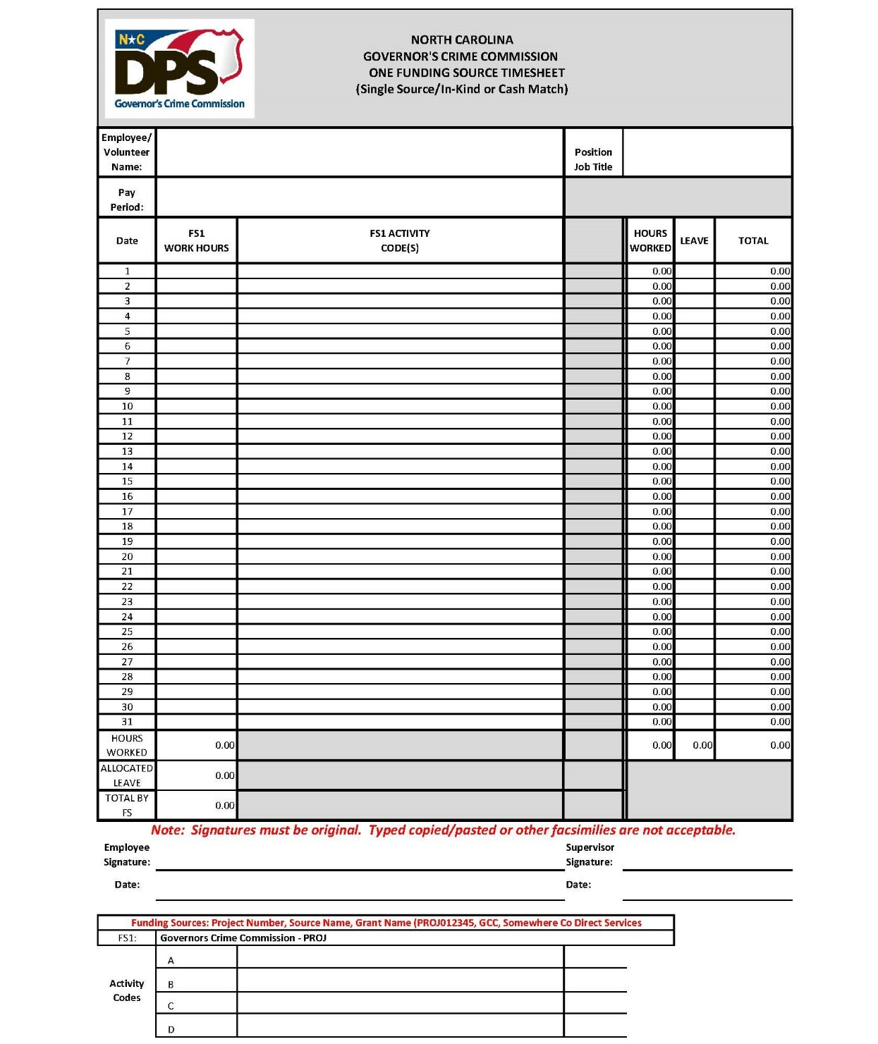

Slide 24
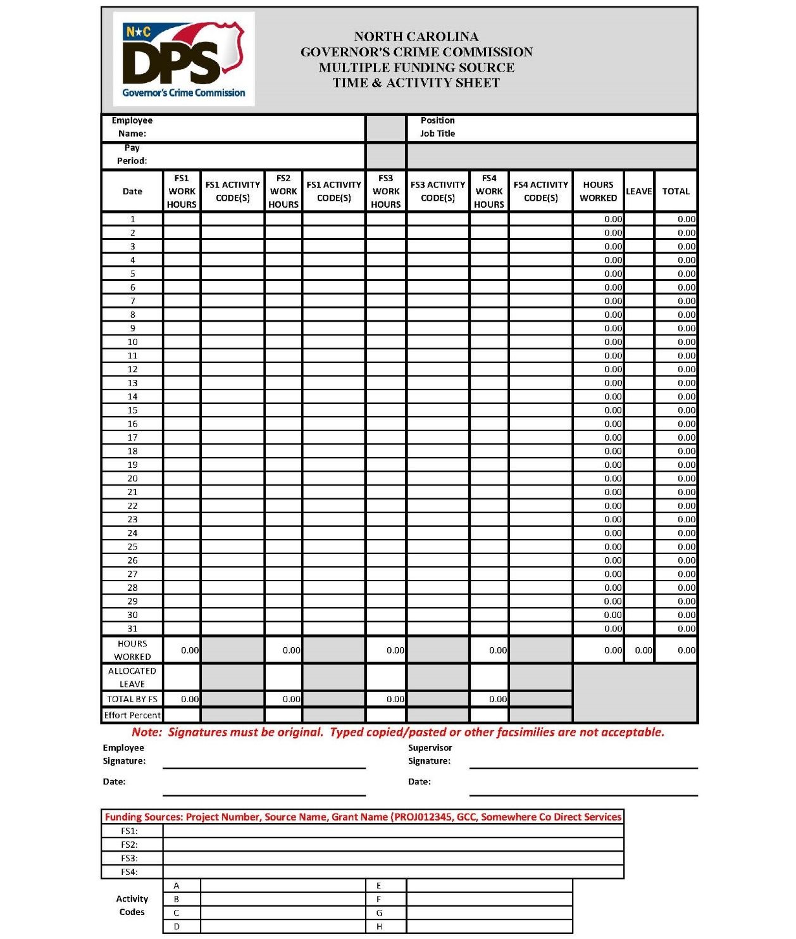

Slide 25
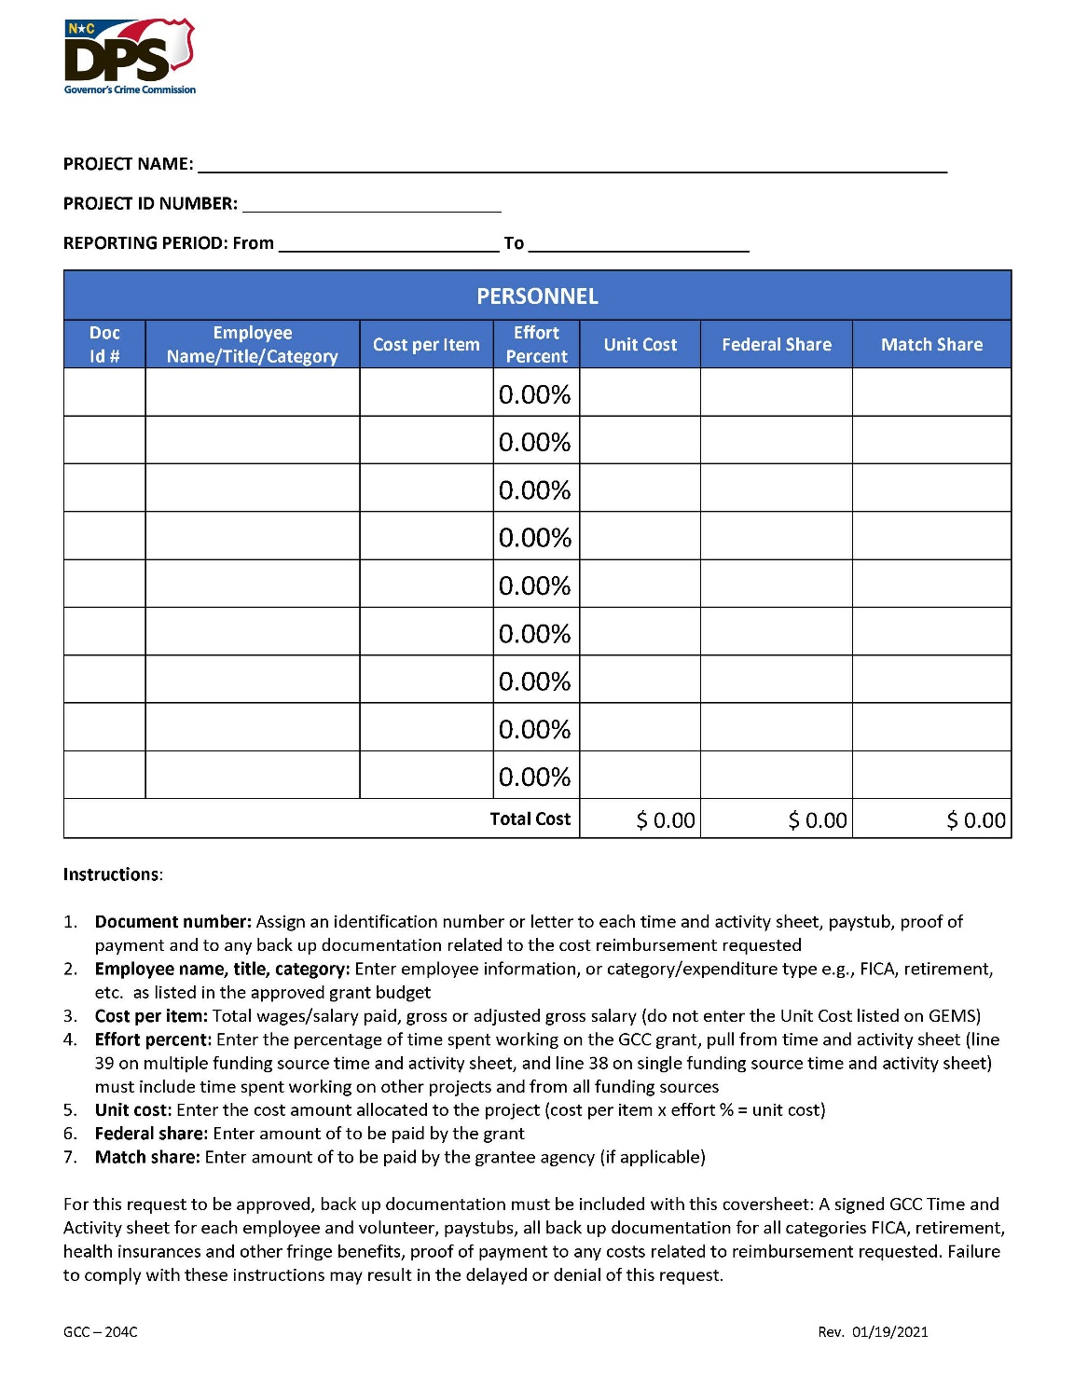
25

Slide 26
Notification of Employee Separation
How: Email your GCC Grant Administrator
When: Within 10 working days of employee’s departure date
Why: GCC is required to ensure that:
  Only authorized grant funded employees are approved for reimbursements
  Services are being provided
What: Employee’s name, position title, end date, salary, and benefits
26

Slide 27
Notification of New Hires
How: Email your GCC Grant Administrator
When: Within 10 working days of the new hire’s start date
Why: GCC is required to ensure that only authorized grant funded employees are approved for reimbursement
What: New hire’s name, position title, start date, salary, and benefits
27

Slide 28
Supporting Documentation
Equipment
28

Slide 29
Supporting Documentation
Receipts, invoices, or any other documentation supporting the purchase
Copies of three bids from vendors if any piece of equipment is $10,000 or more or sole source provider form detailing justification
Equipment purchased with grant funds and a value of $5,000 or more require property tags
Sub-recipient must maintain a “Property Control Record and Equipment Certification Form” (GCC-200) for ALL equipment purchased through grant funds (2 CFR Part 200.313)
Please keep this updated for site reviews and auditors.
29

Slide 30
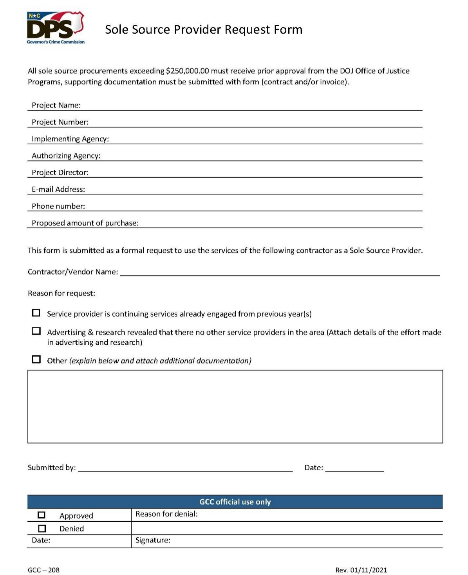
30

Slide 31
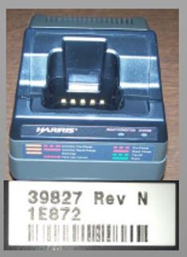
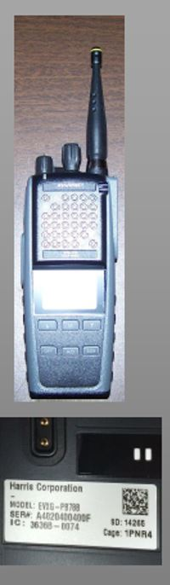

Equipment Must Have A Property Tag
31

Slide 32
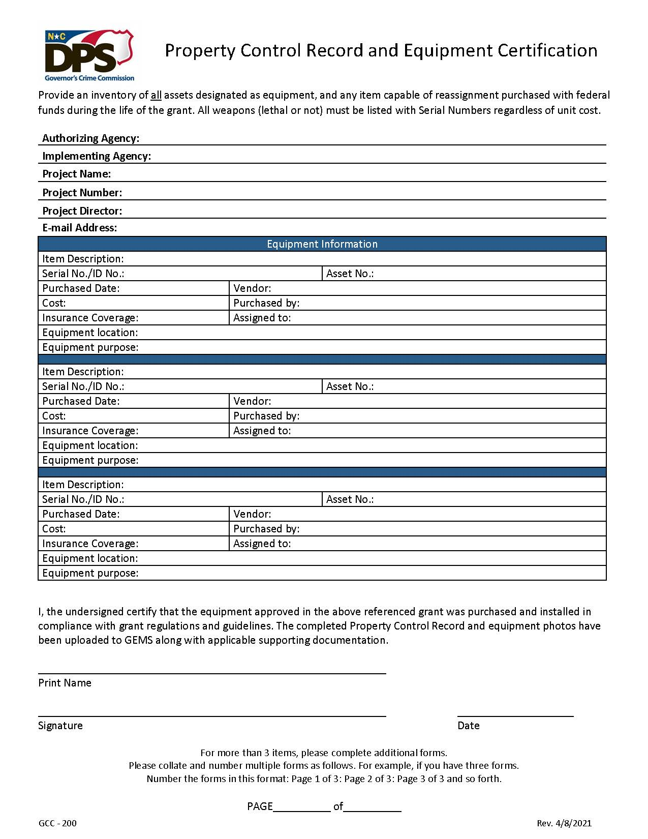
32

Slide 33
33

Slide 34
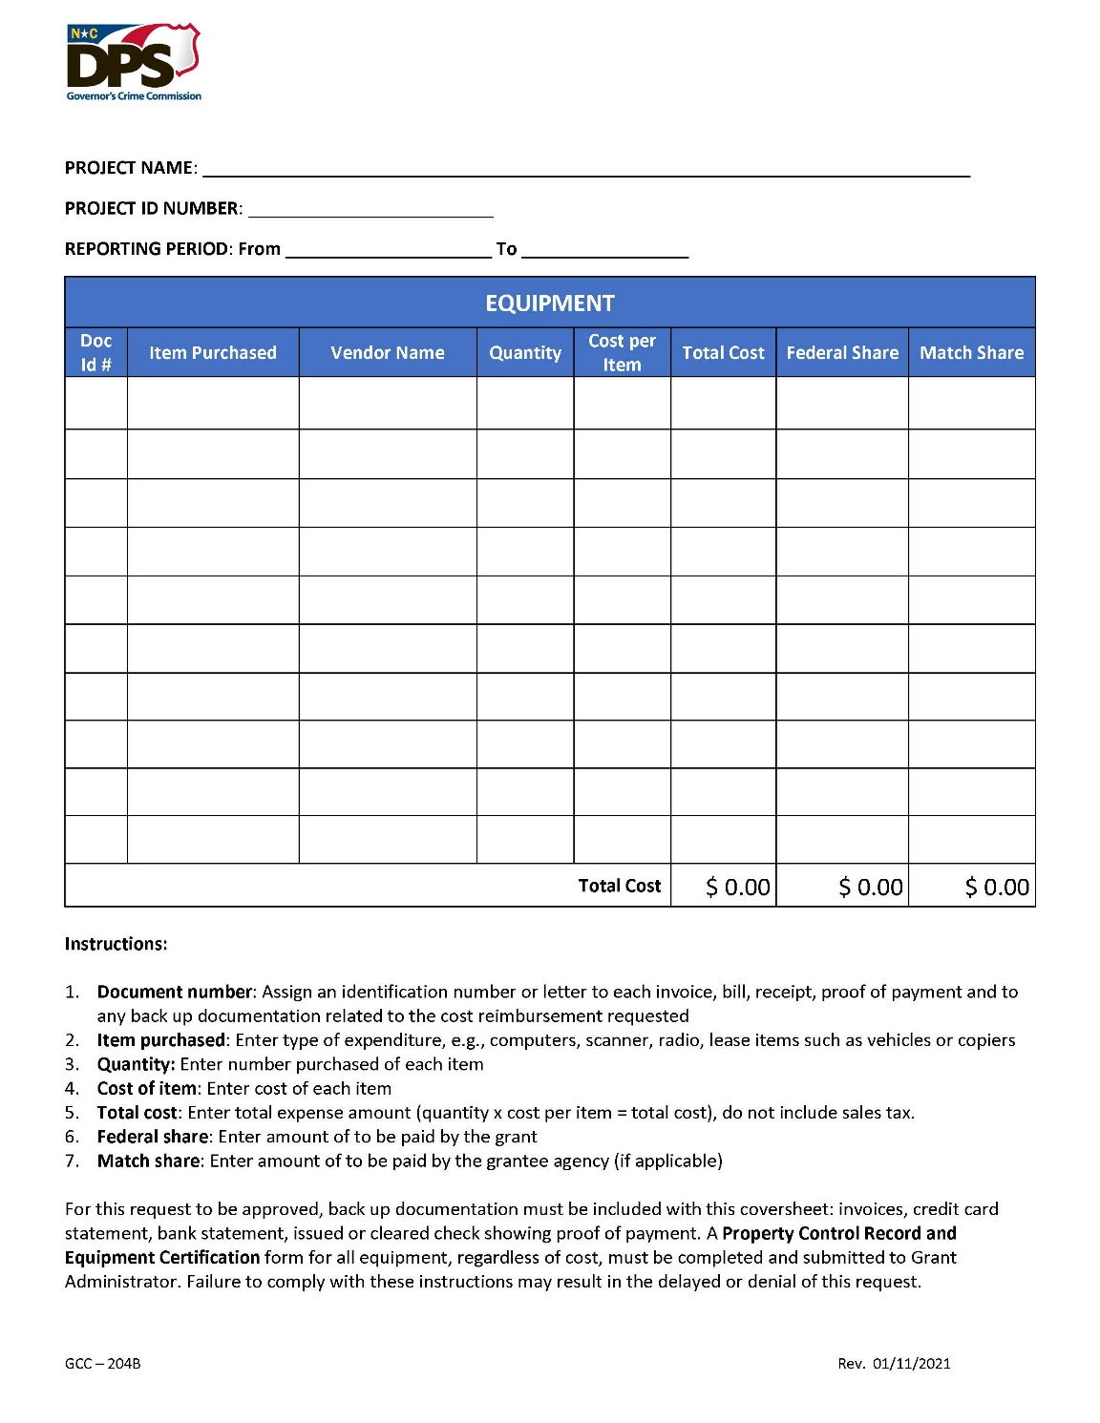
34

Slide 35
Supporting Documentation
Consultants/Contractors
35

Slide 36
Consultants/Contractors
Please NOTE: Starting October 1, 2021, if your budget includes any Contractual lines, your project CANNOT be opened until the Pre-Contract Request Form and the unexecuted contract are approved by your Grant Administrator.
If contract for an individual contractor/consultant, a resume must be provided.
36

Slide 37
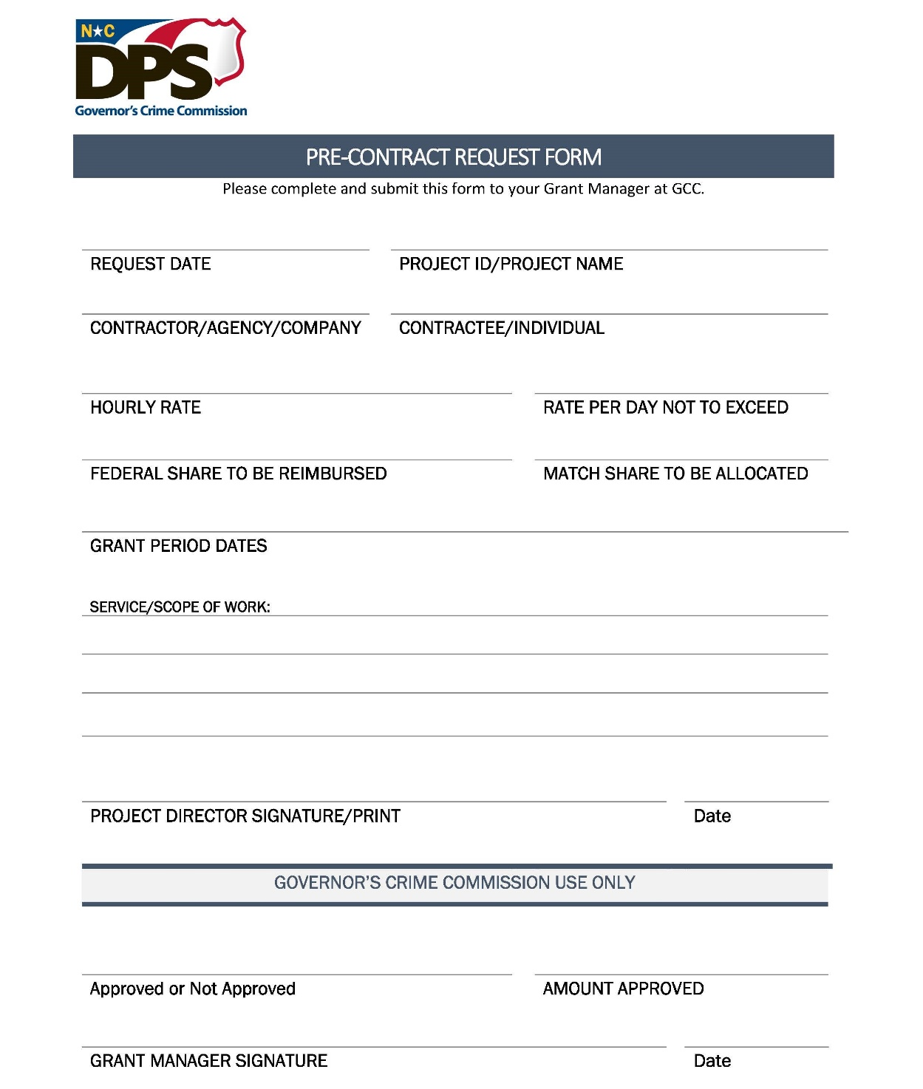
37

Slide 38
Consultants/Contractors
When submitting a reimbursement, a GCC Contractual Coversheet must be utilized.
Invoices from the consultant/contractor must clearly show the vendor's name, date(s) of services, hours worked, payment amount due for the services, and a list of what service(s) the contractor/consultant performed.
If rates are above the capped amount of $81.25 per hour/not to exceed $650 per day, a Contract Excess Rate Request Form must be submitted along with the Pre-Contract Request Form for GCC prior approval.
38

Slide 39
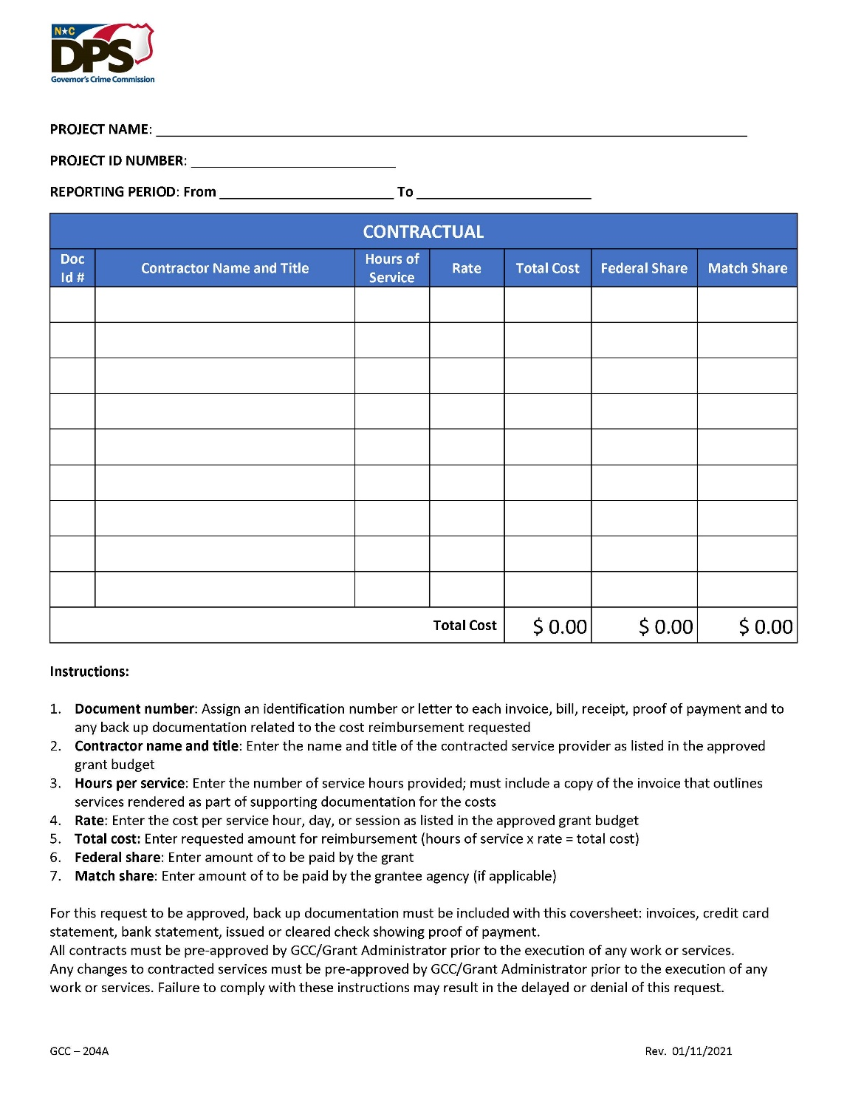
39

Slide 40
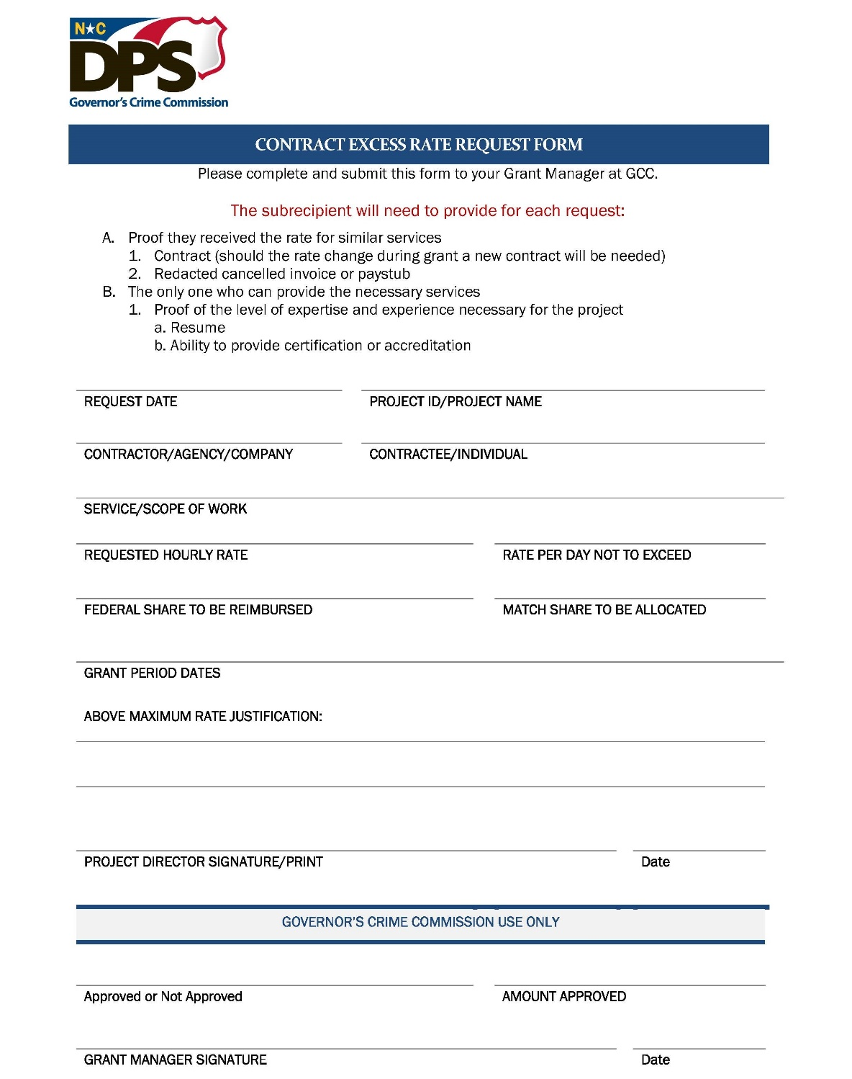
40

Slide 41
Consultants/Contractors
Examples of Consultants/Contractors:
Counselors
Lawyers
Software/hardware computer engineers
Therapists
Grounds maintenance staff
Improper Examples of Consultants/Contractors
  Volunteers
  Board Members
  Employees
41

Slide 42
Supporting Documentation
Travel/Training
(Employees/Volunteers only)
42

Slide 43
Receipts
Conference registration
Conference agenda
Hotel, Airline, Taxi, Rental car receipts
Meals & Mileage– based on agency’s travel policy, if the agency does not have a policy then State per diem rates
Employee mileage reimbursement forms/logs
Out of State Travel requires Prior Approval even though it may be approved in the budget. (A budget modification does not provide prior approval)
43

Slide 44
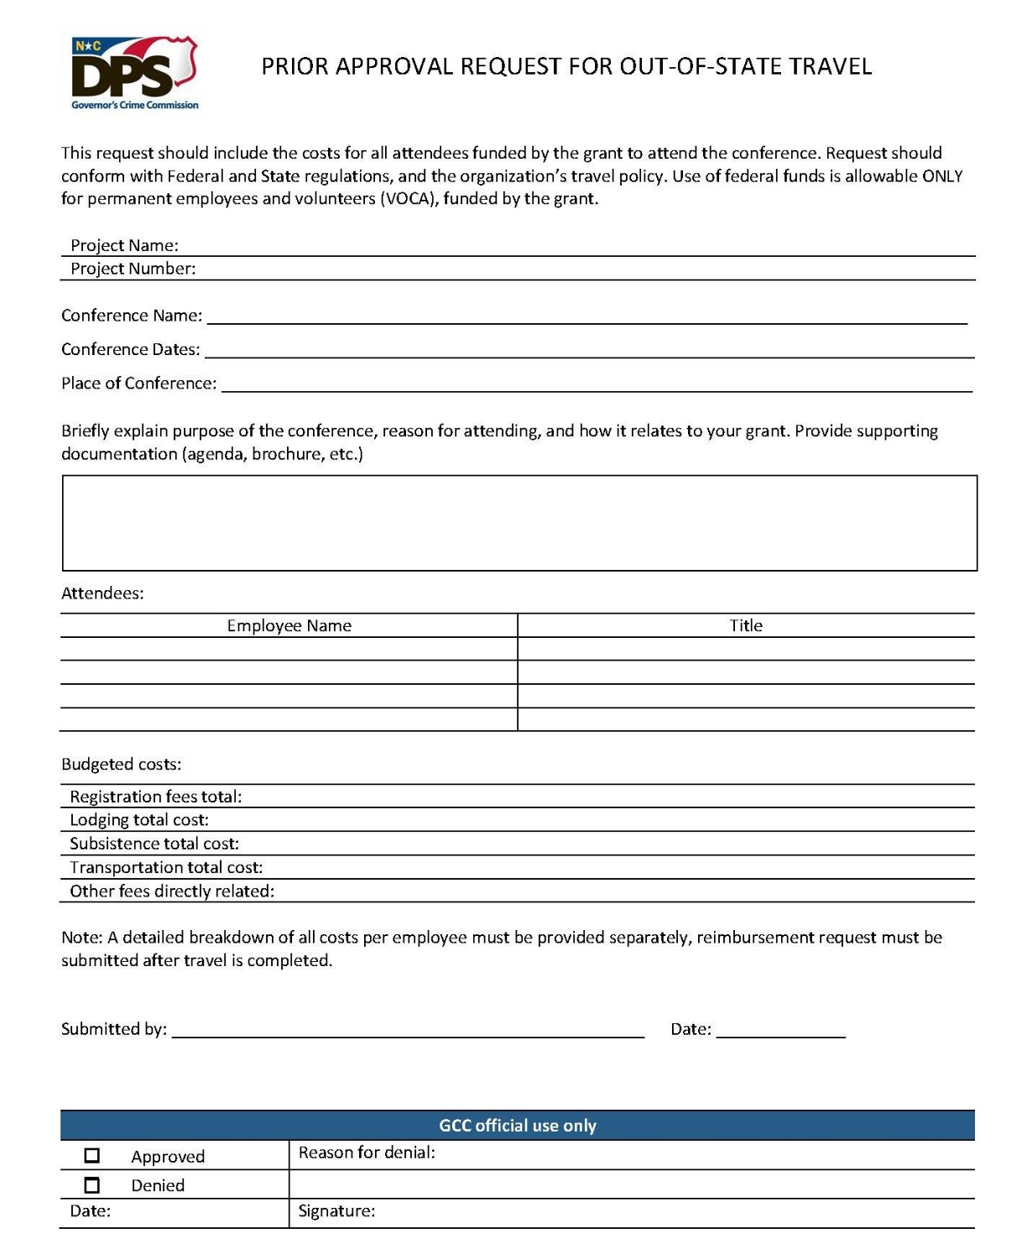
44

Slide 45
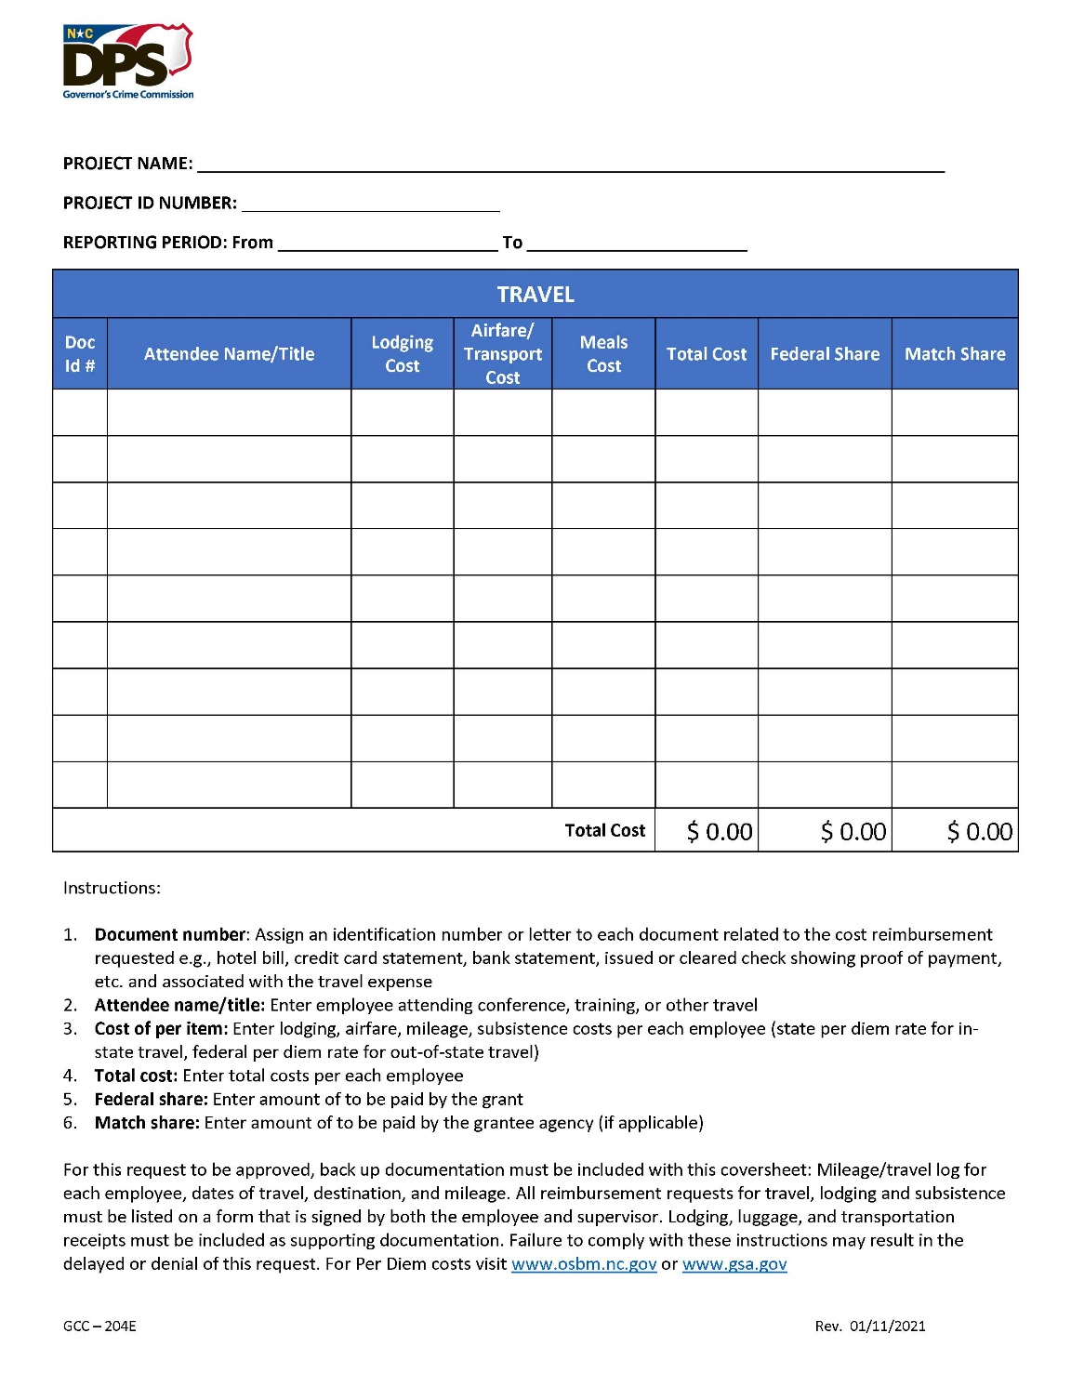
45

Slide 46
Supporting Documentation
Supplies
and
Operating Expenses
46

Slide 47
Supplies and Operating Expenses
Receipts, receipts, receipts
Vendor Invoices (utility bills, invoices, proof of payment)
Rent receipts (or copy of lease and proof of payment)
Receipts/invoices must show the vendor name, date of service/purchase, amount due, and list what services were performed or what was purchased
47

Slide 48
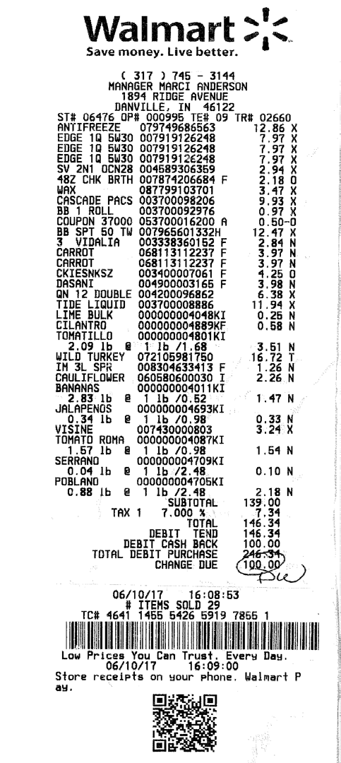
Receipts
There are 3 methods to divide up expenses from receipts between different grants.
  1. Make separate purchases for each grant and get separate receipts, one for each grant.
48

Slide 49
Receipts
2. Make a combined purchase and attach documentation explaining what items were purchased for each grant. Submit copies of the documentation with all grant reimbursement claims.
Grant #xyz1
Grant # xyz2
All the rest of the items purchased
Edge 1Q5W30 | 12.86
Edge 1Q5W30 | 7.97
Edge 1Q5W30 | 7.97
49

Slide 50
Receipts
3. Make a combined purchase and make a copy of the receipt for each grant highlighting the receipt showing which items were charged to that particular grant. Submit copies of the documentation with all grant reimbursement claims.
Yellow | Grant # xyz3 | $39.34
Blue | Grant # xyz4 | $81.38
Green | Grant # xyz5 | $25.62
50

Slide 51
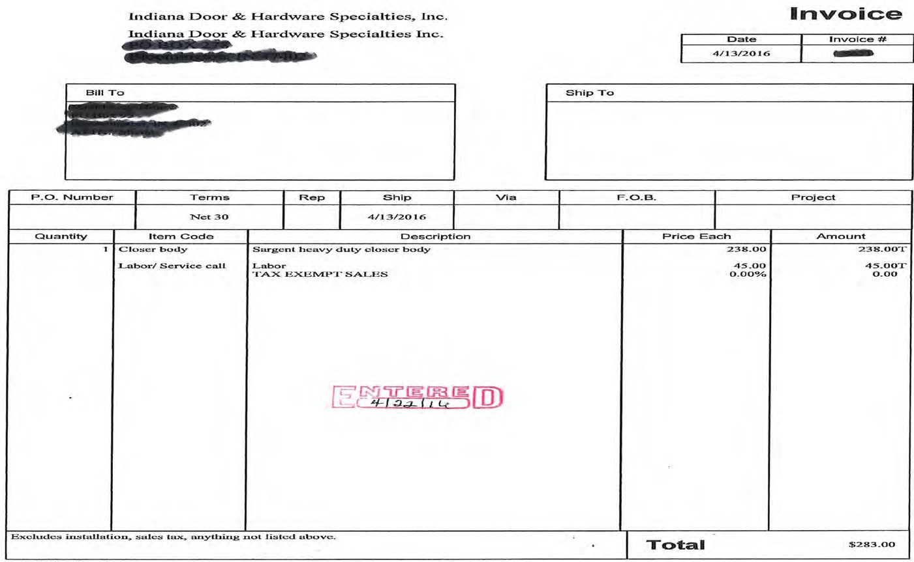
Vendor Invoice
MUST PROVIDE PROOF OF PAYMENT WITH THE INVOICE
0
51

Slide 52
Forms of Proof of Payment
The accepted proof of payment are as follows:
Cleared check/cancelled check – Check the endorsement side of the check, cleared checks are available as scanned images from the online bank account.
Credit card or Bank statement – should contain cardholder address, summary of account information (payment due, balance, etc.) and all other details relevant to the particular transaction for which reimbursement is requested.
52

Slide 53
Forms of Proof of Payment
Bank statement showing expense
Cleared/cancelled check
Invoice showing balance paid
Receipts showing the expense was paid.
53

Slide 54
Receipts
A receipt is any document that contains the following five IRS-required elements:
1. Name of vendor (person or company you paid)
2. Transaction date (when you paid)
3. Detailed description of goods or services purchased (what you bought)
4. Amount paid
5. Form of payment (how you paid – cash, check, or last four digits of credit card)
54

Slide 55
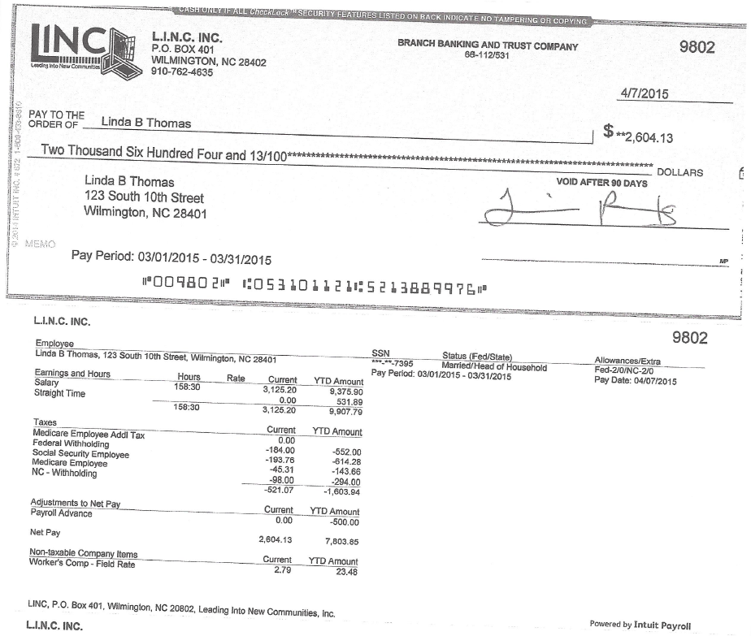
Proof of Payment Example
55

Slide 56
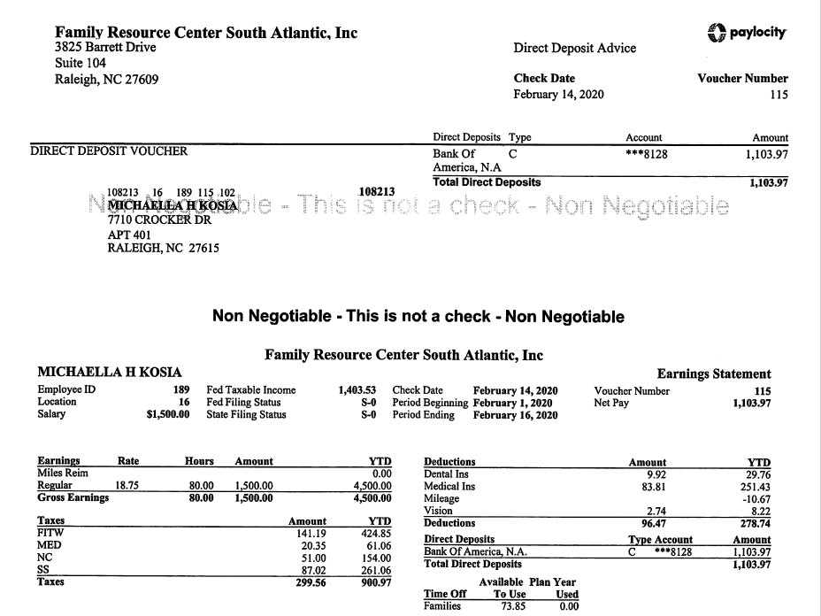
Proof of Payment Example
56

Slide 57
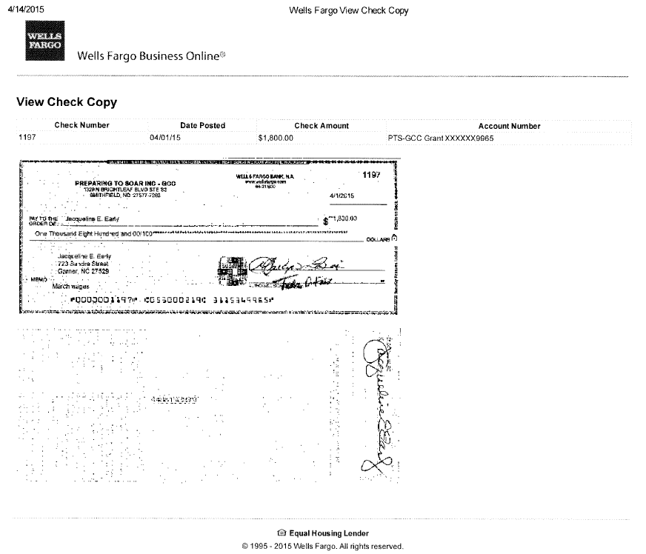
Proof of Payment Example
57

Slide 58
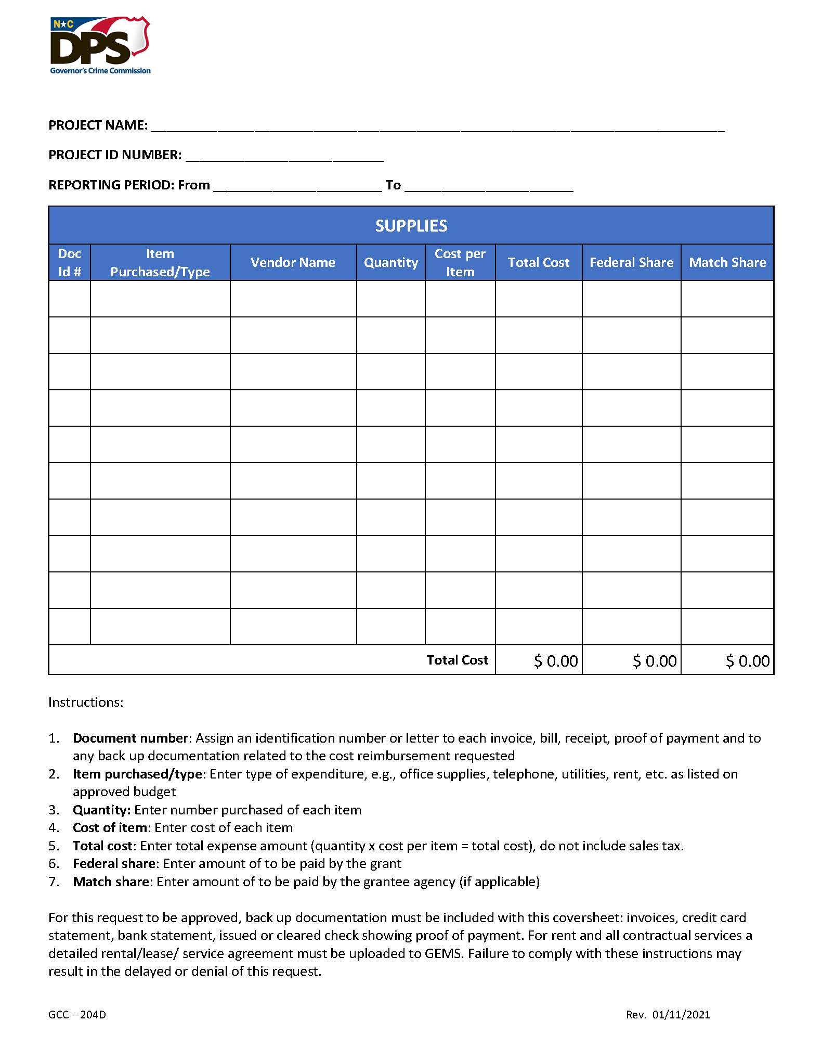
58

Slide 59
Match
Cash Vs. In-Kind
59

Slide 60
What is Match?
Cost sharing or matching means the portion of a project costs not paid by the Federal funds. Also known as grantee share. Aa defined by 2 CFR 200.29
Costs incurred as match for the program's operations have the same restrictions and regulations as costs that will be reimbursed through Federal grant funds. If the cost is not allowable under the federal award, it is not allowable as match.
Unless a project’s match has been waived, a required match must be met according to Federal guidelines prior to the close of the grant.
60

Slide 61
What is Match?
Match requirements are always a specific percentage of the total project costs for an award.
For example: a 20% match on a $100,000 project would be $20,000, where $80,000 is provided by the Federal Government and $20,000 is provided by the sub-recipient.
61

Slide 62
Cash Match
Cash match (hard match) includes cash spent for project-related costs. Qualifying cash match contributions must come from approved sources as required by federal regulations, except acquisition of land, when applicable.
    Cash match is either the grantee’s own funds, general revenue, or cash donations from non-federal third parties or non-federal grants.
62

Slide 63
Cash Match
Budget Lines that can be utilized as cash match:
  Salaries/Benefits
  Travel
  Equipment
  Supplies and Operating Expenses
  Consultants/Contractors
If you do not achieve your cash match goal, you may be required to refund a portion of the Federal funds.
63
63

Slide 64
In-Kind Match
Third party in-kind match (soft match) includes, but is not limited to, the valuation of non-cash contributions. “In-kind” may be in the form of services, supplies, real property, and equipment.
      In-kind donations are non-cash donations of goods or services that can be given a cash value and are used in achieving your program objectives.
For example: If in-kind match is permitted by law, then the value of donated services can be used to comply with the match requirement; third party in-kind contributions may count toward satisfying match requirements, provided the recipient of the contributions expends them as allowable costs.
64

Slide 65
In-Kind Match
Donations of space, equipment, clothing, or items to be utilized to further the grant’s goals and objectives.
Must use fair market value to determine the allowable value of donated items.
Volunteer Hours must be documented and supported by the same methods as any other regular employee.
Requires time and attendance records similar to employees to show daily hours worked; timesheets must be signed by volunteer and an Approving Official. The timesheet must also include a short description of the work performed. The volunteer services must be used for the grant.
Hourly rate must be reasonable and similar to others performing the same job function.
65

Slide 66
2 C.F.R. Subpart D, 200.306
Match criteria
  Are verifiable from the sub-recipient’s records
  Are not included as contributions for any other federal grant
  Are necessary and reasonable for accomplishment of project or program objectives
  Are allowable costs
  Are not paid by Federal funds from another grant or award
  Are approved in the grant budget
  Conform to the provisions of 2 C.F.R. 200, Subpart D, 200.306 (b)
66

Slide 67
Match
Items / costs utilized for match are subject to the same supporting documentation rules previously reviewed for expenditures made with grant funds.
Recipients and sub-recipients must maintain records that clearly show the source, amount and timing of all match contributions.
Though matching contributions do not need to be applied at the exact time or in proportion to the obligation of the Federal funds; applying match contribution at the end of the project’s period of performance will negatively impact the project’s Utilization / Expenditure rate for both Federal and Match funds.
The full matching share must be contributed by the end of the award period.
67

Slide 68
Year End Match
In-kind match contributions must be documented. Subrecipients must ensure that the following information is clearly documented:
  Who is the source?
  What was donated?
  How was the value determined?
  Who verified the information?
68

Slide 69
Reporting
69

Slide 70
Reporting
Timely reporting is critical to GCC’s continued funding.
GCC needs the sub-recipients’ report to complete its own reports to the Federal awarding agencies in an accurate and timely fashion.
Sanctions will be imposed on sub-recipients who fail to report timely.
70

Slide 71
Required Reports and Due Dates
Required Reports | Due Dates
Contracts for Prior Approval with Pre-Contract request form | Immediately
Notice of Grant Implementation- *Includes Attestation which Project Director and Financial Officer must complete this notice before you can submit any reimbursement requests. | Immediately
Initial Sub-grant Award Report | Immediately
Expense Reimbursements Report monthly expenses as they are incurred | Monthly
71

Slide 72
Reports Continued
Performance Reports- You will hear more about these in the breakout.
Progress Reports- You will hear more about these in the breakout
72

Slide 73
Audit (Financial) Reporting
North Carolina state law (G.S. 143C-6-23) requires every nongovernmental entity that receives State or Federal pass-through grant funds from a state agency to file annual reports on how those grant funds were used. Specific requirements for each funding level are as follows:
73
Notes:
Read from the slide.

Slide 74
Non-Governmental Entities Required Reporting
Reporting Levels | Required Documents
Level I (Less than $25,000) A grantee receiving less than $25,000 (combined) in State or Federal pass through funds must submit: | Certification Form State Grants Compliance Reporting for Receipts of Less than $25,000 Level I forms and reporting must be submitted to: DPS_GRANTCOMPLIANCEREPORTS@ncdps.gov.
74

Slide 75
Non-Governmental Entities Required Reporting
Reporting Levels | Required Documents
Level II ($25,000 - $499,999) A grantee that receives between $25,000 - $499,999 (combined) in State or Federal pass-through funding must submit: | Certification Form State Grants Compliance Reporting for Receipts of $25,000 or More Schedule of Receipts and Expenditures Program Activities and Accomplishments Reports Level II forms and reporting must be submitted to: DPS_GRANTCOMPLIANCEREPORTS@ncdps.gov
75

Slide 76
Non-Governmental Entities Required Reporting
Reporting Levels | Required Documents
Level III ($500,000 - $749,999) A grantee that receives a combined $500,000 or more in North Carolina State funding or Federal funding passed through a State Agency must submit: | Certification Form State Grants Compliance Reporting for Receipts of $25,000 or More Program Activities and Accomplishments Reports Level III forms and reporting must be submitted to: DPS_GRANTCOMPLIANCEREPORTS@ncdps.gov. Submit within nine months of the grantee's fiscal year end: Submit to DPS Internal Audit AuditGrantsReport@ncdps.gov a single audit prepared and completed in accordance with Generally Accepted Government Auditing Standards.
76

Slide 77
Non-Governmental Entities Required Reporting
Reporting Levels | Required Documents
Level III ($750,000+) A grantee that receives a combined $750,000 or more in funding from all federal funding sources, even those passed through a state agency must submit: | Certification Form State Grants Compliance Reporting for Receipts of $25,000 or More Program Activities and Accomplishments Reports Level III forms and reporting must be submitted to: DPS_GRANTCOMPLIANCEREPORTS@ncdps.gov. Submit within nine months of the grantee's fiscal year end: Submit to DPS Internal Audit (AuditGrantsReport@ncdps.gov) 1. a single audit prepared and completed in accordance with Generally Accepted Government Auditing Standards. 2. Post the single audit to the Federal Audit Clearinghouse (https://harvester.census.gov/facweb/).Make copies of the single audit available to the public.
77

Slide 78
GCC Website &
The FUTURE OF GEMS
GCC Grant Award Workshop
78

Slide 79
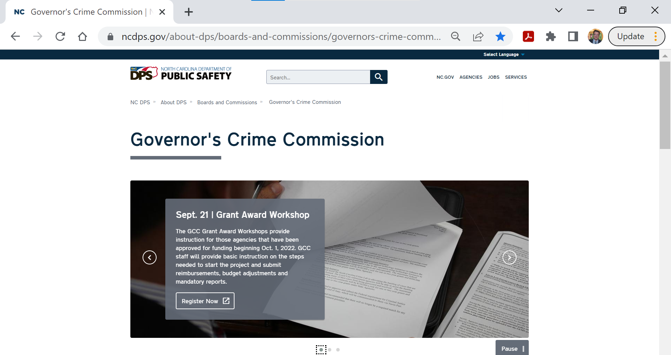
www.ncdps.gov/GCC
79

Slide 80

www.ncdps.gov/GCC
80

Slide 81
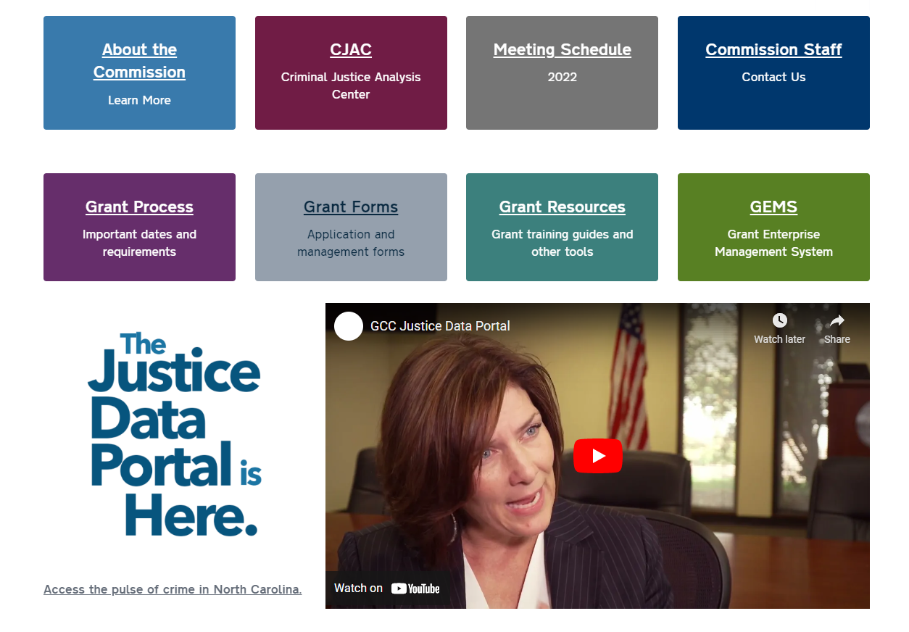
www.ncdps.gov/GCC
81

Slide 82
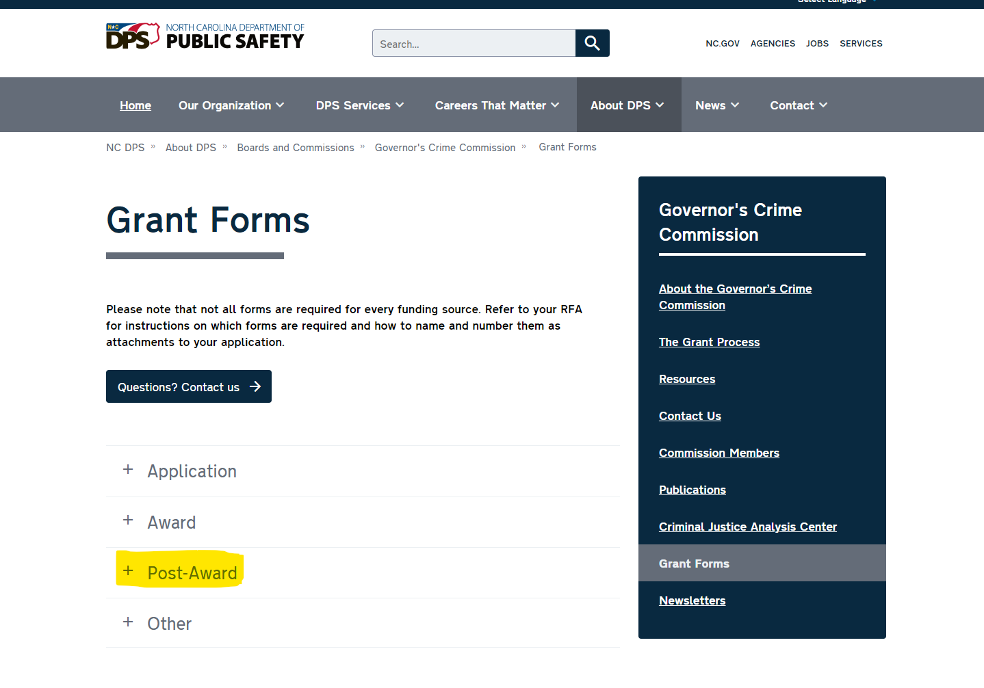
www.ncdps.gov/GCC
82

Slide 83
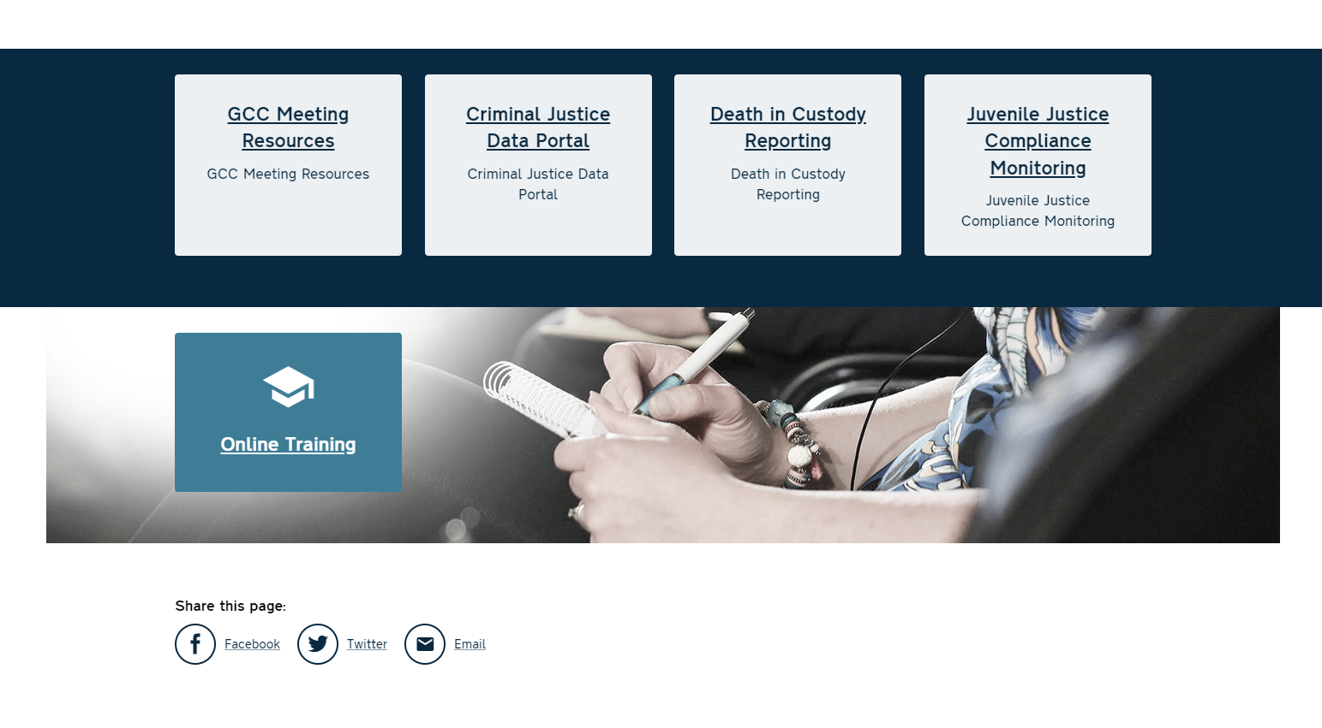
www.ncdps.gov/GCC
83

Slide 84

FUTURE OF GEMS
GEMS is built in an older technology that can no longer be updated. Also, the State of NC is moving to a new Financial System that will not work with GEMS.
2023 will be the last year of using GEMS
A new Grants Management System has been selected and we are in process of signing a contract now. This is the same system used by the Governor’s Highway Safety Program.
We will keep subrecipients updated throughout the process and will provide training in 2023
84

Slide 85
Technical Assistance
If you have any questions or concerns do not hesitate to contact your grants administrator. We are here to help!
85

Slide 86
Thank You
86

