Slide 1
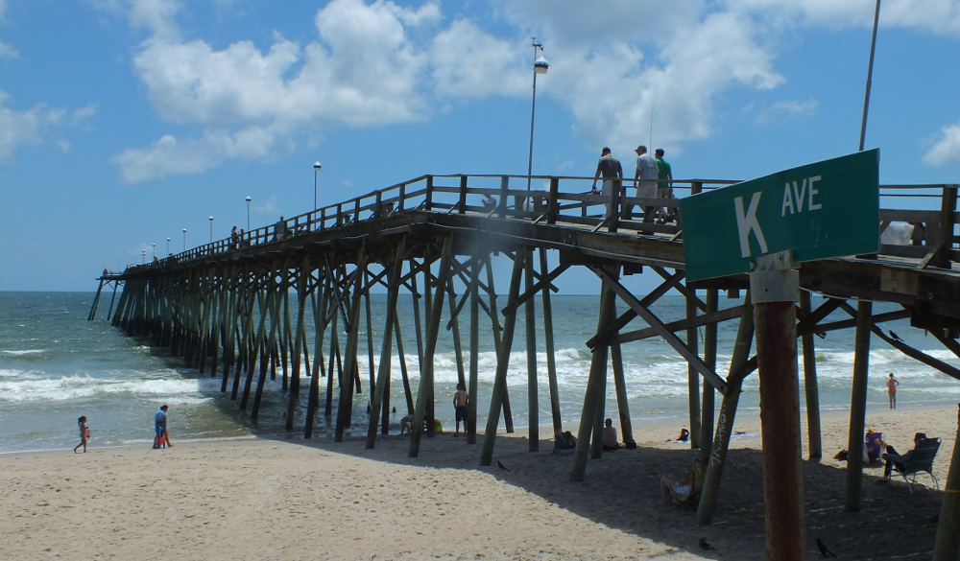
To Construct 7 Stormwater Infiltration Sites
MITIGATION MEASURE The project addresses the hazard of excessive stormwater runoff that overwhelms the existing system, resulting in untreated discharges. It will reduce bacterial contamination and other pollutants entering downstream water bodies by improving runoff treatment and system capacity.
Benefit-Cost Analysis Focus Estimate avoided flood damages to homes, businesses, and public infrastructure using depth-damage functions and historical flood frequency data. Infiltration also adds 5 million gallons/year to the aquifer HOW READY IS IT? This was previously funded through BRIC and we expect to have the phase 1 (60% design, updated costs and a completed BCA) by October 2025.
Town of Kure Beach
$831,375 Amount Requested
Project #
CONCEPT
PRELIMINARY
DESIGN
60% Design w/ Costs
Final Design & Engineering
Permitting & EHP
Contract Ready

Slide 2
REGIONAL HAZARD MITIGATION PLAN ALIGNMENT The proposed dune infiltration project at seven coastal sites aligns with several mitigation actions outlined in the Southeastern North Carolina Regional Hazard Mitigation Plan. Specifically, it supports the plan's emphasis on implementing nature-based solutions to manage stormwater and reduce flood risks. By enhancing dune systems to facilitate stormwater infiltration, the project not only mitigates flooding but also improves water quality, aligning with the plan's objectives for sustainable hazard mitigation strategies. Furthermore, this approach complements the plan's focus on preserving natural coastal features to enhance community resilience against future storm events.
WHAT ELSE DO YOU THINK WOULD BE HELPFUL FOR THE PANEL TO KNOW ABOUT THIS PROJECT? Use this section to briefly highlight any additional information that may not be fully captured elsewhere in your slides but could strengthen the panel’s understanding of your project’s value, feasibility, or urgency. This is your opportunity to address important context that doesn’t neatly fit into other categories. Stay within the slide formatting—do not resize fonts or crowd the slide.
Please save this file as “HMGP.IFM.TownorCountyName.LOIslides” and email it to Kaine.Riggan@ncdps.gov by May 21, 2025. You can delete this message from the slide.
TOWN OF KURE BEACH

