Slide 1

The Security Officer in North Carolina
NORTH CAROLINA
PRIVATE PROTECTIVE SERVICES

Slide 2

Training Objectives
List four functions of the security guard.
List four items that must be provided to the Private Protective Service Board within 30 days of employment.
List three minimum standards for registration as a security guard.

Slide 3
Chapter 74C
According to 74C-2, “no private person, firm, association, or corporation shall engage in, perform any services as, or in any way represent or hold itself out as engaging in private protective services profession or activity in this state without having first complied with the provisions of this chapter”.

Slide 4
Security Functions
Prevention and detection of intrusion, entry, larceny, vandalism, abuse, fire or trespass on private property;
Prevention, observation, or detection of any unauthorized activity on private property;
Protection of patrons and persons lawfully authorized to be on the premises of the person, firm, association, or corporation that entered in the contract for security services;
Control, regulation, or direction of the flow or movement of the public, whether by vehicle or otherwise, only to the extent and for the time directly and specifically required to assure the protection of property.

Slide 5
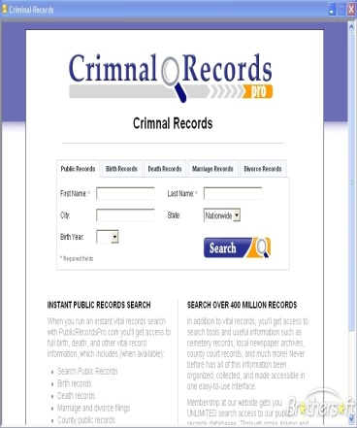
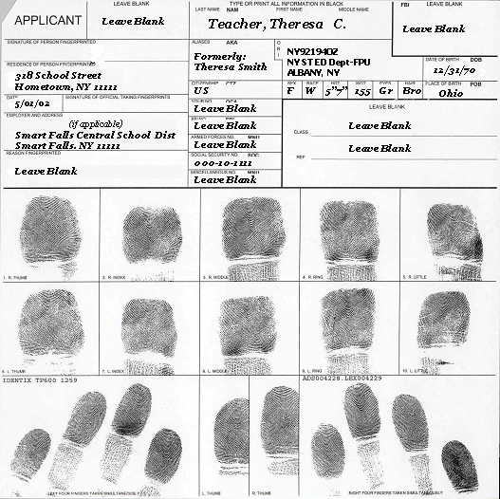

Registration of security guards
Applications must be submitted to PPS within 30 calendar days from the date of hire
Fingerprint card
Picture
Criminal background check

Slide 6
Registration of security guards (cont.)
An unarmed security guard applicant may work using a copy of the application until receipt of pocket registration card
Card is valid for 1 year from the date of original employment.
Can be transferred if registrant changes companies

Slide 7
Registration of security guards (cont.)
Security guards properly registered/licensed in another state
Can work up to 10 days in any given month providing company notifies PPS Board and Director approves
The PPSB Board must be notified of the termination or resignation of any employee registered as a security guard
Law enforcement officers can be registered

Slide 8
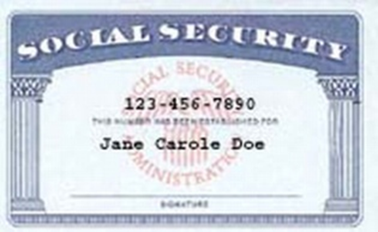

Minimum Standards
Be at least 18 years of age
Be a citizen of the United States or a Resident Alien, with a valid Resident Alien Identification Card
Be of good moral character and temperate habits

Slide 9

Evidence of Lack of Good Moral Character or Habits,
Any of the following in the last 5 years
Conviction by any local, state, Federal, or military court involving the illegal use, carrying, or possession of a firearm
Conviction of any crime involving the illegal use, possession, sale, manufacture, distribution, or transportation of a controlled substance, drug, narcotic, or alcoholic beverage

Slide 10
Continued…..
Conviction of a crime involving felonious (felony) assault or an act of violence
Conviction of a crime involving unlawful breaking and/or entering, burglary, larceny, or any offense involving moral turpitude
A history of addiction to alcohol or a narcotic drug

Slide 11
Continued…..
Been declared incompetent, by any court having jurisdiction, by reason of mental disease or defect, or been involuntarily committed to an institution for treatment of mental disease by a District Court judge
A prior revocation by the PPSB
“The term “Conviction” implies either a plea of guilty, a verdict of guilty or a plea of “No Contest.”

Slide 12
Revocation of Registration
Made any false statement or given false information in connection with any application to PPSB
Violate provisions of Chapter 74C
Impersonate a Police Officer
Engage in services without a license
Fail to provide agreed services
Knowingly make a false report
Willfully fail or refuse to render services to client as agreed upon

Slide 13
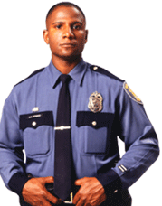


Uniforms & Equipment

Slide 14
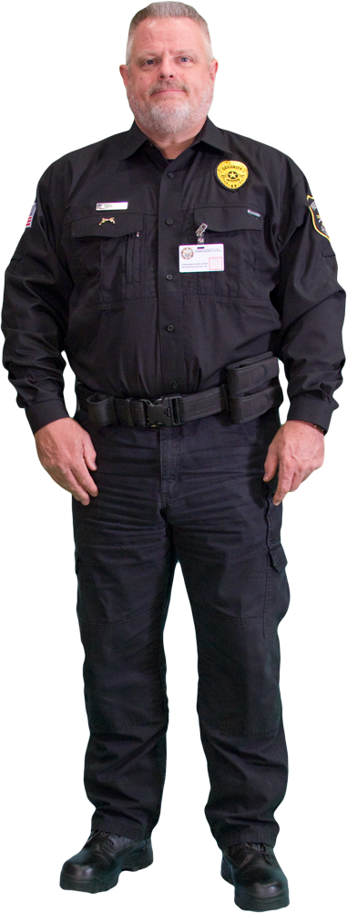
Uniforms and Equipment
“Military Style”
Badges and patches must be different from local law enforcement
  Worn over the left breast pocket and all caps or hats
Tag/Patch with “Security Guard” or “Security Officer” with a tag bearing the guard’s name about it
  Worn over the right breast pocket
Or, wear the PPSB Registration card on the outermost garment

Slide 15
Uniforms and Equipment
Non-Military Uniform
A tag with the words “Security Guard” or “Security Officer” worn
  The director of Private Protective Services can suspend this requirement.

Slide 16
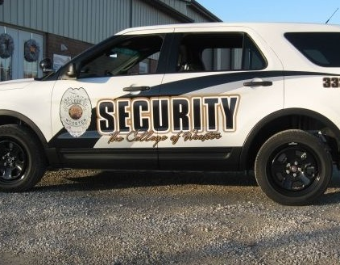
Uniforms and Equipment
No one in PPS may wear/display any badge, insignia, device, shield patch that would indicate they are sworn law enforcement
Vehicles shall not display any wording such as “Law enforcement officer” or “police” or equivalent thereof.

Slide 17
Training Objectives
List four functions of the security guard.
List four items that must be provided to the Private Protective Service Board within 30 days of employment.
List three minimum standards for registration as a security guard.

Slide 18

Questions

Slide 19
Closing Statement
The individual seeking employment as a security guard in North Carolina must meet standards that have been decided and placed into law. These standards are an effort to promote professionalism in the industry and to hire individuals who will bring that professionalism into the industry.

